Slide 1
Lecture 02
Enterprise information architecture
Engr. Anees ur Rahman Khattak
Email: aneeskhattak085@gmail.com
Skype: anees.software
1

Slide 2
Outline
Background
enterprise architecture definition
Architecture overview
system architecture
Enterprise architecture
enterprise architecture frameworks
Need of enterprise architecture
benefits of enterprise architecture
Challenges of enterprise architecture
2
2

Slide 3
Introduction
•An enterprise architecture is a rigorous description of the structure of an enterprise, which comprises enterprise components (business entities), the externally visible properties of those components, and the relationships (e.g. behavior) between them.
EA describes the terminology, the composition of enterprise components, and their relationships with the external environment, and the guiding principles for the requirement (analysis), design, and evolution of an enterprise.
3

Slide 4
Definition
IEEE: “An architecture is the fundamental organization of a system embodied in its components, their relationships to each other, and to the environment, and the principles guiding its design and evolution.”
TOGAF: “Architecture has two meanings depending upon its contextual usage: (1) A formal description of a system, or a detailed plan of the system at component level to guide its implementation; (2) The structure of components, their interrelationships, and the principles and guidelines governing their design and evolution over time.”
The Netherlands Architecture Forum(NAF):“a normative restriction of design freedom and operationally as a set of design principles.”
4

Slide 5
Contd…..
Oxford: “The art or science of building or constructing edifices of any kind for human use…” “The special method or ‘style’ in accordance with which the details of the structure and ornamentation of a building are arranged.”

Slide 6
Enterprise Architecture (cont…)
Enterprise - the highest level of organization, or one that is trans-organizational
Infrastructure - all supportive resources to getting the job done: people, processes, technology
Model - a recreation or representation of the infrastructure
Framework - the collection of the models suited to a specific enterprise
6

Slide 7
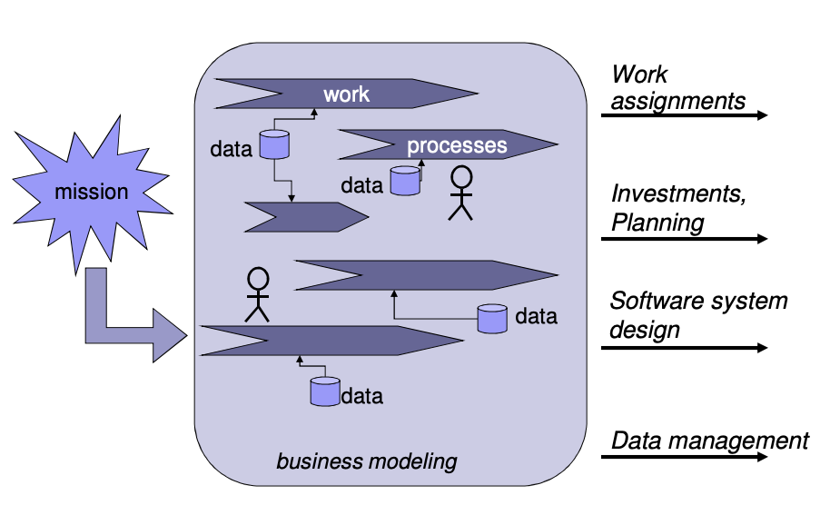
The Enterprise

Slide 8
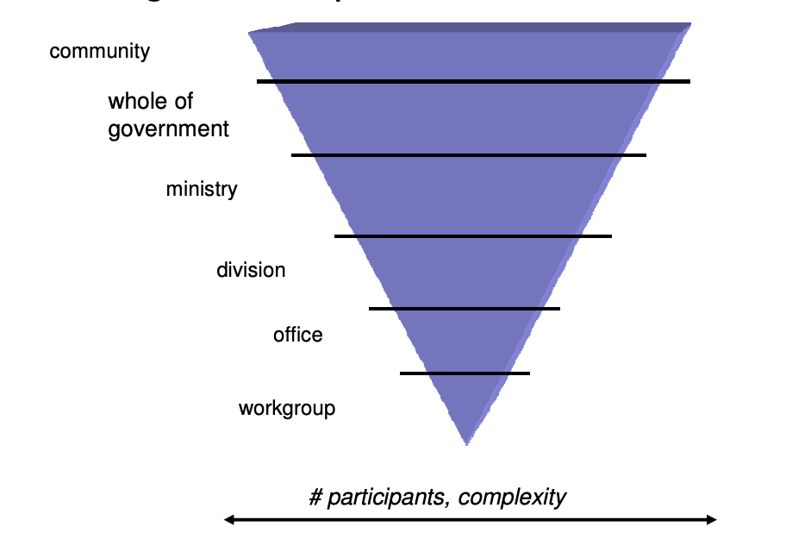
Defining the enterprize

Slide 9
Architectural overview
System Stakeholder:
an individual, team, or organization (or classes thereof) with interests in, or concerns relative to, a system
View:
a representation of a whole system from the perspective of a related set of concerns
Viewpoint:
(a schema of the information in a view) acts as a pattern or template from which to develop individual views by establishing the purposes and audience for a view and the techniques for its creation and analysis

Slide 10
Contd…
Description of the architecture from the viewpoint of a specific stakeholder
The main mechanism of communication between the architect and the stakeholder
Used to ensure accuracy of understanding of the current system
Used to ensure the architecture meets the need of each stakeholder
The collection of views comprises the description of the architecture

Slide 11
Contd…
An architecture framework is a set of tools which can be used for developing a broad range of different architectures.[3] It should:
describe a method for defining an information system in terms of a set of building blocks
show how the building blocks fit together
contain a set of tools
provide a common vocabulary
include a list of recommended standards
include a list of compliant products that can be used to implement the building blocks

Slide 12
System architecture
Design: How each component should be build OO, Class, design patterns etc’.
Differences between architecture and design Many different designs may address the same need Different architectures imply different needs
Sample from reality: House
Architecture: number of rooms, main structure, character, guiding lines.
Design: interior design, rooms structure, electricity, etc’

Slide 13
About Enterprise Architecture
Its not technical!
Aligning IT to business.
Answering all of the enterprise needs
Transverse view.
knowing and managing the current situation, paving the road for the wanted one.
Implementation of information management
Enforce homogeneous solutions and enable “One system” to the users.

Slide 14
Contd…
Architected business information systems will have:
A greater ability to respond to new demands
A greater business value to the organization
A greater ability to use new technology
A faster, simpler and cheaper procurement process
The ability to support a faster time-to-market

Slide 15
Enterprise Architecture frameworks
What is an Architecture Framework?
It is a tool that can be used for developing a broad range of different architectures. It should describe a method for designing an information system in terms of a set of building blocks, and for showing how the building blocks fit together.
There are many enterprise-architecture frameworks none of the enterprise-architecture methodologies is really complete. Each has its strengths and weaknesses.
Examples : TOGAF , ARIS , ZACHMAN ,CIMOSA , DoD
In next lecture we will study frameworks in detail

Slide 16
Need of Enterprise Architecture
The purpose of enterprise architecture is to optimize across the enterprise the often fragmented legacy of processes (both manual and automated) into an integrated environment.
Effective management and exploitation of information through IT is a key factor to business success, and An enterprise architecture addresses this need, by providing a strategic direction for IT activities.

Slide 17
Enterprise Architecture benefits
Providing Flexibility For Environmental Changes
Matching Mission & IT Layer Requirements
Reducing The Risk Of The IT project
Providing Effective Control Of The Organization
Faster, simpler, and cheaper procurement

Slide 18
Challenges
Many EA frameworks , how to choose best fit?
Lack of senior management support
Lack of training
Lack of patience, EA is ongoing iterative cycles

Slide 19
Thank you

