Slide 1
Redundant 7 DOF Anthropomorphic Robotic Manipulator
by
Abdullah Tahir
designed and simulated in matlab as term project of robotics and automation course, project supervised by: dr. ali raza

Slide 2
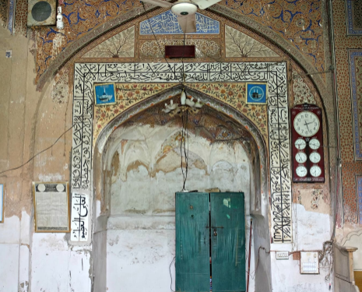
Tasks
Write text on a plane surface.
Masjid’s Mehraab renovation.
1
2
Constraint: Manipulator should be redundant!

Slide 3
Strategy
1
2
3
4
5
Image > Image processing > Trajectory planning > Writing
6
3D Image > Trajectory planning > Renovation
Manipulator Selection Select configuration
Forward Kinematics Joint space to cartesian space
Redundancy Resolution Formula to represent redundancy
Inverse Kinematics Cartesian space to joint space Singularity avoidance
Writing Environment setting
Mehraab Renovation Environment setting

Slide 4
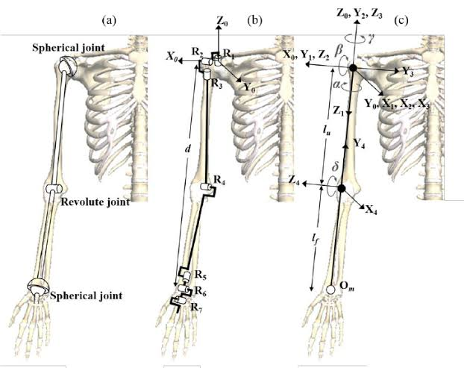
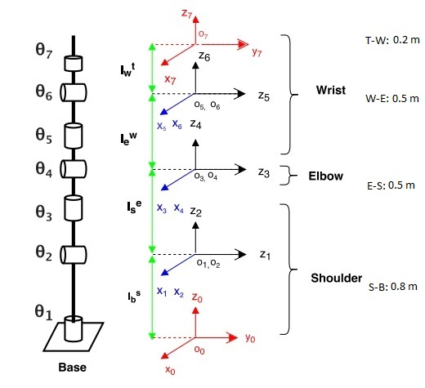
Manipulator Selection
7 DOF
Redundant
Anthropomorphic
S-R-S Configuration

Slide 5

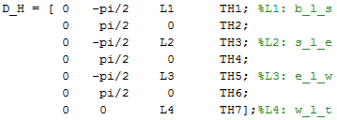
Forward Kinematics
Joint space to cartesian space
General transformation matrix
D-H table

Slide 6
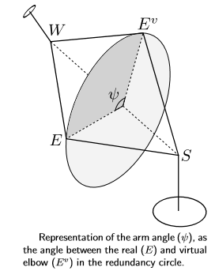
Inverse Kinematics [1/5]
Cartesian space to joint space.
First requirement: Redundancy resolution!
Defining redundancy as arm angle. Finding arm angle using Rodrigues formula.

Slide 7
Inverse Kinematics [2/5]
Rodrigues formula
If v is a vector in ℝ³ and k is a unit vector describing an axis of rotation about which v rotates by an angle θ according to the right hand rule, the Rodrigues formula for the rotated vector v_{rot} is

Slide 8
Inverse Kinematics [3/5]
theta4
Straight forward to calculate.
Shoulder location: Known
Wrist location: Known

Slide 9
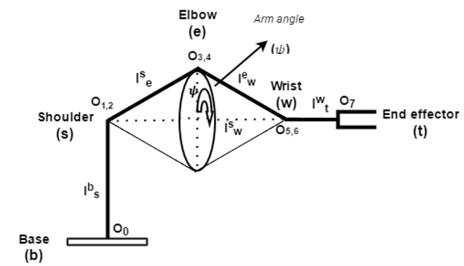
Inverse Kinematics [4/5]
theta 1,2,3

Slide 10

Inverse Kinematics [5/5]
theta 5,6,7

Slide 11
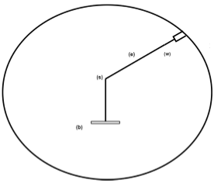
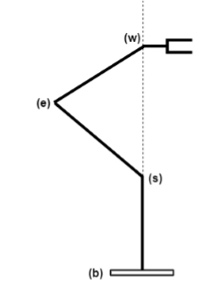
Singularity [1/2]
Infinite joint torques, Infinite velocities
Kinematic singularities
Internal singularities: inside workspace.
Use a different arm angle.
Elbow singularity
Shoulder singularity

Slide 12
Singularity [2/2]
Algorithmic singularities
I have some conditions, one condition for each joint angle, after long derivations, when become zero upon singularity.
Further, that joint angle is avoided to avoid singularity.
Redundancy helps!

Slide 13
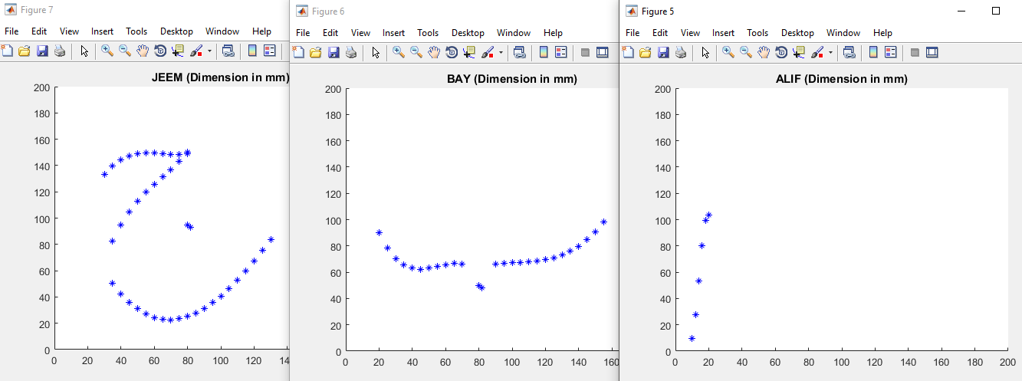
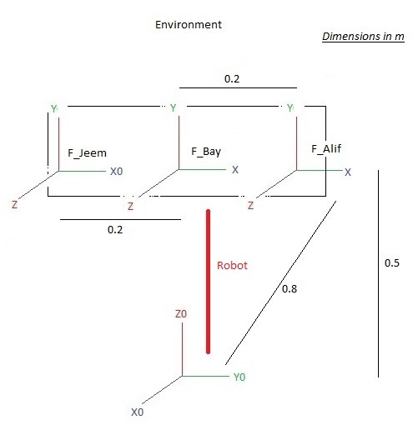

Writing
Write on PC
Trajectory planning
Environm-ent setting
Image processing
Writing

Slide 14
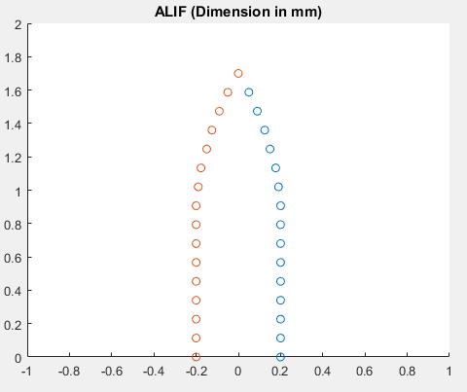
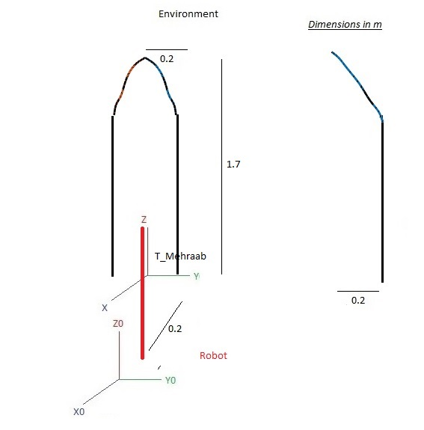
Mehraab Renovation
3D Picture
Trajectory planning
Environm-ent setting
Points selection
Renovation

Slide 15
Thank you!
Questions will be answered after the demonstration.

