Slide 1
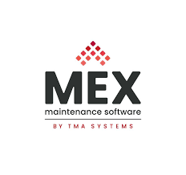
Introduction to MEX maintenance software
Overview, Key Features & Conclusion
Prepared by: Hafiz Muhammad Tahir Nisar

Slide 2
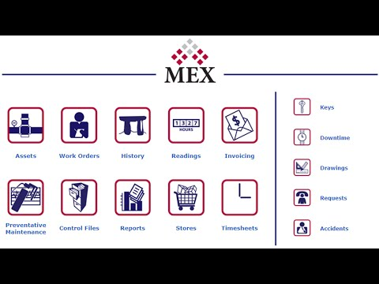
What is MEX?
MEX is a Computerized Maintenance Management System (CMMS) that helps organizations manage assets, work orders, inspections, and inventory.
Developed by Maintenance Experts (Australia) for asset-intensive industries.

Slide 3
Why MEX? – Key Capabilities
Centralized maintenance management system.
Supports work orders, preventive maintenance, and asset registers.
Simple interface with strong reporting and dashboard capabilities.
Suitable for manufacturing, construction, and facility operations.

Slide 4
Important modules in MEX maintenance software
Following are the important modules in MEX maintenance software.
Assets
Work Orders
History
Readings
Invoicing
Preventative Maintenance
Inventory/ Spare parts Management

Slide 5
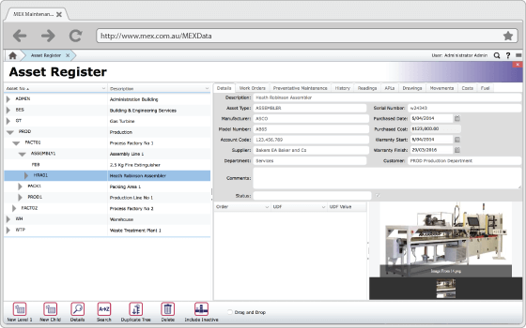
Assets
Serves as the database for all the assets, equipment, machine tools etc.
Stores all assets detail including location, serial number, and maintenance history.
Helps track condition and lifecycle of each asset.
Build assets hierarchy for better assets management.
Supports preventative maintenance planning.

Slide 6
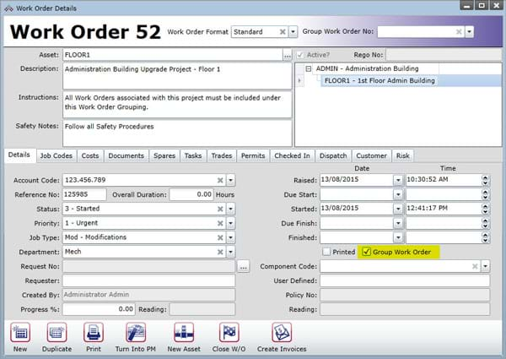
Work Orders
Create, assign, and track maintenance jobs. The jobs can be assign either manually or automatically.
Link materials, labor, and inspection results for traceability.
Work orders can be scheduled at a fixed interval for better man power utilization.
Helps in monitoring the work order either open, complete or in process.

Slide 7
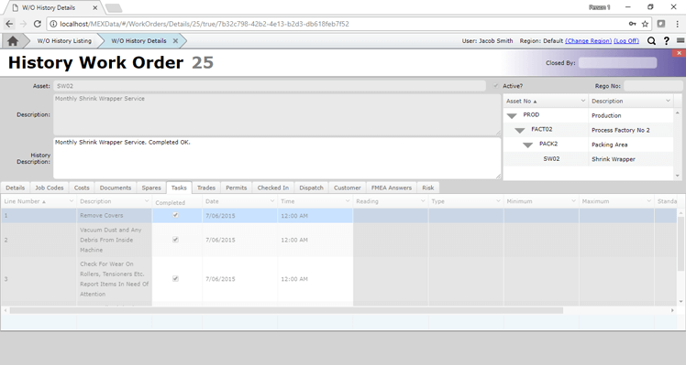
History
After work order is closed in MEX, it becomes a history record.
It helps to tell all the previous maintenance record linked to an asset or work order.
Supports preventative maintenance by checking asset history.
Helps in service/ inspection history for each of the asset.

Slide 8
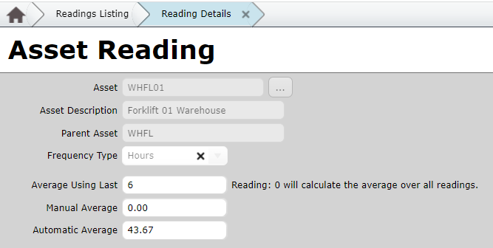
Readings
The readings module record numerical or usage values (hours run, kilometres, cycle, etc.).
Select relevant parent asset and enter the reading via form.
Helps in estimating cost and replacement planning.
Tracks the record of the equipment usage.

Slide 9
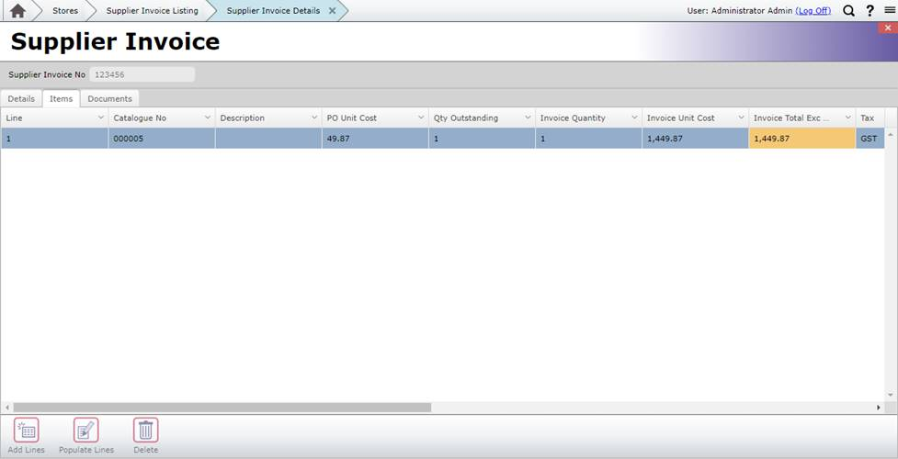
Invoicing
Creates invoice for maintenance work performed.
Integrates with work order data so that when work order is complete, generate invoice directly from it.
Helps manage outstanding invoices, manage payment due dates and revenue tracking.

Slide 10
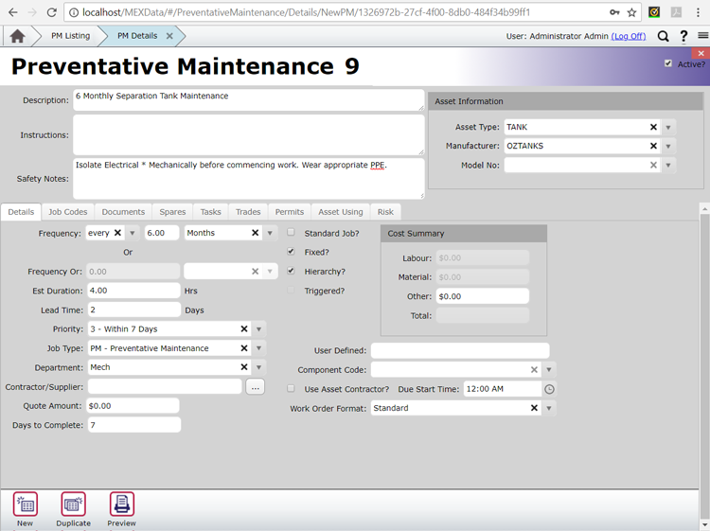
Preventative Maintenance (PM)
Schedule preventative maintenance in advance before the breakdown of the machine occur.
Set frequency either by time, usage or readings so to know when the maintenance is due.
Once the preventative maintenance is schedule, it automatically generates the work orders.
Helps to reduce the downtime and extend asset life time.

Slide 11
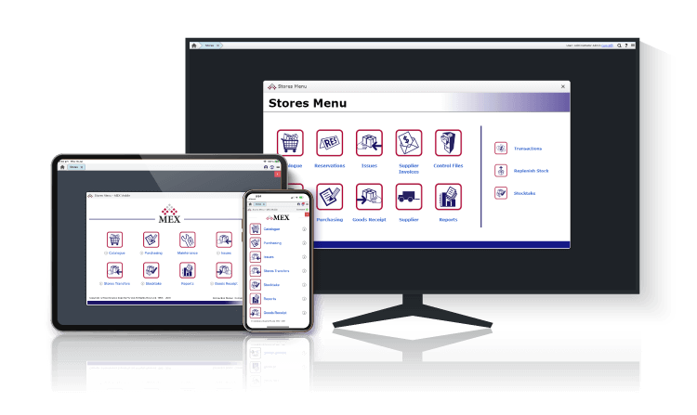
Inventory/ Spare parts Management
When a work order is issue the spare parts list can be issued directly from the inventory.
Helps in managing the stock outs of critical parts.
Helps in keep tracking of consumable items, spare items by managing in a centralized inventory approach.

Slide 12
Benefits Summary
Centralised data and asset visibility
Predictable maintenance costs
Improved compliance tracking
Enhanced decision-making via dashboards
Efficient user interface for different operations
Reliable for large organizations with daily routine tasks.

