Slide 1
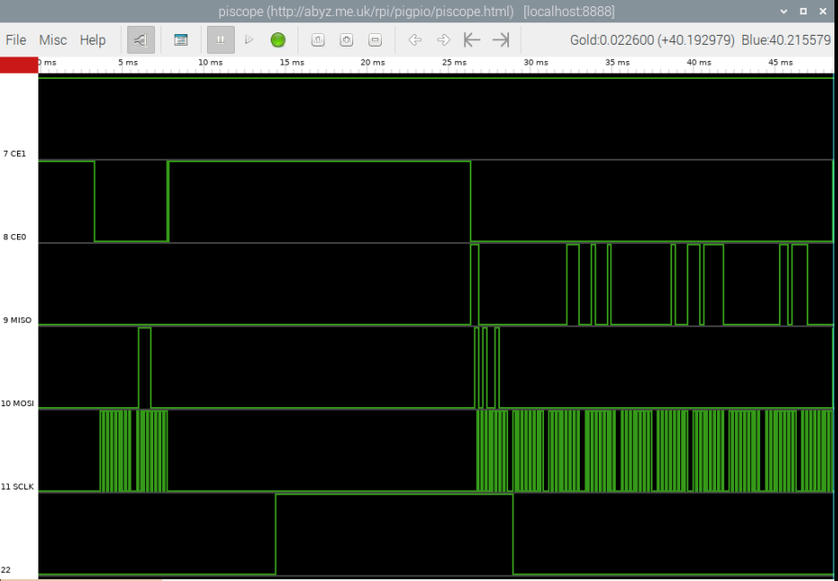
9 Byte result of 3 axis measurement. Two’s Complement Format.
Initialize X, Y, Z axis for single measurement.
Send Address of x axis first register
01110000
10100100
Clock Pulses
1 2 3 4 5 6 7 8 9
Ready Pin Goes High

