Slide 1
Classifying two major cities in Australia

Slide 2
Background
Main idea of this project is to help new immigrant to identify best suburbs for settlement where preferred facilities are available.
This Project would help the immigrant take a better decision on choosing the best neighborhood out of many suburbs to rent their houses in Sydney/Melbourne based on the distribution of various facilities in and around that neighborhood. As an example, this project would compare all the suburbs neighborhoods and analyse the distribution of facility.
Target Audience
Through this project we are expecting following people to benefit out of the findings. • Tourist. • People migrating city for work. • Business person looking for new location to start office etc. • And many more.

Slide 3
Objective
The objective of this project is to find best suitable suburb in Sydney and Melbourne given that new settler have some priority of facility in the suburb. using suburb location data along with Foursquare data and machine learning segmentation and clustering, this project will recommend cluster of suburbs where new settler will be able to get preferred facility.
Aim of this project:
1) Classify Sydney suburbs' based on given preferences and find best suburb that will meet requirements
2) Reclassify Sydney suburb given that house rent, travel time and distance will be minimized, and also meet requirements as per preference and weight
3) Predict Sydney house rent for given facility requirement
4) Classify Melbourne suburbs' based on given preferences and find best suburb that will meet requirements

Slide 4
Tools
Australia Postcode data, suburb data with lat long, [this data added to github as csv file]
Foursquare data
Foursquare API
IBMWatson Account
Jupiter Notebooks
Synthetic Data [program code included]
Python packages and Dependencies:

Slide 5
Python Library
• Pandas - Library for Data Analysis
• NumPy – Library to handle data in a vectorized manner
• JSON – Library to handle JSON files
• Geopy – To retrieve Location Data
• Requests – Library to handle http requests
• Matplotlib – Python Plotting Module
• Sklearn – Python machine learning Library
• Folium – Map rendering Library

Slide 6
Preferred Weight
- Train Station: 2
- Shopping Mall: 1.8
- Bus Station:1. 5
- Turkish Restaurant: 1.4
- Gym: 1.3
- Movie: 1.0
Fish: 1.0
Synthetic data
- House rent
- Travel time
- Distance of suburb from Sydney city centre

Slide 7
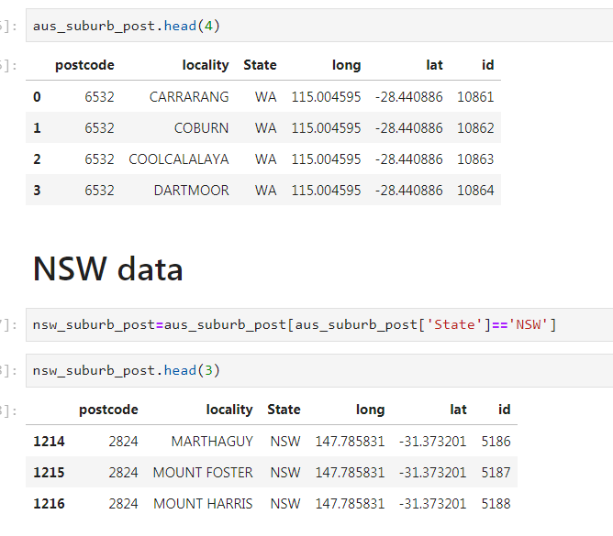
Data needed
We will use geolocation data dataset- Australia Post code data set, where post code, suburb name and lat long given. This data will be uploaded to github. This data will be used to identifying Sydney and Melbourne Suburbs.

Slide 8
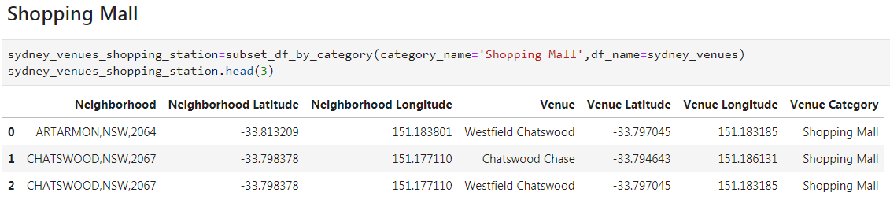
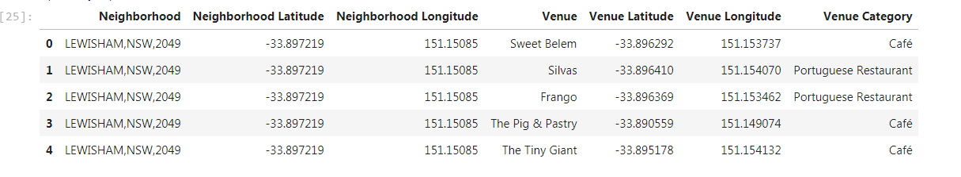
Foursquare data
This data will be collected from Foursquare web site using API.
Foursquare API will be used to query each of the neighbourhood
Data frame will be created for preferred facilities
(1. Movie 2. Shopping Mall 3.Turkish Restaurant 4. Bus 5. Train 6. Fish 7. Gym)

Slide 9
Methodology
Read Australia Postcode data
Extract NSW(Sydney) and VIC (Melbourne data)
Find Sydney Suburbs – postcode between NSW 2000 to NSW 2100
Find Melbourne Suburbs – postcode between VIC 3000 to VIC 3100
Foursquare API was then used to query each of the neighbourhood
Create data frame for preferred facilities (1. Movie 2. Shopping Mall 3.Turkish Restaurant 4. Bus 5. Train 6. Fish 7. Gym)
calculate points based on the client weight preferences:
1. Movie 2. Shopping Mall 3.Turkish Restaurant 4. Bus 5. Train 6. Fish 7. Gym
If suburb contain 1 venue then points is the weight multiplied by 10, but if the suburb contain more than one venue, then that suburb will get additional 1 points for each additional venue present.
venue points= 10*weight + (number of venue -1)
total points= sum of venue points

Slide 10
Methodology
Total number of venue counts is based on the total types of facility/client requirement available at the suburb. Total venue points ranges from 0 to 7. If any suburb contains all 7 client requirements (1. Movie 2. Shopping Mall 3.Turkish Restaurant 4. Bus 5. Train 6. Fish 7. Gym) then the suburb will be awarded 7.0 points.
Unsupervised machine learning algorithm K-mean clustering would be applied to form the clusters of different categories of places residing in and around the neighborhoods. The resulting data frame will be used for Cluster analysis. For cluster analysis, Total points and number of venue used. After cluster analysis, cluster centres were plotted on a Folium map.
This methodology is used for Sydney and Melbourne suburbs. From the resulting data frame, cluster of suburbs with highest number of points, venues extracted and presented.

Slide 11
Methodology
Create Synthetic data for Sydney House rent, Travel time and Distance from the Sydney city centre. I have calculated distance using haversine distance function, then synthetically generated rent and travel time using function.
For this three new attributes, weight is assumed for point calculation.
Re-calculated total points and save data into dataframe.
Use new total points is used for cluster analysis.
KNN algorithm and the same dataframe (Sydney), used for
Developing predictive model to predict Sydney house rent for given the client facility requirement

Slide 12
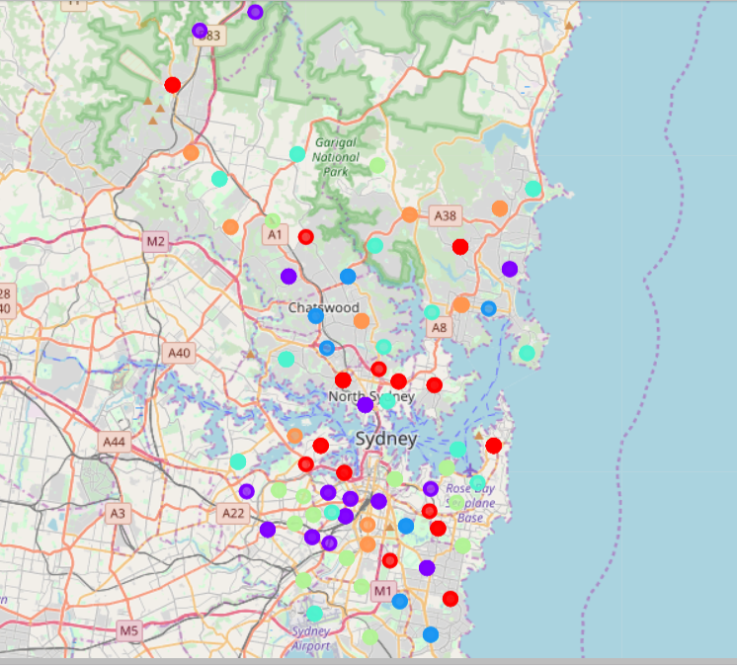
Results
Considering availability of Train Station, Bus Station, Fish, Gym, Movie and Turkish Restaurant within the 2 km distance of suburb
list of best Sydney Suburb given below:
'CASTLE COVE,NSW,2069',
'ROSEVILLE,NSW,2069',
'ROSEVILLE CHASE,NSW,2069',
'PAGEWOOD,NSW,2035',
'MAROUBRA,NSW,2035',
'MAROUBRA SOUTH,NSW,2035',
'KINGSFORD,NSW,2032',
'CENTENNIAL PARK,NSW,2021',
'DACEYVILLE,NSW,2032',
'PADDINGTON,NSW,2021''

Slide 13
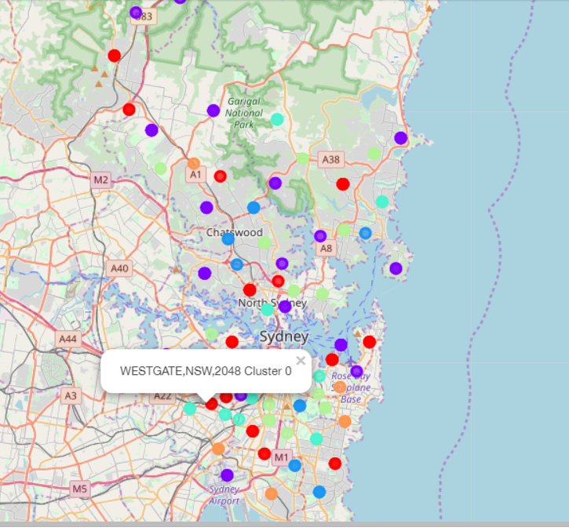
Results
If some other factors such as Rent, Travel\_time, Distance_CBD included in the decision making process then some of the suburb previously selected may not be good option.
list of best Sydney Suburb given below:
'PAGEWOOD,NSW,2035', 'MAROUBRA,NSW,2035',
'MAROUBRA SOUTH,NSW,2035',
'CENTENNIAL PARK,NSW,2021',
'PADDINGTON,NSW,2021',
'MOORE PARK,NSW,2021',
'ROSEVILLE,NSW,2069',
'ROSEVILLE CHASE,NSW,2069',
'CASTLE COVE,NSW,2069',
'KINGSFORD,NSW,2032'

Slide 14
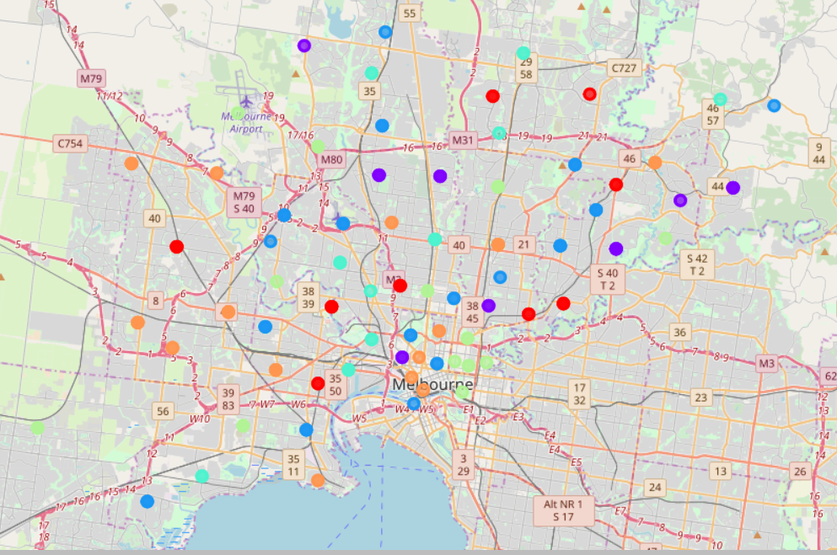
Results
list of best Melbourne Suburb given below:
EPPING DC,VIC,3076
EPPING,VIC,3076
ABERFELDIE,VIC,3040
ESSENDON,VIC,3040
ESSENDON WEST,VIC,3040 KENSINGTON,VIC,3031
FLEMINGTON,VIC,3031 THOMASTOWN,VIC,3074
MOONEE PONDS,VIC,3039
COOLAROO,VIC,3048

Slide 15
Conclusions
New immigrant or any person moving can use this project to identify the suitable place depending on the individual preferences of facilities.
This project will also help to refine decision my adding other constraints such as weekly rent budget, travel distance and time.
It is clear from the analysis that selection best suitable suburbs may change based on the preference and restrictions.
Also developed model using KNN to predict house rent, using another input variable.

