Slide 1
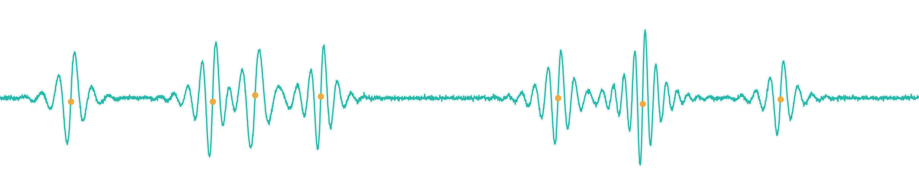
MLMI 2026 · MACHINE LEARNING AND MACHINE INTELLIGENCE · JAPAN
BurstMAE–MIL
A Self–Supervised, Event–Based Learning Framework for Acoustic
Emission–Based Fault Identification in Milling Machines
Muhammad Umar Faisal Saleem Jong–Myon Kim *
Department of Electrical, Electronics & Computer Engineering, University of Ulsan, South Korea · PD Technology Co. Ltd.
99.91%
1.000
4 / 2
Sample-level accuracy
ROC–AUC (all classes)
Fault classes / speeds
Presented at MLMI 2026, Japan
Notes:
Open with the headline: AE signals see micro-damage earlier than vibration, but they are transient and labels are scarce. We solve both with an event-based, self-supervised framework called BurstMAE-MIL. Tease the result: 99.91% accuracy, AUC 1.000, using only a limited number of labeled samples per class.

Slide 2
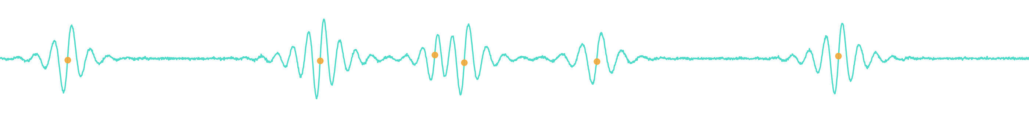
ROADMAP
What we will cover
1
Motivation & Challenge
Why AE matters — and why it is hard to use
THE ONE–LINE IDEA
2
The BurstMAE–MIL Framework
Diagnostic information in AE lives in the bursts — not in the background.
Bursts → self–supervised encoder → attention MIL
3
Experimental Setup & Data
Milling rig, AE sensing, four fault conditions
4
Results & Interpretability
Near–perfect diagnosis and what the model attends to
5
Conclusions & Outlook
Takeaways and directions ahead
BurstMAE-MIL
02
Notes:
Quick roadmap. Keep it to ~15 seconds. The right panel is the thesis the whole talk defends.

Slide 3



MOTIVATION
Why milling diagnosis matters
Reliability is everything
Undetected wear in tools, bearings, and gears causes surface defects, downtime, and costly failures.
THE AE ADVANTAGE
50–400 kHz
Catch damage early
Sensor bandwidth
In precision machining, small defects propagate fast — early detection prevents severe damage.
1 MS/s
Sampling rate, 16–bit
AE sees what others miss
µs–scale
Acoustic emission captures high–frequency stress waves from micro–cracks, deformation, and friction.
Transient burst events
BurstMAE-MIL
03
Notes:
Frame the stakes in plain terms: machines fail, and AE is uniquely sensitive to the earliest signs. The right card gives the physical sensing envelope so the audience trusts the modality.

Slide 4



THE PROBLEM
Three obstacles to AE–based diagnosis
01
02
03
Transient & noisy
Labels are scarce
Event nature ignored
AE is non–stationary and dominated by short, high–energy bursts buried in background noise.
Acquiring large, labeled fault datasets under controlled conditions is impractical in industry.
Treating AE as a continuous series dilutes informative bursts and adds redundant background.
BurstMAE-MIL
04
Notes:
These three obstacles map one-to-one onto the three design choices of our method. Plant that seed now: event-based segmentation, self-supervised learning, attention MIL.

Slide 5



THE BIG IDEA
Focus learning on physically meaningful bursts, learn them without labels, and let attention pick the diagnostic ones.
Event–based
Self–supervised
Weakly supervised
Robust energy + MAD detection isolates transient stress–wave bursts.
A masked autoencoder learns burst structure from unlabeled data.
Attention MIL aggregates bursts using only recording–level labels.
SOLVES: TRANSIENT & NOISY
SOLVES: LABEL SCARCITY
SOLVES: EVENT NATURE IGNORED
BurstMAE-MIL
05
Notes:
This is the heart of the contribution. Each pillar answers one obstacle from the previous slide. Say it slowly so the structure lands.

Slide 6
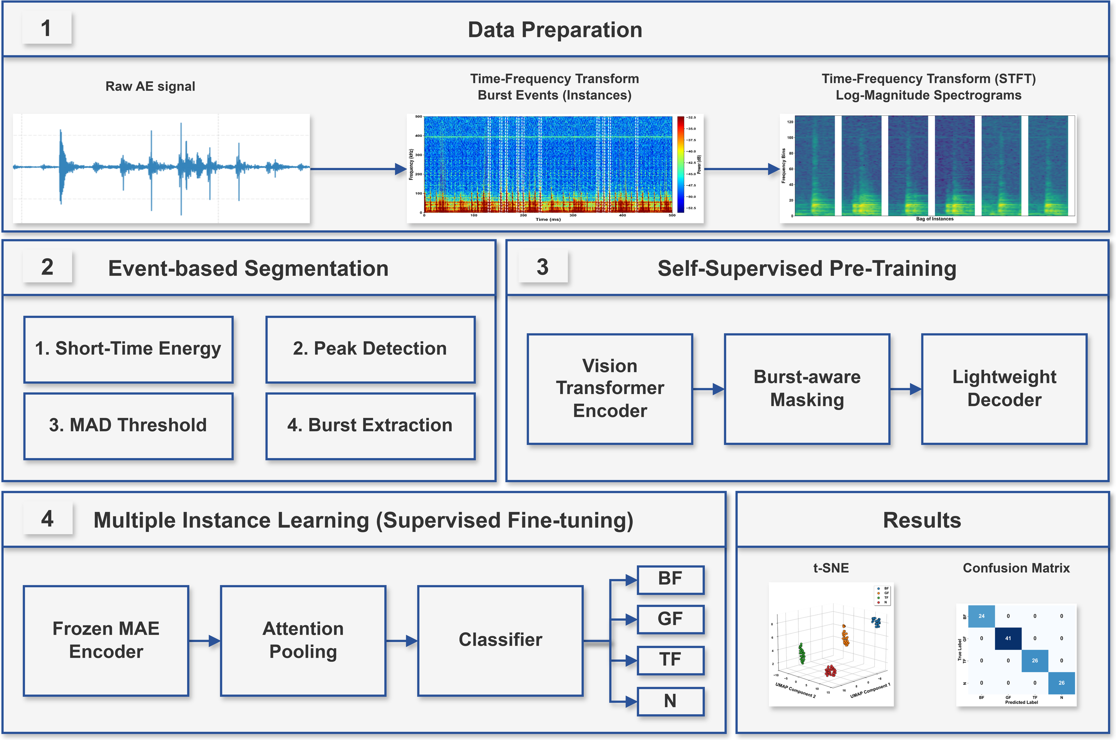
METHOD · OVERVIEW
BurstMAE–MIL at a glance
Raw AE → Burst events → Self–supervised encoder → Attention MIL → Fault diagnosis
BurstMAE-MIL
06
Notes:
Walk the four boxes left to right. Emphasize the pipeline runs end to end from raw AE to a per-recording fault label. The next three slides zoom into the three colored stages.

Slide 7
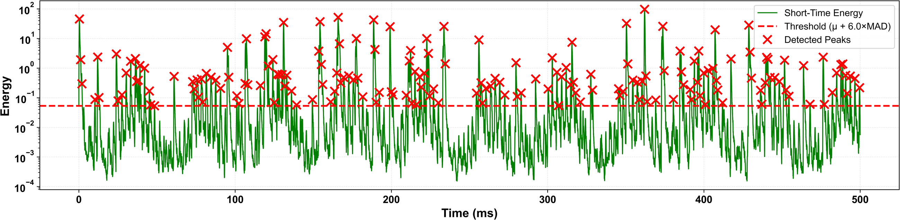
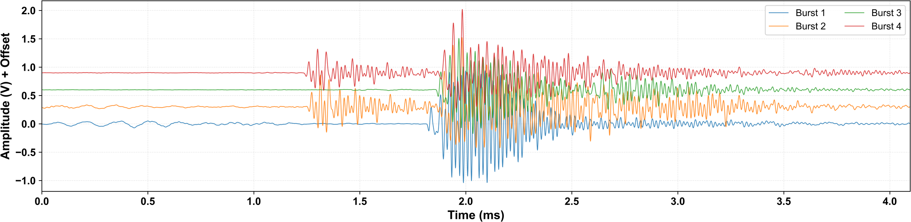
METHOD · STEP 1
Event–based burst segmentation
1
Short–time energy
Short–time energy with adaptive MAD threshold (× detected peaks)
Sliding–window energy E[n] over the raw AE signal.
2
Peak detection
Bursts located as local energy maxima.
3
Adaptive MAD threshold
Extracted transient burst events
Robust threshold from median absolute deviation.
4
Burst extraction
Fixed–length segments centered on each peak.
Learning focuses on physical stress–wave activity — not background.
E[n] = Σ x²[k] · threshold = μ + 6·MAD
BurstMAE-MIL
07
Notes:
The energy-MAD detector is robust to changing noise. Point at the red crosses: each is a candidate burst. Bottom plot shows the clean transients we actually feed forward.

Slide 8




METHOD · STEP 2
Self–supervised representation learning
STFT spectrograms
Each burst → log–magnitude time–frequency image.
MASKED INPUT
Mask & reconstruct
ViT
Encoder
Light
Decoder
Most patches are hidden; the model rebuilds them from context.
No labels needed
The encoder learns intrinsic AE structure from unlabeled bursts.
Transfer the encoder
RECONSTRUCT → EMBEDDING
~ 65% of patches
masked during
pretraining
Decoder is discarded; the encoder becomes a feature extractor.
BurstMAE-MIL
08
Notes:
Explain masked autoencoding simply: hide most of the spectrogram, force the model to fill in the gaps, and it must learn what AE bursts actually look like. We then throw away the decoder and keep the encoder. This is what makes us label-efficient.

Slide 9


METHOD · STEP 3
Attention–based multiple instance learning
Recording = bag of bursts
Each AE file is a set of burst–level embeddings.
BURST EMBEDDINGS (with attention weight)
Learnable attention
Weights rank how diagnostic each burst is.
h1
h2
h3
h4
h5
h6
Selective emphasis
Fault–relevant bursts amplified; background suppressed.
Attention pooling
Recording–level label only
No burst annotations — weakly supervised.
BF
GF
TF
N
Recording–level prediction
BurstMAE-MIL
09
Notes:
The tall amber bars are the bursts the model decides are diagnostic. Pooling weights them, the classifier outputs one label per recording. Crucially, we never told it which burst mattered.

Slide 10
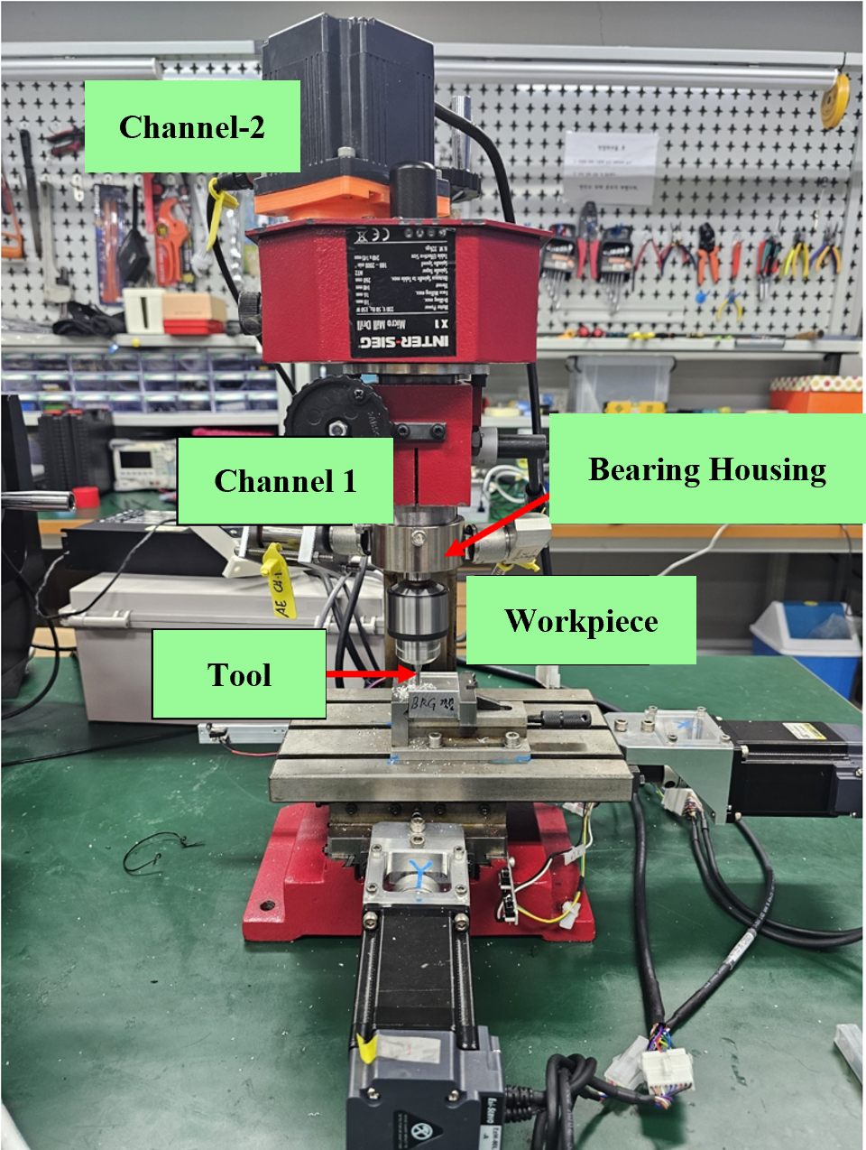
EXPERIMENTS
Setup, sensing & fault conditions
INSTRUMENTATION
FOUR MACHINE CONDITIONS
Sensors
2× R15I–AST piezoelectric
N
Normal
TF
Tool fault
Bandwidth
Intact components
≈ 0.3 mm flank wear
50–400 kHz, 40 dB preamp
DAQ
NI–9223 · 1 MS/s · 16–bit
Material
BF
Bearing fault
GF
Gear fault
C45 medium–carbon steel
Outer–race defect ≈3 mm
Partial tooth removal
Speeds
660 rpm & 720 rpm
INTER–SIEG X1 Micro Mill Drill
1,253 Total recordings
1 s @ 1 MHz Per recording
Train-only Self–supervised pretraining
Stratified Train / val / test split
BurstMAE-MIL
10
Notes:
Real rig, real induced faults verified optically. Stress two integrity points: pretraining used only training-split bursts (no leakage), and all evaluation is at the recording/file level, which matches deployment.

Slide 11
RESULTS
Near–perfect diagnosis under limited labels
99.91%
1.000
+9.0 pts
Sample–level accuracy
ROC–AUC, every class
Over STFT+CNN baseline
METHOD COMPARISON — precision / recall / F1 / accuracy (%)
Method | Speed | Precision | Recall | F1 | Accuracy
STFT + CNN (baseline) | 660 rpm | 91.20 | 91.80 | 90.50 | 90.90
BurstMAE–MIL (ours) | 660 rpm | 99.92 | 99.91 | 99.92 | 99.91
STFT + CNN (baseline) | 720 rpm | 89.40 | 89.60 | 88.90 | 89.20
BurstMAE–MIL (ours) | 720 rpm | 99.92 | 99.91 | 99.92 | 99.91
Under a limited number of labeled samples per class, the fully supervised CNN degrades — our self–supervised, event–based design does not.
11
Notes:
Land the contrast hard. The CNN is a strong, conventional baseline and it sits around 90%. We are at 99.9% with the same scarce labels. Pause on the table; let the two 'ours' rows speak.

Slide 12
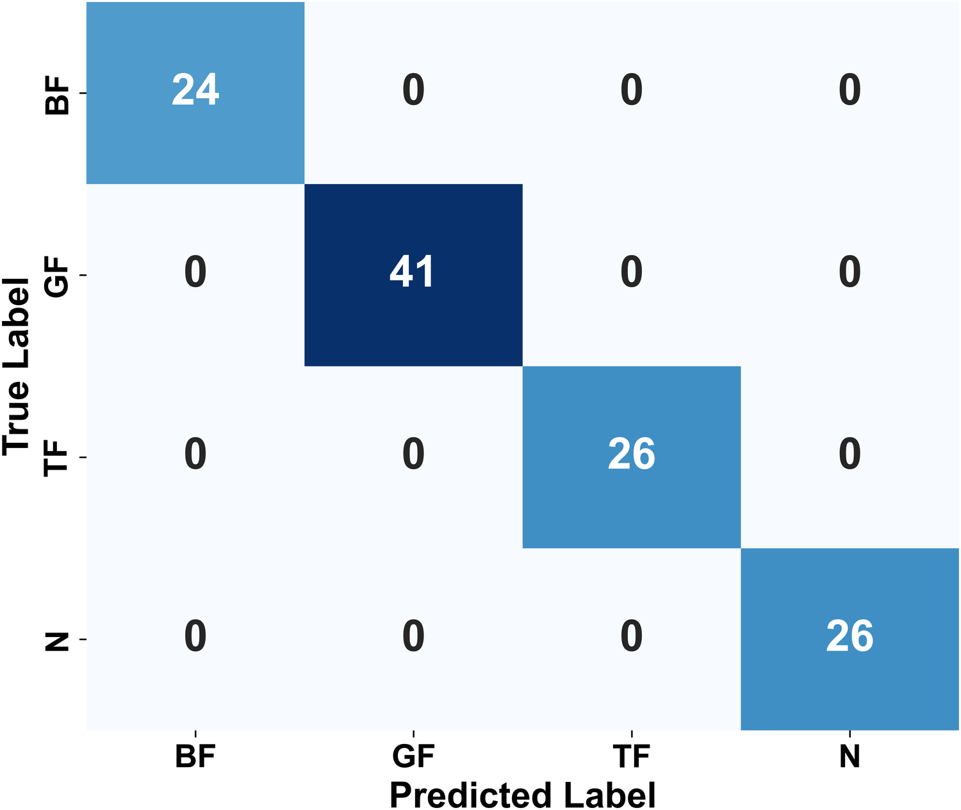
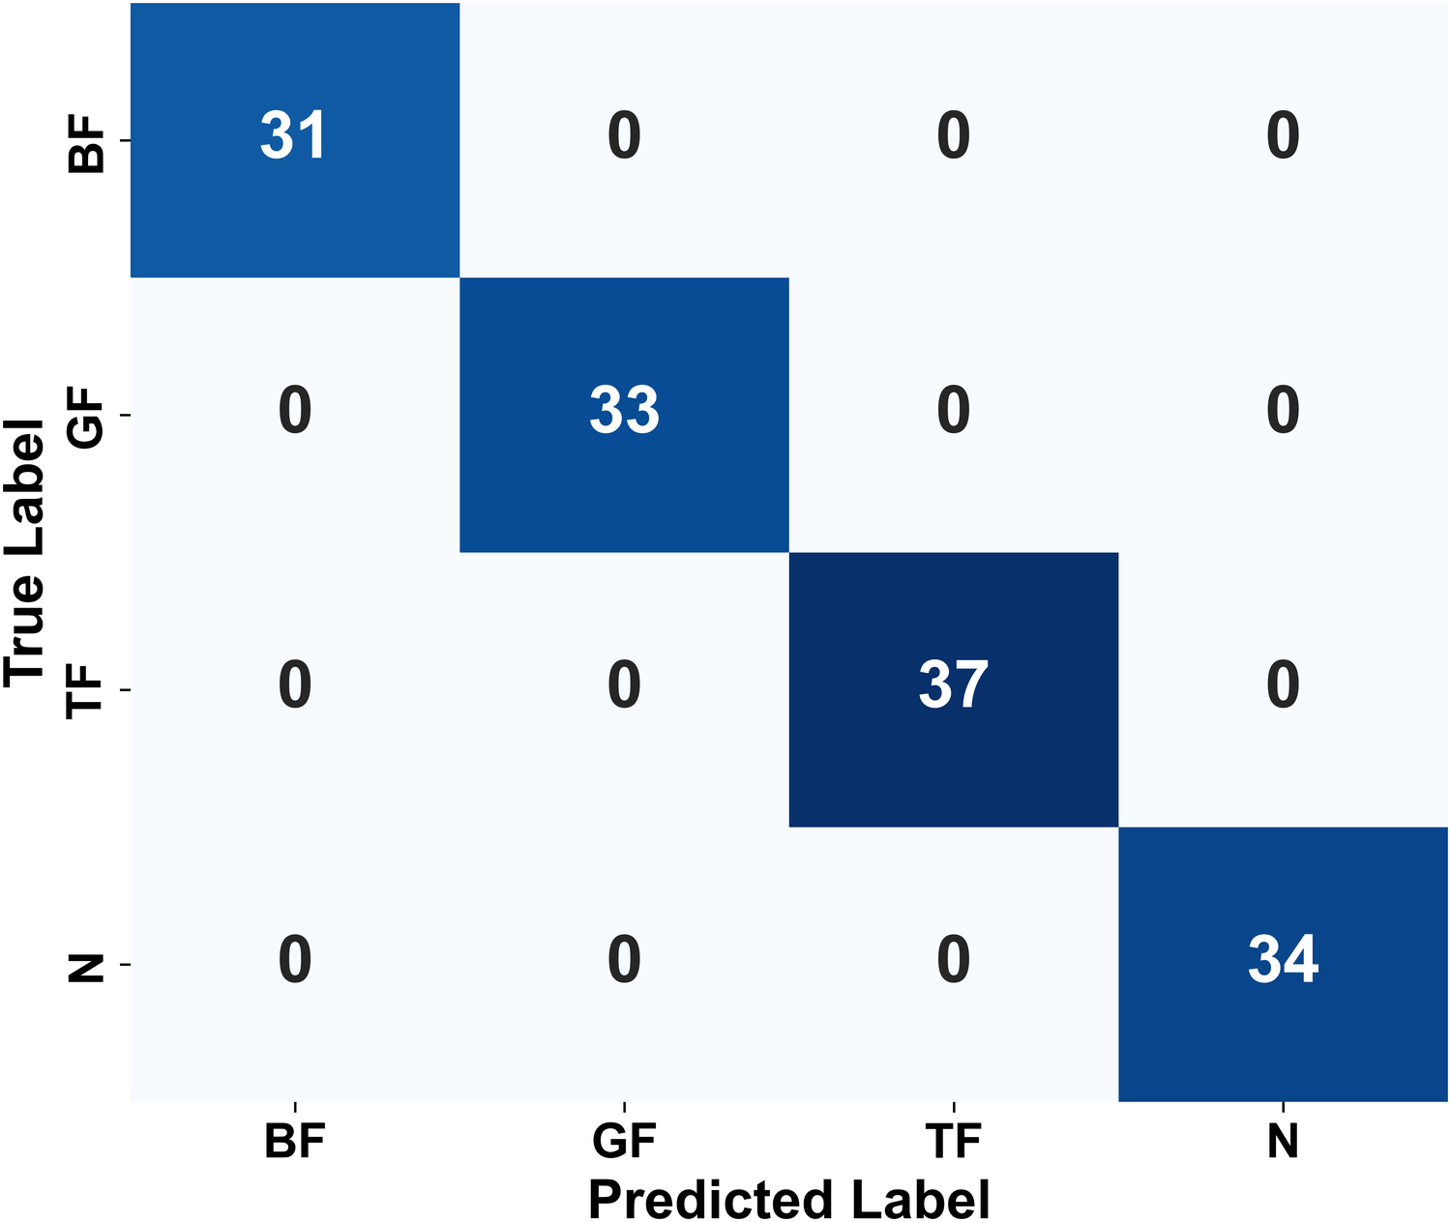
RESULTS · ACCURACY
Flawless class separation
660 RPM · 117 TEST FILES
720 RPM · 135 TEST FILES
Zero off–diagonal errors at both speeds — every fault class is recovered exactly.
BurstMAE-MIL
12
Notes:
Two confusion matrices, both clean diagonals. Note these are different recordings at different speeds, so this is genuine generalization, not a single lucky split.

Slide 13
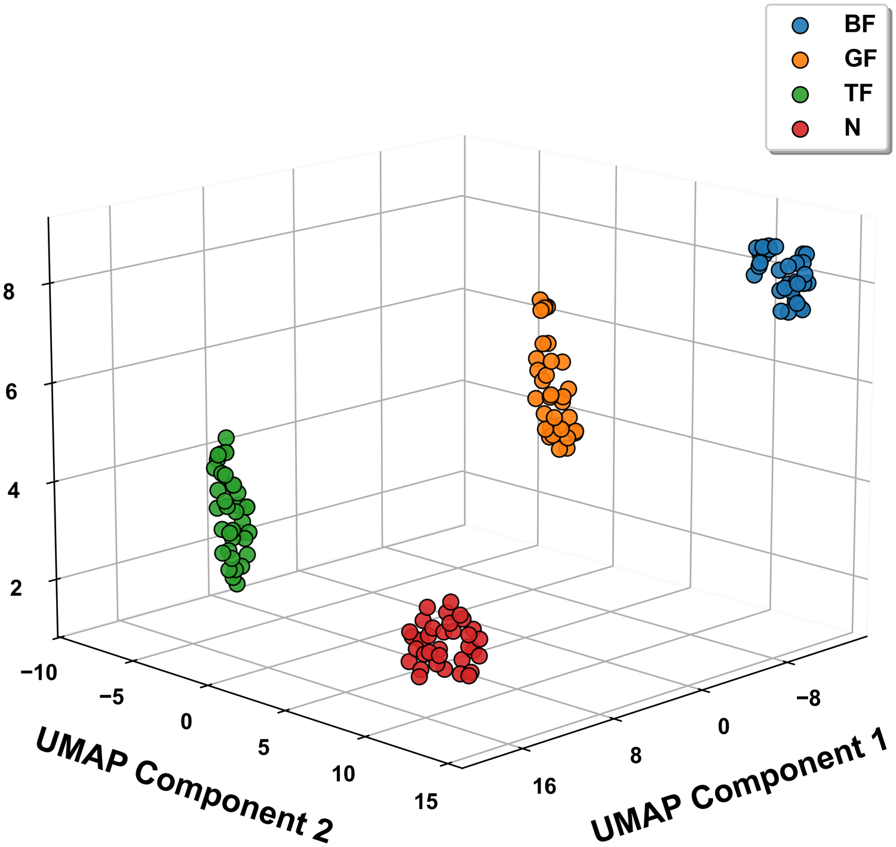
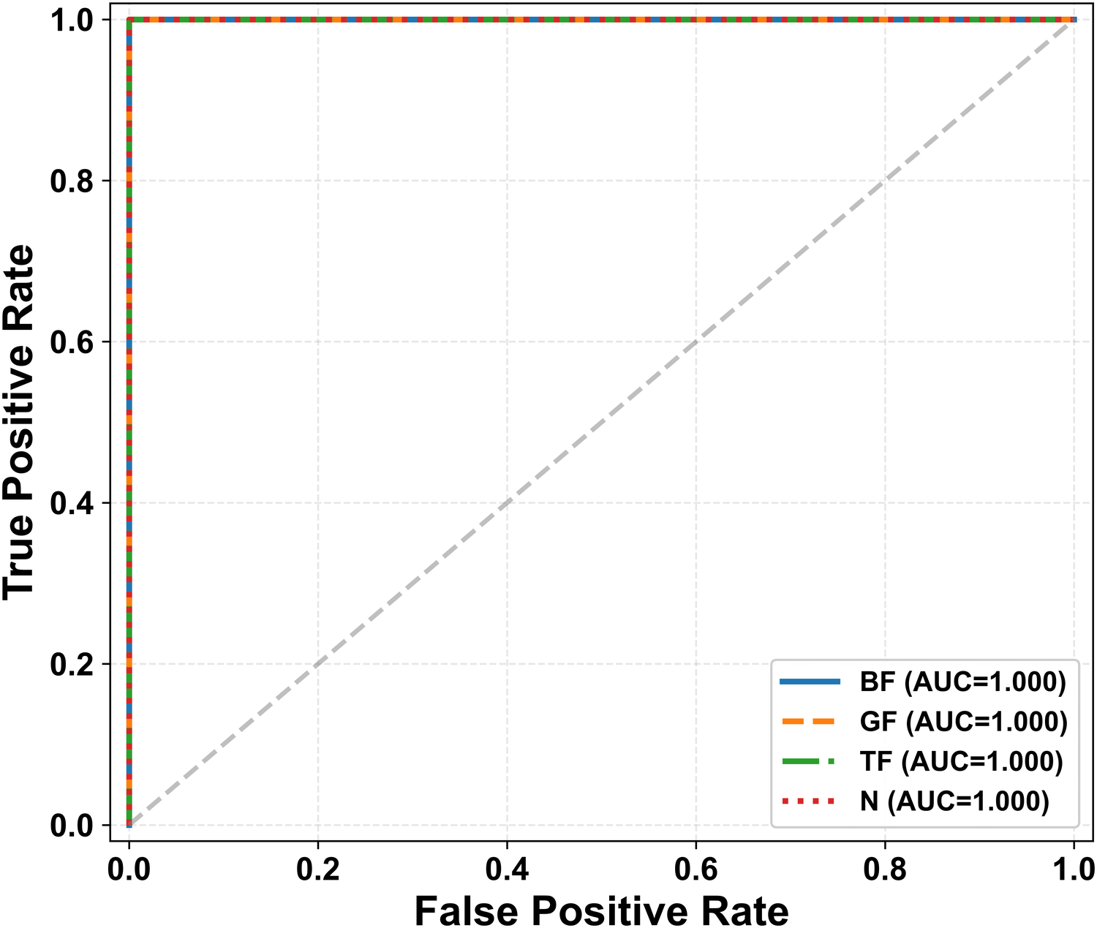
RESULTS · EVIDENCE
Discriminative, well–separated features
LEARNED EMBEDDINGS (UMAP, 720 rpm)
CLASS–WISE ROC
Compact intra–class clusters and clean inter–class gaps; AUC = 1.000 for all classes.
BurstMAE-MIL
13
Notes:
The UMAP shows the four conditions sitting in distinct islands - the encoder learned fault-specific structure, not surface artifacts. ROC corroborates with perfect separability.

Slide 14

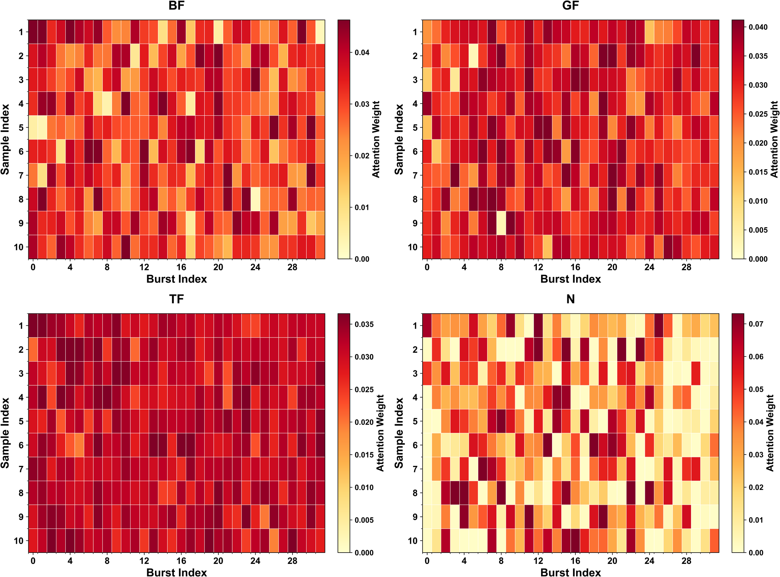

RESULTS · INTERPRETABILITY
What the model attends to
Selective focus
ATTENTION WEIGHTS PER BURST · BF / GF / TF / N (720 rpm)
Attention concentrates on a subset of diagnostically informative bursts.
Class–specific patterns
Each fault type elicits a distinct attention signature across bursts.
No burst labels
Effective instance selection emerges from recording–level supervision alone.
BurstMAE-MIL
14
Notes:
Each heatmap row is a recording; columns are bursts. Bright cells are where the model looks. The point: this interpretability is free - we get it without ever labeling individual bursts.

Slide 15
SYNTHESIS
Three reasons it works
Event–based focus
01
Burst segmentation guides learning to physical stress–wave events, removing background redundancy.
Self–supervised pretraining
02
Robust burst representations are learned without large labeled datasets — critical where AE labels are costly.
Attention aggregation
03
Diagnostic bursts are emphasized and irrelevant ones suppressed under weak, recording–level supervision.
BurstMAE-MIL
15
Notes:
Tie the bow: each design choice neutralizes one of the three obstacles from slide 4. This problem-to-solution symmetry is the cleanest way to make the contribution memorable.

Slide 16




CONCLUSION
A reliable, label–efficient path for AE diagnosis
KEY TAKEAWAYS
Event–based modeling targets the burst–dominated physics of AE.
WHERE NEXT
Variable operating conditions
A masked autoencoder learns strong features from unlabeled bursts.
Cross–machine transfer learning
Attention MIL turns burst embeddings into accurate per–recording labels.
Online, streaming adaptation
Multi–sensor fusion
Perfect sample–level classification at 660 & 720 rpm under scarce labels.
Causal analysis of burst–damage links
BurstMAE-MIL
16
Notes:
Summarize in three sentences, then point forward. The future-work panel signals this is part of a larger research program, which reviewers and award committees like to see.

Slide 17
THANK YOU
Questions & Discussion
PRESENTER
AFFILIATION
CORRESPONDING
Muhammad Umar
University of Ulsan, Korea
jmkim07@ulsan.ac.kr
BurstMAE–MIL · MLMI 2026, Japan
Supported by the NIPA Manufacturing Industry AI Convergence Infrastructure Project (S0403–25–1001) and the MOTIE Technology Innovation Program (RS–2022–00142509).
Notes:
Invite questions warmly. Have backup slides ready for: STFT settings, MAE mask ratio, attention formulation, and why the CNN baseline degrades. Thank the funders briefly if time allows.

