Slide 1



Spatial Filtering
34
42
71
115
169
163
178
39
34
41
55
88
142
174
33
29
32
51
71
102
150
26
25
29
38
68
76
132
29
30
34
33
53
57
89
28
26
28
31
35
46
62
26
27
29
26
28
29
40
Muhammad Umar
Graduate Research Assistant, Ulsan Industrial AI Lab
Department of Electrical, Electronic and Computer Engineering, University of Ulsan
28 September 2026

Slide 2



My academic background
Bachelor of Science
(2019-2023)
Major: Computer Systems Engineering
Final Year Project
University of Engineering
and Technology, Peshawar
Deepfake Video Detection Using Deep Learning
Doctor of Philosophy
(2023-Present)
Major: AI and Computer Engineering
Laboratory: Ulsan Industrial Artificial Intelligence Laboratory
Research Publications: 25
University of Ulsan,
South Korea
Research Area
Journal | Conference
15 First Author: 5 Co-author: 10 | 10 First Author: 3 Co-author: 7
Intelligent Fault Diagnosis and Predictive
Maintenance for Industrial Rotating Machines
Number of Citations: 395+

Slide 3
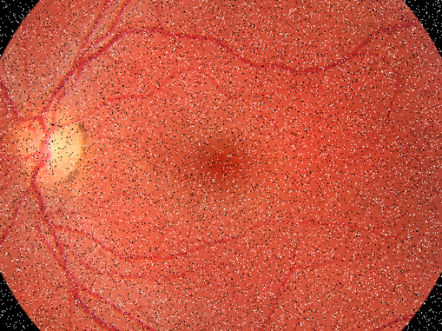
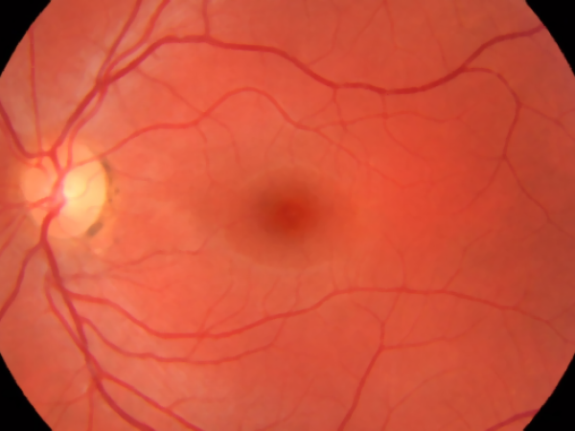
Would you trust a diagnosis from the image on the left?
NOISY INPUT
FILTERED
Same retina. Same data. Different visibility.
3/33

Slide 4
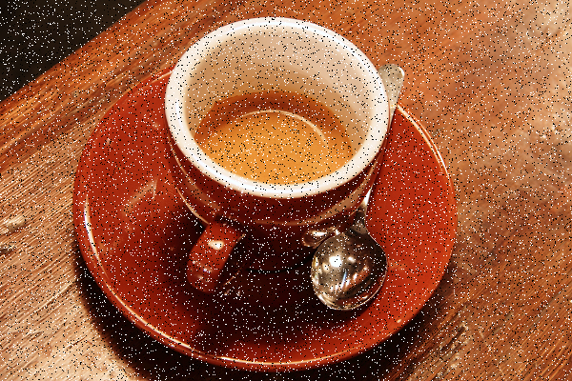

Which image would you trust?
Synthetic salt-and-pepper noise
Original / after ONE line of code
4/33

Slide 5
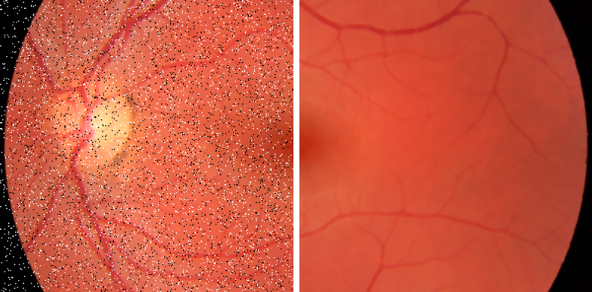
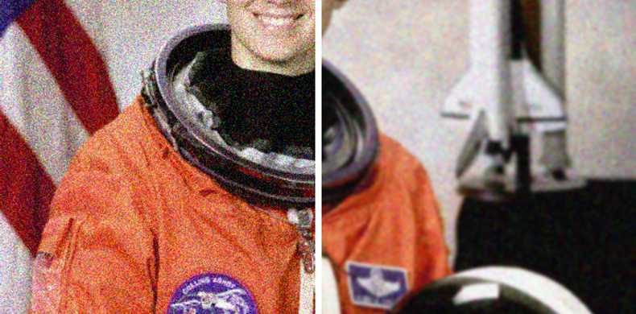
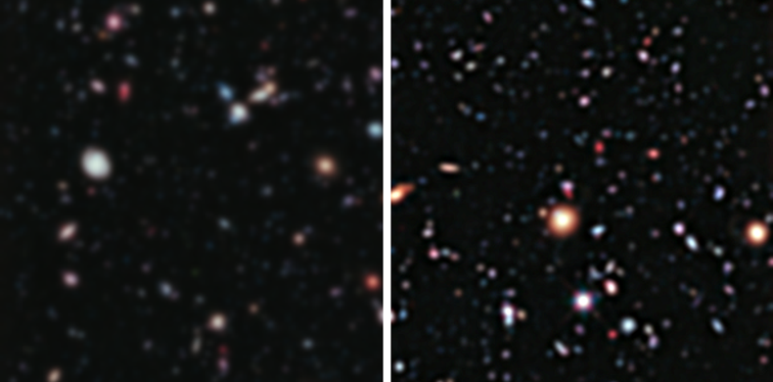
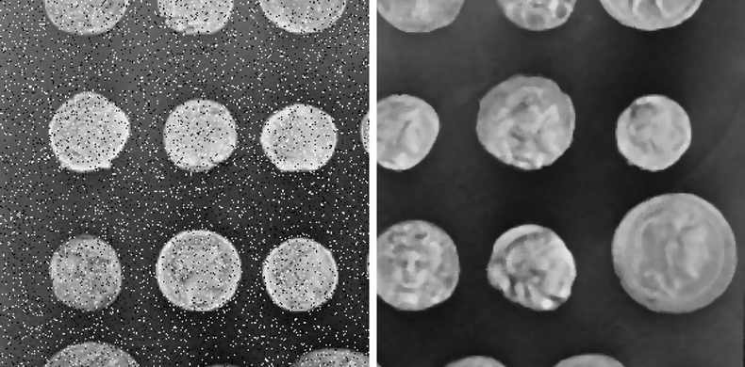
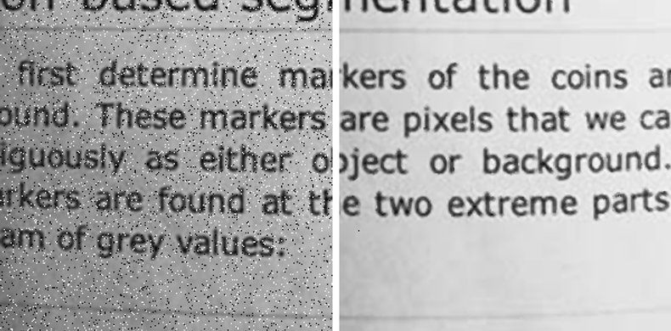
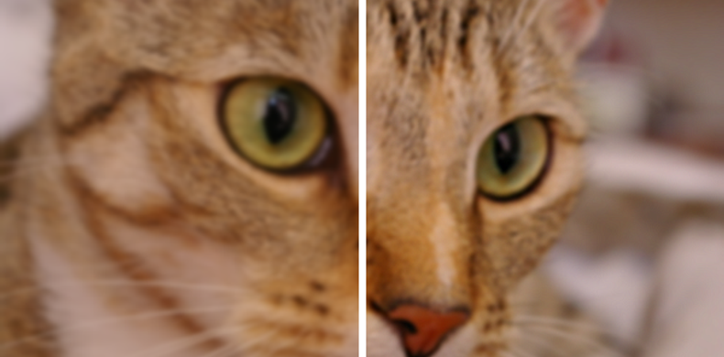
Why do we filter images?
BEFORE
AFTER
BEFORE
AFTER
BEFORE
AFTER
Medical Imaging
Security Cameras
Astronomy
Reduce imaging noise before clinical analysis
Remove night-time grain from CCTV
Improve the visibility of faint stars
BEFORE
AFTER
BEFORE
AFTER
BEFORE
AFTER
Industrial Inspection
Documents and OCR
Smartphone Cameras
Clean item images before counting or measuring
Erase scan specks before text recognition
The 'sharpness' in every photo we take
5/33

Slide 6
Today’s agenda
1
2
3
4
5
Image basics
›
Spatial filtering
›
Smoothing
›
Sharpening
›
Case studies
6/33

Slide 7
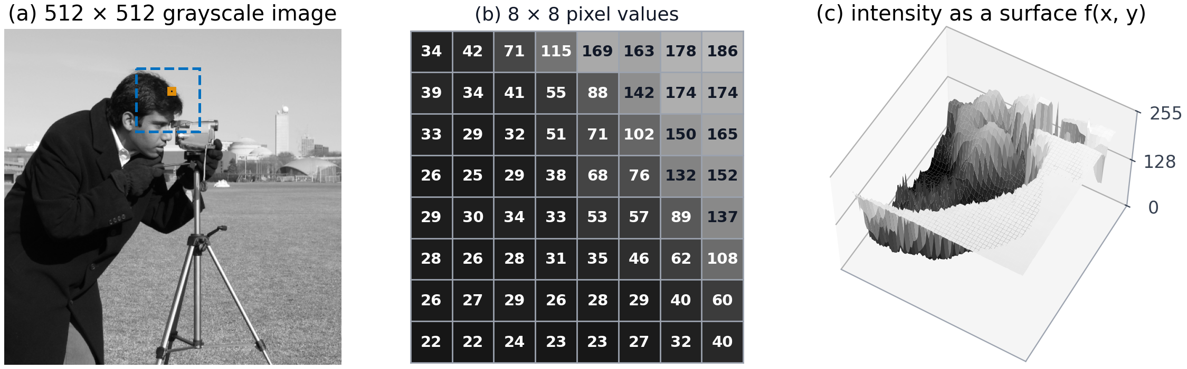
A picture is a grid of numbers
➜ Zoom into any photo and we will find tiny squares called pixels.
➜ Each pixel stores one number:
0
128
255
Black grey white
7/33

Slide 8
Spatial filtering
➜ Changing each pixel by looking at the pixel and its neighbours.
N
N
N
N
P
N
N
N
N
P = the pixel we are changing
N = its 8 neighbours
Amber box = 3 × 3 neighbourhood
8/33

Slide 9
How it works: a small window slides over the image
12
15
18
20
22
24
12
15
18
20
22
24
12
15
18
20
22
24
14
30
34
36
25
23
14
30
34
36
25
23
14
30
34
36
25
23
16
32
40
38
27
21
16
32
40
38
27
21
16
32
40
38
27
21
18
33
37
35
29
20
18
33
37
35
29
20
18
33
37
35
29
20
20
22
24
26
30
19
20
22
24
26
30
19
20
22
24
26
30
19
21
23
22
25
27
18
21
23
22
25
27
18
21
23
22
25
27
18
Step A: top-left
Step B: move one to the right
…then the next row
1
Place
2
Combine
3
Write
4
Slide
the window on a pixel
the 9 numbers with a rule
the answer in the new image
to the next pixel and repeat
The main difference between filters is how Step 2 combines the neighborhood values.
9/33

Slide 10
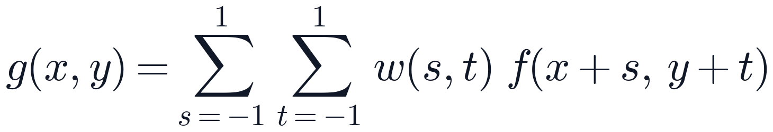













The math of linear spatial filtering
$$g(x, y)$$
the new pixel value we are computing
$$w(−1,−1)$$
$$w(−1,0)$$
$$w(−1,1)$$
$$f(x+s, y+t)$$
an old pixel inside the 3 × 3 window
$$w(0,−1)$$
$$w(0,0)$$
$$w(0,1)$$
$$w(s, t)$$
the weight: how much that pixel counts
$$w(1,−1)$$
$$w(1,0)$$
$$w(1,1)$$
$$Σ Σ$$
add up all 9 products (s and t go −1, 0, +1)
the kernel (mask): 9 weights
Multiply each neighbor by its weight, then add everything.
10/33

Slide 11
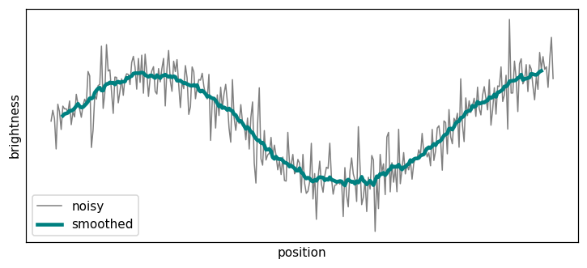
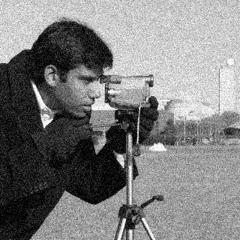

Smoothing
➜ Reducing unwanted local intensity variations.
➜ Also called blurring or low-pass filtering.
2 smoothing tools:
Averaging filter
Median filter
noisy
smoothed (3 × 3 average)
11/33

Slide 12
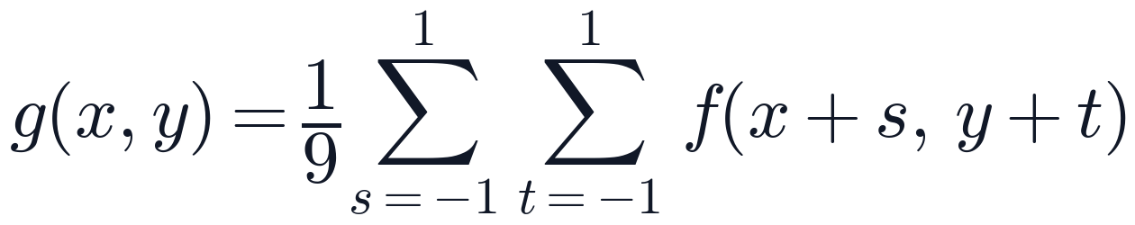
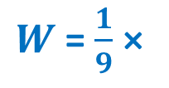
Averaging filter: the math
➜ Each output pixel is the mean of the nine values in a 3×3 neighborhood.
1
1
1
1
1
1
$W$ = $\frac{1}{9}$ ×
1
1
1
Add the 9-pixel values in the window
Divide by 9
That is the new centre pixel
3×3 averaging kernel
Every weight equals 1/9, and all weights sum to 1.
12/33

Slide 13
Averaging filter: example
A flat area (value 10) with one noisy pixel (100):
10
10
10
Sum = 10+10+10+10+100+10+10+10+10 = 180
20
10
100
10
Mean = 180 ÷ 9 =
10
10
10
The noise dropped from 100 to 20. Better, but not gone.
Averaging does not remove the bad pixel. It spreads it over the neighbors.
13/33

Slide 14




Averaging on a real image: the size of the window matters
original
3 × 3: 9 pixels
9 × 9: 81 pixels
21 × 21: 441 pixels
Bigger window → more noise removed → but more blur (loss of details)
Weakness: averaging cannot tell noise from edges, so edges get blurred too.
14/33

Slide 15
Median filter: example
➜ Sort the neighbourhood from small to large and take the middle value.
10
10
10
Step 1: sort the 9 values
10
10
10
10
10
10
10
10
100
10
100
10
Step 2: take the 5th value (the middle of 9)
10
10
10
Average
Median
20
10
The true value was 10. The median gets it exactly.
15/33

Slide 16


Sharpening
Sharpening increases local contrast around edges and fine structures, making intensity transitions appear more distinct.
soft
sharpened
16/33

Slide 17
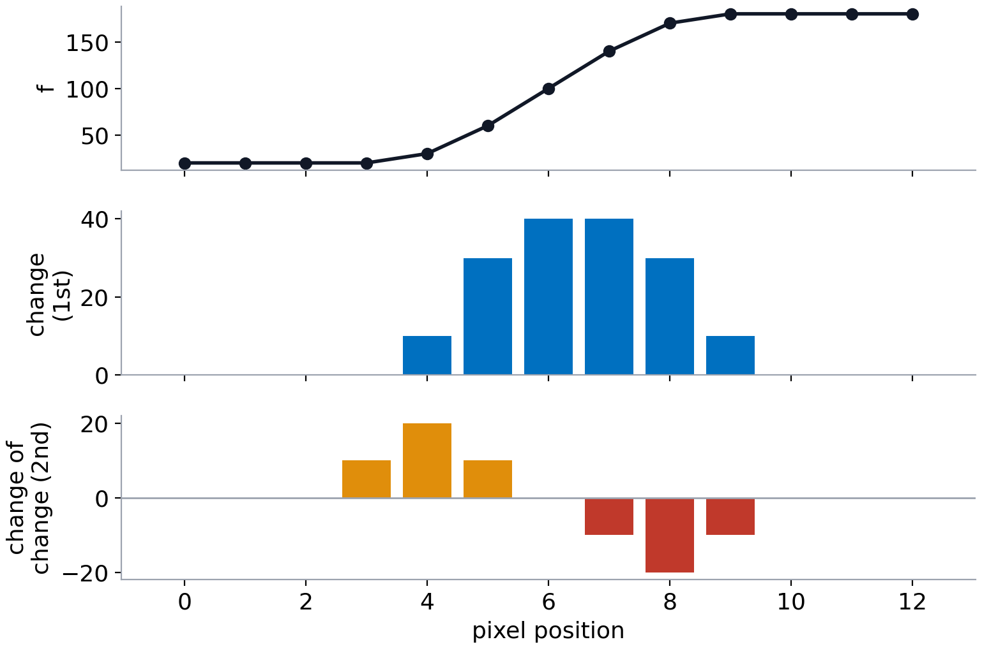
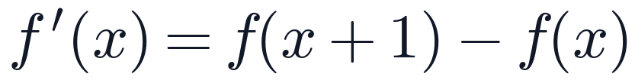
An edge is a place where brightness changes fast
➜ Sharpening finds the edges and makes them stronger.
1st derivative = change
How much does the brightness change from one pixel to the next?
2nd derivative = change of the change
Is the change speeding up or slowing down? It is + at the start of an edge and − at the end.
17/33

Slide 18
The Laplacian as a second-derivative filter
0
1
0
➜ The Laplacian measures local curvature by adding the second derivatives in the horizontal and vertical directions.
1
-4
1
0
1
0
the Laplacian kernel
(named after Pierre-Simon Laplace)
18/33

Slide 19



The 4-neighbour Laplacian kernel
➜ A one-dimensional second derivative uses the weights [1, -2, 1]. Adding the horizontal and vertical responses produces the 2-D Laplacian.
0
0
0
0
1
0
0
1
0
1
-2
1
+
0
-2
0
=
1
-4
1
0
0
0
0
1
0
0
1
0
Horizontal (x): $f_{xx}$
Vertical (y): $f_{yy}$
Laplacian $∇^{2}f$
19/33

Slide 20
Laplacian response in flat regions and at edges
50
50
50
50
50
200
50
200
200
50
50
50
50
50
200
50
200
200
50
50
50
50
50
200
50
200
200
flat area
dark side of an edge
bright side of an edge
50+50+50+50 − 4×50
50+50+50+200 − 4×50
200+200+50+200 − 4×200
0
+150
−150
For this kernel, uniform regions produce 0. A dark pixel next to brighter pixels produces a positive response. A bright pixel next to darker pixels produces a negative response.
20/33

Slide 21
Case Studies
CASE 01
Salt-and-pepper noise in microscopy
median filter
CASE 02
Gaussian noise in a portrait
Gaussian (weighted average) filter
CASE 03
Low-contrast lunar surface
Laplacian sharpening
CASE 04
Blurry uploads in a photo app
sharpening + blur screening
21/33

Slide 22
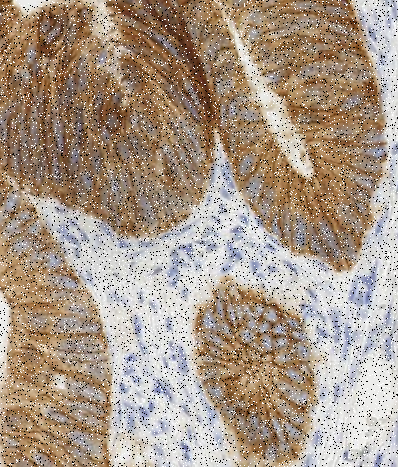
Salt-and-Pepper noise in microscopy
CASE 01
CONTEXT: Histopathology tissue image
NOISE MODEL: Synthetic salt-and-pepper noise added to 10% of the pixels
EFFECT: Noise obscures nuclei and cell boundaries
OBJECTIVE: Remove impulse noise while preserving structural detail
For an 8-bit image: Salt = 255 | Pepper = 0
22/33

Slide 23
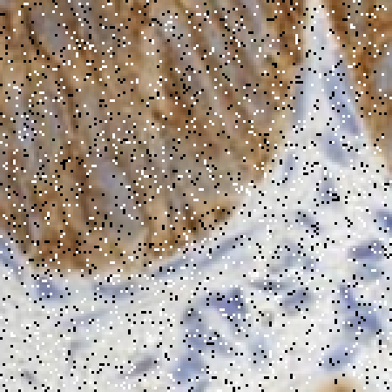
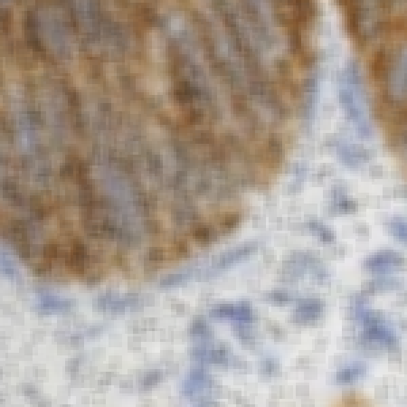
A 5×5 averaging filter
ATTEMPT 1
Average 5 × 5
BEFORE
AFTER
A 5×5 Averaging Filter Reduces Noise but Blurs Detail
23/33

Slide 24
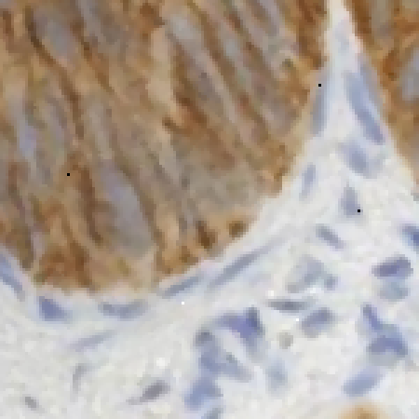
A 3×3 median filter
ATTEMPT 2
Median: sort the 9 values, take the middle one
BEFORE
AFTER
A 3×3 Median Filter Best Preserves Detail in This Test
24/33

Slide 25
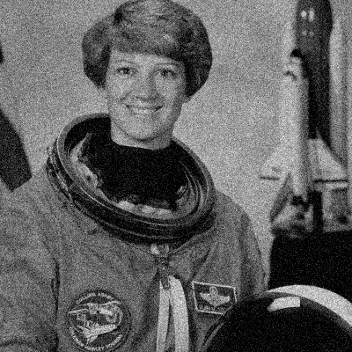

Gaussian noise in a grayscale image
CASE 02
CONTEXT: Grayscale portrait used to test image denoising
NOISE MODEL: Gaussian noise causes small random changes across the image
EFFECT: Grain obscures facial features and fine edges
OBJECTIVE: Reduce noise while preserving recognizable structures
Gaussian noise introduces small intensity errors across many pixels.
$$g\left(x,y\right)=f\left(x,y\right)+n\left(x,y\right), n∼𝓝\left(0,σ_{n}^{2}\right)$$
$f$: clean image $n$: noise $g$: observed image
25/33

Slide 26



A 5×5 gaussian filter
Noisy input
Box filter 5 × 5
Gaussian filter 5 × 5
Box filter 11 × 11: Over-smoothed
1
4
6
4
1
4
16
24
16
4
1/256 ×
Nearby pixels receive larger weights. This 5 × 5 kernel (σ ≈ 1) reduces noise while keeping more detail than equal-weight averaging.
6
24
36
24
6
4
16
24
16
4
1
4
6
4
1
26/33

Slide 27
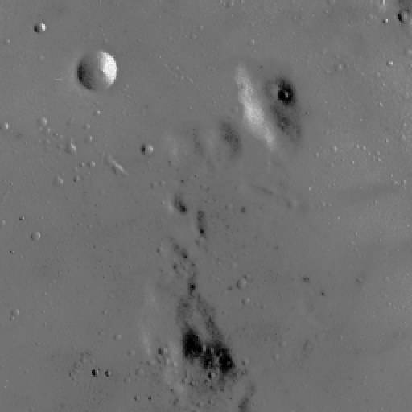
Laplacian sharpening for lunar surface detail
CASE 03
CONTEXT: Low-contrast lunar surface image
IMAGE CONDITION: Small intensity differences make fine structures difficult to see
EFFECT: Crater rims and ridges have weak edge contrast
OBJECTIVE: Enhance fine detail while limiting noise amplification
Sharpening emphasizes rapid spatial changes in intensity.
27/33

Slide 28
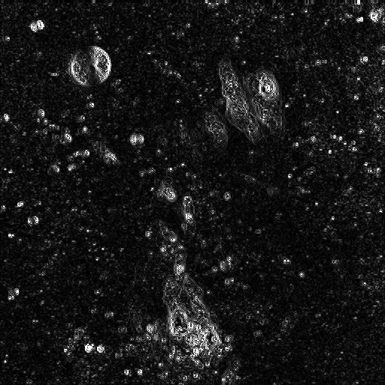
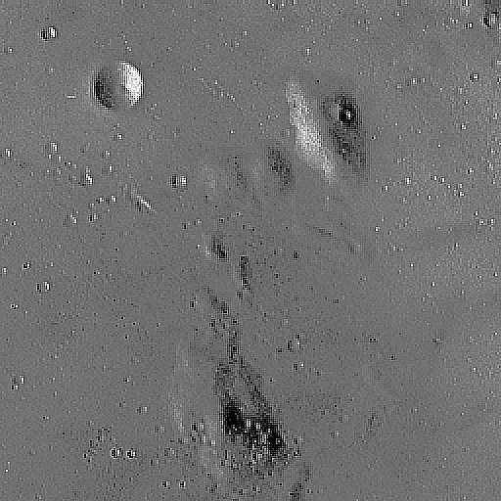



Laplacian sharpening
Original Image $f$
Laplacian Magnitude $\left|∇^{2}f\right|$
Sharpened Image $g$
28/33

Slide 29

How the Laplacian responds to a blurred edge
Blurred Edge Intensity $f(x)$
First and Second Derivatives
0
1
0
1
1
1
Read the two curves:
1st derivative: non-zero along the whole ramp → thick edges
2nd derivative: + at the start, − at the end → thin, crisp detail
The Laplacian uses the 2nd derivative
1
-4
1
1
-8
1
Sums to 0
Flat areas → 0. It only reacts to change.
0
1
0
1
1
1
4-neighbour
8-neighbour
29/33

Slide 30
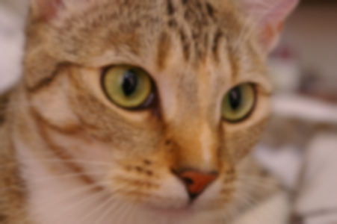
Sharpening and blur detection for a photo app
CASE 04
CONTEXT: Photo-sharing application
IMAGE DEGRADATION: Uploaded photos may contain defocus or motion blur
EFFECT: Blur weakens edges and hides fine texture
OBJECTIVE: Sharpen mildly blurred images and detect severe blur automatically
The application needs enhancement for mild blur and quality screening for severe blur.
30/33

Slide 31
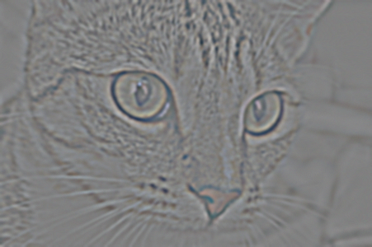


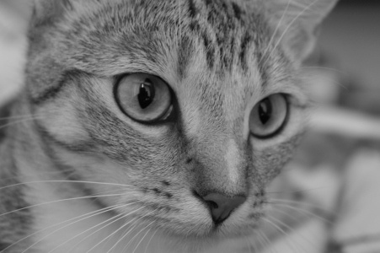




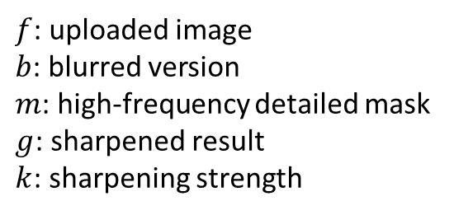
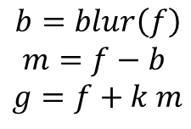



How the Laplacian responds to an edge
TASK A
Adjustable Sharpening
$$b=blur\left(f\right)$$
$$m=f−b$$
$$g=f+k m$$
$f$: uploaded image
$b$: blurred version
$m$: high-frequency detailed mask
$g$: sharpened result
$k$: sharpening strength
Input, $k=0$
Detailed mask, $m$
$k=1;$ Balanced
$$k=3$$
The parameter $k$ controls sharpening strength. Large values increase edge contrast but can create halos and amplify noise.
TASK B
Automatic Blur Screening
Keep
Warn
Reject
Blur score = Var[∇²f]
Sharp photo → many edges → high score
Blurry photo → few edges → low score
Threshold the score: keep, warn or reject
399
8
2
31/33

Slide 32
The three filters side by side
Averaging filter
Median filter
Laplacian filter
1
1
1
0
1
0
1/9 ×
1
1
1
mid
1
-4
1
1
1
1
0
1
0
Rule
Rule
Rule
mean of 9 pixels
middle of sorted 9 pixels
2nd derivative; sharpen f − ∇²f
Best for
Best for
Best for
Gaussian (grain) noise
salt-and-pepper noise
making edges crisp
Weakness
Weakness
Weakness
blurs edges; only dilutes specks
slower (sorting)
boosts noise too
32/33

Slide 33
Thank You
For queries, please contact: muhammadumar@mail.ulsan.ac.kr

