Slide 1


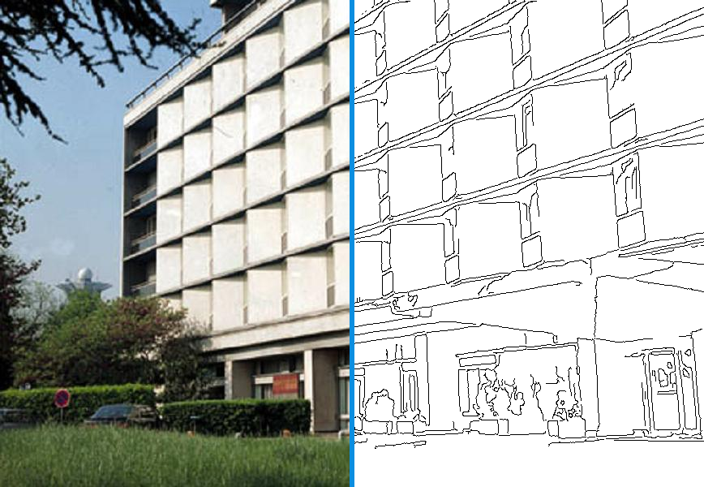

Edge Detection
Muhammad Umar
Graduate Research Assistant, Ulsan Industrial AI Lab
Department of Electrical, Electronic and Computer Engineering, University of Ulsan
photo
edges
05 October 2026

Slide 2
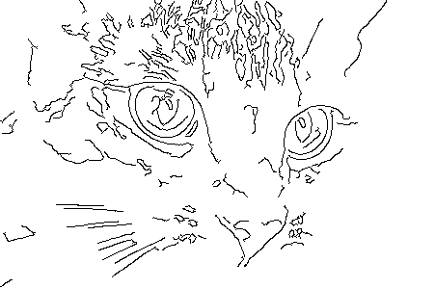
Can you guess what this image is?
2/34

Slide 3
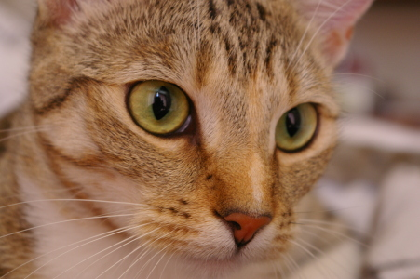
Yes, you guessed right
Only the edges: 5% of the pixels
Your brain recognized it from the edges alone.
A computer (and our brain) can recognize objects from edges alone. Edges carry most of the information.
3/34

Slide 4
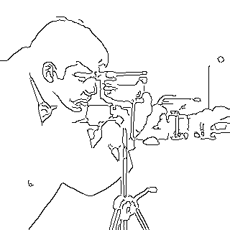
Edge Detection
1
Why edges matter, and what causes them
2
Gradient operators: Roberts, Prewitt and Sobel
3
Laplacian and the Canny detector
4/34

Slide 5
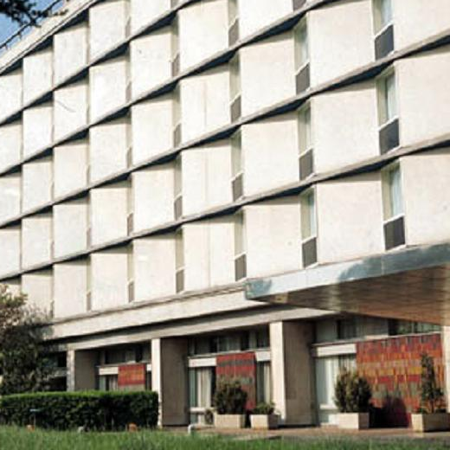
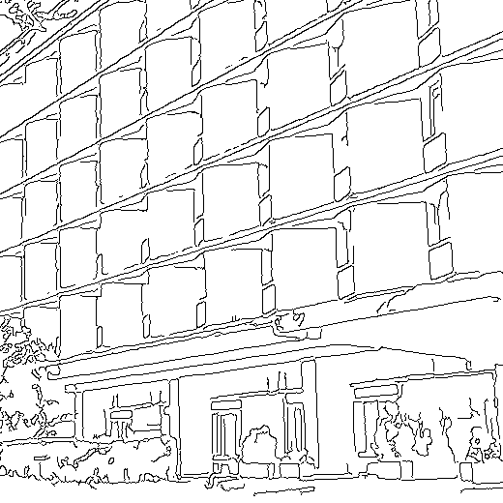
Why edges? They carry the information
photo: 270,400 pixels
edges: only 7.8% of them
1
A few strokes are enough
An artist draws a recognizable scene with just a few lines.
2
Edge = rapid change
An edge is where image intensity changes quickly within a small region.
3
A compact description
Edge detection turns a 2-D image into a set of points (curves) that keep the shapes.
We can recognize the building, its windows and floors.
Edges keep most of the information in a small fraction of the pixels (7.8% here).
5/34

Slide 6
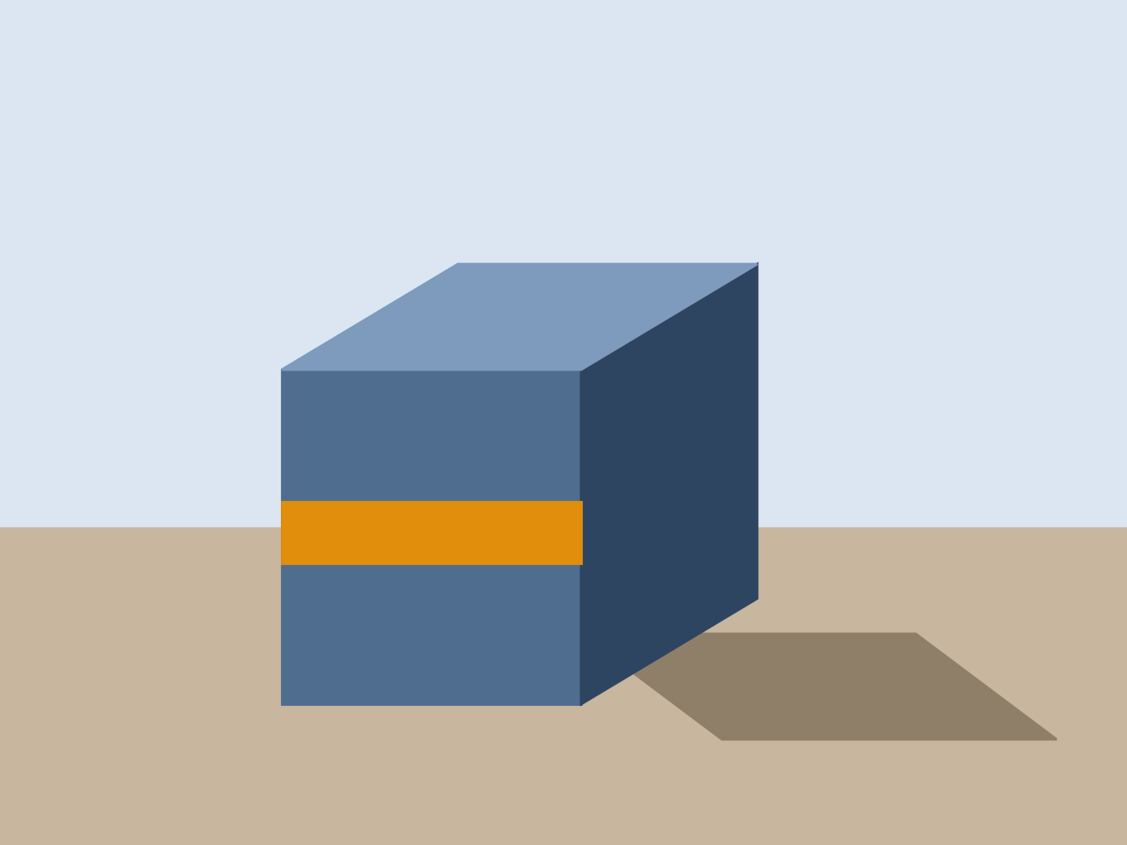
What causes an edge?
1
Surface normal
two faces of an object meet at a corner
2
Depth
one object is in front of another (box vs wall)
2
3
Surface reflectance
3
1
paint, texture or a change of colour (orange stripe)
4
4
Illumination
a shadow or a highlight on the table
An image edge can come from geometry (shape, depth), material (color) or light (shadow).
6/34

Slide 7




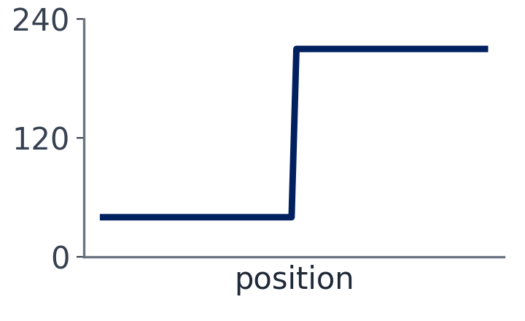
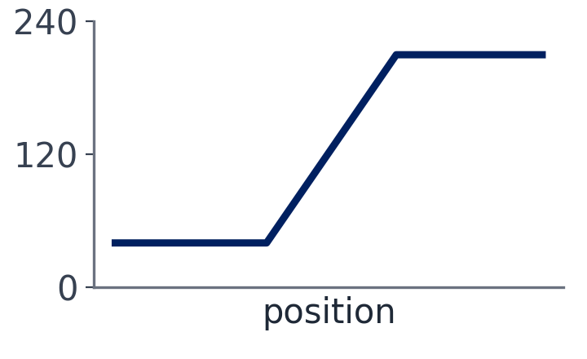
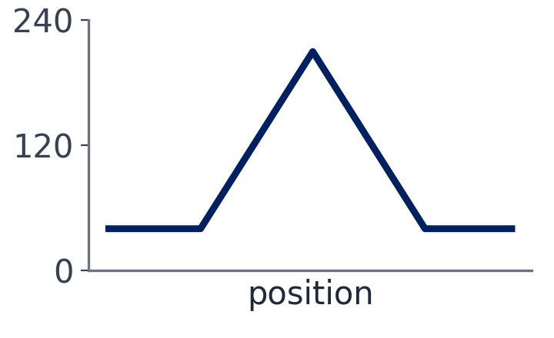
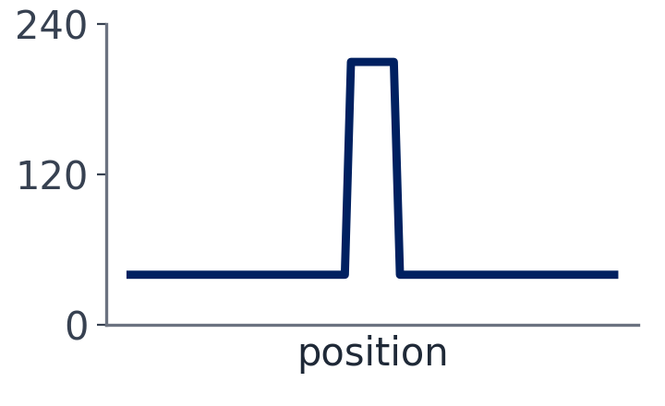
Types of edges
Step edge
Ramp edge
Roof edge
Line edge
sudden jump (ideal)
gradual change (real, blurred)
rises, then falls
a thin bright line
Top: how it looks. Bottom: brightness along a row (the intensity profile).
Real edges are noisy and discrete (made of pixels).
Four shapes: step, ramp, roof and line. In real photos they are blurred, pixelated and noisy.
7/34

Slide 8
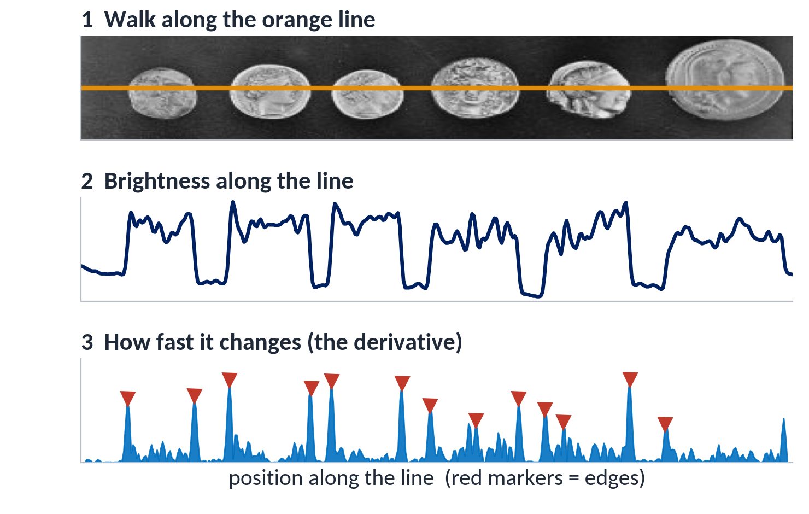
An edge is a sudden jump in brightness
1
Walk along a line
Read the pixel values one by one.
2
Plot the brightness
Coins are bright, the background is dark.
3
Measure the change
Big change = edge. That is the derivative.
Where the brightness changes fast (red markers), there is an edge.
An edge is where the brightness changes fast, so we find edges with derivatives.
8/34

Slide 9
What do we want from an edge detector?
It should tell us…
It should perform well…
1
Position
1
High detection rate
where exactly is the edge?
find all real edges, miss none
2
Magnitude (strength)
2
Good localization
how strong is the change?
mark each edge exactly where it is
3
Orientation (direction)
3
Low noise sensitivity
which way does the edge run?
do not turn noise into fake edges
We will judge Roberts, Prewitt, Sobel, Laplacian and Canny against these six points.
9/34

Slide 10
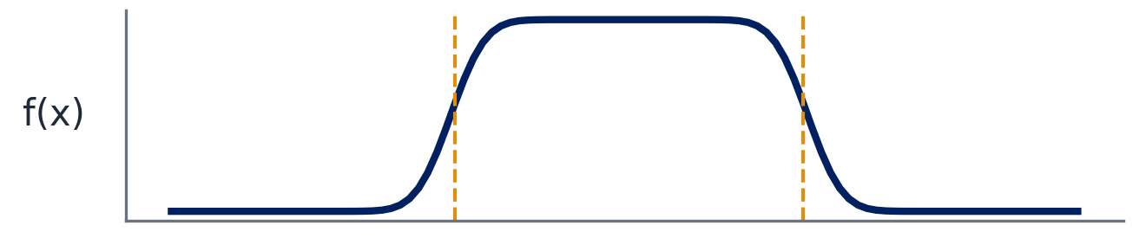
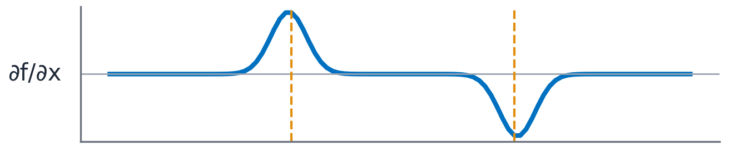
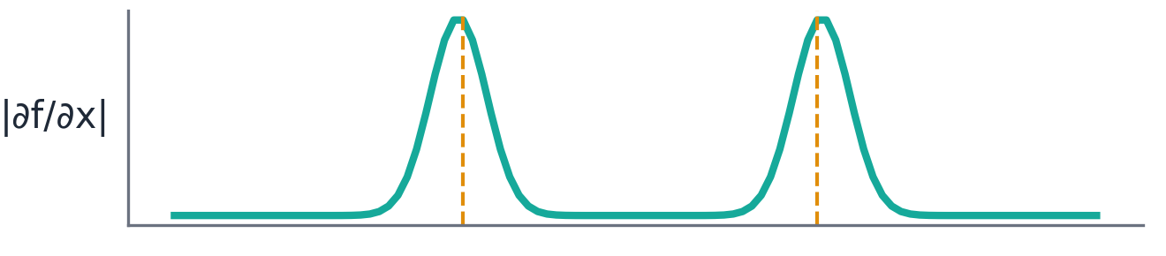
1-D edge detection with the first derivative
signal with two edges
f(x): two edges
The signal rises (edge 1), then falls (edge 2).
first derivative: local extrema
∂f/∂x: local extrema
+ peak at the rising edge, − peak at the falling edge.
absolute value: local maxima = edges
|∂f/∂x|: local maxima
Its peaks give both the location and the strength of each edge.
10/34

Slide 11
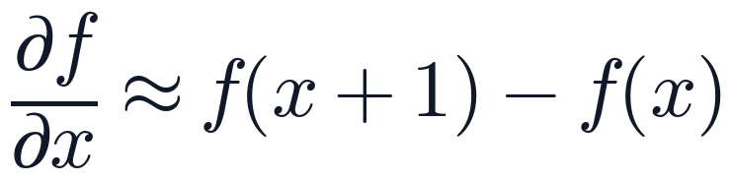
Derivative of a row of pixels
1
Subtract neighbours
f(3) − f(2) = 80 − 10 = +70;
f(6) − f(5) = 10 − 80 = −70
position x
0
1
2
3
4
5
6
7
2
Absolute value
f(x)
10
10
10
80
80
80
10
10
|+70| = |−70| = 70: both are strong edges.
∂f/∂x
0
0
70
0
0
-70
0
3
Threshold (T = 30)
|∂f/∂x|
0
0
70
0
0
70
0
70 > 30 → edges between x = 2|3 and x = 5|6.
The sign tells dark → bright (+) or bright → dark (−).
Differences sit between two pixels.
A big |difference| = an edge. All other differences are 0, so flat areas give no edges.
11/34

Slide 12
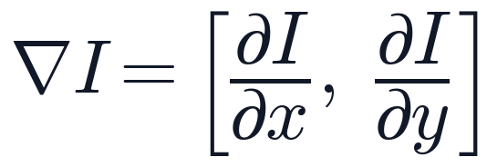



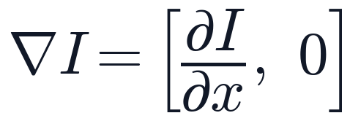
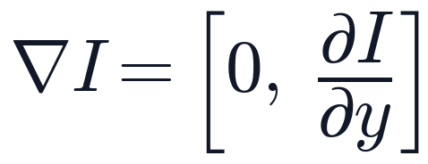
From 1-D to 2-D: the gradient
x: left → right (columns) y: top → bottom (rows)
changes left → right only
changes top → bottom only
changes in both directions
gradient horizontal → the edge is vertical
gradient vertical → the edge is horizontal
gradient diagonal → the edge is diagonal
The gradient points where brightness increases fastest (orange arrows).
12/34

Slide 13
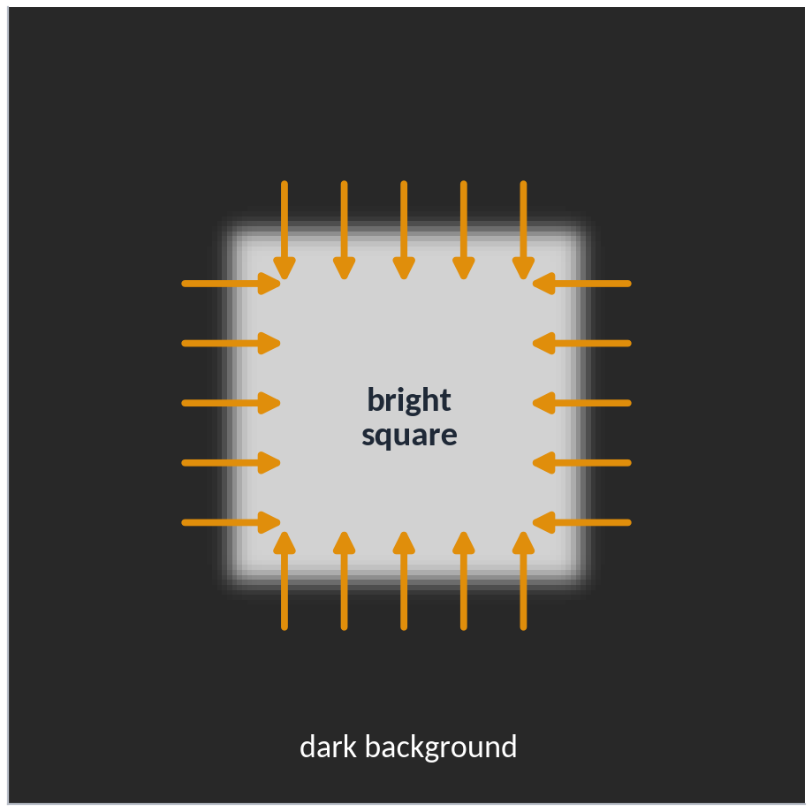
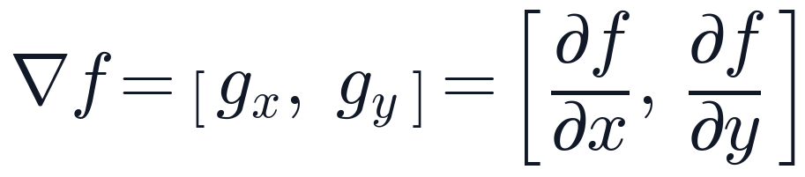
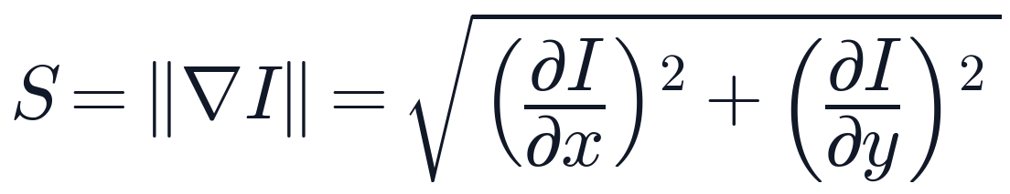
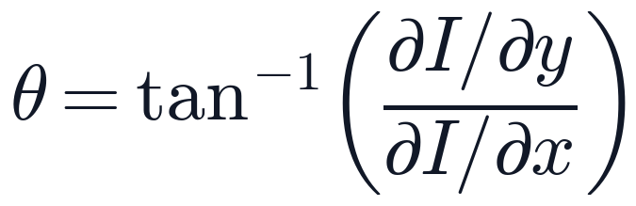
The gradient: edge strength and direction
the gradient: the two derivatives together
magnitude M: how strong the edge is
direction θ: which way it gets brighter
each arrow is a gradient: it points from dark to bright, across the edge
Each arrow is a gradient: its length is the edge strength, and it points from dark to bright, across the edge.
13/34

Slide 14





$G_{x}$ and $G_{y}$ on a simple square
input: a bright square
Gx: left → right change
Gy: top → bottom change
strength S
finds the vertical sides
finds the horizontal sides
the whole outline
red = getting brighter (positive) blue = getting darker (negative)
Gx measures change left → right, so it sees the vertical sides. Gy measures change top → bottom, so it sees the horizontal sides.
An image has two directions, so edge detectors compute two derivatives: Gx and Gy.
14/34

Slide 15
Discrete gradient operators briefly
Roberts (2 × 2)
Prewitt (3 × 3)
Sobel (3 × 3)
Sobel (5 × 5)
-1
-2
0
2
1
0
1
-1
0
1
-1
0
1
-4
-8
0
8
4
∂I/∂x (Gx)
-1
0
1
-2
0
2
-6
-12
0
12
6
-1
0
-1
0
1
-1
0
1
-4
-8
0
8
4
-1
-2
0
2
1
-1
-4
-6
-4
-1
1
0
-1
-1
-1
-1
-2
-1
-2
-8
-12
-8
-2
∂I/∂y (Gy)
0
0
0
0
0
0
0
0
0
0
0
0
-1
1
1
1
1
2
1
2
8
12
8
2
1
4
6
4
1
diagonal differences, no smoothing
average + difference
weighted average + difference (most used)
more smoothing, less noise, thicker edges
Every operator = a difference across the edge, plus more or less smoothing along it.
15/34

Slide 16
Roberts operator (2 × 2)
Solved: a vertical edge
1
Good localization
0
1
1
0
10
100
A tiny 2 × 2 window marks the edge very precisely.
-1
0
0
-1
10
100
2
Very noise sensitive
No smoothing at all: noise gives false edges.
Gx
Gy
Gx = 0 × 10 + 1 × 100 + (−1) × 10 + 0 × 100 = 90
3
Poor detection
Gy = 1 × 10 + 0 × 100 + 0 × 10 + (−1) × 100 = −90
Weak edges are easily missed.
S = √(90² + 90²) ≈ 127
Roberts is the simplest gradient operator: precise but noisy.
16/34

Slide 17
Prewitt: average + difference in one kernel
1
-1
0
1
1
Right minus left
×
=
−1 on the left column, +1 on the right column.
1
-1
0
1
-1
0
1
1
-1
0
1
Averaged over 3 rows
difference: right − left
2
average
3 rows
Prewitt Gx
This smooths the noise along the edge.
-1
-1
-1
0
0
0
3
Sums to zero
A flat area always gives 0.
1
1
1
Prewitt Gy (rotated 90°)
Prewitt Gx = (average of 3 rows) × (right − left). Gy is the same kernel turned by 90°.
17/34

Slide 18
Prewitt by hand
10
10
10
-1
0
1
-10
0
10
Result
Gx
180
Gx = 180
Gy = 180
10
10
100
×
-1
0
1
=
-10
0
100
→
10
100
100
-1
0
1
-10
0
100
S = √(180² + 180²)
≈ 254.6
10
10
10
-1
-1
-1
-10
-10
-10
Gy
180
10
10
100
×
0
0
0
=
0
0
0
→
θ = tan⁻¹(180/180) = 45°
10
100
100
1
1
1
10
100
100
The gradient points down-right (towards the bright pixels); the edge runs diagonally.
window × kernel = products → add all nine
Multiply cell by cell, add the nine products. Gx = 180 and Gy = 180, so the edge is diagonal (45°).
18/34

Slide 19
Sobel: Prewitt with a stronger center row
1
Only one change
1
-1
0
1
-1
-2
-1
The middle row counts 2, not 1.
2
×
-1
0
1
=
-2
0
2
0
0
0
1
2
1
2
Centre matters most
1
difference: right − left
-1
0
1
Edges are located a little more precisely.
Sobel Gy
Sobel Gx
3
Used inside Canny
The only change from Prewitt: the center row (highlighted) counts 2 instead of 1, so the pixel's own row matters most.
Sobel is the standard gradient operator.
Sobel = (1-2-1 weighted average) × (right − left). Same idea as Prewitt, with more weight in the middle.
19/34

Slide 20
Sobel by hand
 | Prewitt | Sobel
Gx | 180 | 270
Gy | 180 | 270
S | 254.6 | 381.8
θ | 45° | 45°
10
10
10
-1
0
1
-10
0
10
Gx
270
10
10
100
×
-2
0
2
=
-20
0
200
→
10
100
100
-1
0
1
-10
0
100
10
10
10
-1
-2
-1
-10
-20
-10
Gy
270
10
10
100
×
0
0
0
=
0
0
0
→
10
100
100
1
2
1
10
200
100
Both find the same edge in the same direction. Sobel gives the centre pixels more weight.
window × kernel = products → add all nine
Same direction (45°), larger numbers: Sobel's weights add up to 4 per side instead of 3.
20/34

Slide 21
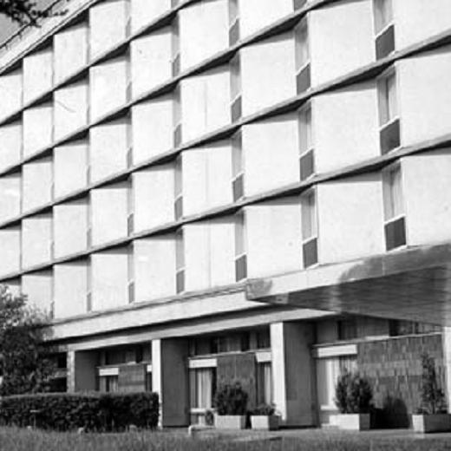
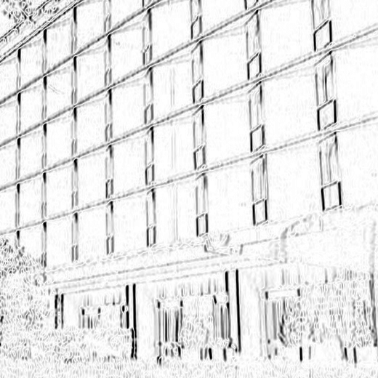
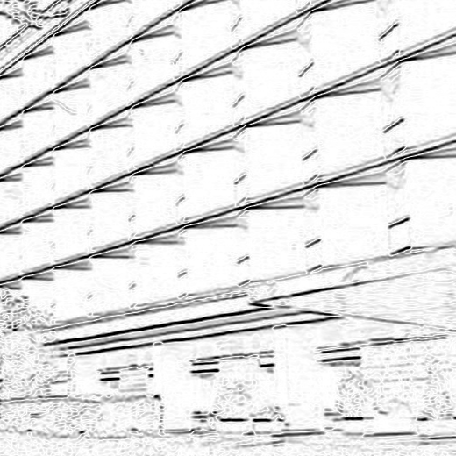
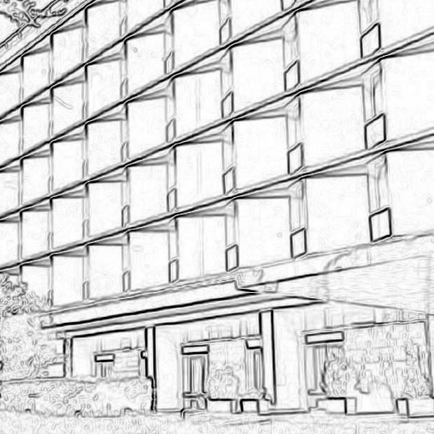
On a real building
input
|Gx|: vertical edges
|Gy|: horizontal edges
S: all edges
Orange boxes: Gx picks up vertical window frames, Gy picks up horizontal floor lines. Dark = strong edge.
Gx and Gy each see one direction; the magnitude combines them into a complete edge map.
21/34

Slide 22
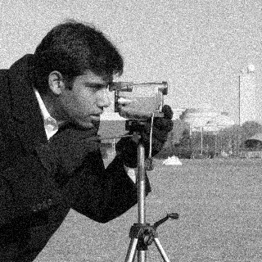
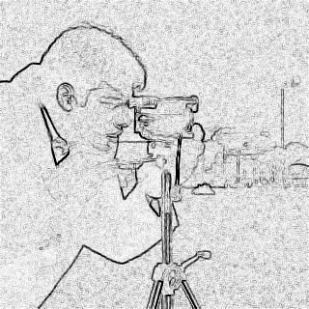

Prewitt vs Sobel on a noisy image
noisy input (σ = 18)
Prewitt strength
Sobel strength
Look closely: the two maps are almost identical. Both still show a lot of background noise.
Prewitt and Sobel behave very similarly. Both give a strength map, not clean edges, so we need Canny.
22/34

Slide 23


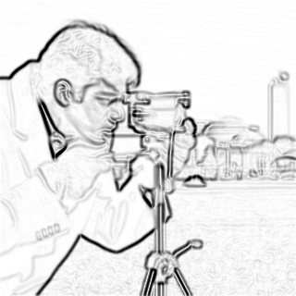
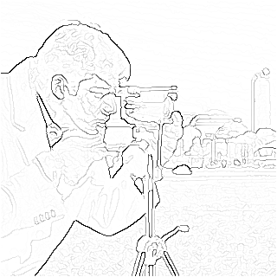
Canny in four steps
input
1 smooth
2 gradient
3 thin
4 link
➜
➜
➜
➜
2-D Gaussian blur (σ ≈ 1.4)
Sobel on the smoothed image: S and θ at every pixel
non-maximum suppression: keep only the peak
double threshold + hysteresis
smooth → gradient → thin → link. Each step fixes one weakness of simple thresholding.
23/34

Slide 24
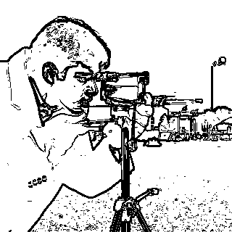
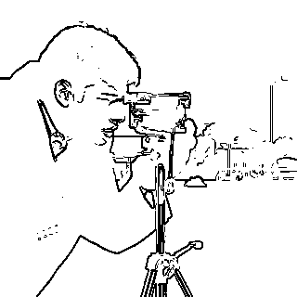
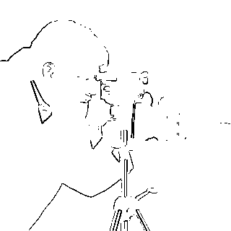
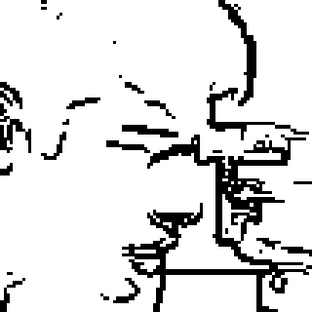
Edge thresholding
T too low: false edges
T medium
T too high: broken edges
zoom: thick edges
1
False edges: noise above T
2
Thick edges: several pixels wide
3
Broken edges: gaps where the edge is weak
One threshold gives false, thick or broken edges. Canny fixes this with thinning and hysteresis (two thresholds).
24/34

Slide 25
Noise Models
1
Noise is added to the image
2
Gaussian, uniform, and impulse noise
3
Diagnose noise with a histogram
25/34

Slide 26
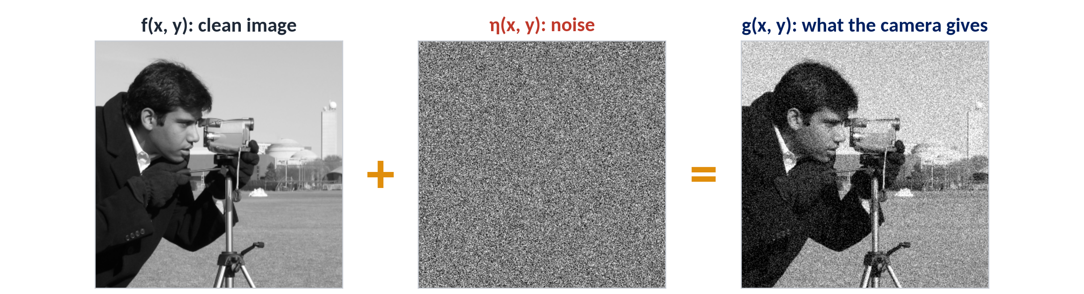
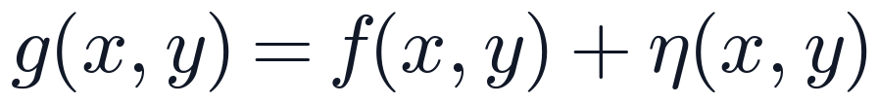
Noise is something added to the true image
A noise model describes which values η can take, and how often. Its shape tells us which filter to use.
26/34

Slide 27
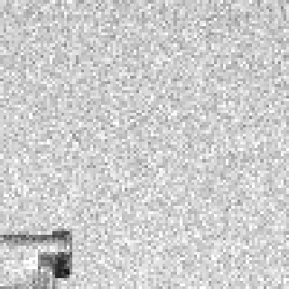
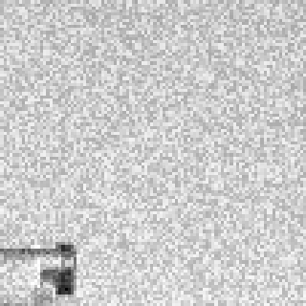
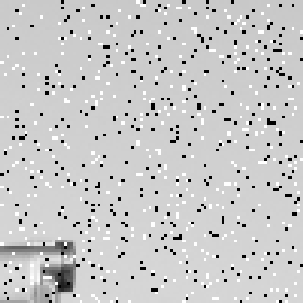
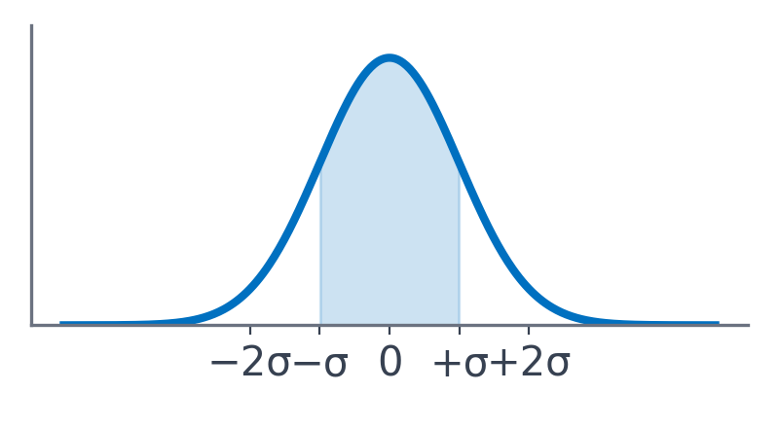
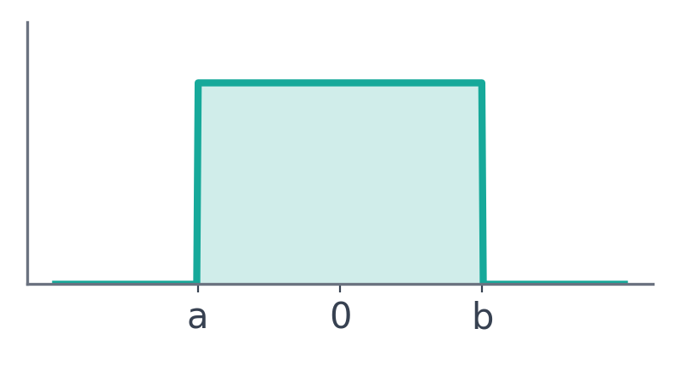
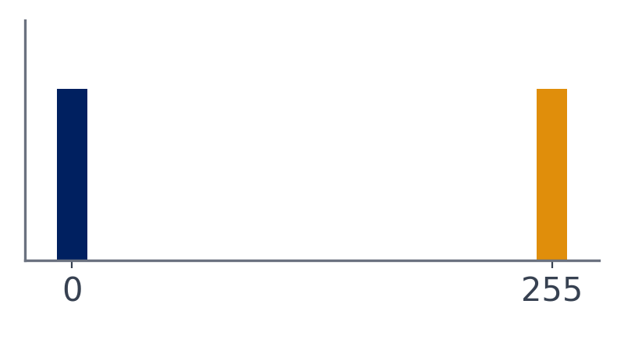
Three kinds of noise
Gaussian
Uniform
Impulse (salt & pepper)
every pixel slightly wrong (bell curve)
every pixel slightly wrong (flat)
a few pixels completely wrong
Top: what it looks like (zoom). Bottom: its probability curve (pdf).
Gaussian and uniform: every pixel slightly wrong. Impulse: a few pixels completely wrong.
27/34

Slide 28
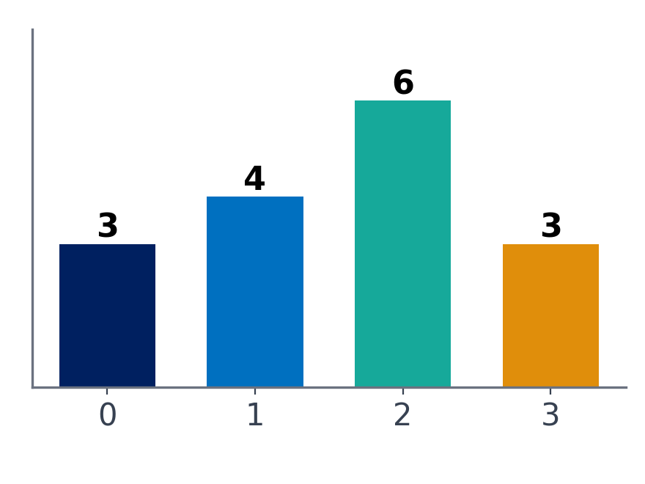
Build a histogram
a tiny 4 × 4 image
count each value
0
0
1
1
0
2
2
1
value | 0 | 1 | 2 | 3
count | 3 | 4 | 6 | 3
→
3
2
2
1
3
3
2
2
histogram
The histogram shows how many pixels have each value; it ignores where they are. For noise, we look at the histogram of a flat region.
A histogram counts pixels per value. The shape of the histogram is the fingerprint of the noise.
28/34

Slide 29


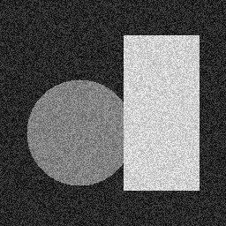
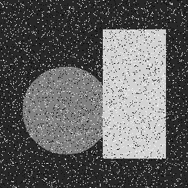
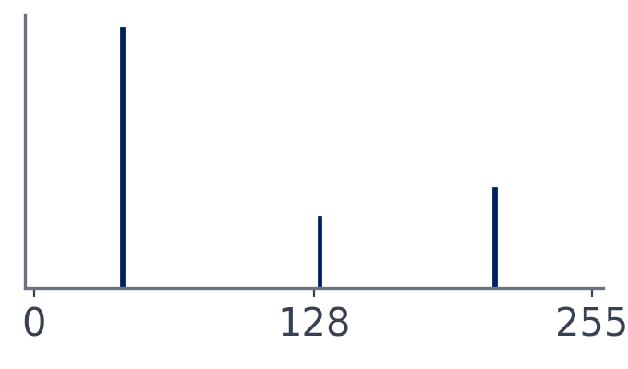
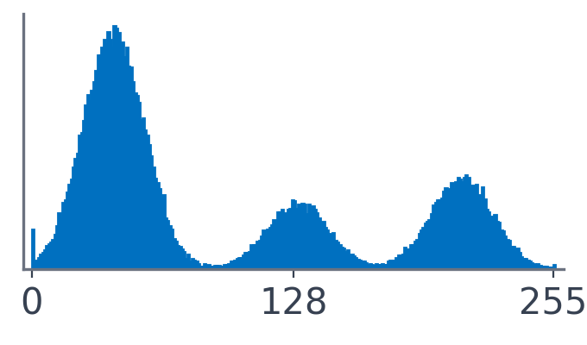
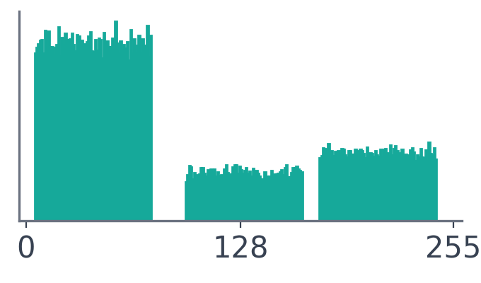
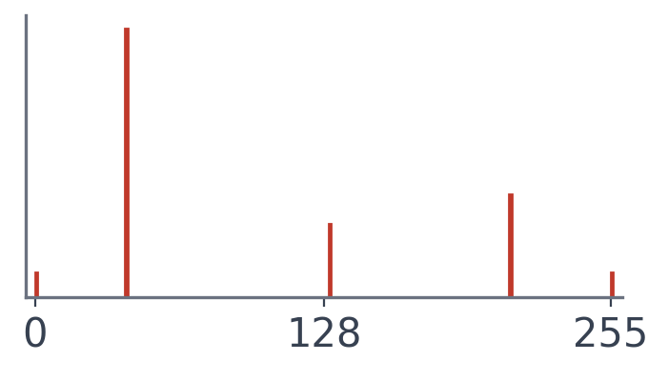
The histogram shows the noise
clean
+ Gaussian
+ uniform
+ impulse
3 spikes
3 bell curves
3 flat blocks
spikes + 0 and 255
A test image with 3 flat regions has 3 spikes. Noise reshapes each spike into its own pdf shape.
29/34

Slide 30


Gaussian noise
• z̄ = centre (mean)
• σ = width (standard deviation)
• 68% of the noise is within ±σ
• Source: sensor electronics, heat, low light
Small errors are common and big errors are rare. Every pixel is a little bit wrong.
30/34

Slide 31



Uniform noise
• Every value from a to b equally likely
• Here a = −35, b = +35 → σ ≈ 20
a = −35, b = +35 → mean z̄ = (−35 + 35)/2 = 0;
σ² = (35 − (−35))²/12 = 70²/12 ≈ 408 → σ ≈ 20.2.
A flat pdf: any error between a and b is equally likely, and nothing outside.
31/34

Slide 32




Impulse (salt-and-pepper) noise
• Pepper = 0 (black), salt = 255 (white)
• Most pixels are untouched
• Source: dead pixels, bit errors, dust
A few pixels jump to the extremes (0 or 255); all the others are perfect.
32/34

Slide 33









Diagnose a real photo
Gaussian
Uniform
Impulse
orange box (sky) → zoom → histogram: bell shape
orange box (sky) → zoom → histogram: flat block
orange box (sky) → zoom → histogram: spikes at the ends
Pick an area that should be flat (the sky). Its histogram shows the noise type: bell, block or spikes.
33/34

Slide 34

Thank You
For queries, please contact: muhammadumar@mail.ulsan.ac.kr

