Slide 1

The Machine Learning Landscape
Dr. Muhammad Farooq Siddique
Assistant Professor UET Mardan

Slide 2

Learning Objectives
1
2
3
Understanding basic concepts of Machine learning
Get familiar with the tools and frameworks
Understanding Machine Learning Development Lifecycle

Slide 3

What is Machine Learning?
Machine Learning focuses on the use of data and algorithms to imitate the way that human learn, gradually improving its accuracy.
OR
Machine Learning used to describe a variety of tools and techniques which allow a computer program to learn and improve over time.

Slide 4


AI vs ML vs DL
Artificial Intelligence means creating smart machines to mimic human behavior.
AI
Reactive Machines Limited Memory Theory of Mind Self awareness
Machine Learning is a subset of AI, and builds a model based on training data to make predictions.
ML
Supervised Learning Unsupervised Learning Reinforcement Learning
DL
Convolutional Neural Networks Recurrent Neural Network Generative Adversarial Network Deep Belief Network
Deep Learning is a subset of ML algorithms to solve complex problems.

Slide 5

Types of Machine Learning
Machine Learning
Supervised
Unsupervised
Semisupervised
Reinforcement
Regression Classification
Clustering
Dimensionality Reduction Anamoly Detection Association Rule

Slide 6
Supervised Learning Algorithms
Classification
Decision Trees
Support Vector Machines Random Forest
K Nearest Neighbors Naive Bayes
Regression
Linear Regression Logistic Regression Lasso Regression Ridge Regression

Slide 7


Unsupervised Learning Algorithms
Clustering Dimensionality Reduction Association
K-Means DBSCAN
Hierarchical clustering Analysis
Principle Component Analysis
Kernel PCA t-SNE
Apriori Eclat

Slide 8

Batch vs Online Machine Learning
Batch Learning:
Training is performed on the entire dataset at once.
Model is trained iteratively on the entire dataset for multiple epochs. Computationally expensive and requires sufficient memory to hold the entire dataset.
Typically used when the dataset fits in memory and when periodic retraining is feasible.
Online Learning:
Training is performed incrementally on individual data instances or mini-batches. Model is updated continuously as new data becomes available.
Suitable for handling large datasets and streaming data.
Enables real-time learning and adaptation to changing conditions.

Slide 9
Instance vs Model based Machine Learning
Instance-based Learning:
Model makes predictions based on similarities between new instances and instances in the training dataset.
No explicit training phase; all training data is stored and used for inference.
Simple and easy to implement but can be computationally expensive during prediction.
Model-based Learning:
Model learns underlying patterns and relationships from training data.
Training phase involves estimating model parameters that optimize a predefined objective function.
Model makes predictions based on learned parameters without directly comparing new instances to training instances.
Typically more efficient for prediction but requires more upfront computational resources for training.

Slide 10

ML Life Cycle
Frame the problem Gathering Data Data Preprocessing
Exploratory Data Analysis EDA Feature Engineering / Selection Model Training and Evaluation Model Deployment
Model Testing

Slide 11
Application of ML
Retail - Amazon/ BigBazar Banking and Finance Transport
Manufacturing and Maintenance Social Media

Slide 12
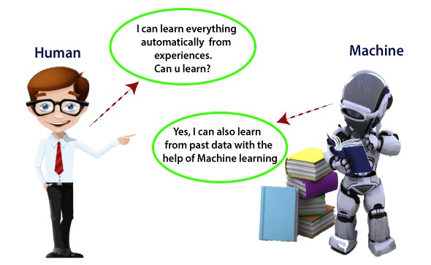
Sketch

Slide 13
Challenges in Machine Leaning
Data Collection Insufficient Data
Non representative data poor quality data Irrelevant features Overfitting
Underfitting Cost Involved

Slide 14
Thank you!

