Slide 1


Hostel
Management
system
Team Members: Mumtaz Ali Muhammad Maaz Muhammad Abubakar

Slide 2
Introduction
The Hostel and Mess Management System simplifies hostel and mess operations with features like room allocation, automated mess bill notifications, biometric attendance, online payment integration, and a complaint management system. It ensures efficient management, better communication, and a user-friendly experience for students and administrators.

Slide 3
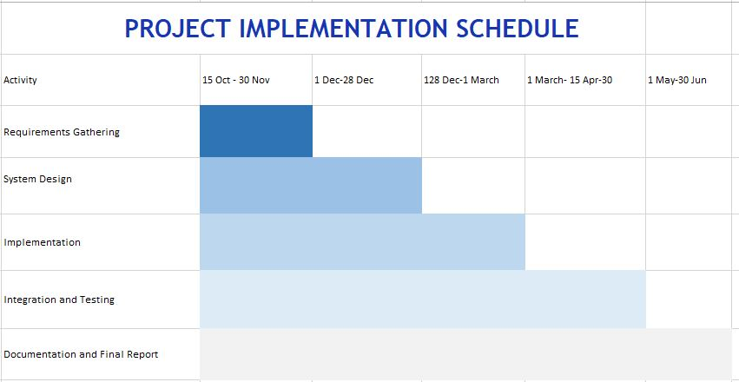

Slide 4
Current Challenges
Difficult Room Management
Slow Student Registration
Complicated Staff Schedules
Time-Consuming Billing
Disorganized Meal Planning
Poor Communication
Slow Checkout Process

Slide 5
Objectives
Room and Hostel Management
Complaint Management System
Automated Mess Bill Notification
Biometric Attendance Integration
Online Payment Integration
Enhance Communication and Student Clearance

Slide 6
Modules
Hostel Management
Room Allocation
View Room Details
Admin Management
Student Management
Complaint System
Visitor Management
Mess Management
Attendance System
Payment System
Notification System
Notice Board.

Slide 7
Progress

Slide 8
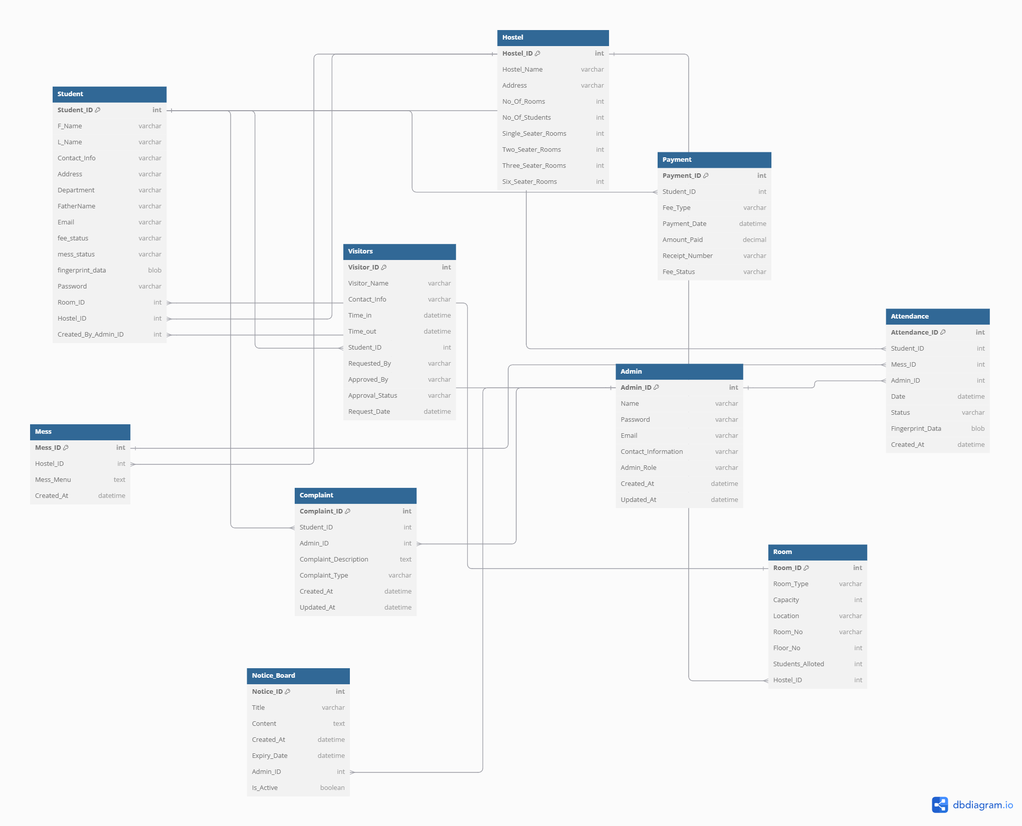
Complete ERD

Slide 9
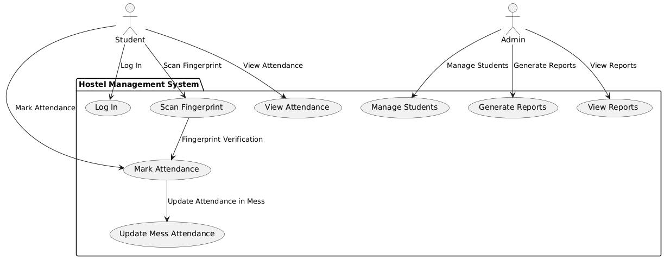
Use Case Diagram

Slide 10
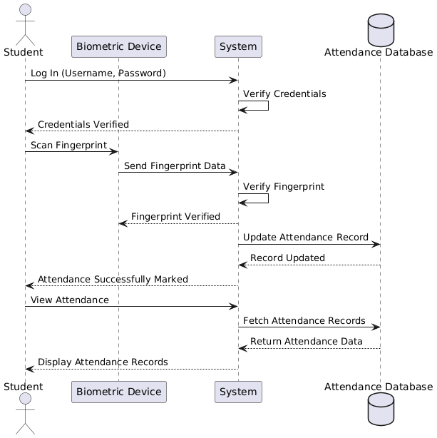
Sequence Diagram

Slide 11
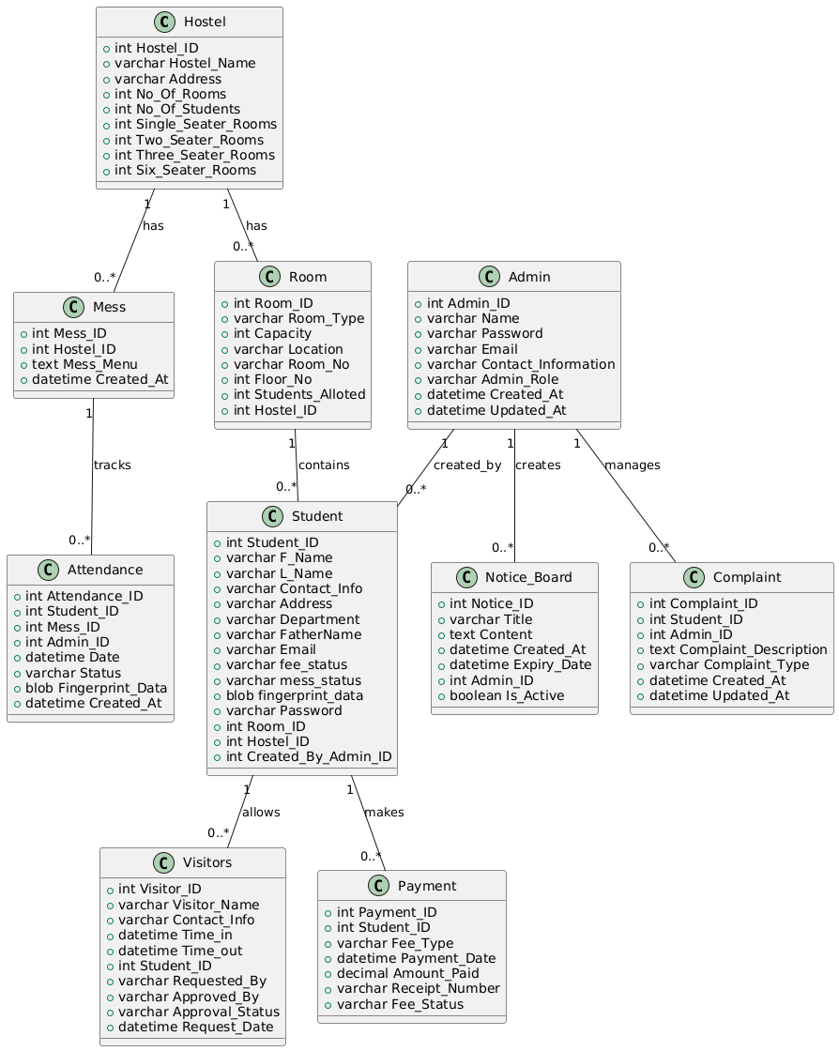
Class Diagram

Slide 12
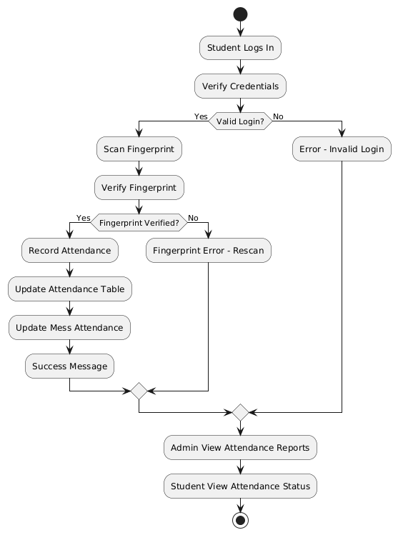
Flow Chart:

Slide 13
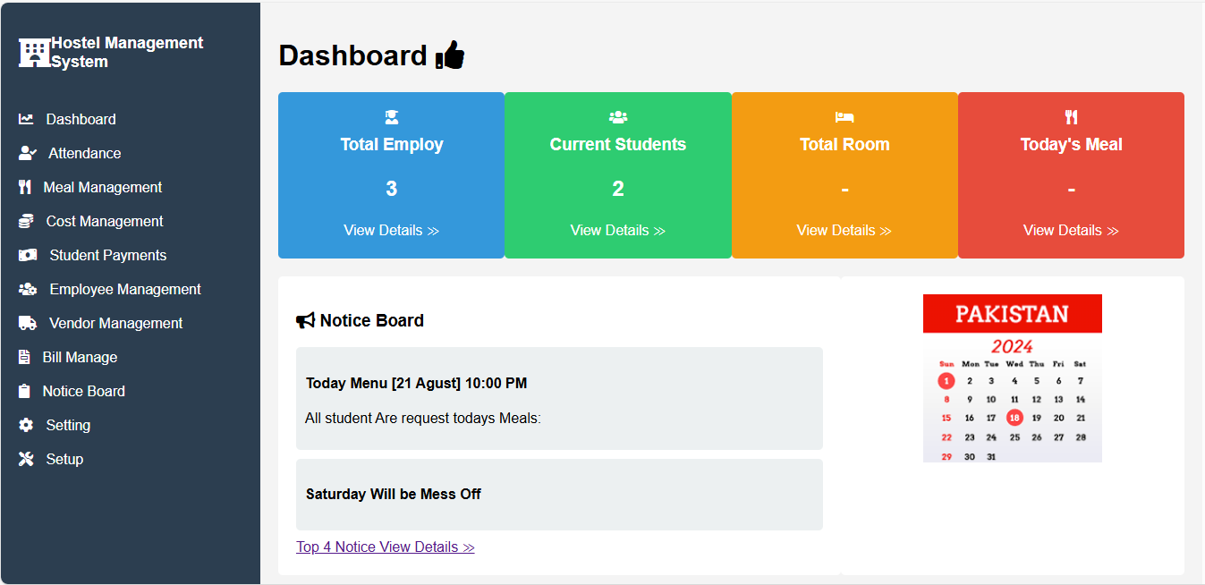

Slide 14
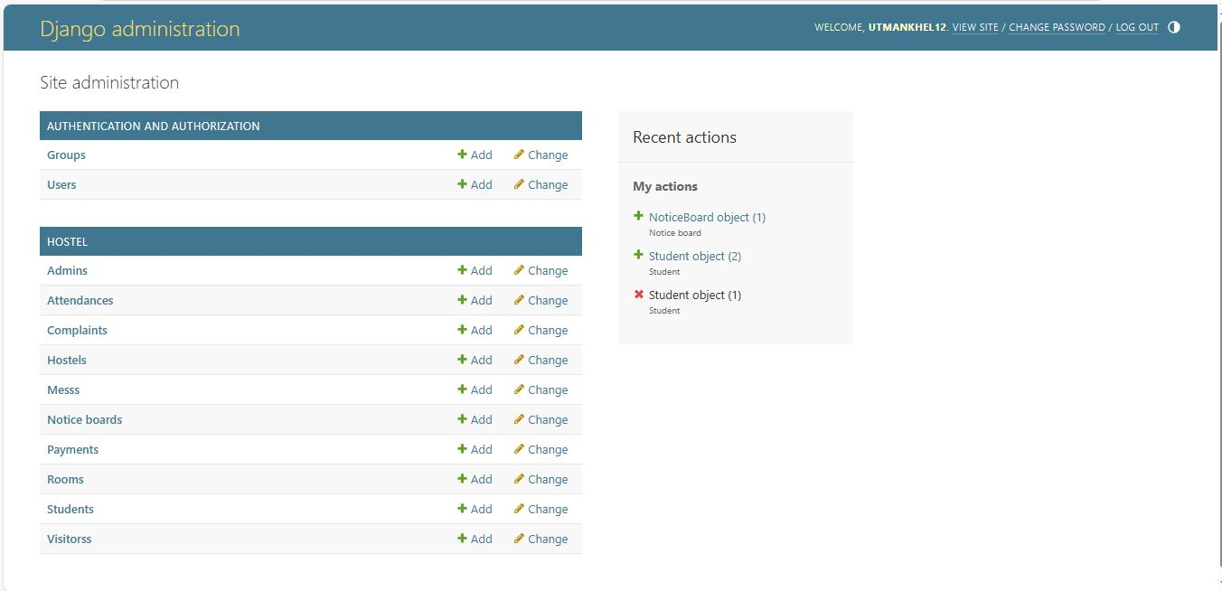

Slide 15
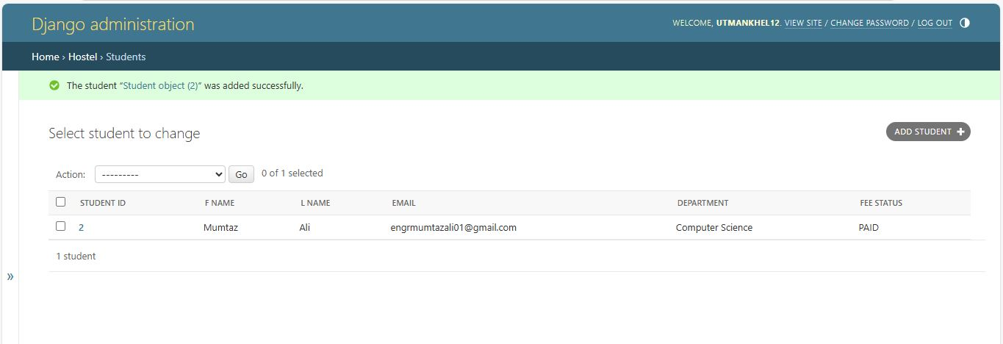
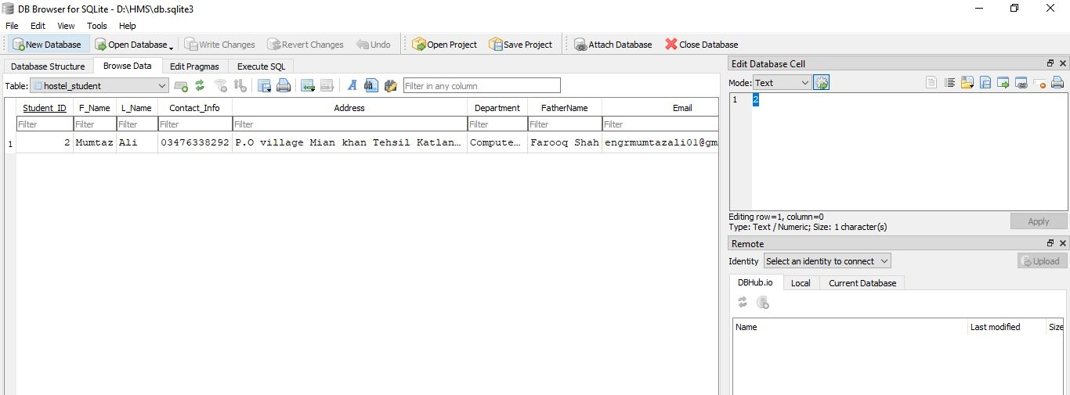

Slide 16
Thank You!

