Slide 1


Hostel
Management
system
Team Members: Mumtaz Ali Muhammad Maaz Muhammad Abubakar

Slide 2


Introduction
Hostel Management System is a computer program to help run hostels better.
It makes tasks like room bookings, student check- ins, and bill payments much easier.
The system helps hostel staff work more efficiently and saves time.
It also makes life more comfortable for students living in the hostel.

Slide 3




Current Challenges
Difficult room management Slow student registration Complicated staff schedules Time-consuming billing Disorganized meal planning Poor communication
Slow checkout process

Slide 4





Objectives
Develop a user-friendly computerized
system
Enhance resident services
Improve administrative processes
Enhance Communication and Student Clearance

Slide 5
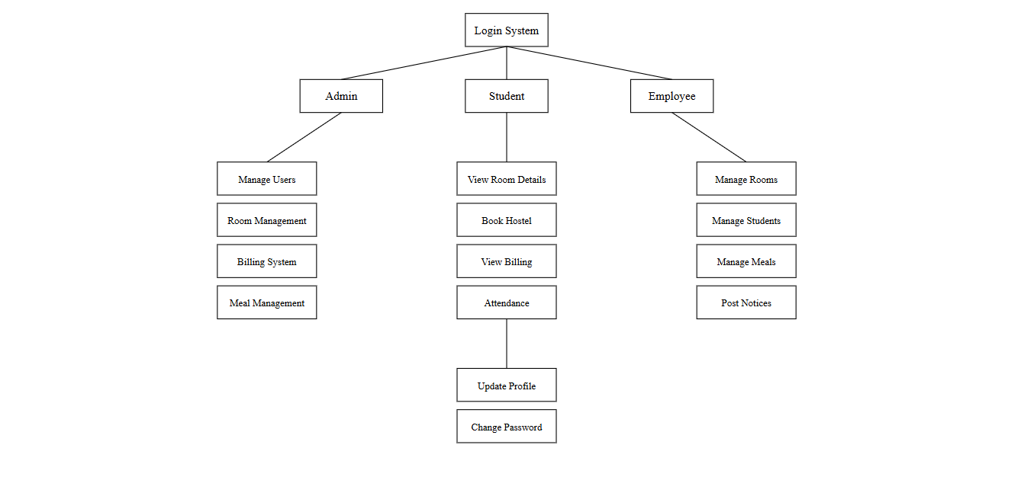
Modules
Login System
View Room Details
Book Hostel
Student Registration
Manage Students
Employee Management
Attendance and Billing System
User Management
Room Management
Meal management
Vendor Management
Cost Management
Notice Board.

Slide 6





How We'll Build It
Gather Requirements
Design System
Development
Deploy and Train
Maintain and Support

Slide 7







Our Tech Stack
FRONTEND
HTML, CSS, Bootstrap, JavaScript
BACKEND
Laravel framework, PHP, MySQL
DATABASE
MySQL
SOFTWARE REQUIREMENT
WAMP/XAMPP/MAMP/LAMP Server
SECURITY
SSL encryption for secure data transmission and OAuth for authentication.
PAYMENT INTEGRATION
PayPal, Easypaisa, Stripe for secure transactions.

Slide 8
PROJECT IMPLEMENTATION SCHEDULE
Activity | 15 Oct - 30 Nov | 30 Dec-15 Jan | 15 Jan-20 Feb | 20 Feb-30 Mar | 1 May-15 Jun | 15 Jun-10 Jul
Requirements Gathering | √
System Design |  | √
Frontend Development |  | √
Backend Development |  |  | √ | √
Integration and Testing |  |  |  |  | √
Documentation and Final Report |  |  |  |  |  | √

Slide 9
Thank You!

