Slide 1
Introduction
The Hostel and Mess Management System simplifies hostel and mess operations with features like room allocation, automated mess bill notifications, biometric attendance, online payment integration, and a complaint management system. It ensures efficient management, better communication, and a user-friendly experience for students and administrators.

Slide 2
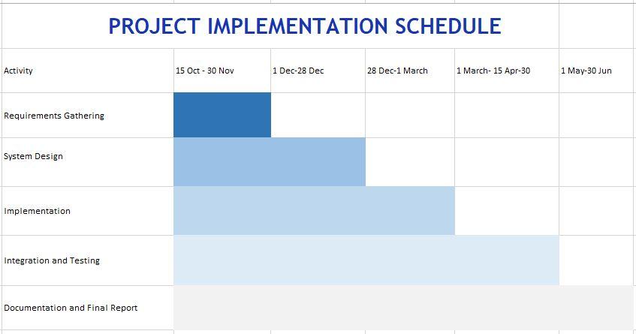

Slide 3
Modules
Hostel Management
Room Allocation
View Room Details
Admin Management
Student Management
Complaint System
Visitor Management
Mess Management
Attendance System
Payment System
Notification System
Notice Board.
Notes:
https://chatgpt.com/c/6776ca46-7780-8004-a1bf-d49023290fdc

Slide 4
Progress

Slide 5
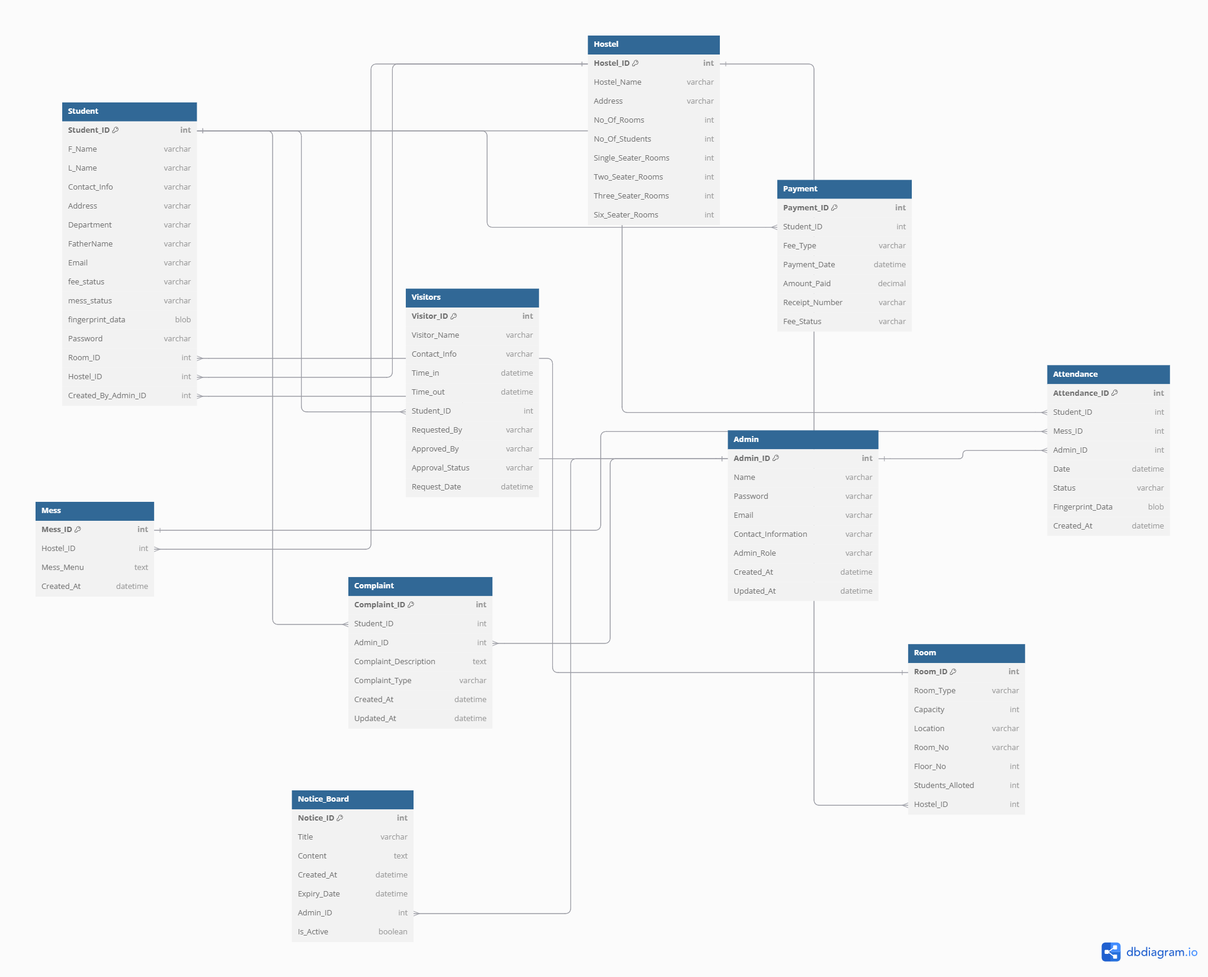
Complete ERD

Slide 6
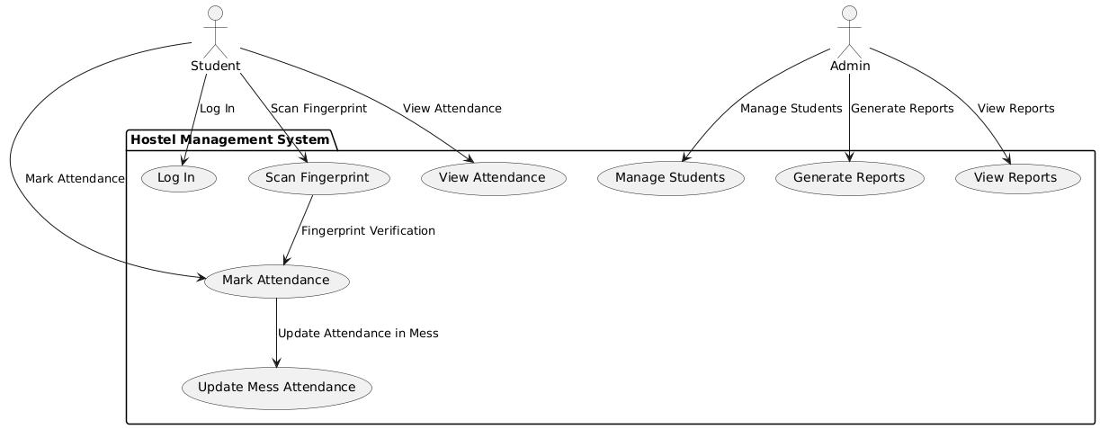
Use Case Diagram

Slide 7
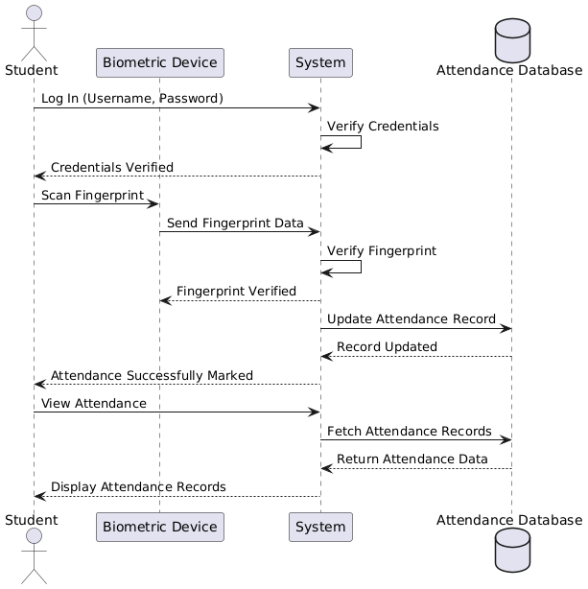
Sequence Diagram

Slide 8
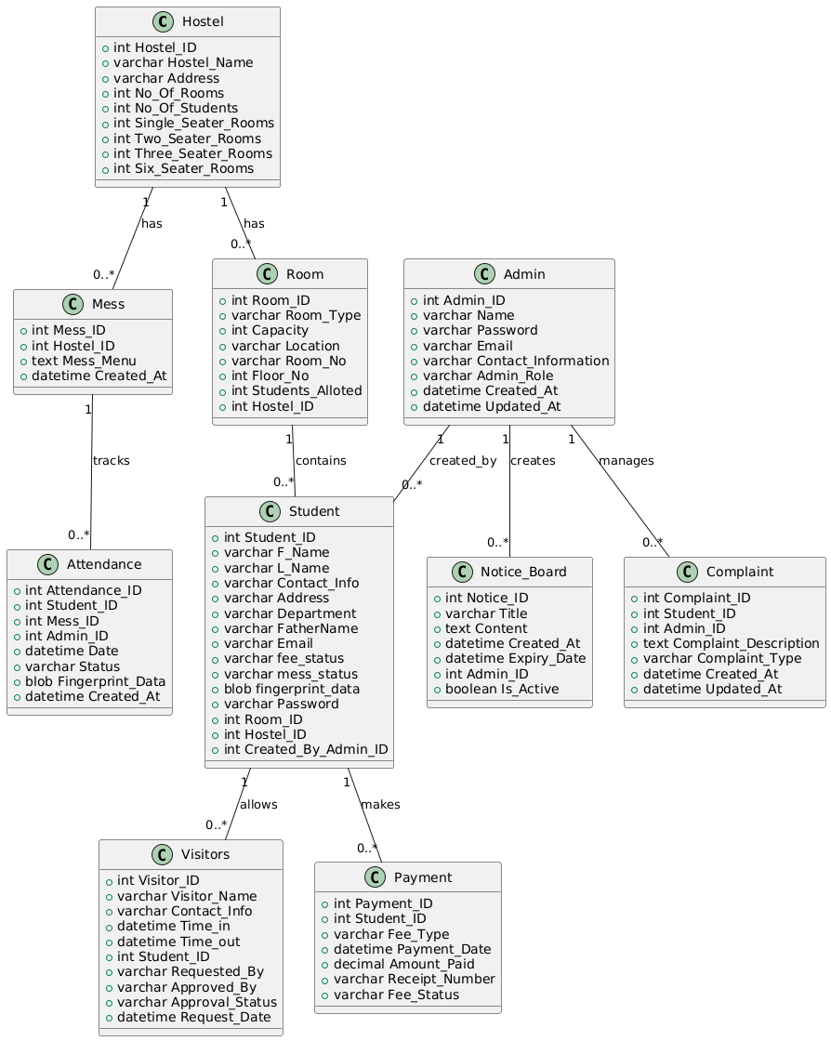
Class Diagram

Slide 9
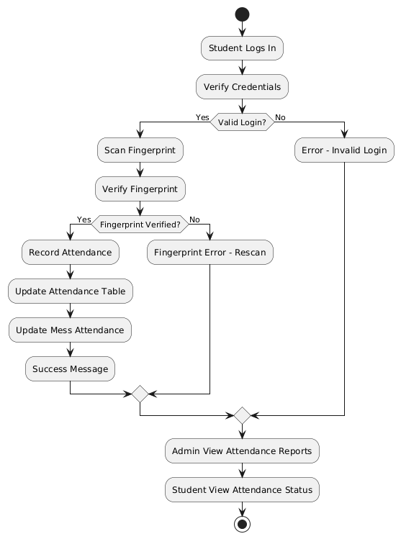
Flow Chart:

Slide 10
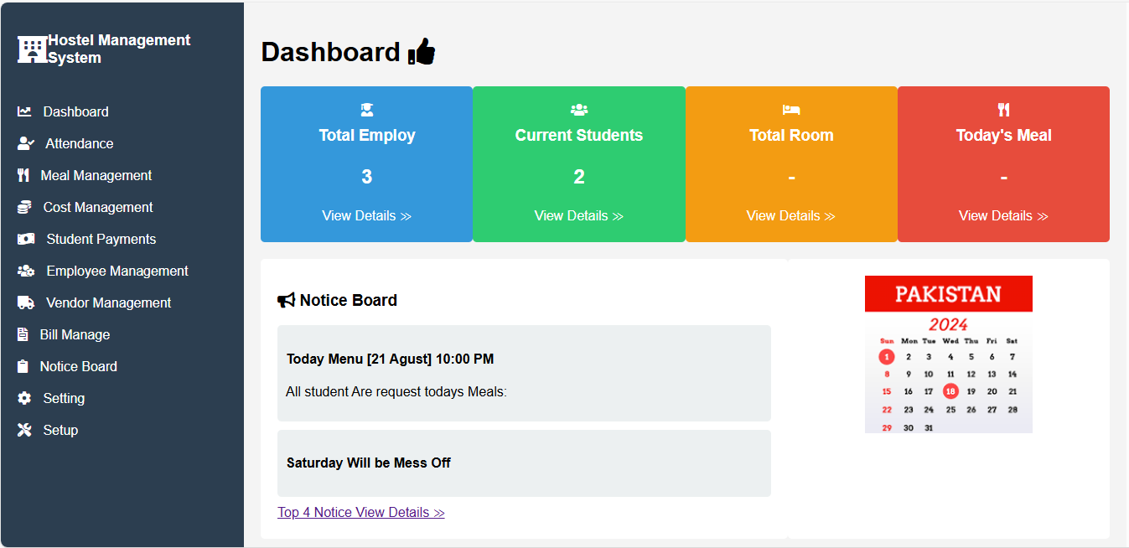

Slide 11
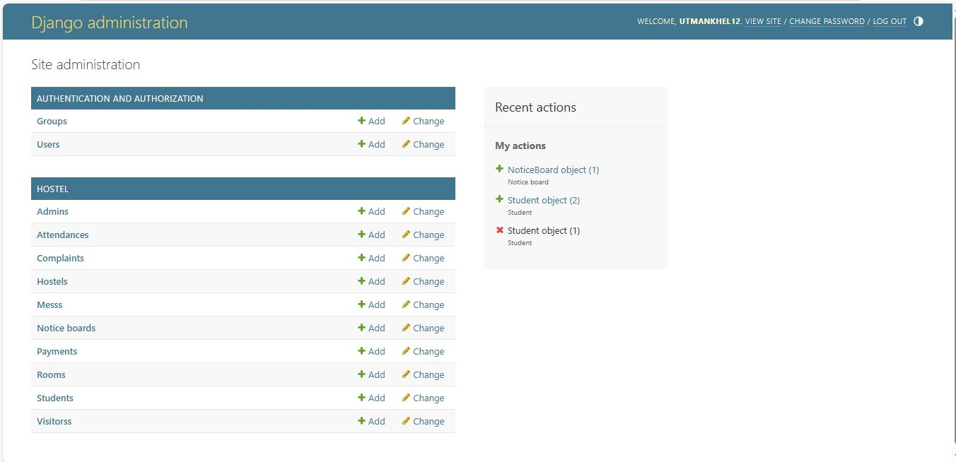

Slide 12
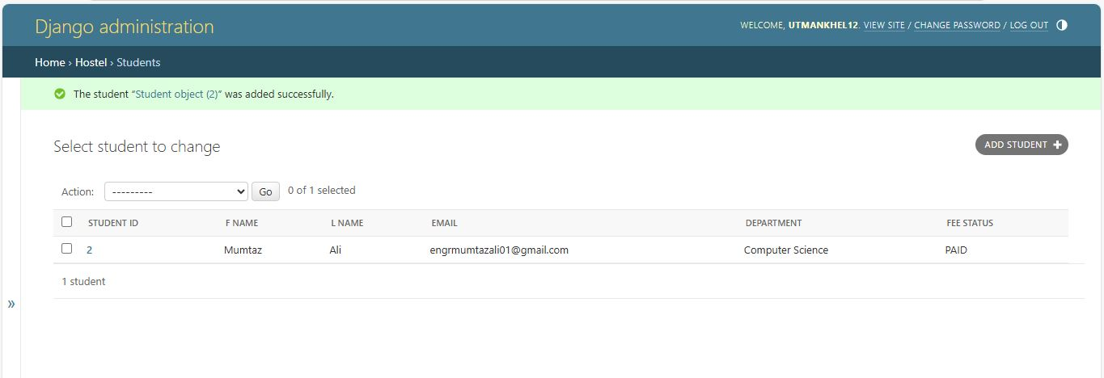
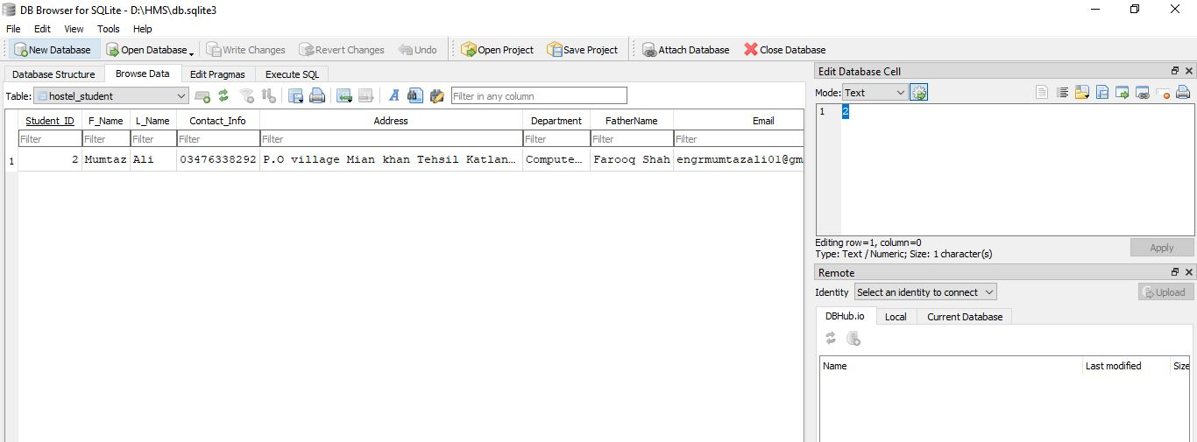

Slide 13
Thank You!

