Slide 1


Hostel
Management
system
Team Members:
Mumtaz Ali
Muhammad Maaz Muhammad Abubakar
Supervision by: Dr Sarwar Shah Saib.

Slide 2
Introduction
Hostel and Mess Management System simplifies hostel and mess operations.
Features include:
Room allocation.
Complaint management system.
Ensures efficient management.
Biometric attendance.
Online payment integration.
Automated mess bill notifications.
Improves communication.
Provides a user-friendly experience for both students and administrators.

Slide 3
Objectives
Room and Hostel Management
Complaint Management System
Automated Mess Bill Notification
Online Payment Integration
Attendance Integration

Slide 4
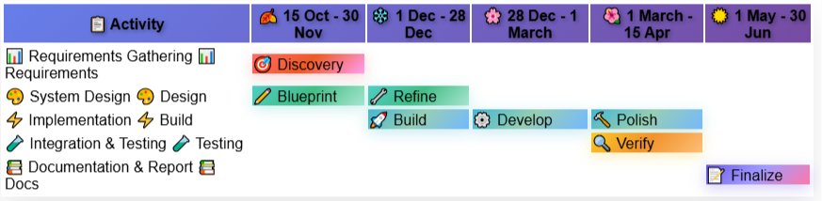
Project Implementation Schedule

Slide 5
Modules
Hostel Management
Room Allocation
View Room Details
Admin Management
Student Management
Complaint System
Visitor Management
Mess Management
Attendance System
Payment System
Notification System
Notice Board.

Slide 6
Progress

Slide 7
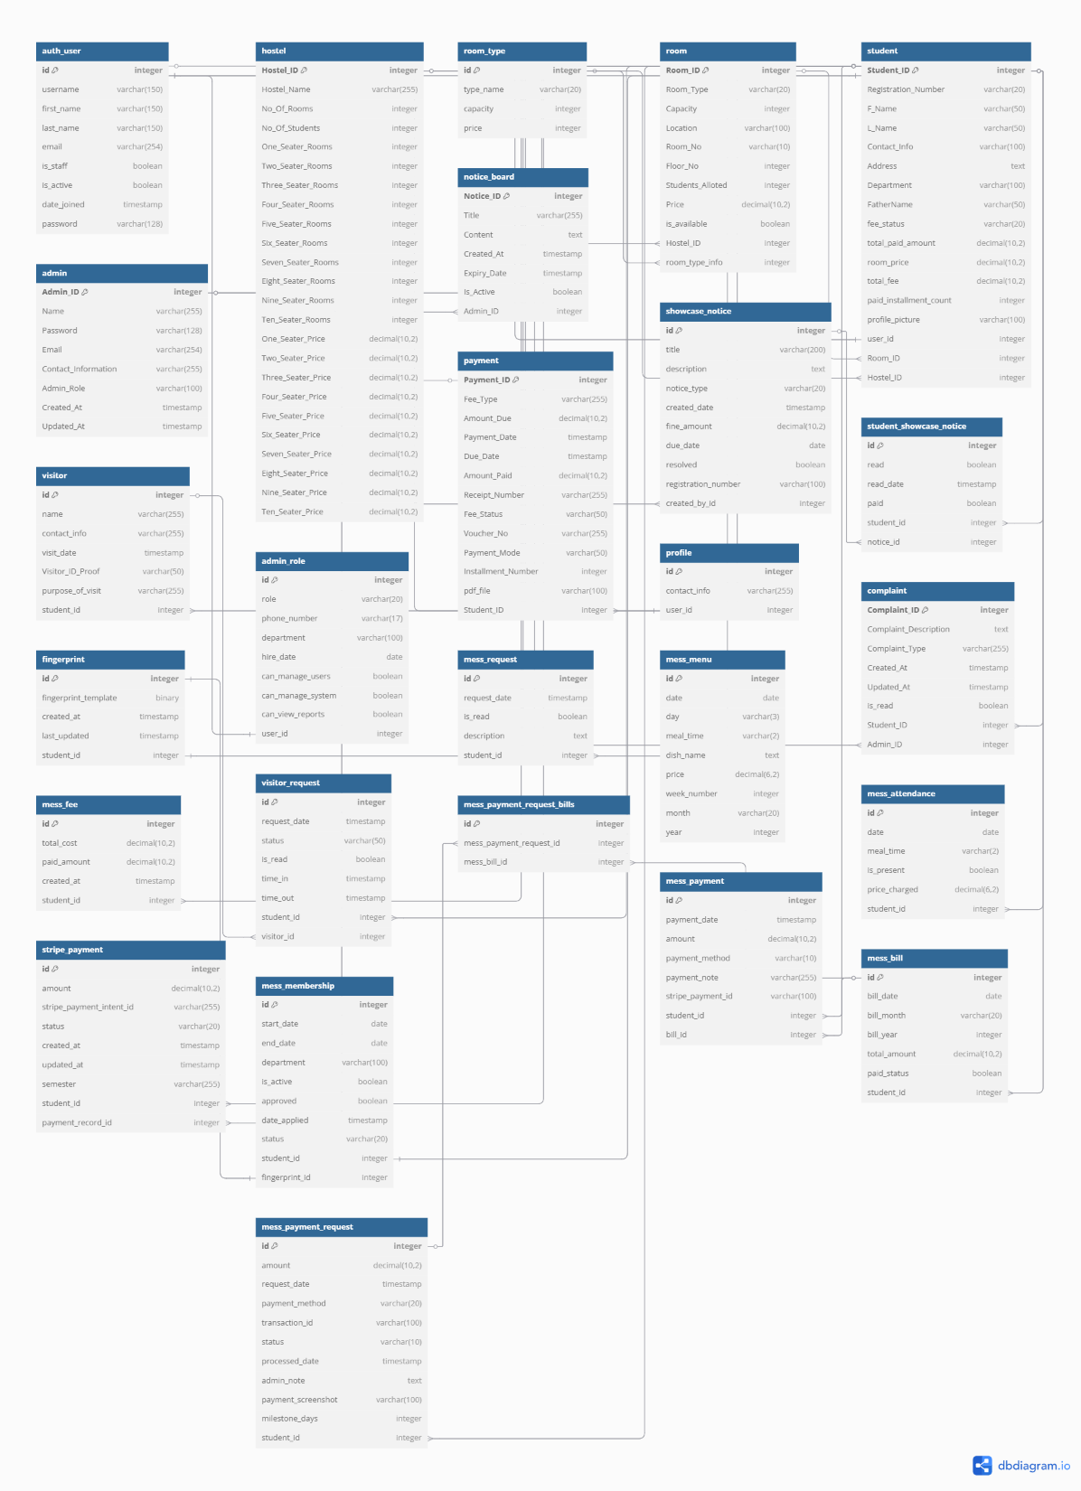
Complete ERD

Slide 8
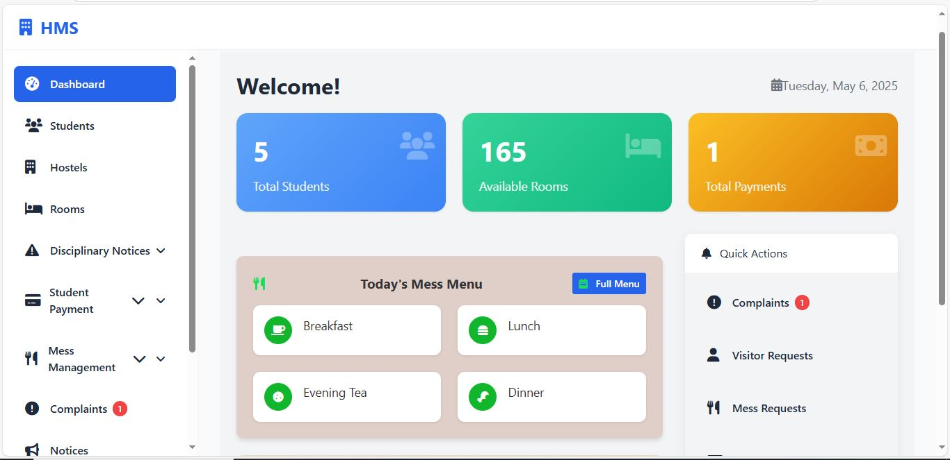
Admin Dashboard

Slide 9
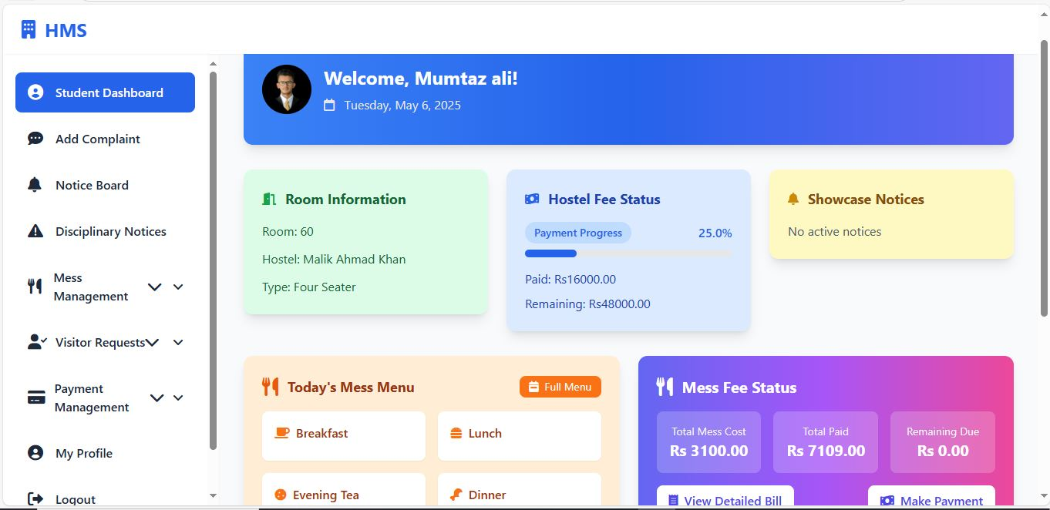
Student Dashboard

Slide 10
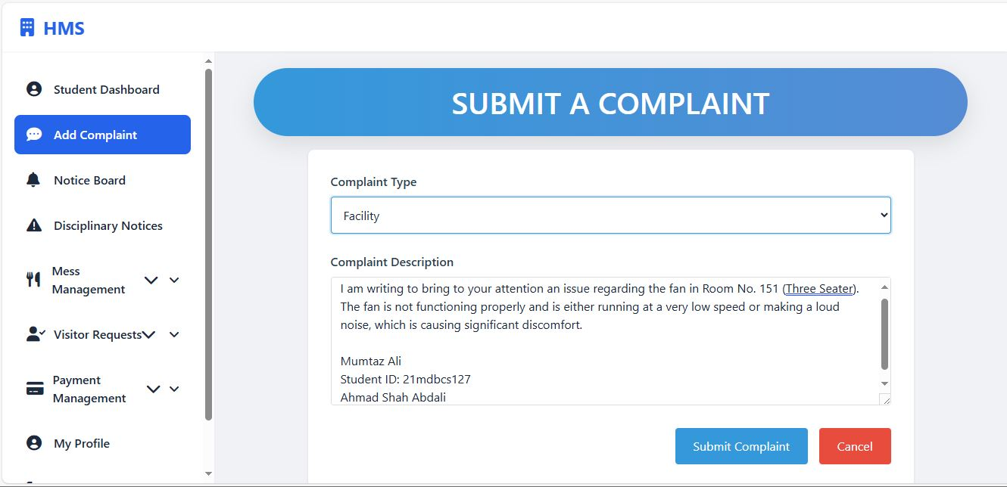
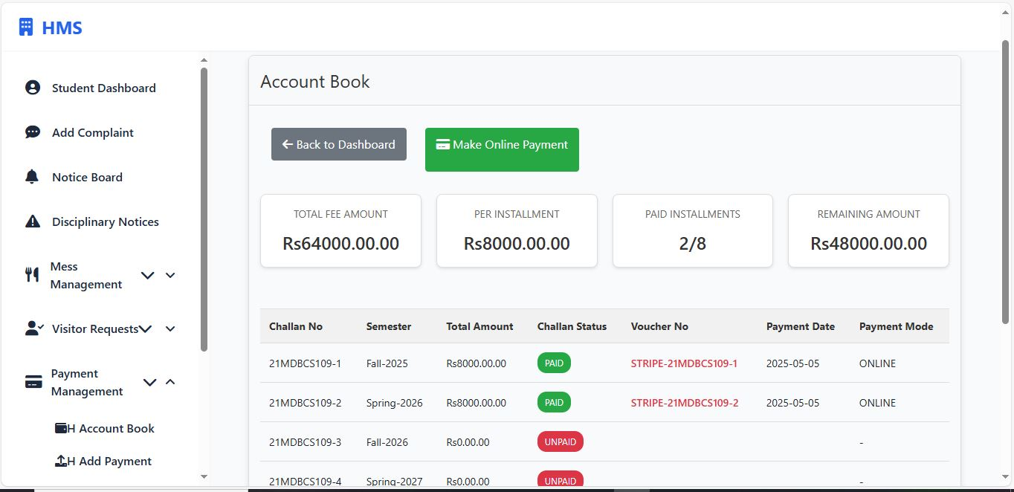
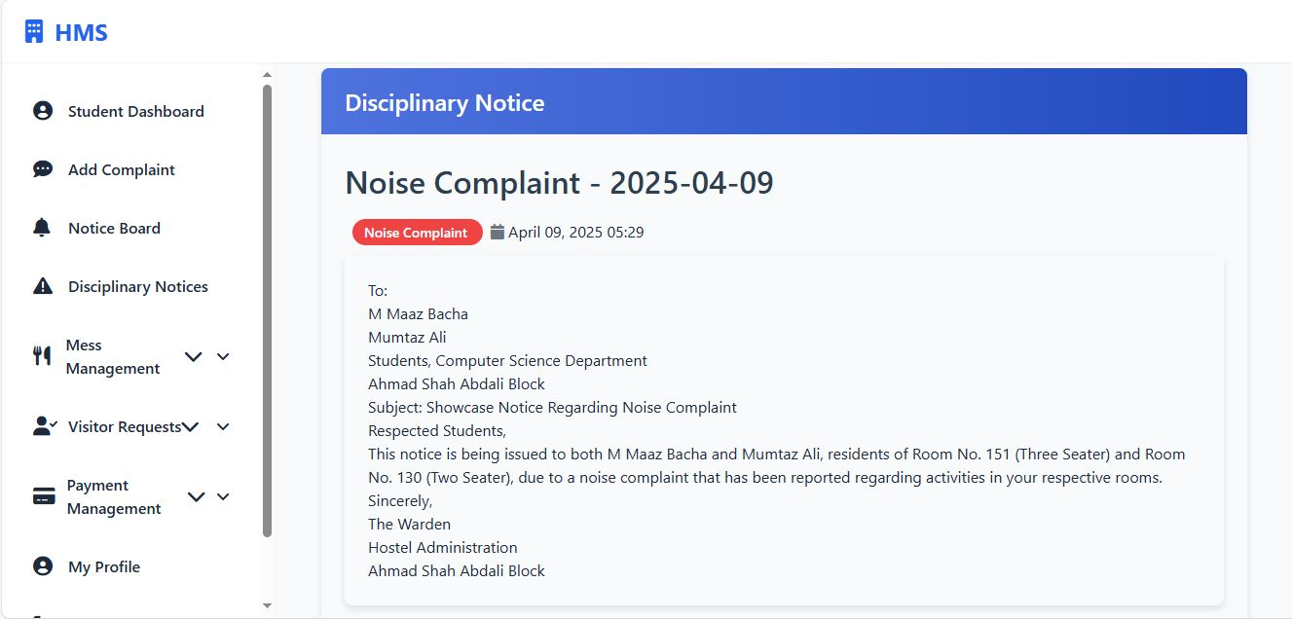
Some Demo Screen Shot

Slide 11
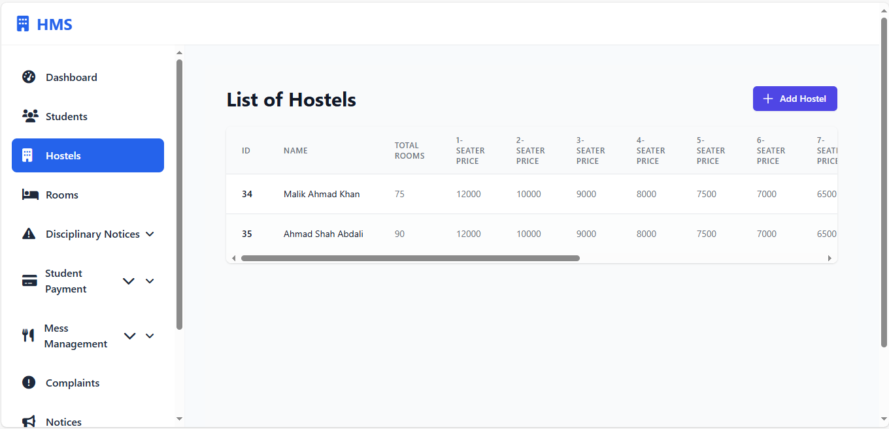
Hostel Management System

Slide 12
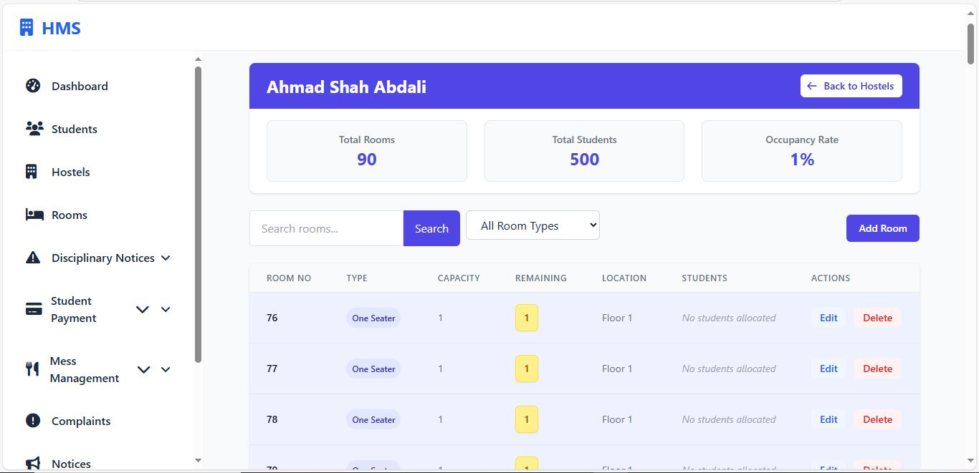
Room Allocations

Slide 13
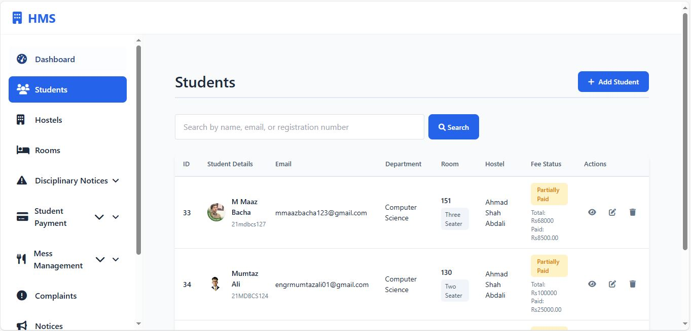
Student Management

Slide 14
Thank You!

