Slide 1
Jitter Plot of Data Collected by Skogforsk

Slide 2
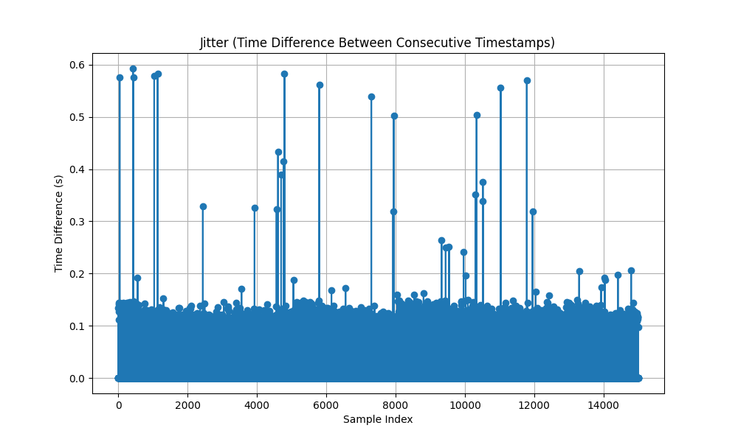
Figure 1: Jitter plot for the data collected 11:06-11:11

Slide 3
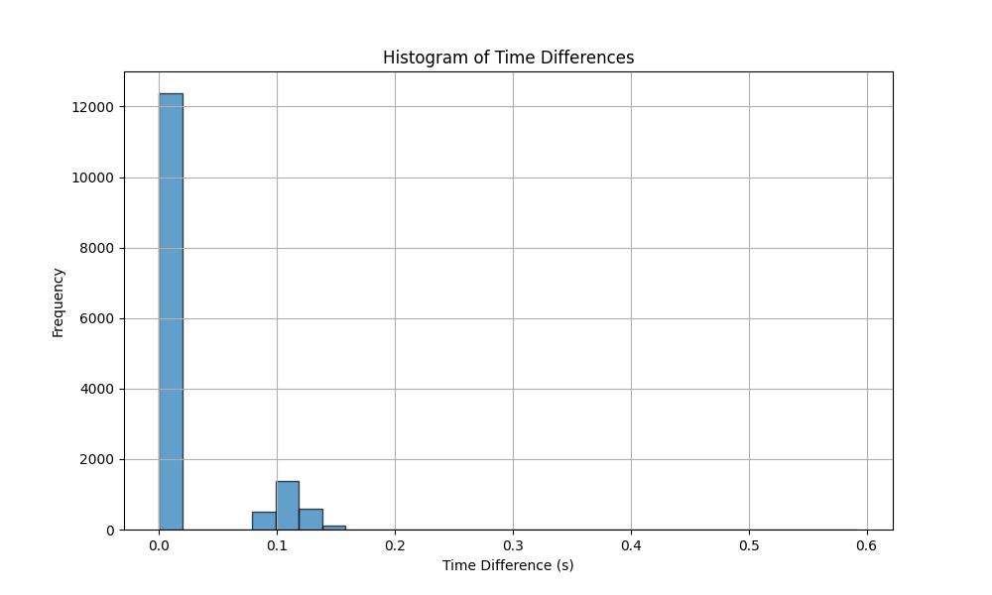
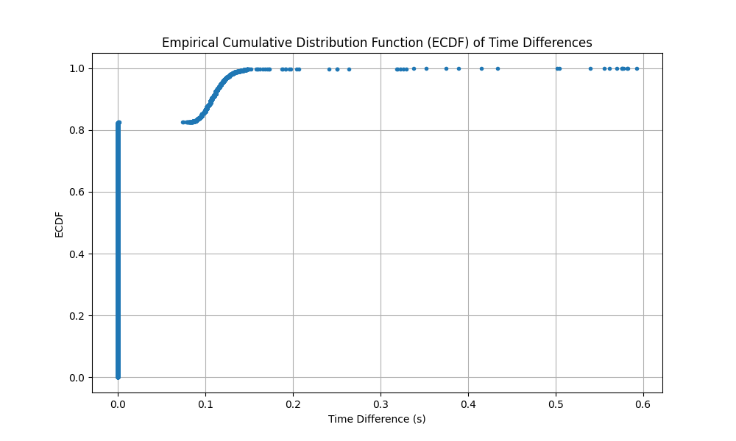
Figure 1: Histogram and CDF plot for the data collected 11:06-11:11

Slide 4
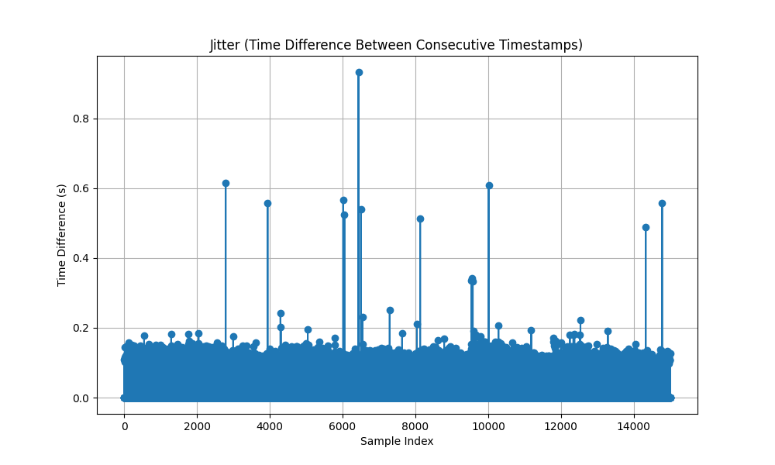
Figure 1: Jitter plot for the data collected 11:11-11:16

Slide 5
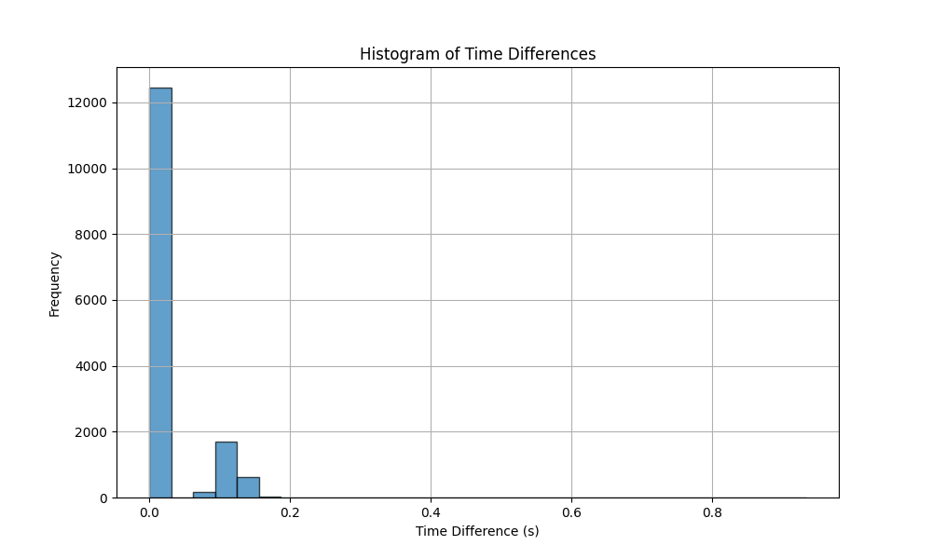
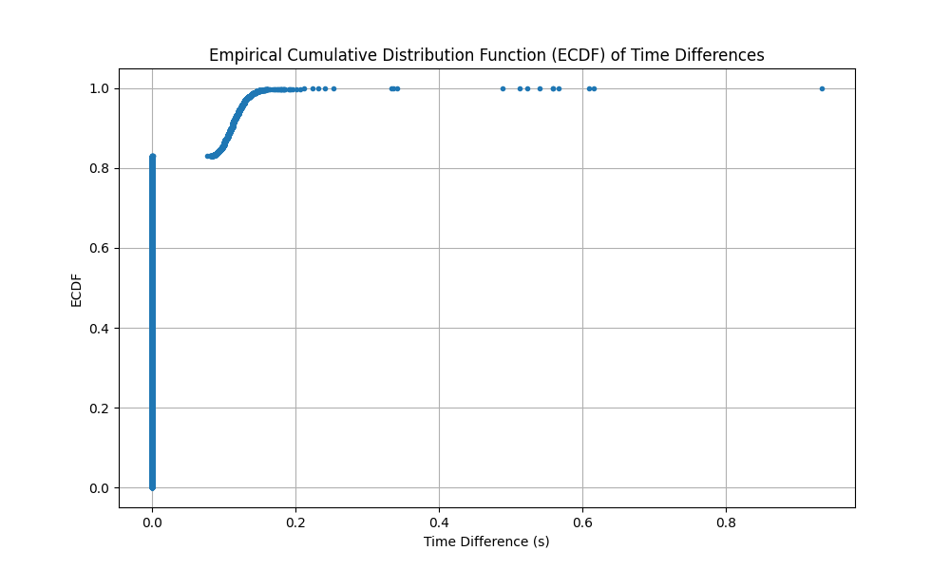
Figure 1: Histogram and CDF plot for the data collected 11:11-11:16

Slide 6
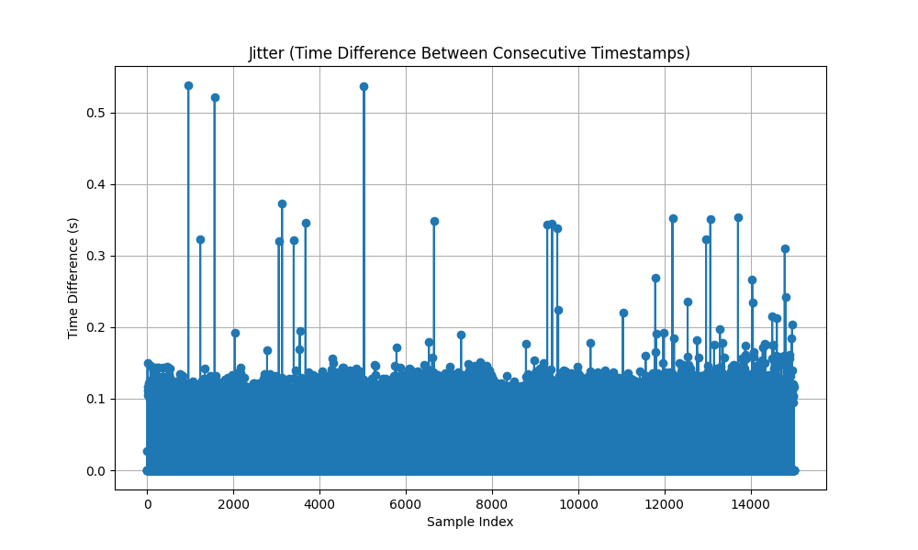
Figure 1: Jitter plot for the data collected 11:16-11:21

Slide 7
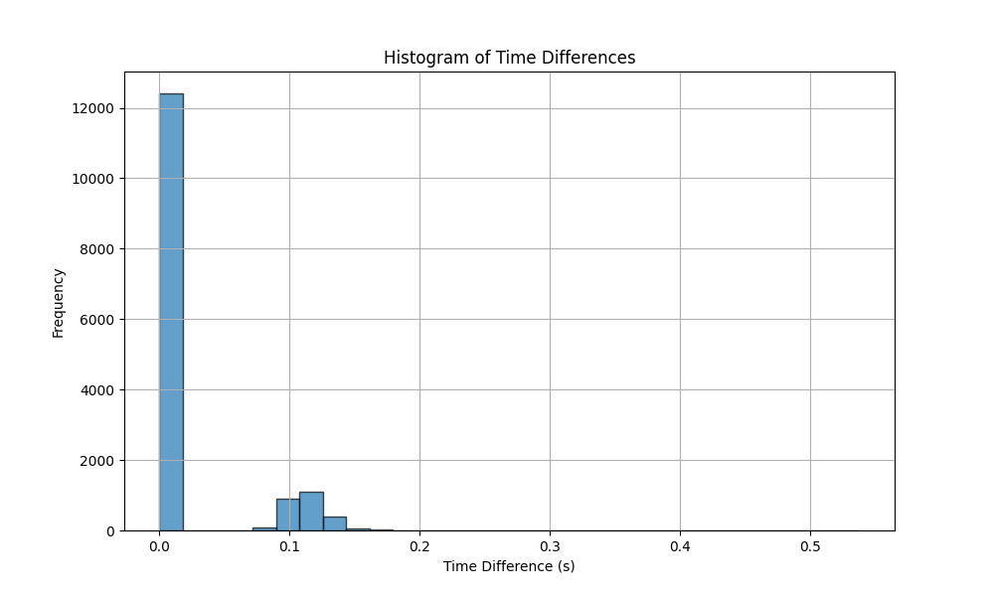
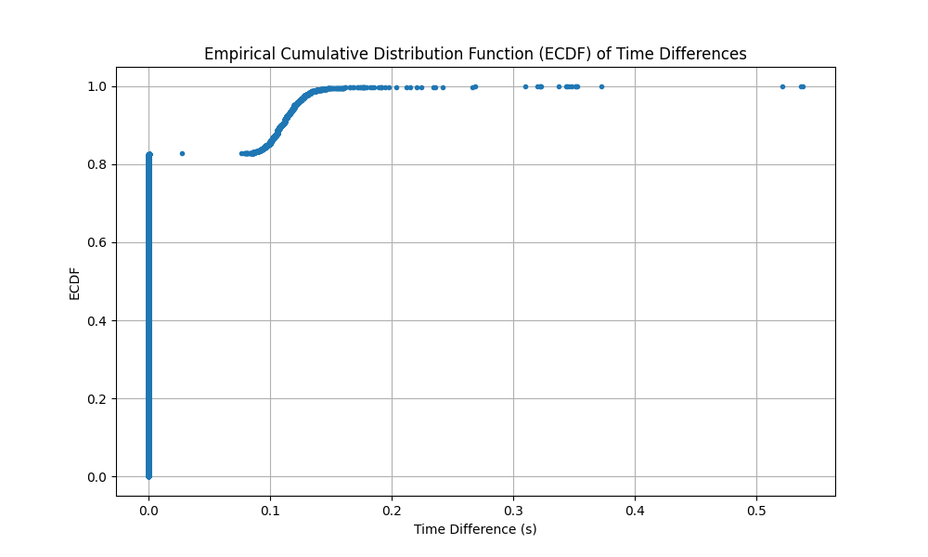
Figure 1: Histogram and CDF plot for the data collected 11:16-11:21

Slide 8
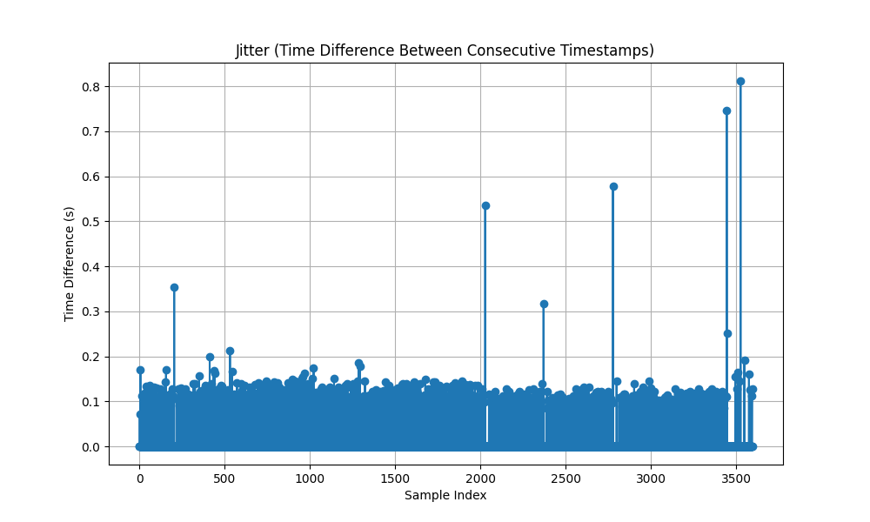
Figure 1: Jitter plot for the data collected 11:21-11:23

Slide 9
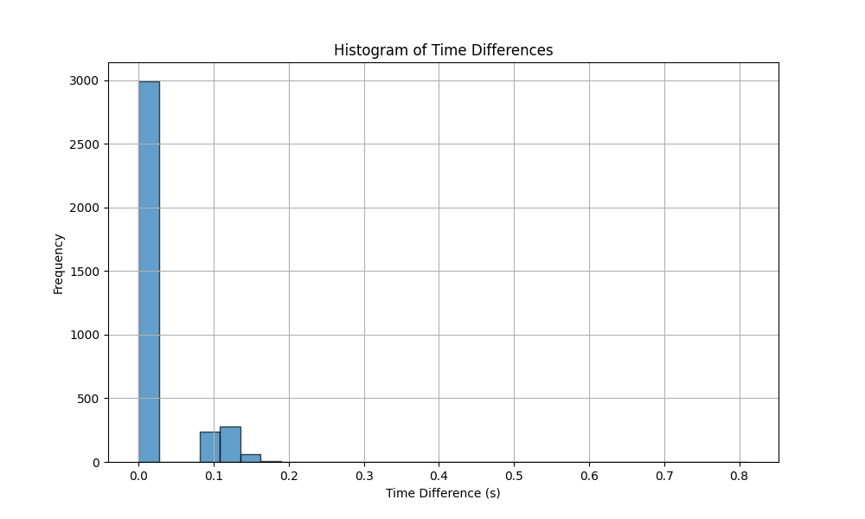
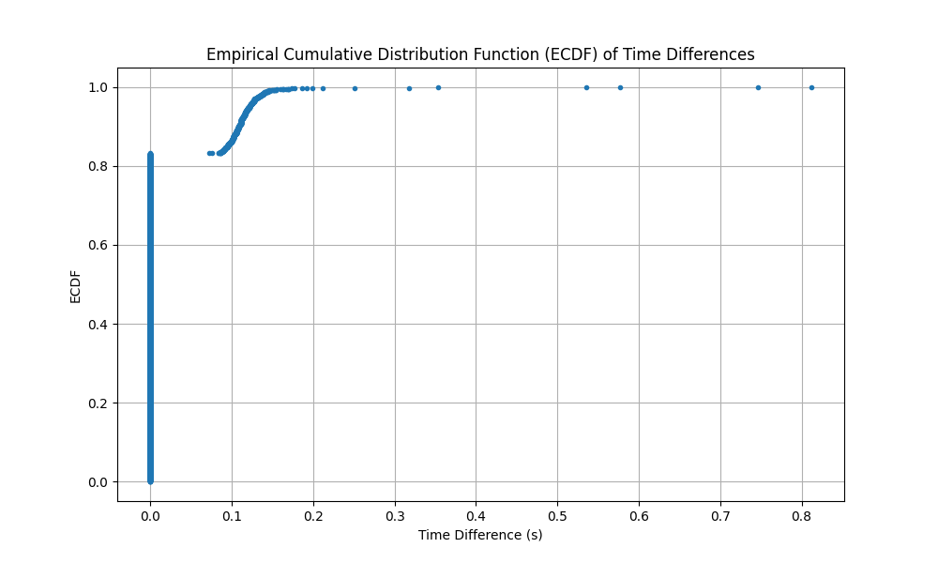
Figure 1: Histogram and CDF plot for the data collected 11:21-11:23

Slide 10
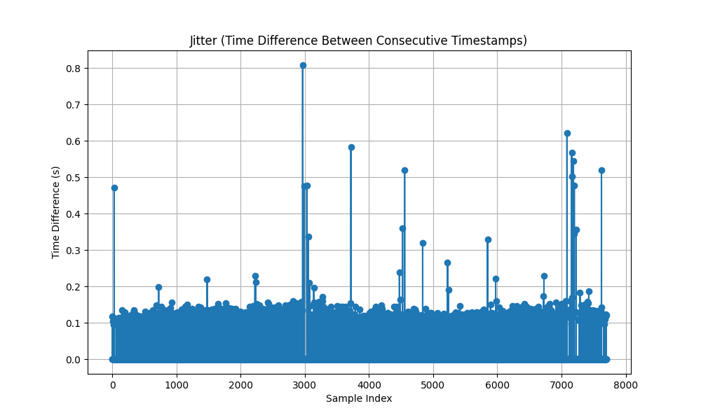
Figure 1: Jitter plot for the data collected 11:23-11:25

Slide 11

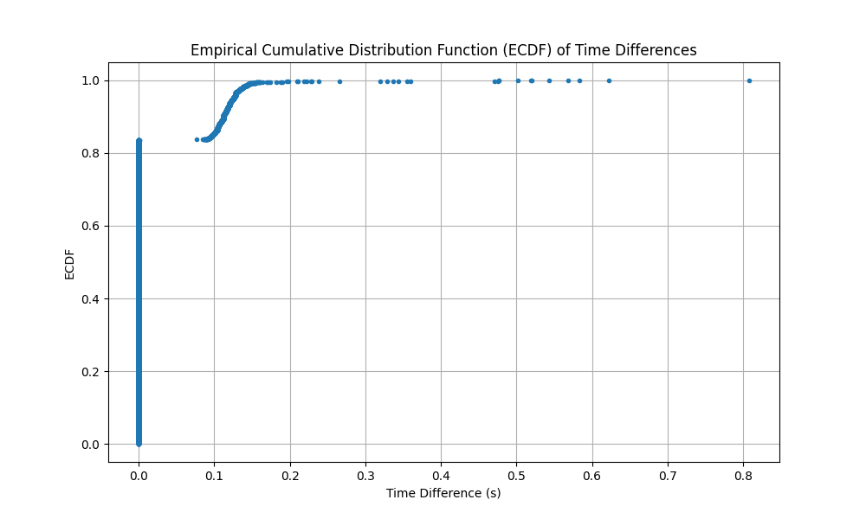
Figure 1: Histogram and CDF plot for the data collected 11:23-11:25

