Slide 1

WP4: Value added energy and non-energy data-driven services for DR in energy-efficient residential buildings - Handover
12/05/2025 → Remote

Slide 2
Agenda
Updates at WP level
Service file
D4.3
ToC
Release plan
Updates at Task level
Next steps
Recap of the actions

Slide 3
Updates from last meeting
ACTIONS FROM LAST MEETING (For all the WP participants)
Complete the service file - thanks to who have already updated
Continue to follow the well-established plans at the task level
A couple of AI-based scenarios prepared for 21st ETIP SNET Regional Workshop | ETIP SNET - thanks to DOMX and UNIVPM for the great support (slides available here)

Slide 4
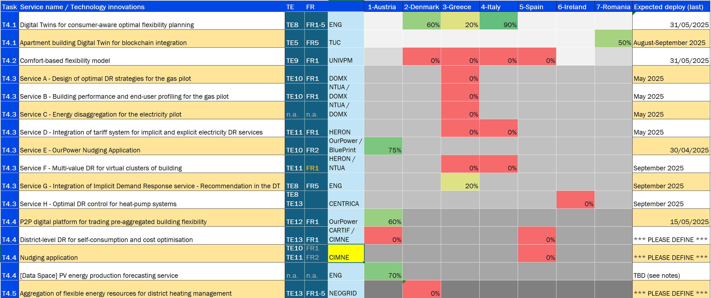
New «Summary» in the service file
DEDALUS - Services developed per pilot.xlsx

Slide 5
D4.3 "Final wave" of DEDALUS Digital Twins and data-driven services for residential DR
DEDALUS_D4.3_ENG_ToC_v0.1.docx
Table of contents
1. Introduction (ENG) 12
1.1. Purpose and audience of the document 12
1.2. Relation to other activities 12
1.3. Structure of the document 12
2. Digital Twins for optimal assets vs consumers flexibility planning (ENG, TUC) 13
2.1. Digital Twins for consumer-aware optimal flexibility planning (ENG) 13
2.1.1. Overview of the service 13
2.1.2. Architectural diagram 14
2.1.3. Data for service execution 14
2.1.4. Service output 14
2.1.5. Main benefit and innovation 14
2.1.6. Development activity 15
2.1.7. Outlook for the future expected releaseTest results and possible evolutions 15
2.2. Apartment building Digital Twin for blockchain integration (TUC) 16
2.2.1. Overview of the service 16
2.2.2. Architectural diagram 16
...
3. Optimal trade-off among comfort, energy and building performance (UNIVPM) 18
...
4. Optimal DR management strategies (implicit and explicit) adaptable to different segments of residential energy consumers (DOM-X) 21
4.1. Service A - Design of optimal DR strategies for the gas pilot 22
...
5. Local flexibility management for energy communities and self-consumption/cost optimisation (OURPOWER) 37
...
6. Optimal Aggregation of flexible energy resources for heat vs electrical flexibility valorisation (NEOGRID) 40
...
Conclusions (ENG) 44
References 45

Slide 6

Next steps and actions
D1.2
D4.3 (Month 29) --> 31/09/2025
MS10 (Month 29) --> 31/09/2025 Final software release
NEW (RELEASE PLAN (for the documental part)
Official start (First ToC): 22/05/2025 // anticipated by 2 months
1st round of contributions: 15/06/2025 // early results if any, or planned
2nd round of contributions: 13/07/2025 // expected bulk of contents
3rd round of contributions: 31/08/2025 // refinements / late contents
Please continue updating DEDALUS - Services developed per pilot.xlsx:
Find your company name in column C and complete the row, especially column G and H, expected deployment date and current % completion

Slide 7
TASK 4.1
Digital Twins for optimal assets vs consumers flexibility planning
ENG(18), HERON(6), CENTRICA(5), TUC(6) from Task4.4
Pilot 2 Denmark, Pilot 3 Greece, Pilot 4 Italy, Pilot 7 Romania

Slide 8
Task 4.1 - Activities – DK, GR, IT Pilots
Updates:
IT: We have prepared, with UNIVPM, the comfort service for deployment (T4.2). We are finalizing the integration with the DT. We are in contact with NTUA to integrate energy data into the flow as well.
DK: Neogrid provided us with the mapping needed to show the data in the 3D model. We are waiting to integrate the ITL with the DT and finalize the DT.
GR: Preliminary study on clustering methods for data visualization in the DT.
Software development: 90% 31/05 (IT) - 60% 30/06 (DK) - 20% 31/07 (GR)
Next steps:
IT: Finalize the integration of the Comfort Service (T4.2) with the DT. Integrate also the energy data from NTUA. Deploy the DT and the services on Pilot site. Partecipate to the workshop (10/06)
DK: Integrate the ITL with the DT. Finalize DT and the Simulation Engine.
GR: Agree on how to visualize data by clustering with Heron (email, call will follow).
Issues:
IT: is not an issue, we are just waiting for energy data from NTUA.
DK: we are waiting for the final version of the ITL to be integrated into the DT.
GR: a lot of work to be done, need to speed up.

Slide 9
Task 4.1 - Activities – RO Pilot
Updates:
…
…
Software development: NN% (expected release: YY/MM)
Next steps:
…
…
Participation to workshop? Yes (expected date) / No
Issues:
…
…
Missing data / requirements? Yes (from whom) / No

Slide 10
Task 4.2
Optimal trade-off among comfort, energy and building performance
UNIPVM (14), ENG(5), ISRAA(7)
Pilot 2 Denmark, Pilot 3 Greece, Pilot 4 Italy, Pilot 5 Spain

Slide 11
Task 4.2 - Activities
Updates:
Finalize the integration of the Comfort Flexibility Service (CFS) with the Digital Twin (DT) for the Italian pilot.
Had a call with NTUA to understand how their service could be integrated into ours.
Software development: 90%
Next steps:
Deploy the CFS for the Italian pilot in collaboration with ENG.
Participate in a technical workshop for technicians scheduled for June 10, hosted by ISRAA.
Schedule a call with Neogrid to understand the situation regarding the TSV.
Issues:
No TSV data from Danish pilot.
Waiting for updates from Greek and Spanish pilot leaders to start the collection of environmental and subjective data (TSV).

Slide 12
Task 4.3
Optimal DR management strategies (implicit and explicit) adaptable to different segments of residential energy consumers
DOM-X(12), ENG(5), NTUA(6), OurPower(6), BLUEPRINT(8), HERON(9), CENTRICA(4)
Pilot 1 Austria, Pilot 3 Greece, Pilot 6 Ireland

Slide 13
Task 4.3 - Activities – Service A (DR in gas pilot)
Updates:
Mobile App Notifications, already integrated in the existing DomX mobile app.
Integration planned for the new DomX mobile app, which is intended for use in the next heating season.
Household Clusters: Finalization in progress; target completion by end of May 2025.
Software development: 95% (expected release: 31/05)
Next steps:
Define methodology to measure Demand Response (DR) acceptance by end-users, to enable accurate KPI calculation.
Organize and prepare for the technical workshop, planned for October / November 2025.
Issues:
What kind of information should be included in the current deliverable regarding DR implementation progress? Also, which deliverable should include our final findings and evaluation?

Slide 14
Task 4.3 - Activities – Service B
A multi-dimensional unsupervised machine learning framework for clustering residential heat load profiles
Updates:
Incorporation of user behavioural dimension
Software development: 95% (expected release: 09/2025)
Next steps:
Finalization of dimensions
Participation to workshop? No
Issues:
Missing data / requirements? No

Slide 15
Task 4.3 - Activities – Service C
Updates:
Introduction of clustering methods to improve DAE’s model accuracy and disaggregation resolution.
Improved appliance detection rates observed post-clustering.
Evaluated performance on unseen households.
Software development: 80% (expected release: 2025/07)
Next steps:
Deploy clustered DAE on production HERON platform.
Participation to workshop? No
Issues:
-
Missing data / requirements? No

Slide 16
Task 4.3 - Activities – Service D
Updates:
Development finalisation
Software development: 60% (expected release: 06/25)
Next steps:
Integration with DR service
Development for multipliers
Participation to workshop? Yes (26/5)
Issues:
Missing data / requirements? No

Slide 17
Task 4.3 - Activities – Service E
Updates:
Austrian app will be finished next week
Software development: 95% (expected release: 25/05)
Next steps:
Bugfixing on OurPower energy database due to issues with hierarchical energy communities
Publish to app on app stores (Google, Apple)
Participation to workshop? Yes (end of May)
Issues:
Bugs in OurPower energy database due to hierarchical energy communities

Slide 18
Task 4.3 - Activities – Service F
Updates:
Finalistion of the DR framework and optimisation engine architecture (MetroLivEnv paper)
Continuous onboaring of households & flexible assets -> finalisation of the dissagregation process
Software development: 30% (expected release: 06/25)
Next steps:
Integration with dissagragation service
Finalisation of the DR service development
Test and Validation
Development for multipliers
Participation to workshop? Yes (26/5)
Issues:
Integration process but under discussion with other services
Missing data / requirements? No

Slide 19
Task 4.3 - Activities – Service G
Updates:
mockups of the dashboards in which the service outputs will be displayed
Software development: 10% (expected release: 07/25)
Next steps:
Integrate Service F outputs into the Digital Twin.
Participation to workshop? No
Issues:
Waiting for development of the Service F and the GR Digital Twin.
Missing data / requirements? No

Slide 20
Task 4.3 - Activities – Service H
Overview:
Thermal digital twins: predict the future evolution of the indoor temperature of a house based on the outdoor temperature and heating controls. A second model predicts the temperature of the hot water tank.
Use the thermal models to determine optimal controls for the heat pump. The objective is to a) keep the indoor temperature above the setpoint, b) provide hot water when needed c) minimize the electricity cost and d) minimize the carbon emissions.
Software development: 70% (expected release: September 2025)
Next steps:
Finetune thermal models on historical data of a house to maximise accuracy
Deploy in Pilot
Participation to workshop? Yes (December 2025)
Issues:
Pilot contract not yet signed

Slide 21
Task 4.4
Local flexibility management for energy communities and self-consumption/cost optimisation
OurPower(10), ENG(5), CARTIF(8), COMS(8), BLUEPRINT(8), CIMNE(4), ROMUR(4)
Pilot 1 Austria, Pilot 5 Spain

Slide 22
Task 4.4
Updates:
COMS is working on the EC analysis and simulation tools for the pre-aggregation platform
First version of EC settlement module deployed
Focus on planning for the flexibility provisioning and scheduling
OurPower's energy database API is available, focus on finalizing the energy community management platform
CARTIF is evaluating the integration of the service with the Austrian API.
CIMNE is improving the optimization algorithm and establishing the API connections for the Spanish pilot
CIMNE is testing the algorithms with real-time simulation in Typhoon hill enviroment.
Software development: 80% (expected release: 25/05)
Next steps:
Finalize developments and data/service integration
Bugfixing on OurPower energy database due to issue with hierarchical energy communities
Participation to workshop? Yes (end of May)

Slide 23
Task 4.5
Optimal Aggregation of flexible energy resources for heat vs electrical flexibility valorisation
NEOGRID(10), ENG(5)
Pilot 2 Denmark

Slide 24
Task 4.5
Updates:
…
…
Software development: NN% (expected release: YY/MM)
Next steps:
…
…
Participation to workshop? Yes (expected date) / No
Issues:
…
…
Missing data / requirements? Yes (from whom) / No

Slide 25




Thank you!
DEDALUS-HORIZON.EU
@DEDALUS_EU
@DEDALUS_EU
INFO@DEDALUS-HORIZON.EU

Slide 26
WP4 – Tasks
 |  | Main contact | Deputy contact
Task 4.1 | Digital Twins for optimal assets vs consumers flexibility planning [M5-M29] ENG, HERON, CENTRICA | Lorenzo Cristofori | Alessandro Rossi
Task 4.2 | Optimal trade-off among comfort, energy and building performance [M5-M29] ENG, CARTIF, ENG, UNIVPM, ISRAA | Sara Casaccia | Richard Kaculi
Task 4.3 | Optimal DR management strategies (implicit and explicit) adaptable to different segments of residential energy consumers [M5-M29] ENG, NTUA, OurPower, BLUEPRINT, HERON, DOM-X, CENTRICA | Giannis Kazdaridis | Stratos Keranidis
Task 4.4 | Local flexibility management for energy communities and self-consumption/cost optimisation [M5-M29] ENG, CARTIF, COMS, OurPower, BLUEPRINT, CIMNE, ROMUR, TUC | Andrija Goranović | Natascha Fenz
Task 4.5 | Optimal Aggregation of flexible energy resources for heat vs electrical flexibility valorisation [M5-M29] ENG, NEOGRID | Henrik Lund Staermose | Josefine Kejser
Involved partners: ​
Technology enablers main developers: ENG, HERON, CENTRICA, ​CARTIF, UNIVPM, OurPower, DOM-X, TUC, NEOGRID, NTUA, COMS, CIMNE
Supporting partners (mainly from the pilots): ISRAA, BLUEPRINT, ROMUR
check
DEDALUS_Mailing Lists_TEAMS.xlsx

Slide 27
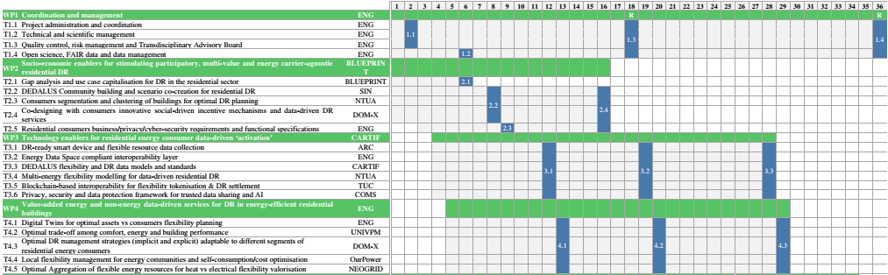
WP4 – Work plan and timeline
April 2025
Deliverables: DEDALUS Digital Twins and data-driven services for residential DR
D4.1 ENG, OTHER, M13 (“First wave” release) → due in May 2024 → submitted 10 Jul APPROVED (29 Aug)
D4.2 ENG, OTHER, M20 (“Second wave” release) → due in Dec 2024 → submitted 10 Mar
D4.3 ENG, OTHER, M29 (“Final wave” release) → due in Sep 2025 → ToC will be anticipated by 2 months
to deal with summer break: 22 May
s
MS4 1st technology development cycle completion (ENG, M13) -> ACHIEVED
MS7 2nd technology development cycle completion (CARTIF, M20) -> ACHIEVED
MS10 Final technology development cycle completion (ENG, M29) -> ONGOING
D1.2

Slide 28
Activity monitoring
Data requirements
WP4 folder
Task-pilot involvement
Tables
Service development %
Sheets (one per pilot)
DEDALUS - Services developed per pilot.xlsx

