Slide 1
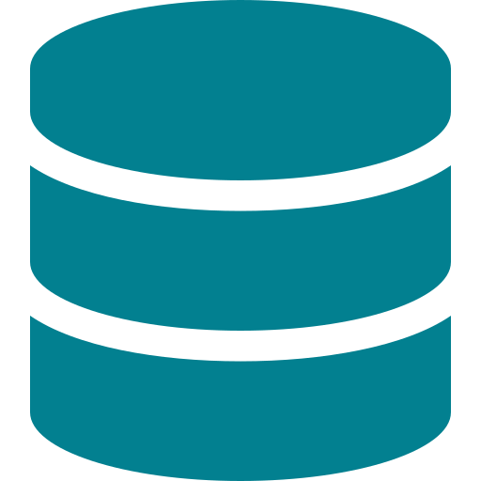
Lab 032
Kubernetes Storage
PVs, PVCs & Why They Must Match
What you'll learn:
• What pods, YAML, PVs and PVCs actually are
• How Kubernetes connects storage to containers
• Why binding fails — and how to fix it

Slide 2




What is a Pod?
The Analogy
What's inside a Pod?
Think of a pod like a shipping container.
The container itself is the metal box — that's your application (e.g. a database process).
The pod is the pallet it sits on — it adds a bit of infrastructure around the container: networking, storage mounts, restart rules.
Kubernetes manages pallets (pods), not the boxes (containers) directly.
Container(s)
The actual app running (e.g. PostgreSQL image)
Volume mounts
Where storage gets attached (e.g. /data)
Config
Environment variables, secrets, resource limits
Identity
A name, IP address, and restart policy
In this lab: the pod named 'database' runs a DB container and needs a volume mounted at /data
Lab 032 — Kubernetes Storage | cloud-engineer-labs

Slide 3
What is YAML? — How Kubernetes Knows What You Want
YAML = the instruction sheet
A minimal Pod YAML
YAML is just a text file that tells Kubernetes what you want to exist.
Every resource in Kubernetes — pods, PVCs, PVs, deployments — is described in a YAML file.
You write what you want. Kubernetes reads it and makes it happen (or tells you why it can't).
Think of it like a form you fill in at a bank. The form describes what you want. The bank (Kubernetes) decides if it can do it.
apiVersion: v1 ← which API to use
kind: Pod ← what type of resource
metadata:
name: database ← its name in the cluster
spec: ← what we want it to do
containers:
- name: db
image: postgres:15 ← the Docker image to run
volumes:
- name: data
persistentVolumeClaim:
claimName: db-pvc ← references the PVC
Lab 032 — Kubernetes Storage | cloud-engineer-labs

Slide 4
What is a PersistentVolume (PV)?
The Analogy: A Physical Storage Unit
A PV is real storage that exists in the cluster — like a physical storage unit at a depot. It has a fixed size, a location (/data/db on this Pi), and specific capabilities.
Capacity
Access Mode
StorageClass
10Gi
ReadWriteOnce
fast-storage
How much space exists
How many nodes can mount it simultaneously
The 'tier label' — must match the PVC
The PV is created by the cluster administrator (or automatically by a StorageClass provisioner in production). In this lab, it's created manually with a YAML file — a hostPath volume pointing to /data/db on your Pi.
Lab 032 — Kubernetes Storage | cloud-engineer-labs

Slide 5

What is a PersistentVolumeClaim (PVC)?
The Analogy: A Rental Application Form
A PVC is a request for storage — written by the developer (you), not the admin. You say what you need: how big, what access mode, what storage class. Kubernetes finds a PV that matches and connects them. The pod then uses the PVC — it never talks to the PV directly.
PV vs PVC — Who does what?
PersistentVolume (PV)
PersistentVolumeClaim (PVC)
Created by
Cluster admin (or provisioner)
Developer / app team
Represents
Real storage that exists
A request for storage
Analogy
The storage unit at the depot
Your rental application
Defined in
pv.yaml
pvc.yaml
Referenced by
Nothing directly
The Pod's volumeMount
Lab 032 — Kubernetes Storage | cloud-engineer-labs

Slide 6
How PV + PVC Binding Works — The 3 Matching Rules
Kubernetes acts like a matchmaker. Before connecting a PVC to a PV, it checks three things must align:
Rule 1
Rule 2
Rule 3
StorageClass must match
Access Mode must match
PVC size ≤ PV capacity
PV:
fast-storage
PV:
ReadWriteOnce
PV:
10Gi available
PVC:
fast-storage
PVC:
ReadWriteOnce
PVC:
≤ 10Gi requested
Like a brand filter. Kubernetes only compares PVCs and PVs that share the same StorageClass label — even if the size and access mode are perfect.
Describes how the volume can be mounted. RWO = one node at a time. RWX = many nodes. The PVC must not ask for more than the PV supports.
The PV must have at least as much space as the PVC requests. Asking for 20Gi from a 10Gi PV will always fail.
All three must match — miss any one and the PVC stays Pending forever.
Lab 032 — Kubernetes Storage | cloud-engineer-labs

Slide 7
What Was Broken in This Lab — 3 Mismatches
The broken PVC asked for things the PV couldn't provide:
Access Mode
The PV only supports one node at a time. The PVC was asking for multi-node access — which this storage backend doesn't support.
PV:
ReadWriteOnce
Fixed to:
PVC:
ReadWriteMany
ReadWriteOnce
Storage Size
You can't fit 20Gi of stuff into a 10Gi storage unit. Kubernetes won't bind a PVC to a PV too small to satisfy it.
PV:
10Gi
Fixed to:
PVC:
20Gi
10Gi
StorageClass
These are different labels. Kubernetes treats them as completely separate pools — it won't cross-match them even if everything else fits.
PV:
fast-storage
Fixed to:
PVC:
standard
fast-storage
Lab 032 — Kubernetes Storage | cloud-engineer-labs

Slide 8
The Fix — Why Delete and Recreate?
Why can't we just edit the PVC?
The 4 fix steps
Kubernetes treats core PVC fields as immutable — you cannot change accessModes or storageClassName on an existing PVC.
Think of it like a signed contract. Once submitted, the key terms are locked. If the terms are wrong, you void it and submit a new one.
The PV is left completely untouched — it's a separate object. Only the PVC (the request) is deleted and recreated with the correct values.
1
Remove the broken PVC
kubectl delete pvc db-pvc
2
Remove the stuck pod
kubectl delete pod database
3
Create the corrected PVC
kubectl apply -f pvc.yaml
4
Recreate the pod
kubectl apply -f db-pod.yaml
Lab 032 — Kubernetes Storage | cloud-engineer-labs

Slide 9

Key Takeaways
A Pod is a wrapper around a container
Kubernetes manages pods. Your app runs inside the container inside the pod.
YAML is how you tell Kubernetes what to do
Every resource — pod, PV, PVC — is declared in a YAML file and applied with kubectl.
PV = the actual storage, PVC = the request
The admin provisions PVs. You write PVCs. Kubernetes binds them when all three rules match.
All 3 must match: class, mode, size
StorageClass, accessMode, and capacity must all align. Miss one — PVC stays Pending.
PVCs are immutable — delete and recreate
You can't edit core PVC fields. Delete the PVC, fix the YAML, reapply.

