Slide 1
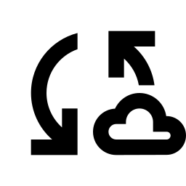
LAB 061
Terraform State Mismatch
Drift Detection
What happens when someone changes AWS behind Terraform's back — and how to fix it.
3
1
0
Drift Scenarios
Corruption Script
Manual Console Steps
Cloud Engineer Labs | Terraform / State | Advanced

Slide 2
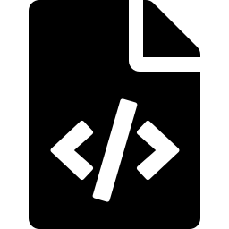
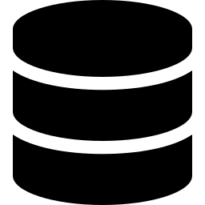

CORE CONCEPT
Terraform's Three Sources of Truth
main.tf
terraform.tfstate
AWS Reality
Configuration
State File
Live Infrastructure
What you want
to exist.
The blueprint.
You write this.
What Terraform
thinks exists.
Written after
every apply.
What actually
exists in AWS
right now.
When all three match — no drift.
When they diverge — terraform plan will tell you.

Slide 3

CORE CONCEPT
What Is State Drift?
Drift happens when AWS reality moves without Terraform knowing.
1
terraform apply runs — Terraform creates resources and writes the state file.
2
Someone logs into the AWS console and changes things manually — tags, config, deletes a resource.
3
Terraform's state file still reflects the original apply. It has no idea what just happened.
4
terraform plan compares config + state + real AWS. It finds differences. That gap is drift.
Important: terraform plan tells you what drifted — not whether it was intentional. That always requires human context.

Slide 4

DIAGNOSTIC TOOL
Reading terraform plan Output
The symbols
The arrow direction
+
Create — resource doesn't exist yet
"Environment" = "production" -> "staging"
-
Destroy — resource will be removed
LEFT of arrow = current AWS reality RIGHT of arrow = what your config says
~
Update in-place — attributes will change
In this example:
-/+
Destroy + recreate — can't update in-place
AWS has production
Config says
staging
Terraform wants to change it to
staging — which is wrong.
The config needs updating.

Slide 5
LAB SCENARIOS
Three Types of Drift in This Lab
Tag Drift
Fix: Update config to match
the new correct values
1
Tags changed in console
staging/ops → production/engineering
Config Drift + AWS Constraint
Fix: Change config to Enabled
(AWS won't let you disable it)
2
Versioning enabled in console
Config still says Disabled
Deleted Resource
Fix: Let Terraform recreate it
on next apply
3
Security group deleted in console
Terraform still tracks it in state

Slide 6

KEY COMMAND
terraform state rm — Clearing Stale Memory
terraform state rm aws_security_group.app
terraform
The Terraform CLI
state
Sub-command for directly manipulating the state file
rm
Removes a resource record from the state file
aws_security_group.app
Resource address — type.name, matching main.tf
state rm does NOT delete anything in AWS. It only removes Terraform's tracking record of the resource.

Slide 7
STATE FILES
The Files Terraform Creates — What They Are
terraform.tfstate
Never commit to git. Never share. Add to .gitignore.
Terraform's live record of every resource it manages. Written after every apply or destroy. Contains real AWS resource IDs, attributes, and metadata.
terraform.tfstate.backup
Also excluded from git. Safe to delete after a clean lab run.
Automatic backup of the previous state, written before every operation that modifies state. Your recovery point if something goes wrong mid-apply.
.terraform/
Safe to delete — always regenerated by terraform init.
Directory created by terraform init. Contains downloaded provider plugins (AWS provider, random provider, etc.) and internal Terraform metadata.
.terraform.lock.hcl
Commit to git in real projects. Delete for a clean lab reset.
Lock file recording exact provider versions selected during init. Ensures everyone on the team uses identical provider versions. Like package-lock.json.

Slide 8

LAB WORKFLOW
Resetting the Lab — What Each Command Does
terraform destroy
Removes all resources Terraform manages from AWS. Always run this at the end of a lab — AWS charges for running resources.
rm -f terraform.tfstate terraform.tfstate.backup
Deletes the state file and its backup. Without this, the next run thinks resources already exist and starts with drift.
rm -rf .terraform
Deletes downloaded provider plugins. Forces a clean terraform init next time, downloading the latest provider versions.
rm -f .terraform.lock.hcl
Deletes the version lock file. Allows the next init to resolve provider versions fresh.

Slide 9




REAL WORLD
State Management in Production
Remote State
State Locking
In production, state is stored in S3 + DynamoDB or Terraform Cloud — never a local file. Versioned, backed up, centrally accessible.
DynamoDB provides a lock that prevents two engineers running terraform apply simultaneously. Without it, concurrent runs corrupt the state.
Drift Detection
Never in Git
CI/CD pipelines run terraform plan on a schedule and alert when drift is detected. You don't wait to discover it manually.
State files contain sensitive resource metadata and cause merge conflicts. Always .gitignore them and use a remote backend.

Slide 10
REFERENCE
Key Commands — Lab 061
terraform init
Download providers, set up backend — always first
terraform plan
Compare config + state + AWS, show proposed changes
terraform apply
Execute the plan — make real changes in AWS
terraform destroy
Remove all managed resources from AWS
terraform state list
List all resources currently tracked in state
terraform state show <address>
Show full details of a specific resource in state
terraform state rm <address>
Remove a stale record from state without touching AWS
terraform apply -refresh-only
Update state to match current AWS reality — no infra changes

Slide 11

Lab 061 — What You Learned
Terraform tracks infrastructure through three things: config, state file, and AWS reality
State drift occurs when AWS is changed outside Terraform — console, CLI, or another tool
terraform plan is your diagnostic tool — it shows what drifted and what direction
The arrow direction matters: left is current reality, right is where config wants to go
Some drift is intentional (update the config) — some is a mistake (let Terraform revert or recreate)
terraform state rm clears stale state records — it never touches AWS resources
State files contain sensitive data and must never be committed to git
In production, state lives remotely with locking to prevent concurrent corruption

