Slide 1
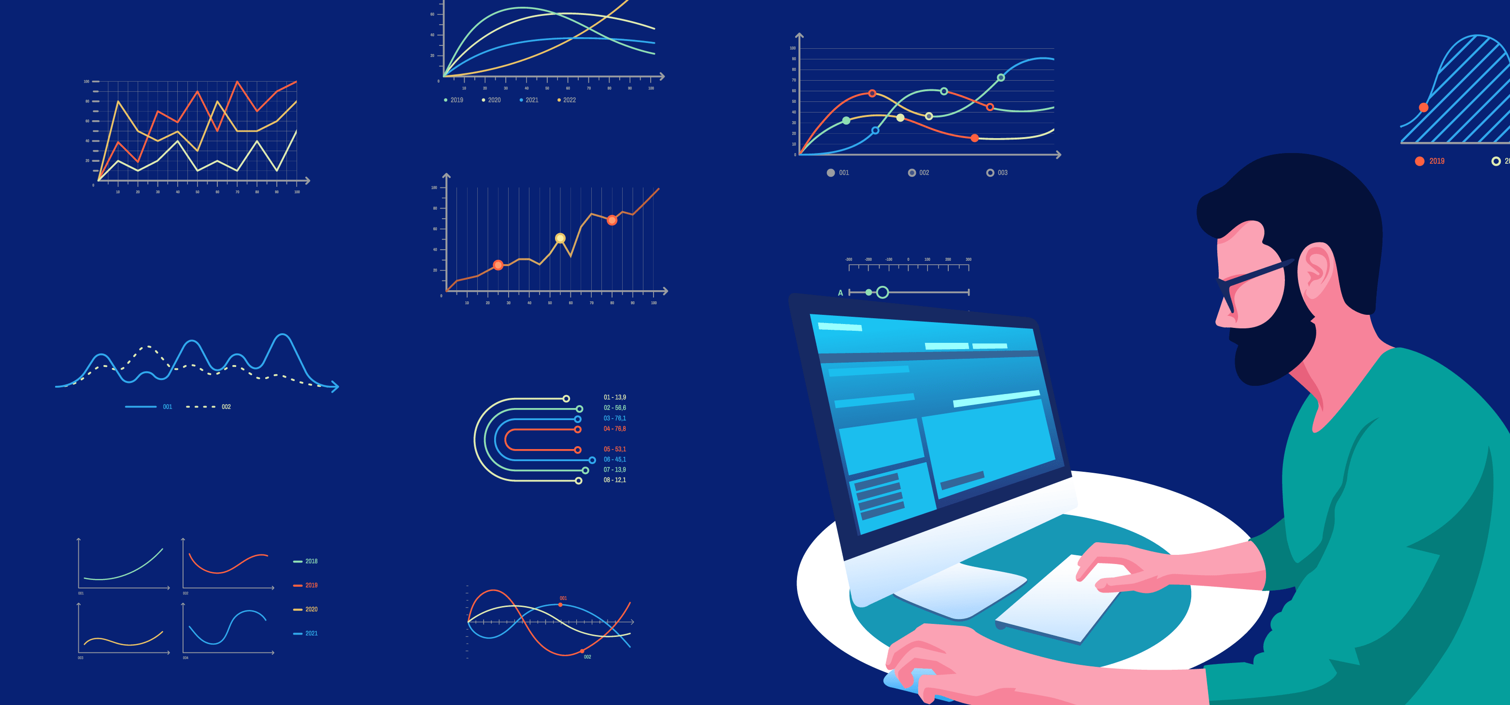
‘Steam’ platform’s data analysis
Sultan al-otaibi

Slide 2
Outline
In the upcoming slide, we will talk and briefly cover the following phases :
Overview
Project Pipeline
Dataset
EDA
Modelling
Project Outcomes

Slide 3

overview

Slide 4
What is ‘Steam’?
Steam is a software platform developed by Valve Corporation that offers digital rights management (DRM), multiplayer gaming, video streaming, cloud computing, social networking, and community features..
Steam provide a huge scale of data in gaming industry, for instance, number of games, users, platforms..etc as well as historical data of ‘legacy’ games and platform.
why ‘Steam’ ?
making data more fun to manipulate with ☺.

Slide 5

Project pipeline

Slide 6

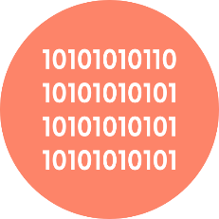
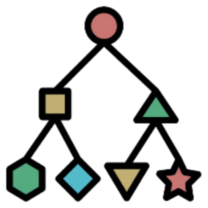


Raw Data
Cleaned Data
Modelling
Pre-Processing
Output
Import data
Split Data
Dealing with nulls

Slide 7
Dataset

Slide 8
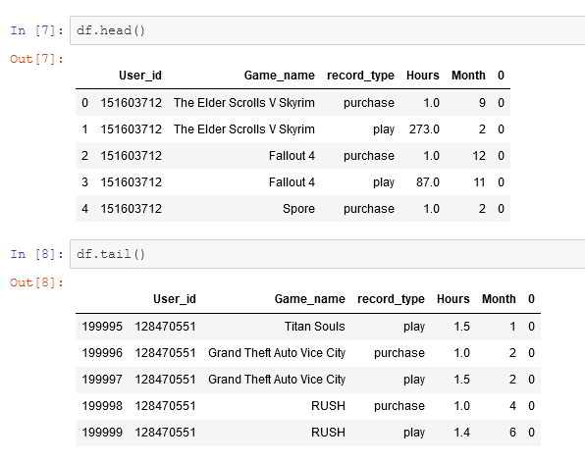
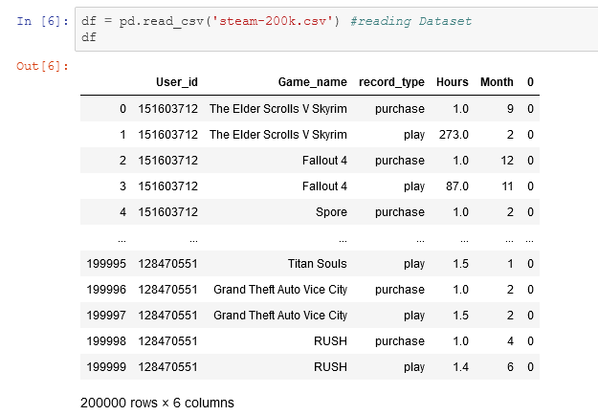
Kaggel
https://www.kaggle.com/tamber/steam-video-games/version/1.
Around 200k records
6 features

Slide 9
Pre-processing
Renaming columns.
Dealing with missing values
Removing nulls
Splitting dataframes

Slide 10
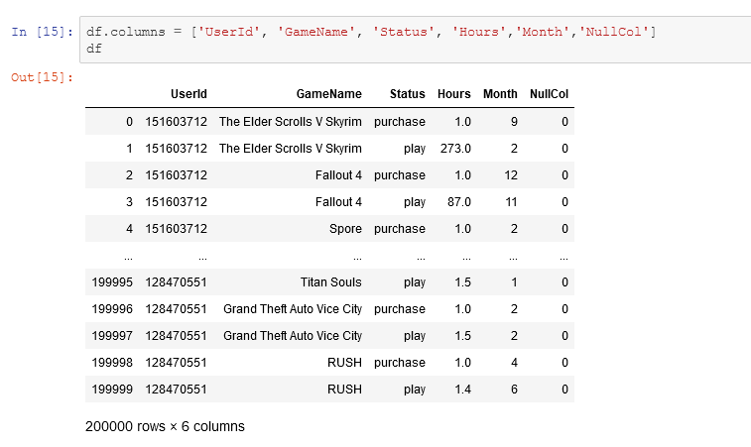
Pre-processing
Renaming columns.

Slide 11
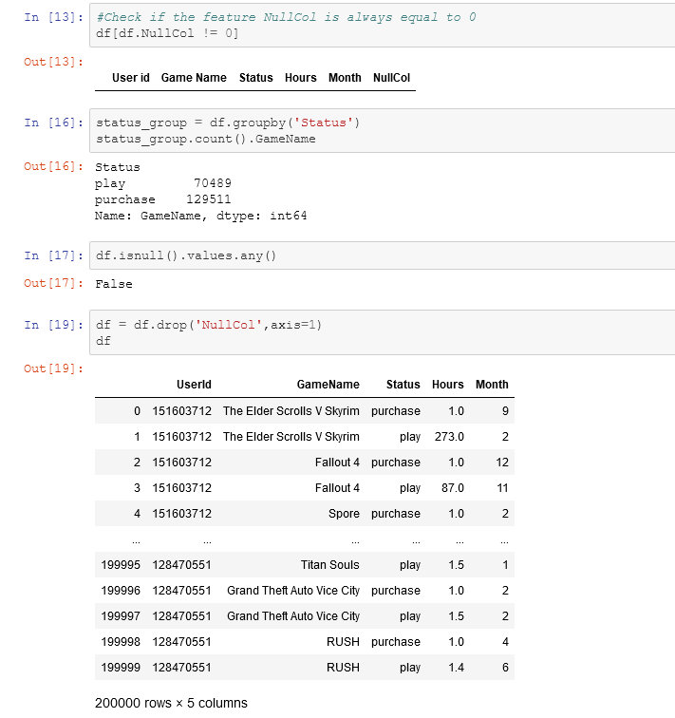
Pre-processing
Dealing with missing values
=200k
Looks clean to start with ☺

Slide 12
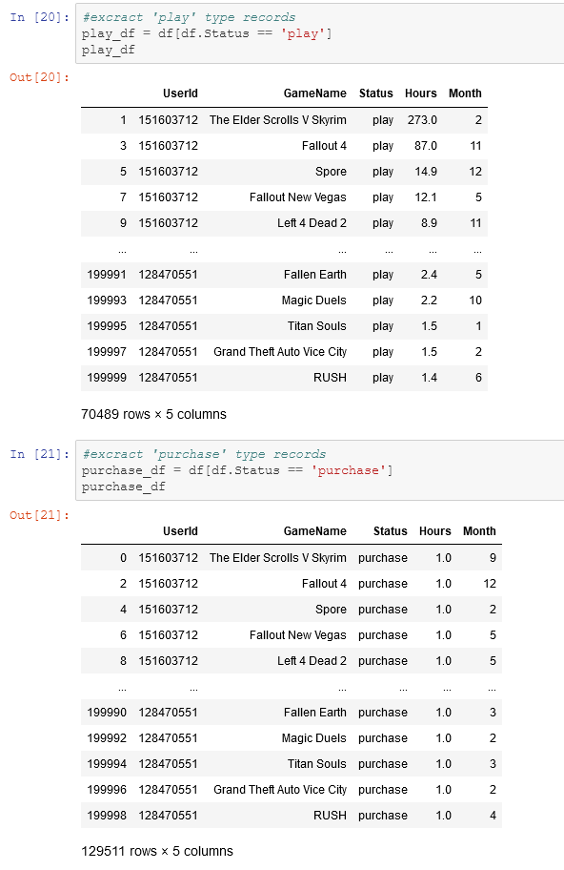
Pre-processing
Splitting dataframes :
‘Play” dataframe
‘Purchase’ dataframe

Slide 13
Exploratory data analysis

Slide 14
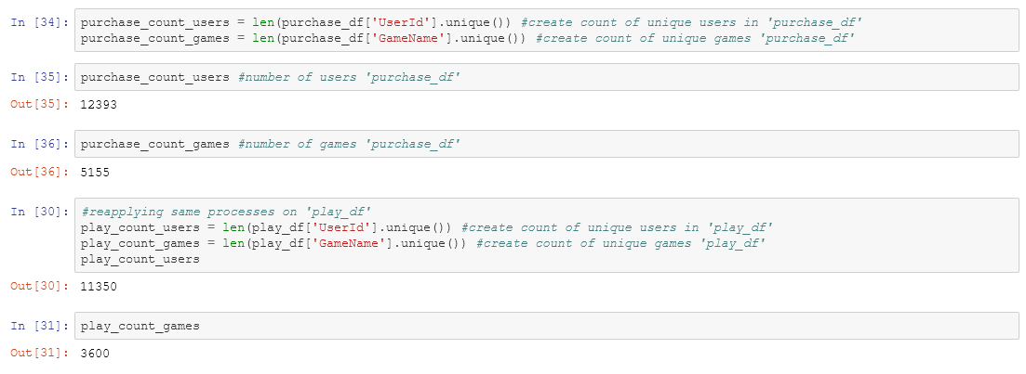
Dataset statistics
Numbers,
numbers,
and numbers ☺

Slide 15
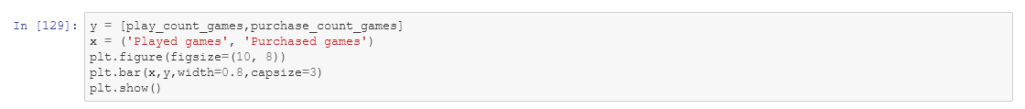
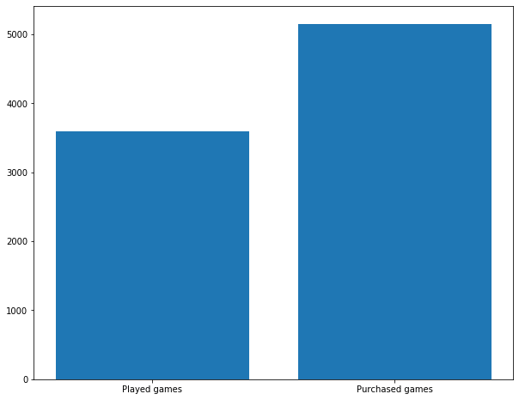
Bar Chart Comparison of two Data frames

Slide 16
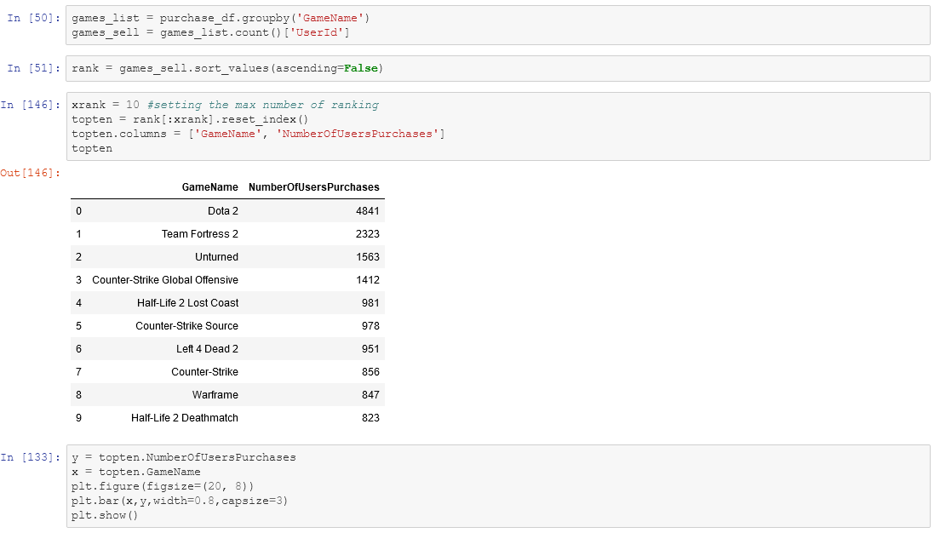
Extracting Most Purchased Game

Slide 17
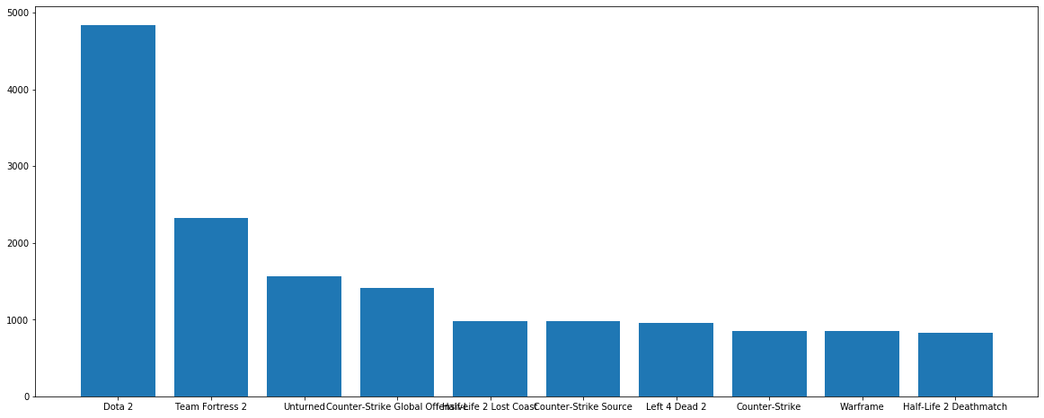
Extracting Most Purchased Game

Slide 18
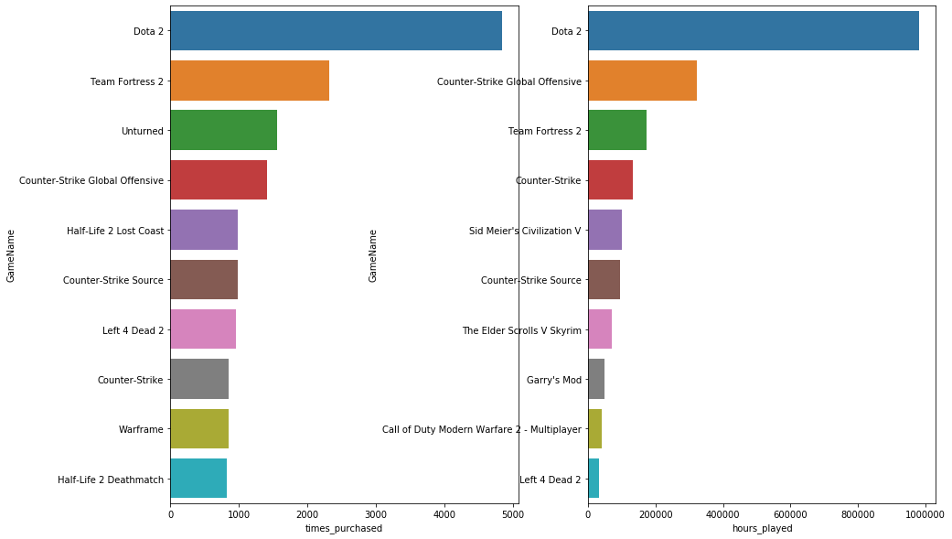
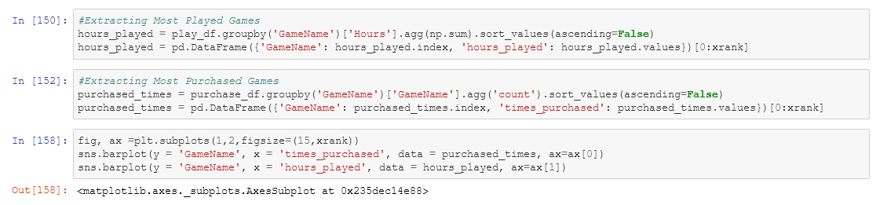
Most Games Purchased vs Hours Played Comparison

Slide 19
Modelling

Slide 20
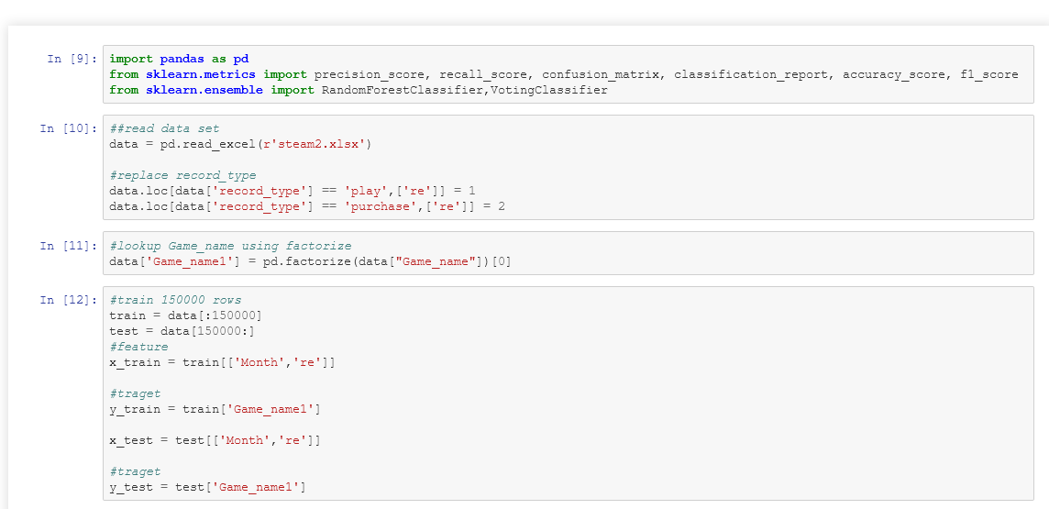
Random forest

Slide 21
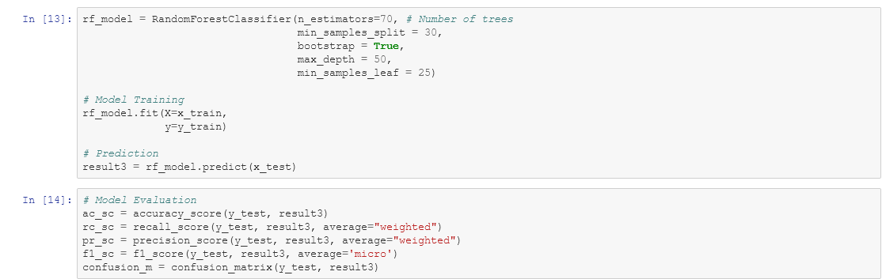
Random forest

Slide 22
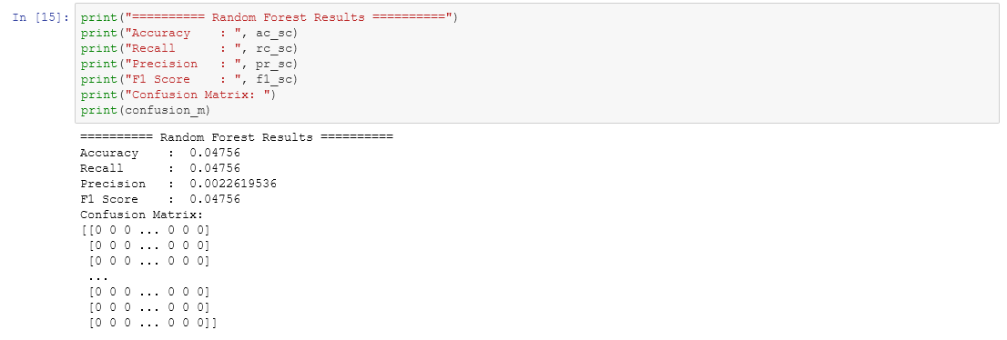
Random forest

Slide 23
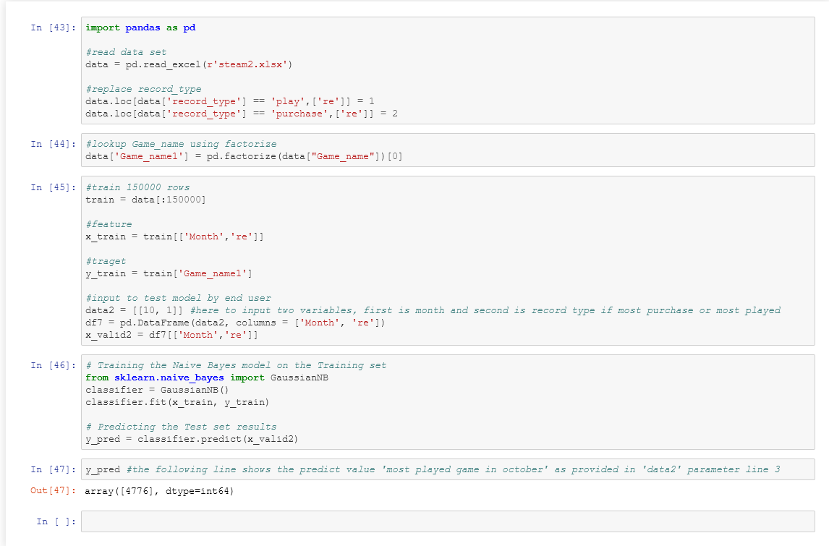
Naïve bayes

Slide 24
Naïve bayes

Slide 25
Project Outcomes
Need a larger scale of data, and re-train the model
Not every ‘fun’ data you can manipulate ☺

Slide 26
Thanks!
Sultan Al-Otaibi

