Slide 1
Reinforcement Learning
Enguerrand Monard
Clément Cosserat
Escape Room

Slide 2
Hi there !
This is the presentation of our work on the RL class project

Slide 3
In this project, we created several rooms to which the agent has to adapt every time

Slide 4
First, let us introduce the environment

Slide 5
| and _ are the walls of the room
P stands for Player
D stands for Door, the goal of the agent
K stands for Key, the item required to open the door, if present on the map
X is an Obstacle, it is a tile the agent cannot cross
In this environment :

Slide 6
| and _ are the walls of the room
P stands for Player
D stands for Door, the goal of the agent
K stands for Key, the item required to open the door, if present on the map
X is an Obstacle, it is a tile the agent cannot cross
In this environment :

Slide 7
| and _ are the walls of the room
P stands for Player
D stands for Door, the goal of the agent
K stands for Key, the item required to open the door, if present on the map
X is an Obstacle, it is a tile the agent cannot cross
In this environment :

Slide 8
| and _ are the walls of the room
P stands for Player
D stands for Door, the goal of the agent
K stands for Key, the item required to open the door, if present on the map
X is an Obstacle, it is a tile the agent cannot cross
In this environment :

Slide 9
| and _ are the walls of the room
P stands for Player
D stands for Door, the goal of the agent
K stands for Key, the item required to open the door, if present on the map
X is an Obstacle, it is a tile the agent cannot cross
In this environment :

Slide 10
------
| DP|
| |
| |
| |
------
For example :
This is the simplest room of the game

Slide 11
------
| DP|
| |
| |
| |
------
For example :
This is the simplest room of the game
The player only has to go left once to open the door

Slide 12
------
| ← |
| |
| |
| |
------
For example :
This is the simplest room of the game
The player only has to go left once to open the door
Whenever the player moves, its last orientation is shown

Slide 13
------
|D X|
| X |
| |
|X PK|
------
Another example :
This is the most complex room of the game

Slide 14
------
|D X|
| X |
| |
|X PK|
------
Another example :
This is the most complex room of the game
The player must get the key,

Slide 15
------
|D X|
| X |
| |
|X PK|
------
Another example :
This is the most complex room of the game
The player must get the key,
get around the obstacles,

Slide 16
------
|D X|
| X |
| |
|X PK|
------
Another example :
This is the most complex room of the game
The player must get the key,
get around the obstacles,
and open the door

Slide 17
The agents we implemented are Q-Learning and Expected Sarsa

Slide 18
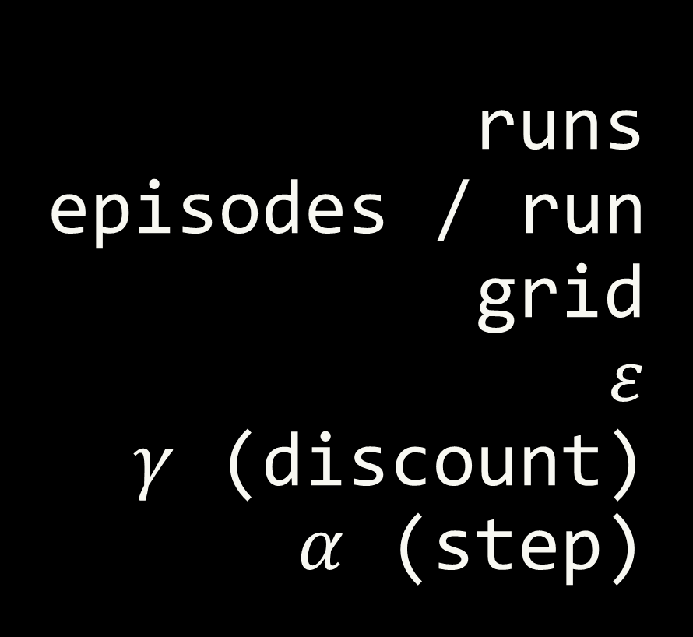
We chose the following parameters :
runs
episodes / run
grid
$$ε$$
$γ$ (discount)
$α$ (step)
->
->
->
->
->
->
5
30
4x4
0.1
1
0.8

Slide 19
Let’s see the agents in action !

Slide 20
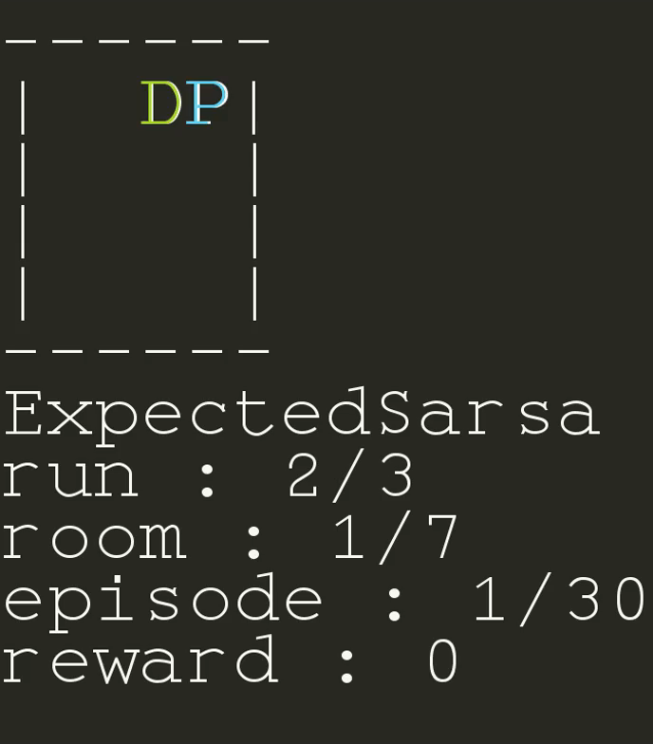

Slide 21
This is the simplest room, let’s see what Expected Sarsa does

Slide 22
It wanders a bit but finds its way after the two trials

Slide 23
Now the agent knows that the top right corner is a good place

Slide 24
But it knows nothing about the rest of the map

Slide 25
Let’s skip the 29 next episodes and let’s move on to the second room

Slide 26
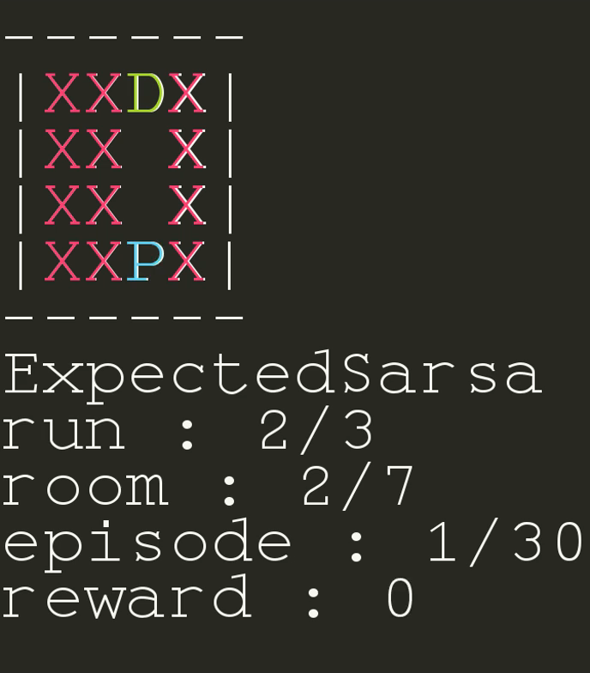
In this room, the agent only needs to go all the way up

Slide 27
It knows nothing about its surrounding and explores aimlessly

Slide 28
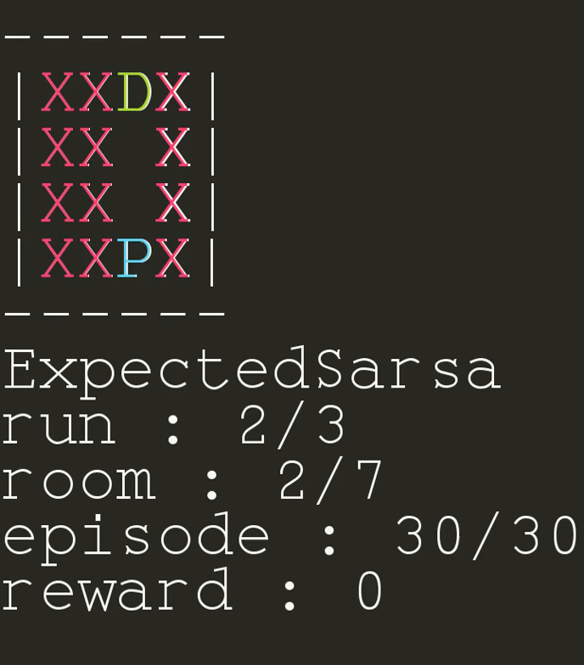
After some training though, it goes straight to the point

Slide 29
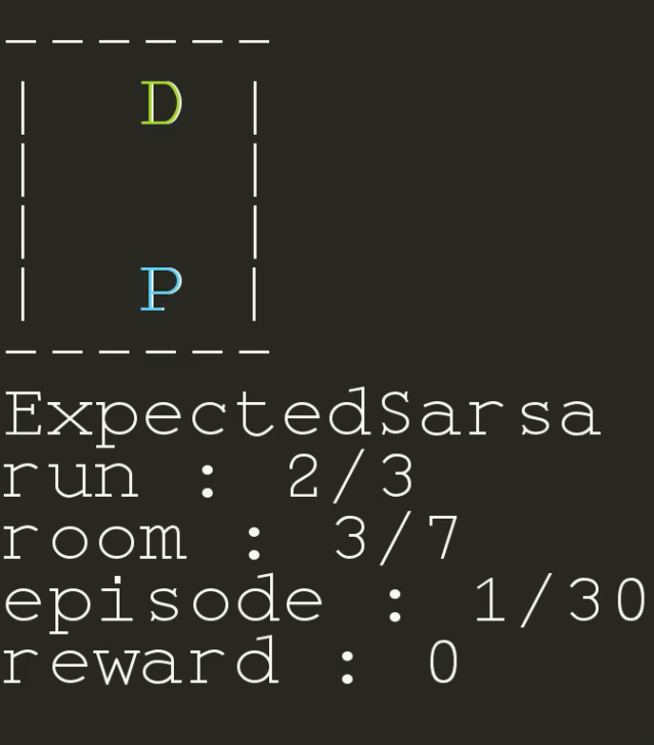
The next room is very similar

Slide 30
The agent retains its knowledge about previous states, so no need to learn anything !

Slide 31
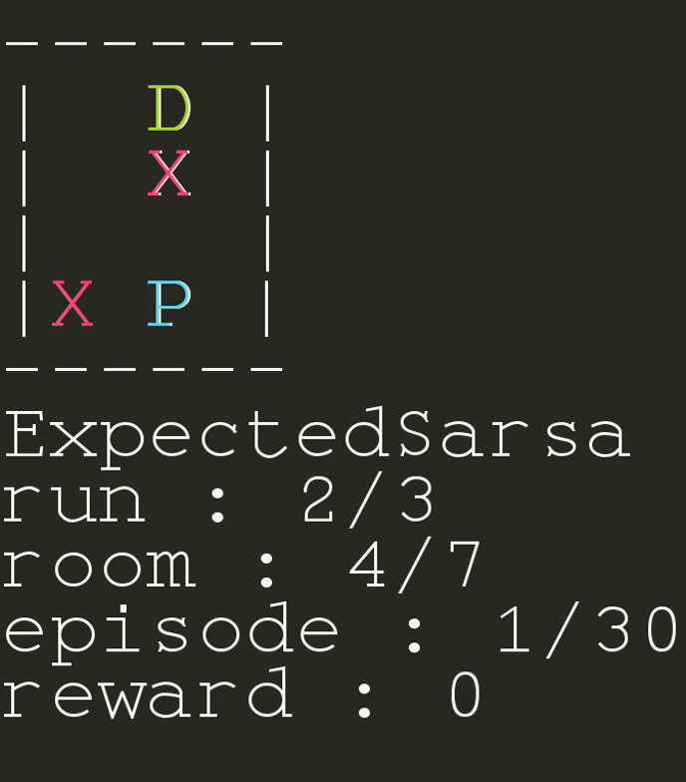
Now there is an obstacle, how will the agent react ?

Slide 32
The lower the reward, the more it understands that this is a bad action
It gets blocked for a while and needs to unlearn that UP is the right action here
Look at the reward going down
-----------
<-------

Slide 33
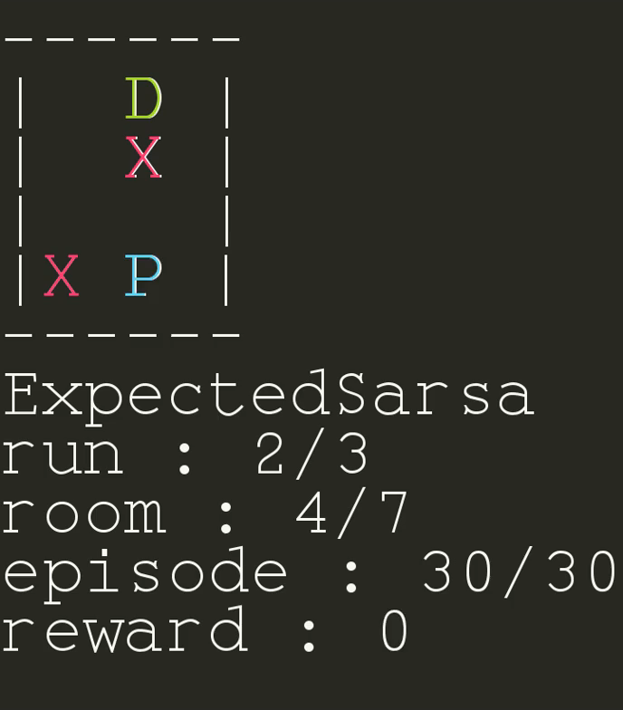
After some learning...

Slide 34
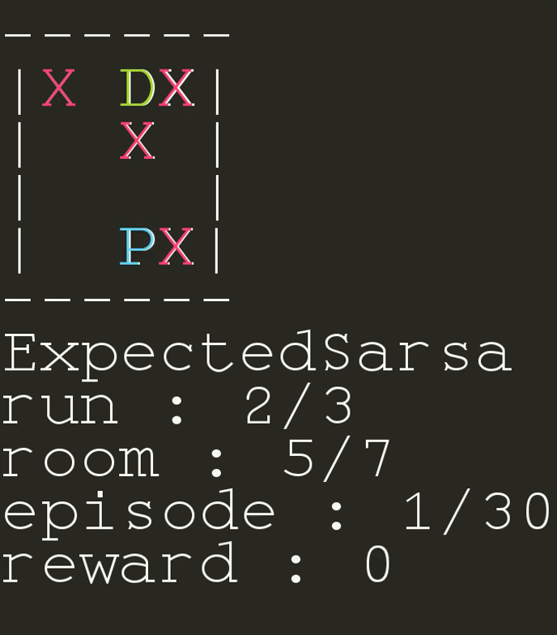
In this room this is a similar layout, except it is forced to go left

Slide 35
It gets stuck...
This takes a while, let’s fastforward

Slide 36
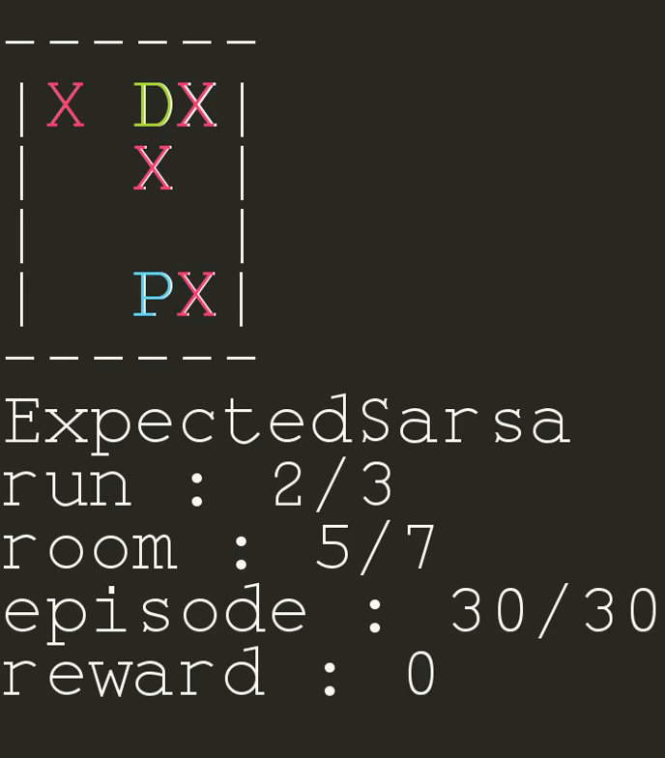
Once again, after some value learning...

Slide 37
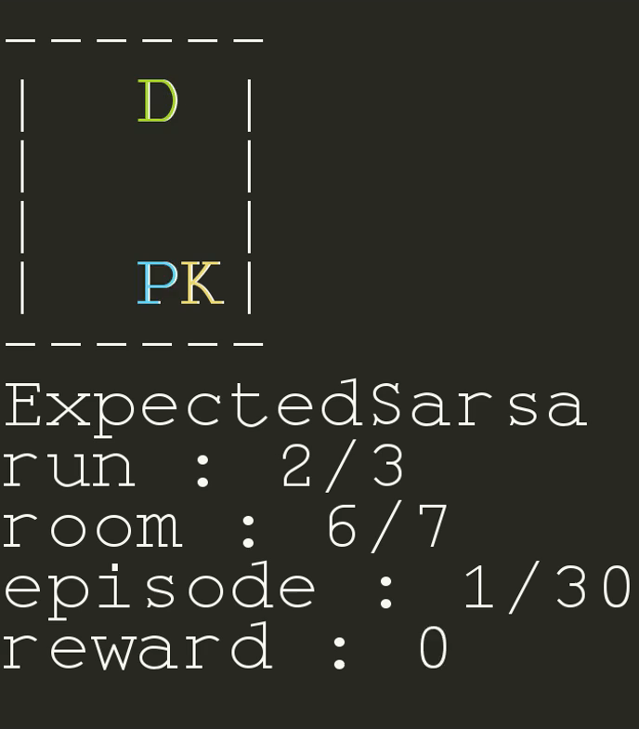
Let’s put a key in the room !

Slide 38
Going as usual won’t work out well
Hurray it finally got the key !
The door is locked...
The door is still locked
Now it must get to the door but it struggles because having the key is totally new

Slide 39
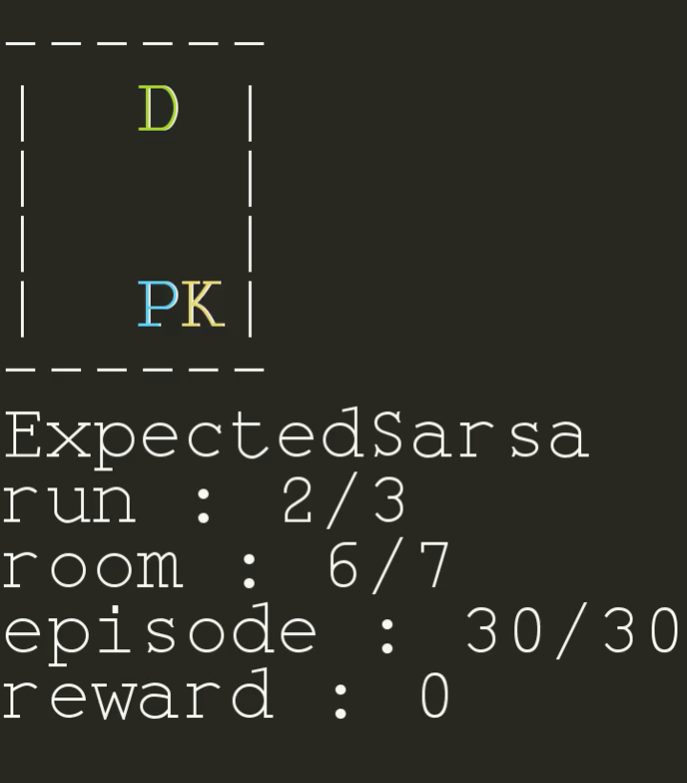
And again, after 29 episodes...

Slide 40
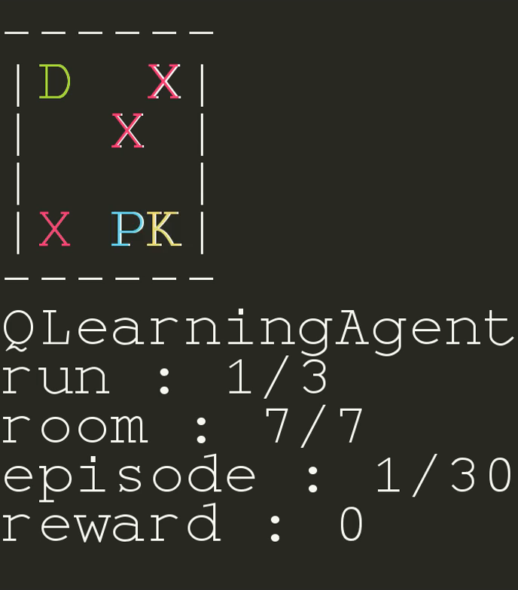
This is the last room

Slide 41
Again...
Guess what happens...
It gets stuck...

Slide 42
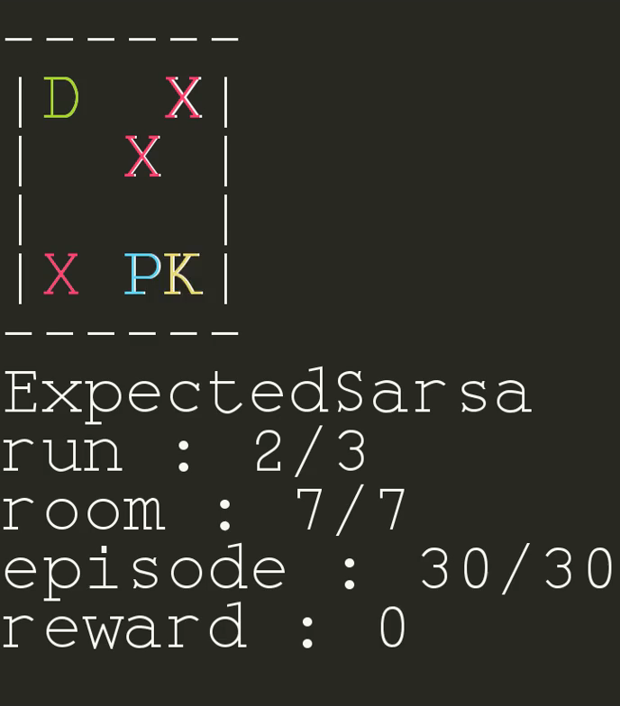
And, last but not least, the ultimate final last episode

Slide 43
Thanks for watching until the end !

