Slide 1
Good quality spectrum
Continuous fragments (b/y ions)
High intensity
Good S/N

Slide 2
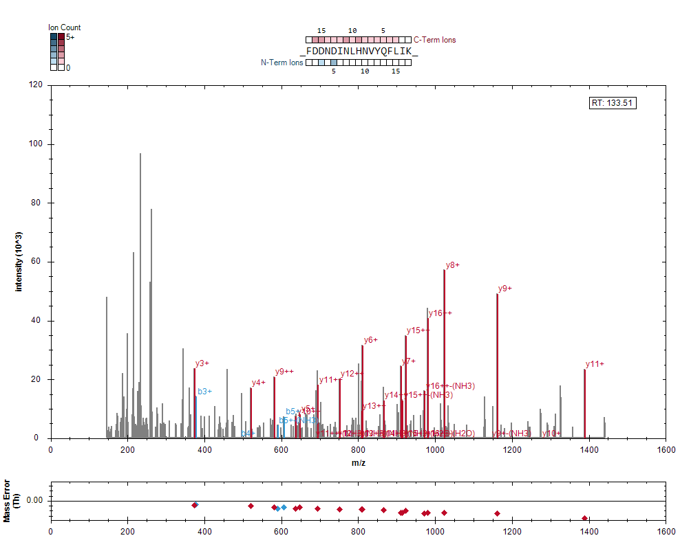

Slide 3
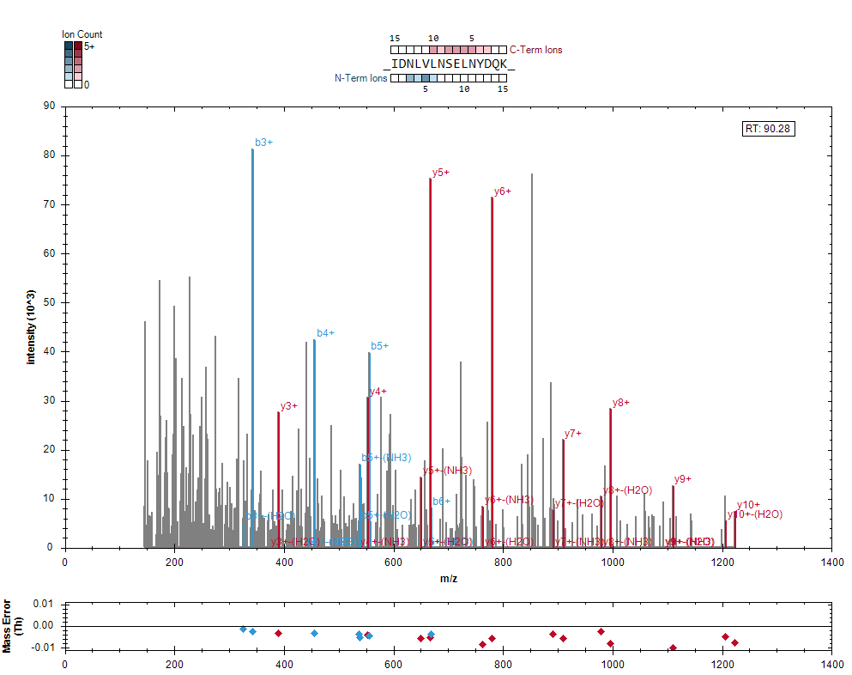

Slide 4
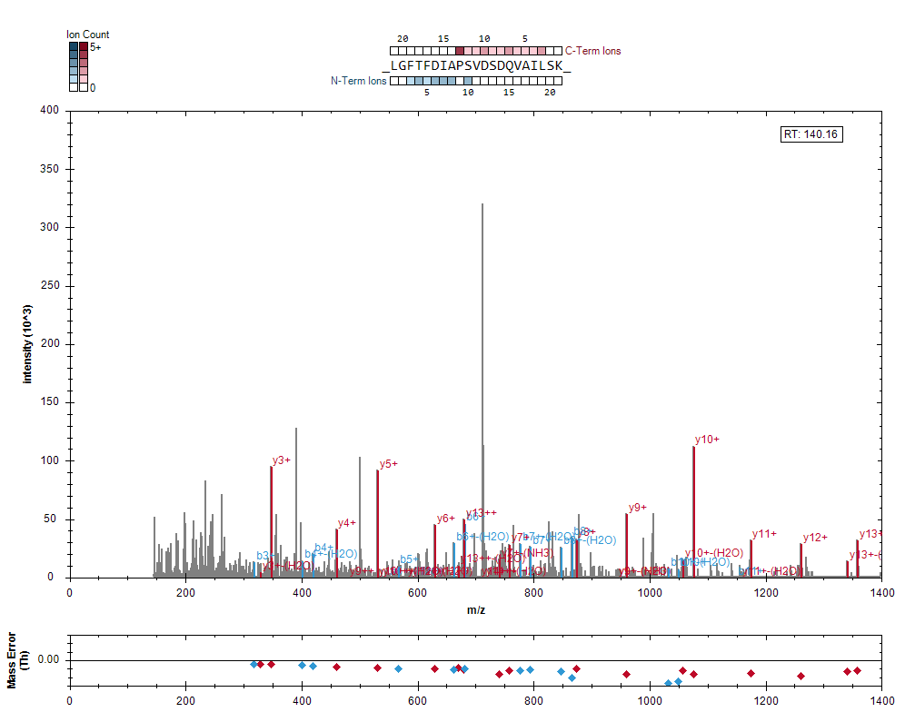

Slide 5
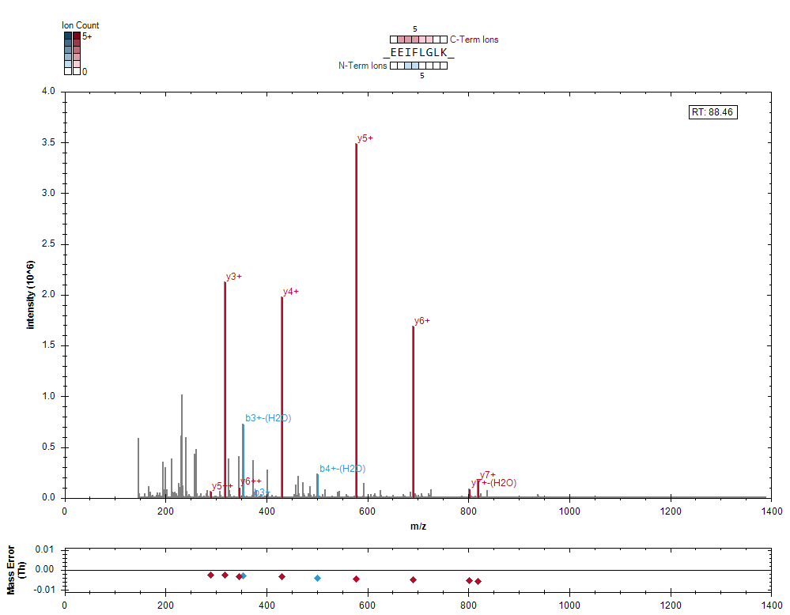

Slide 6
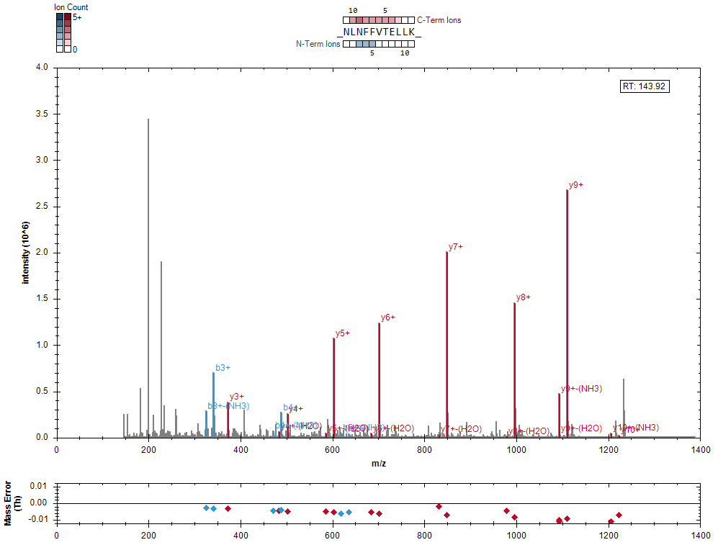

Slide 7
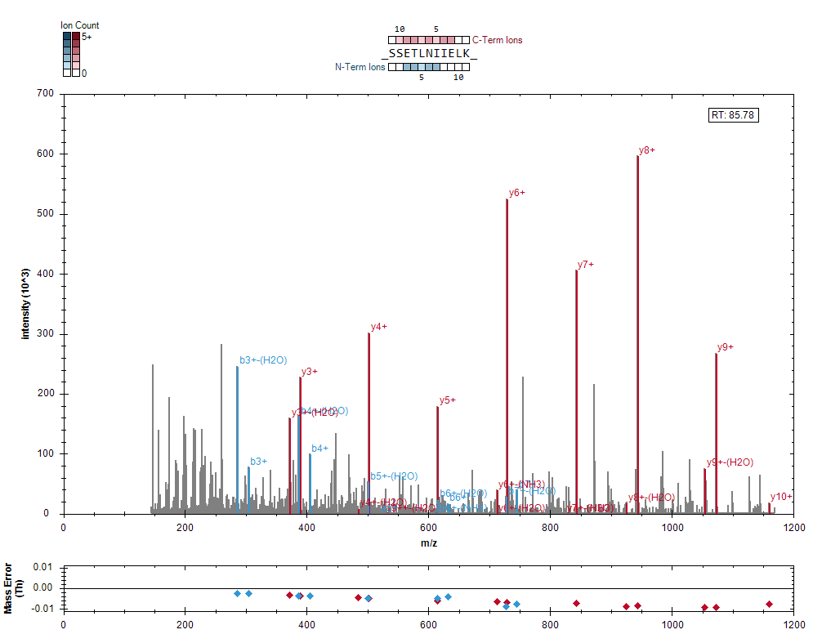

Slide 8
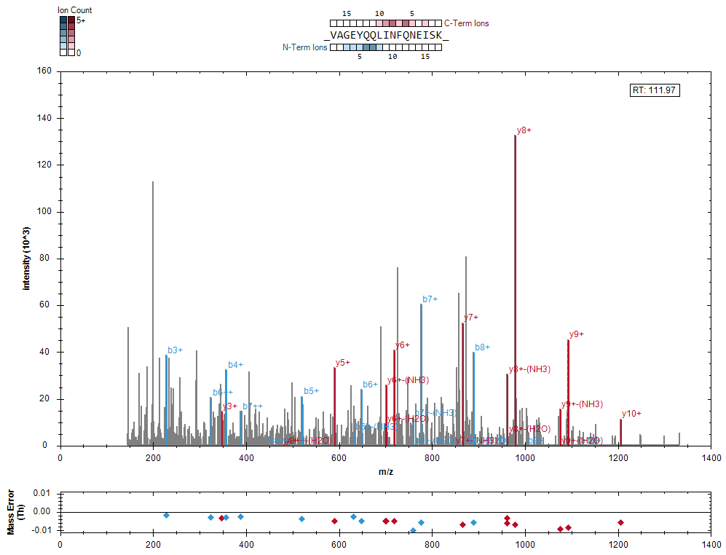

Slide 9
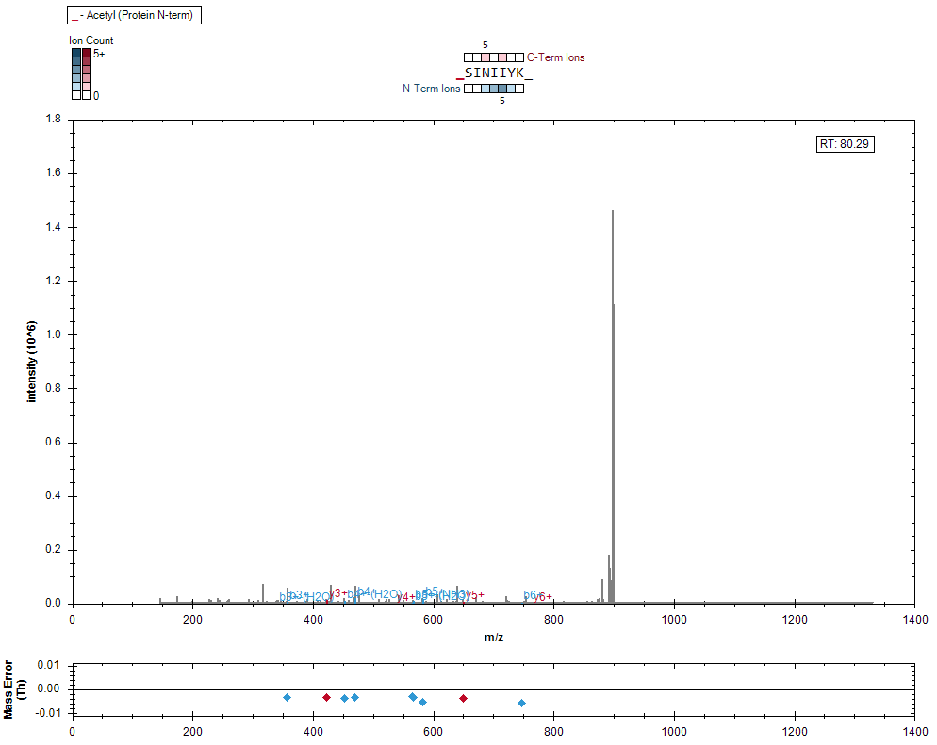
Low quality spectrum
_[Acetyl (Protein N-term)]SINIIYK_.1

