Slide 1
Web Development
Javascript
Eng. Wael Salama Cell: 0122 172 4503 eng.wsalama@gmail.com http://wsalama.000webhostapp.com

Slide 2
Git
-3-
https://github.com/engwsalama/webdev_js.git

Slide 3

JS History
-3-
Javascript
LiveScript
Mocha JScript
ECMAScript
Brendan ike who created javascript in 1995 in 10 days
Its development code name was Mocha under the the supervision of Netscape and Sun Microsystems
Netscape and Microsystems are partner and development java language
Brendan Ike in 1995

Slide 4
JS History
-3-
The language was called Live scripts
Then it was renamed to java script as a joke to Sun Microsystems.
The people were confused in the two languages java and js
Microsoft saw this and reversed engineered javascript, they called js script and integrated it into the E-3 browser in 1996
For standard purposes and make one language runs in all types of browser, all those versions went to the European Computer Manufacturers Association hence the name ECMAScript
Since ES1 or ECMAScript version one there has been many revisions, ES5 in 2009 and now we have version 9 ECMAScript 2018 which adds additional features to this language

Slide 5
How Javascript works
-3-
The browser has three main programs that we are interested in
DOMParser
It interface provides the ability to parse XML or HTML source code from a string into a DOM Document, this takes the HTML code and it converts it into structured page that we visually
CSSParsa
It will take our CSS code and then it will make sure that our document layout is rendered correctly… CSSOM, — the CSS Object Model.
The both HTML and CSS are combined and we have something called the layout engine or rendering engine inside of a browser which actually

Slide 6
How Javascript works
-3-
The browser has three main programs that we are interested in
Javascript engine
In a browser, the JavaScript engine runs in concert with the rendering engine via the Document Object Model. This engine program can go by different names in different browsers:
SpiderMonkey is Mozilla's JavaScript engine written in C and C++.
Chrome V8
Chakra is the JavaScript engine of the Internet Explorer browser
Opera is working on a JavaScript engine, called Carakan

Slide 7
How Javascript works
-3-
The sole job of Javascript engine is to take the javascript syntax that is in human readable and convert it to machine language
So , this is why we call it it client side because the files are being downloaded onto the client's computer and processed on the client's computer
If we take a look at the javascript engine specifically this is actually either going to be an interpreter or going to have compilation involved in there such as a JIT (Just In Time)compiler such as google Chrome V8

Slide 8

Objects in Javascript
-3-
Nouns, Adjectives
Properties
Verbs
Verbs performing an action which is a function
{
width:25,
height:27,
color: “red”;
weight:5,
eat: function(){"Eat the apple.";},
throw: function() {"Throw the apple away.";},
},
Apple has Nouns such as
{
width:25,
height:27,
color: “red”;
weight:5,
}
Noun is Color , but string red is an adjective

Slide 9


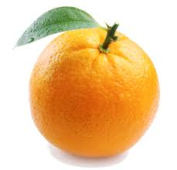
Objects in Javascript
-3-
When a function is within an object it's still a function , but we give it another name called a method
Method it simply means a function that is contained within an object
{
width:25,
height:27,
color: “red”;
weight:5,
}
{
width:25,
height:27,
color: “red”;
weight:5,
}
{
width:25,
height:27,
color: “red”;
weight:5,
}

Slide 10
Objects in Javascript
-3-
each image has its properties (Nouns and Adjectives)
If i want to gather those images in one file , how do i know which property or noun describe wich image... you can not.
That's why objects are so important because they allow you to group information together that relate to certain aspects of your program
{
width:25,
height:27,
color: “red”;
weight:5,
}
{
width:25,
height:27,
color: “red”;
weight:5,
}
{
width:25,
height:27,
color: “red”;
weight:5,
}

Slide 11
Objects in Javascript
-3-
Object from your life
Your computer; ,it is an objective has properties such as width , height , color, weight , keyboard , and then look at what you can do with the computer: you can type , print , etc
At your life select any object and open a curly basis brackets {} and put the properties , such as fridge : {
make:"lg",
width:2000,
height:4000,
open:function () {...}
}

Slide 12
Objects in Javascript
-3-
Next level is embedded objects
objects can contain objects just like everyday life { {} }, for example :
Your computer , it is not just made up of one object, you may have a camera , screen , keyboard; of which have their own nouns and verbs associated with each component in your computer and you can break it down and go as complex as you would like
What we need to do is encapsulate all of those objects and components together into one object so , in encapsulation we have a main parent object and subobjects
Encapsulation is grouping data together whether it be nouns and verbs or both

Slide 13
Objects in Javascript
-3-
finally ,we have nouns and adjectives which describe the object and verbs which are actions performed on that object and finally objects can contain other objects
Nouns, Adjectives
Properties
Verbs
Hierarchy
Objects within objects

Slide 14
Primitive Data Types VS. Reference Types
Primitive Data Types:
Stored directly in the location the variable access stored on the stack
Reference Data Types:
Accessed by reference
Objects that are stored on the heap
A pointer to a location in memory

Slide 15
Primitive Data Types
String
Number
Boolean
Null
Undefined
Symbols(ES6)

Slide 16
Reference Data Types / Objects
Arrays
Object Literals
Functions
Dates

Slide 17
Dynamically Typed Languages
Types are associated with values not variables
The same variable can hold multiple types
We do not need to specify types
Most other languages are statically types (java, C#, C++)
There are supersets of JS and add ons to allow static typing (TypeScript, Flow)

Slide 18
Variables
-3-

Slide 19
Data Types
-3-

Slide 20
Types Conversion
-3-

Slide 21
Math Object
-3-

Slide 22
String Methods
-3-

Slide 23
Template Strings
-3-

Slide 24
Array & Array Methods
-3-

Slide 25
Dates & Time Methods
-3-

Slide 26
IF Statement
-3-

Slide 27
Switches
-3-

Slide 28
Functions
-3-

Slide 29
Loops
-3-

Slide 30
Window Object
-3-

Slide 31
Block Scope
-3-

Slide 32
DOM
-3-

Slide 33
What is the DOM?
Document
DOCUMENT OBJECT MODEL
Tree of nodes/elements created by the browser
JavaScript can be used to read/write/manipulate to the DOM
Object Oriented Representation
Root Element
<html>
Element:
<head>
Element:
<body>
Element:
<title>
Attribute:
“href”
Element:
<a>
Element:
<h1>
Text:
“My Link”
Text:
“My Header”
Text:
“My Title”

Slide 34
Document Object
-3-

Slide 35
DOM - Selector Single Element
-3-

Slide 36
DOM - Multiple Single Elements
-3-

Slide 37
DOM - Traversing
-3-

Slide 38
DOM - Creating Elements
-3-

Slide 39
DOM - Removing & Replacing Elements
-3-

Slide 40
DOM - Event Listeners
-3-

Slide 41
DOM - Mouse & Keyboard Events
-3-

Slide 42
DOM - Bubbling & Delegation
-3-

Slide 43
DOM - Local Session Storage
-3-

Slide 44
Task List Project - Part 1
-3-

Slide 45
Constructor & This Keyword
-3-

Slide 46
Built-in Constructors
-3-

Slide 47
Prototypes
-3-

Slide 48
Prototypes Inheritance
-3-

Slide 49
Object.create
-3-

Slide 50
ES6- Classes
-3-

Slide 51
ES6- Sub-Classes
-3-

Slide 52
Book List Project
-3-

Slide 53
AJAX
-3-

Slide 54
Synchronous Code
-3-
posts =loadPostsSync();
// ... Wait til posts are fetched
// ... do something with posts
doTheNextThing(); // Has to wait until posts load
There are many factors to be considered such as band-width , network speed , etc.
In this way of writing this code we're going to have to wait until the posts are fetched and then do something with the post and then only after that's done can we move on to the doNextThing() function
So this is what's called a blocking code.
It's going to block until the posts are fetched and loaded which obviously slows things down

Slide 55
Asynchronous Code
-3-
loadPostsAsync(function(){
// ... Wait til posts are fetched
// ... do something with posts
});
doTheNextThing(); // Doesn't has to wait until posts load
In this case instead of just pulling the posts out of a SYNC function we are passing in a callback function which is just one method for handling a sync code.
This call back will run and fetch the posts and allow us to do something with the post
The doTheNextThing() does not have to wait until the posts are fetched and loaded
So , the program is not blocked and it will simply just keep going even if it takes a while for the posts to be fetched
It is not going to stop the doTheNextThing() function from running.
In turn this is much faster and that's the beauty of async javascript and async programing (AJAX)

Slide 56
Browser/Server APIs
-3-
Most Async code you work with will be part of an API or Library, such as:
Ajax and XMLHttpRequest (XHR) object
There is a few ways to handle Async code such as :
Callbacks
Promises

Slide 57
What is Ajax
Asynchronous JavaScript & XML
Set of web technologies
Ajax is Not programming language or a framework or a library , it's a set of web technologies to send and receive data from the client and server
Send & Receive data asynchronously
Does not interfere with the current page
It does this behind the scenes without having the explicity reload the webpage.
JSON has replaced XML for the most part
Most of the API returned JSON data not XML or in some cases they'll return both
Ajax can also work with just plain text.

Slide 58
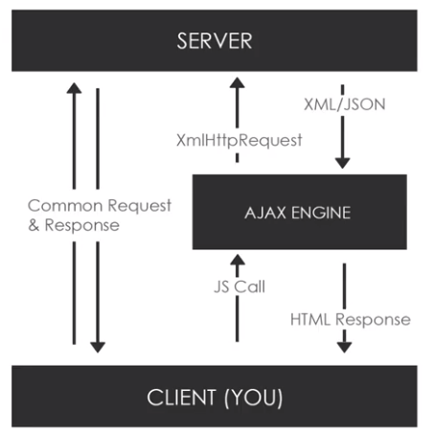
What is Ajax
-3-
Make async requests in the background
No page reload/refresh
Fetch data
very interactive

Slide 59
XmlHttpRequest(XHR) Object
-3-
API in the form of an object
Provided by the browser JS environment
Methods transfer data between client/Server
Can be used with other protocols than HTTP
Can work with data other than XML(JSON,plain text)

Slide 60
Libraries & Other Methods
-3-
Fetch API ..It’s part of core Javascript and browser
Axios
Superagent
JQuery
Hode HTTP

Slide 61
XHR Object
-3-
Xhr-index.html
xhr-app.js

Slide 62
Getting Data From External API
-3-
http://www.icndb.com/api/
icn-index.html
icn-app.js

Slide 63
Fetch API Data
-3-
json-index.html
json-app.js

Slide 64
REST API
-3-

Slide 65
What Is An API?
-3-
Application Programming Interface
Contract Provided by one piece of software to another
Structured request and response

Slide 66
REST APIs
-3-
REpresentational State Transfer
REST API , how client communicates with the server to extract the required information
Architecture style for designing network applications
Relies on a client-server protocol,almost always HTTP
Treats server objects as resources that can be created or destroyed
Create an object of the data requested by the client and then send the values of the object in response to the user
Can be used by virtually any programming languages
All APIs have their own rules and structure

Slide 67
REpresentational State Transfer
-3-
State is came from , when a client sends a request for data , and API search in the server once finds the data , API returns the values of client’s request in an object state to deal with
N.B , it does not need to create an object every time you request , but the state is changed and represented each time , so REST is defined
It is an architectural style as well as an approach for communications purpose that is often used in various web services development
This architectural style of REST helps in leveraging the lesser use of bandwidth

Slide 68
Principles of REST API
-3-
REST defines 6 architectural constraints which make any web service – a true RESTful API.
Stateless
Make all client-server interactions stateless. The server will not store anything about the latest HTTP request the client made. It will treat every request as new. No session, no history

Slide 69
Principles of REST API
-3-
Client Server
This essentially means that client application and server application MUST be able to evolve separately without any dependency on each other. A client should know only resource URIs, and that’s all
Layered System
REST allows you to use a layered system architecture where you deploy the APIs on server A, and store data on server B and authenticate requests in Server C, for example.

Slide 70
Principles of REST API
-3-
Uniform Interface
To obtain the uniformity to the application REST has defined 4 interface constraints which are
Resource identification
The source manipulation using representations
Self descriptive messages
Any single resource should not be too large and contain each and everything in its representation. Whenever relevant, a resource should contain linksc (HATEOAS) pointing to relative URIs to fetch related information.Hypermedia as the engine of the application state (HATEOAS).

Slide 71
Principles of REST API
-3-
Cacheable
Caching brings performance improvement for the client-side and better scope for scalability for a server because the load has reduced.
In REST, caching shall be applied to resources when applicable, and then these resources MUST declare themselves cacheable. Caching can be implemented on the server or client-side.

Slide 72
Principles of REST API
-3-
Code on Demand
Well, this constraint is optional.
Most of the time, you will be sending the static representations of resources in the form of XML or JSON.
But when you need to, you are free to return executable code to support a part of your application, e.g., clients may call your API to get a UI widget rendering code. It is permitted.

Slide 73
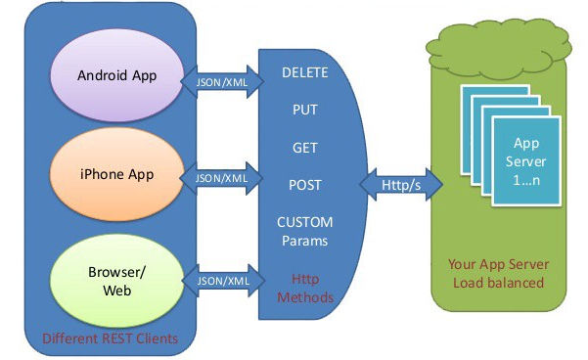
Methods of REST API
-3-

Slide 74
HTTP Requests
-3-
GET: Retrieve data from a specified resource
POST: Submit data to be processed to a specified resource
PUT : Update a specified resource
DELETE : Delete a specified resource
HEAD:Same as get but does not return a body
OPTIONS:Returns the supported HTTP methods
PATCH:Update partial resource

Slide 75
API Endpoints
-3-
GET: https://someurl.com/api/users // Get all users
GET: https://someurl.com/api/users/1 // Get a single user
POST: https://someurl.com/api/users // Add a user
PUT: https://someurl.com/api/users/1 // Update a user
DELETE: https://someurl.com/api/users/1 // Delete a user
POST & PUT & DELETE you send a data

Slide 76
Callback Function
-3-
A callback function is a function passed into another function as an argument, which is then invoked inside the outer function to complete some kind of routine or action.
callback.html
callback0.js & callback1.js

