Slide 1
Web Development
HTML5 & CSS
Eng. Wael Salama Cell: 0122 172 4503 eng.wsalama@gmail.com http://wsalama.000webhostapp.com

Slide 2
Git
-1-
https://github.com/engwsalama/webdev_html_css.git

Slide 3
HTML5
-1-

Slide 4
HTML Formatting - Headings - Paragraph
-1-

Slide 5
Image
-1-

Slide 6
List
-1-

Slide 7
Table
-1-

Slide 8
Form
-1-

Slide 9
Document Object Model
-1-

Slide 10
CSS Cascaded Style Sheet
-1-

Slide 11
Working with CSS
-1-
Styles...

Slide 12
Font
-1-

Slide 13
Border
-1-

Slide 14
Styling table
-1-

Slide 15
Div- Span
-1-

Slide 16
Links
-1-

Slide 17
HTML4 Organization
-1-
<div class=”header”>
<div class=”nav”>
<div class=”section”>
<div class=”footer”>

Slide 18
HTML5 Organization
-1-
<header>
<nav>
<section>
<footer>

Slide 19
Form & Datalist
-1-

Slide 20
Multiple & descendant
-1-

Slide 21
Child
-1-

Slide 22
Attribute
-1-

Slide 23
hover
-1-
Pseudo-classes
A CSS pseudo-class is a keyword added to a selector that specifies a special state of the selected element(s).
State of element based on user activity {page interacts with user activity}

Slide 24
Before & After
-1-
Pseudo-Element
A CSS pseudo-element is a keyword added to a selector that lets you style a specific part of the selected element(s).

Slide 25
Adjacent
-1-
Pseudo-Element
A CSS pseudo-element is a keyword added to a selector that lets you style a specific part of the selected element(s).

Slide 26
Selection
-1-
Pseudo-Classes & Pseudo-Element

Slide 27
nth-child
-1-

Slide 28
Combined Selectors
-1-

Slide 29
Cascade
-1-

Slide 30
Cascade
-1-
Three things decide which styles get applied
Importance: normal (any style) or !important ( color:red !important;)
Specificity:
Source order

Slide 31
Cascade
-1-
Specificity: means by which browsers decide which CSS property values are the most relevant to an element and, therefore, will be applied.
Look at the element that is being styled. Add the total number of each category in the selector expression. Treat this like a software version number.:
ID selectors (e.g., #example).
Classes, pseudo-classes, attribute selectors (e.g., .example), attributes selectors (e.g., [type="radio"]) and pseudo-classes (e.g., :hover).
Type selectors (elements and ::pseudo-elements)(e.g., h1) and pseudo-elements (e.g., ::before).

Slide 32
Cascade
-1-
Specificity Examples
0.4.2 = .red .big p.one.two span { }
1.1.1 = #simon p.first { }
The second version is more important and gets applied second (if these were pointing at the same element)

Slide 33
Cascade
-1-
Source Order
CSS declarations come from different origins:
The user-agent (browser) style sheet; each browser has own styles
the author style sheet; each developer has own styles as different types below
and the user style sheet.
Within the author style sheet origin we also have:
External stylesheet;
Embedded <style> element;
Inline style attribute.

Slide 34
Float
-1-

Slide 35
Text Shadow
-1-

Slide 36
Box Shadow
-1-

Slide 37
Google Fonts
-1-

Slide 38
@font-face
-1-

Slide 39
CSS Functions
-1-
CSS functions are used as a value for various CSS properties.
rgb() function to provide a color value
attr() function to retrieve the value of an HTML attribute.

Slide 40
Relative Units
-1-
Em
Rem
Viewport

Slide 41
Line-Height
-1-
Unitless

Slide 42
Custom Properties
CSS Variables
-1-
Define one variable
Var() function
Variable scope

Slide 43
CSS Layout
-1-

Slide 44
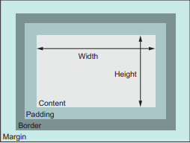
CSS Layout
-1-
Why two columns did not sitting side by side?...
They they line wrapped. that's because of the default behavior of the box model.
When you set the width or height of an element, you're specifying the width or height of its content; any padding, border, and margins are then added to that width
Example:
An element with a 300px width, a 10px padding, and a 1px border has a rendered with of 322px (width+padding+border)for both sides

Slide 45
CSS Layout
-1-
To solve this problem
Make the second column width 26%They they line wrapped. that's because of the default behavior of the box model.
Use calc(30% - 3em) in second column width
Adjusting the box model

Slide 46
Combined absolute-relative

Slide 47
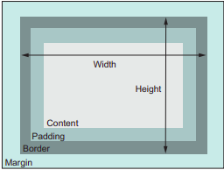
CSS Layout
-1-
Box Model.
As the default, box model is not what you will typically want to use , because it will be equal to content + padding+border.
Instead, you will want your specified widths to include the padding and borders.
CSS allows you to adjust the box model behavior with its box-sizing property
By default , box-sizing is set to the value of content-box, this means that any height or width you specify sets the size of the content box.
You can assign a value of border-box to the box sizing instead.
That way , the height and width properties set the combined size of the content , padding, and border,

Slide 48
CSS Position
-1-
Static
Relative
Absolute
Fixed

Slide 49
Flexbox

Slide 50
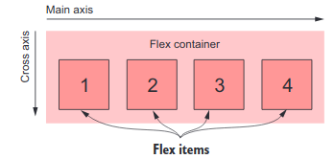
CSS Flexbox
Flexbox begins with the familiar display property
Applying display:flex to an element turns it into a flex container, and its direct children turn into flex items.
By default,flex items align side by side, left to right, all in one row.
The flex container properties are:
Flex-direction
Flex-wrap
Flex-flow
Justify-content
Align-items
Align-content

Slide 51
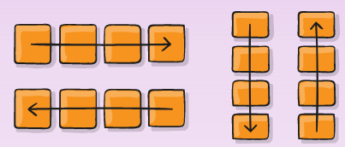
CSS Flexbox- Properties for the parent
Flex Container
display:flex;
This defines a flex container; inline or block depending on the given value. It enables a flex context for all its direct children.
Flex-direction:row | column
Think of flex items as primarily laying out either in horizontal rows or vertical columns.
flex-direction:reverse-row;
flex-direction:reverse-column;

Slide 52
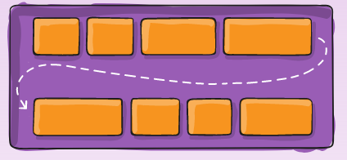
CSS Flexbox- Properties for the parent
Flex Container
Flex-wrap: nowrap | wrap | wrap-reverse;
By default, flex items will all try to fit onto one line. You can change that and allow the items to wrap as needed with this property.
flex-flow
This is a shorthand for the flex-direction and flex-wrap properties, which together define the flex container's main and cross axes.
The default value is row nowrap.

Slide 53
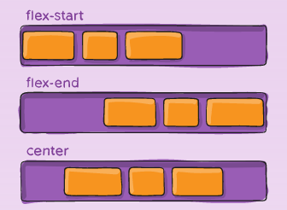
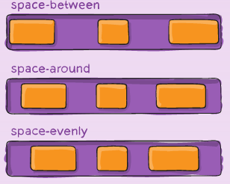
CSS Flexbox- Properties for the parent
Flex Container
Justify-content: This defines the alignment along the main axis.
justify-content: flex-start | flex-end | center | space-between | space-around | space-evenly

Slide 54
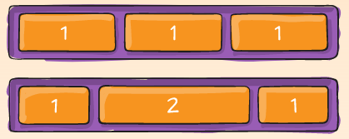
CSS Flexbox- Properties for the Children
Flex items
Flex-grow
This defines the ability for a flex item to grow if necessary
Negative numbers are invalid.
flex-grow: <number>; /* default 0 */
flex-shrink
This defines the ability for a flex item to shrink if necessary.
Negative numbers are invalid.
flex-shrink: <number>; /* default 1 */

Slide 55
CSS Flexbox- Properties for the Children
Flex items
Flex-basis
This defines the default size of an element before the remaining space is distributed.
It can be a length (e.g. 20%, 5rem, etc.) or a keyword.
The auto keyword means "look at my width or height property"
flex-basis: <length> | auto; /* default auto */

Slide 56
CSS Flexbox- Properties for the Children
Flex items
Flex
This is the shorthand for flex-grow, flex-shrink and flex-basis combined.
flex-shrink and flex-basis are optional.
The default is 0 1 auto, but if you set it with a single number value, it's like <number> 1 0.
flex: none | [ <'flex-grow'> <'flex-shrink'>? || <'flex-basis'> ]

Slide 57
CSS Grid

Slide 58
CSS Statements
There are two kinds of statements:
Rulesets (or rules) that, as seen, associate a collection of CSS declarations to a condition described by a selector.
At-rules that start with an at sign, '@' followed by an identifier.
Each type of at-rules, defined by the identifier.
They are used to convey metadata information (like @charset or @import), conditional information (like @media or @document), or descriptive information (like @font-face).

Slide 59
CSS Statements
Nested Statements
These are statements that can be used in a specific subset of at-rules.
@media at-rule content is applied only if the device on which the browser runs matches the expressed condition
@document at-rule content is applied only if the current page matches some conditions

Slide 60
CSS Structure
-1-

Slide 61
How CSS is Structured?
-1-
Applying CSS to your HTML
External stylesheet
Internal stylesheet
Inline stylesheet

Slide 62
How CSS is Structured?
-1-
Selectors
Universal Selector [Example: * will match all the elements of the document.]
Type selector
Class selector
ID selector
Attribute selector
Grouping selectors
Selector list

Slide 63
How CSS is Structured?
-1-
Combinators
Child Combinator
General sibling combinator
Adjacent sibling combinator
Column combinator
Pseudo
Pseudo classes
Pseudo elements
Refer to css selector at : https://github.com/engwsalama/webdev_html_css

Slide 64
How CSS is Structured?
-1-
Specificity & Cascade
Properties & Values
Functions
@rules…[@import]
Shorthands
Comments /* */

Slide 65
Responsive Design
-2-
Viewport
Media Queries
Flexbox
Grids

Slide 66
Print - media query
-2-

Slide 67
Flexbox
-2-
Flexbox is one dimensional that deals with layout in one dimension at a time — either as a row or as a column.
The flex-wrap property specifies whether the flexible items should wrap or not.
If the elements are not flexible items, the flex-wrap property has no effect.

Slide 68
Grid
-2-
The CSS Grid Layout Module offers a grid-based layout system, with rows and columns, making it easier to design web pages without having to use floats and positioning.
A grid layout consists of a parent element, with one or more child elements.
Display Property should be grid or inline-grid

Slide 69
Variables
-2-

Slide 70
Sass
Syntactically Awesome Style Sheets
-2-
Sass is a CSS preprocessor, which adds special features such as variables, nested rules and mixins (sometimes referred to as syntactic sugar) into regular CSS. The aim is to make the coding process simpler and more efficient. Let's explore in more detail.
https://sass-lang.com/documentation
Browser could not read sass file , so will need to convert it to css

Slide 71
Sass
Syntactically Awesome Style Sheets
-2-
To install sass compiler in Linux:
sudo npm install -g sass
To convert Sass file into CSS file :
sass cssFile sassFile
To make Sass watch any changes and compiled automatically to css file , you can use
sass --watch sassFile.scss:cssFile.css

Slide 72
Nesting In Sass
-2-

Slide 73
HTML References
-2-
https://developer.mozilla.org/en-US/docs/Web/HTML
https://www.w3schools.com/html/default.asp
https://www.w3schools.com/css/
https://flatuicolors.com/
http://www.webestools.com/
https://www.fontsquirrel.com/tools/webfont-generator

