Slide 1
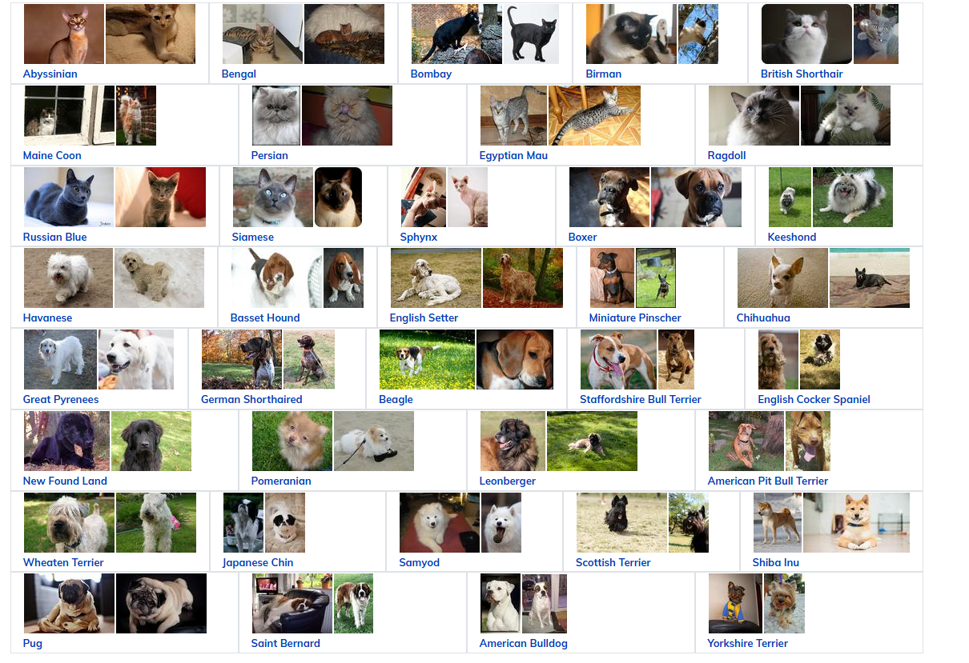
“Oxford-IIIT Pet Dataset: Classification & Segmentation

Slide 2
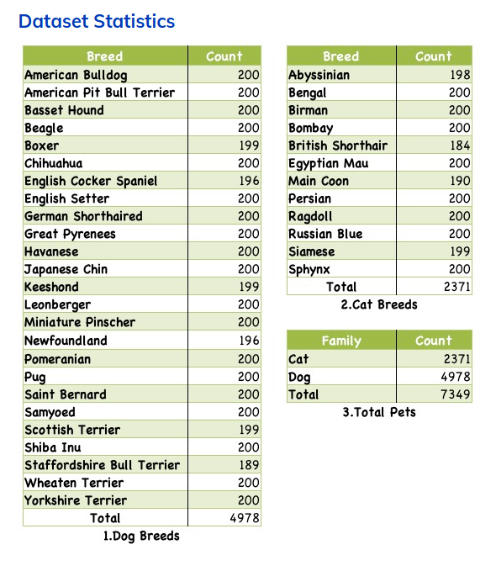
1. Introduction & Problem Statement
What is the Oxford-IIIT Pet Dataset?
It is a dataset for pets classification & Segmentation consists of 37 category pet dataset with roughly 200 images for each class. The images have a large variations in scale, pose and lighting. All images have an associated ground truth annotation of breed, head ROI, and pixel level trimap segmentation.
Why choosing this task?
I saw it challenging as there are many possible ways to work around it, so choosing what to do, and how to implement it was a challenge that I liked!

Slide 3
2. Understanding the Oxford-IIIT Pet Dataset
Dataset Overview:
Total Images: 7,349 images of 37 pet breeds (cats & dogs).
Tasks:
Classification: Predict pet breed.
Segmentation: Identify pet pixels from background.
Labels Available:
Image-level labels (for classification).
Pixel-wise segmentation masks (for object boundary detection).
How I Explored the Dataset
Used Pandas & Matplotlib to check label distribution.
Plotted sample images to understand breed variations.
Checked segmentation masks to see how well the pets are outlined.

Slide 4
3. Data Preprocessing
Loading & Structuring the Dataset for classification:
The dataset was split into: Training Set (70%)Validation Set (15%)Test Set (10%)
Key Actions: Used ImageDataGenerator
B. Splitting Data for Segmentation Model Training
Since the dataset already provides predefined splits for images and masks so I used this split (TrainVal) and (Test)
Then split the (TrainVal) so 80% of it goes for training and the remaining 20% goes for validation.

Slide 5
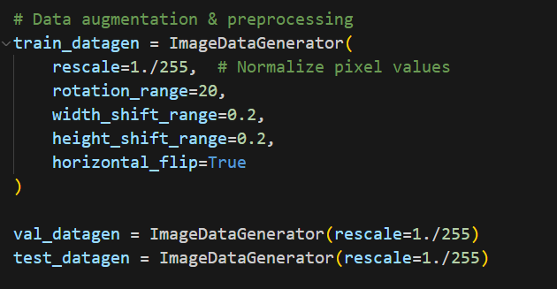
c. Image Processing for Classification:
Steps Taken:
Resized all images to 224×224 for uniform input shape.
Normalized pixel values (dividing by 255) for better model stability.
Augmented images:
Rotation (20°) → Helps handle different orientations.
Horizontal Flipping → Simulates real-world pet variations.
Brightness Adjustments → Handles lighting differences.
Zooming & Cropping → Ensures focus on the pet.
Implemented augmentation methods to prevent overfitting by simulating real-world scenarios and to help generalize more.

Slide 6
D. Image Processing for Segmentation (UNet)
Since UNet requires pixel-wise segmentation, preprocessing is different.
~> Steps Taken:
Resized images & masks to 256×256 (keeping aspect ratio).
Converted masks into binary format:
Pixel value 1 = Pet
Pixel value 0 = Background
Data augmentation for segmentation:
Used rotation, flipping, and elastic deformation.
Ensured masks match the transformed images. (256, 256, 3)

Slide 7
4. Classification Approaches
Method 1: Simple CNN
Architecture:
Convolutional Layers (e.g., 3 Conv layers with ReLU & MaxPooling).
Flatten & Fully Connected Layers.
Softmax Output for Multi-class Classification.
Training Details:
Loss Function: Categorical Cross-Entropy.
Optimizer: Adam.
Epochs: 100 epochs.
Performance Metrics: Accuracy - Loss & Confusion Matrix.

Slide 8
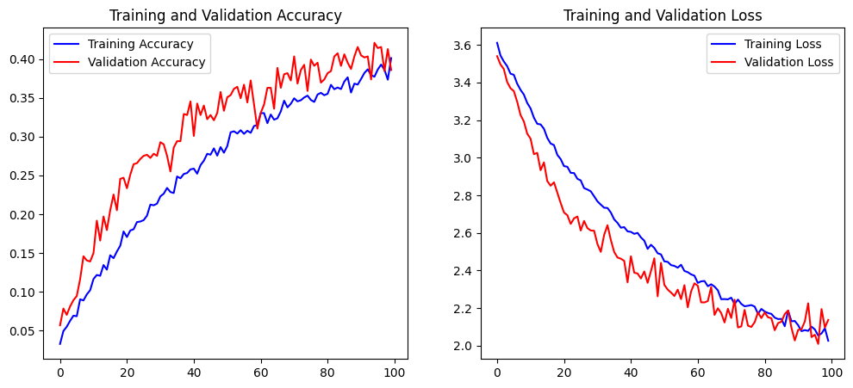
Graphed results:

Slide 9
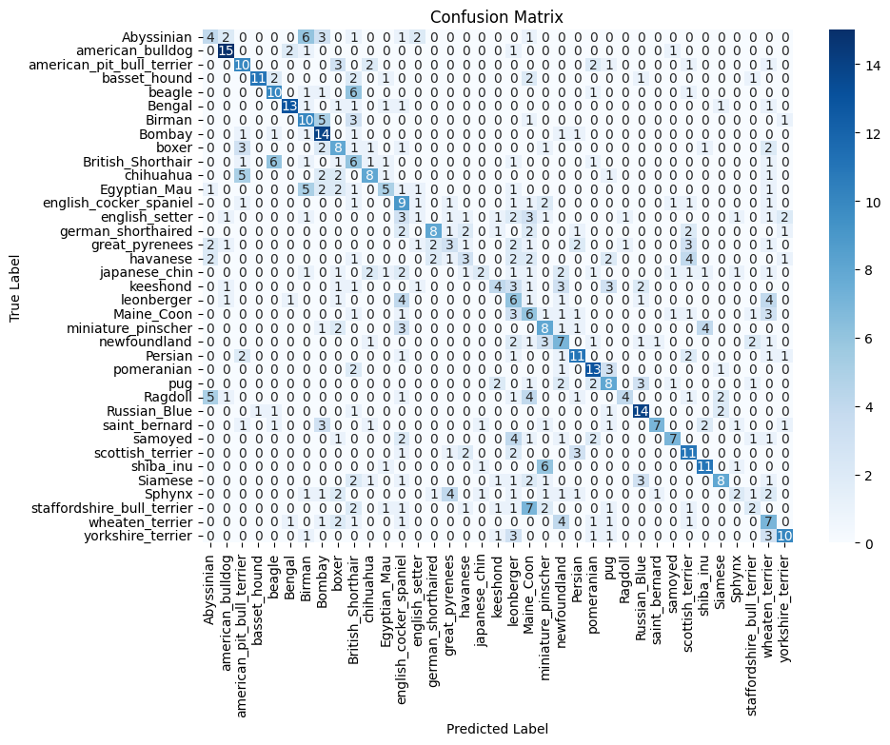

Slide 10
Method 2: Transfer Learning with ResNet34
Why ResNet34?
Handles deep networks better due to skip connections.
Pre-trained on ImageNet → helps in feature extraction.
Fine-tuning Strategy:
Used pre-trained ResNet34 as a feature extractor.
Unfroze last few layers for fine-tuning.
Adjusted learning rate and regularization.

Slide 11
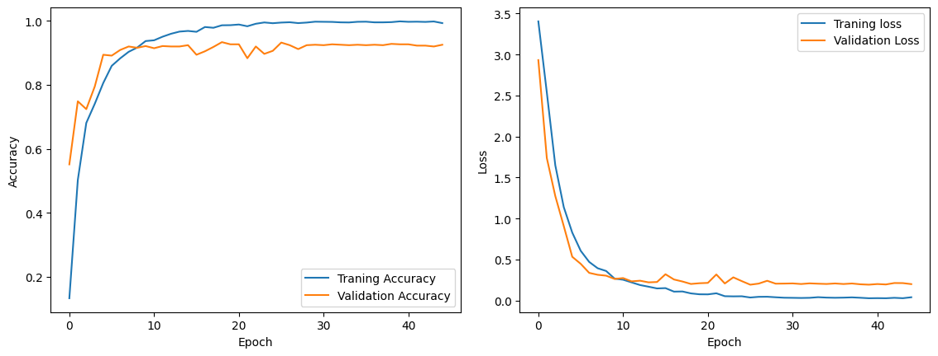
Graphed results:

Slide 12
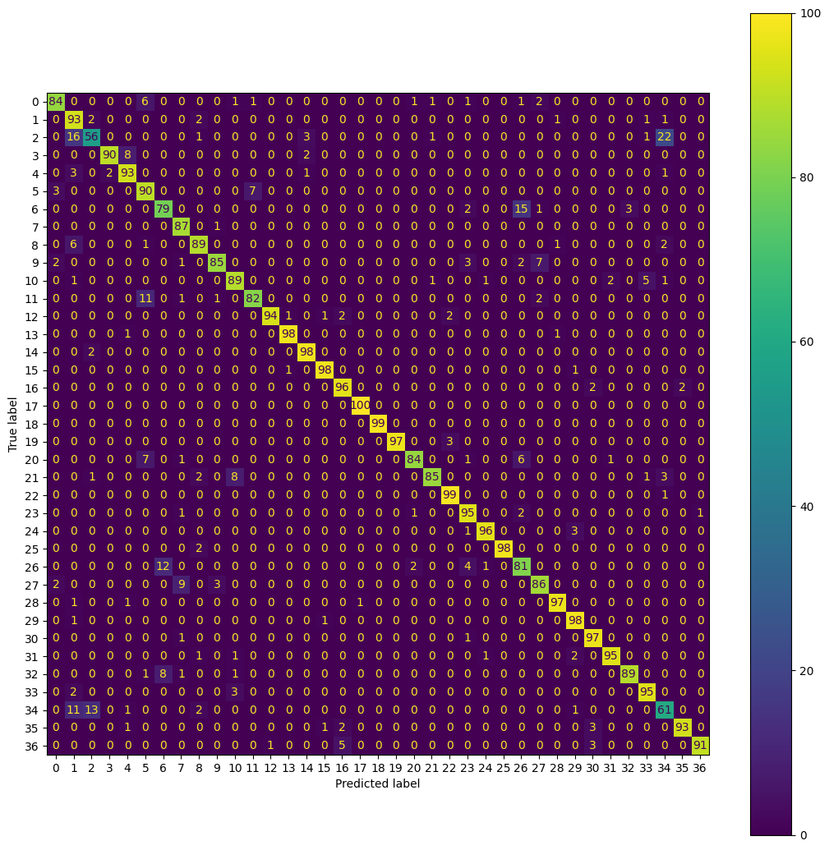

Slide 13
6. Segmentation Approach
Why UNet?
Effective for pixel-wise predictions.
Encoder-Decoder structure helps localize pet regions.
🔹 Architecture Overview:
Encoder (Convolutional Blocks): Extracts features.
Bottleneck: Compresses features.
Decoder (Upsampling & Skip Connections): Reconstructs pet masks.
Used Evaluation Metrics:
1. Intersection over Union (IoU).
2. Dice Coefficient.
3. Pixel Accuracy.

Slide 14
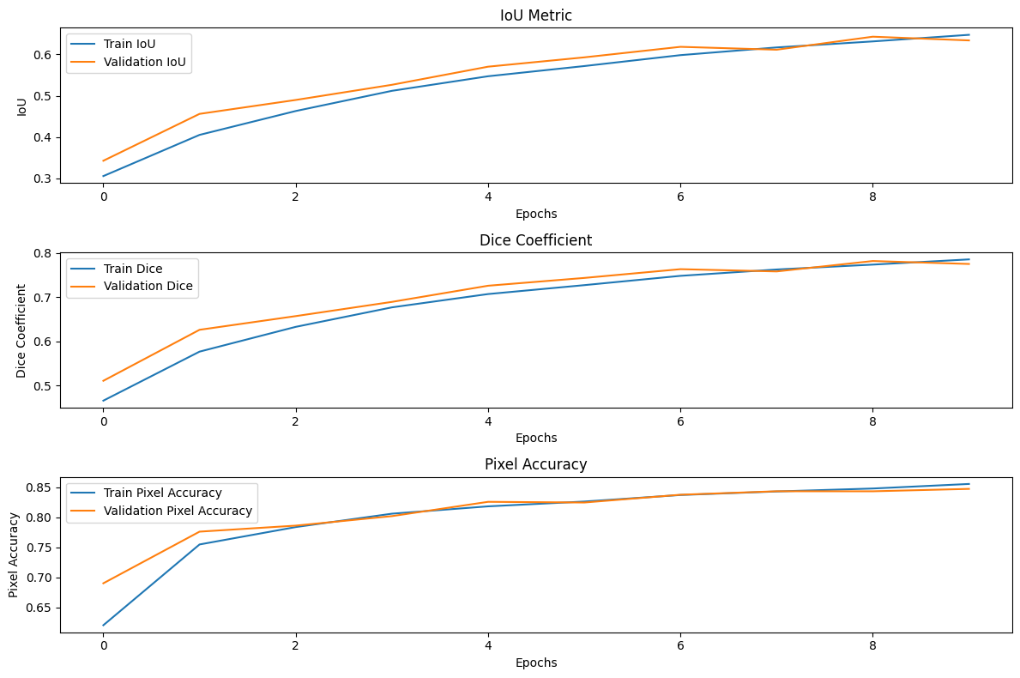
Graphed results:

Slide 15
7. Areas for Improvement
With additional computational resources, several enhancements could be explored:
Model Architecture
Test more modern architectures (EfficientNet, Vision Transformer)
Experiment with different custom CNN configurations
Implement ensemble methods
Try different backbone networks

Slide 16
6. Conclusion & Future Work
Summary of Findings:
ResNet34 performed better than CNN for classification.
UNet worked well but could be improved with post-processing.
Future Improvements:
Try deeper architectures like ResNet50 or EfficientNet.
Use attention mechanisms for better segmentation.

