Slide 1
Customer Prediction for Churn
Agenda :
Introduction
Data Preprocessing and cleaning.
Data Visualisation.
Data Transformation .
Machine learning algorithms .
Results and conclusion .
Sample Test.

Slide 2
Introduction
Project Objectives is to provide and apply Machine learning algorithm on a bank database where a recorded features enrolled in the database .
The customer classify each customer where he exited or not .
Use the machine learning algorithm to detect and predict if new customer come with feature list to know whether he will probably exit or not .

Slide 3
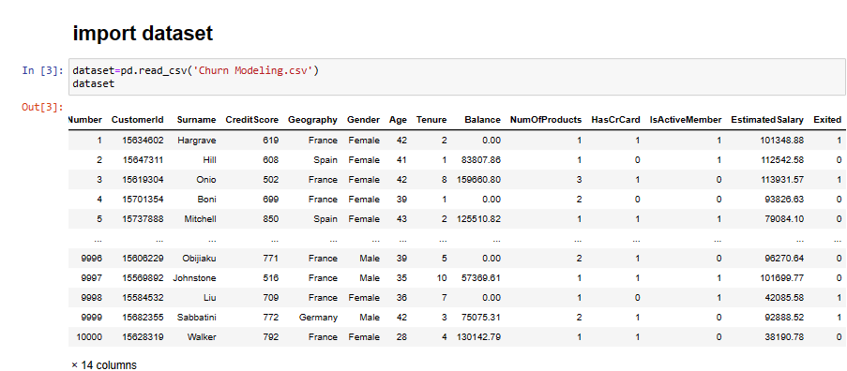
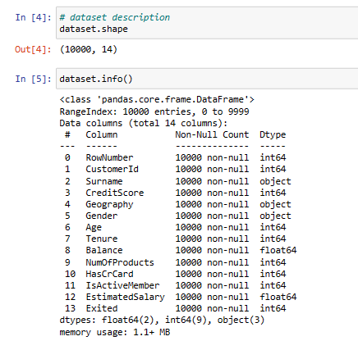
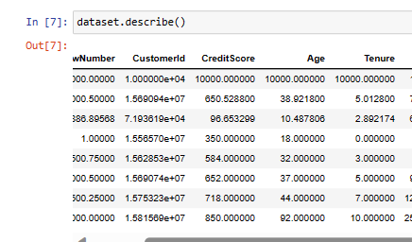
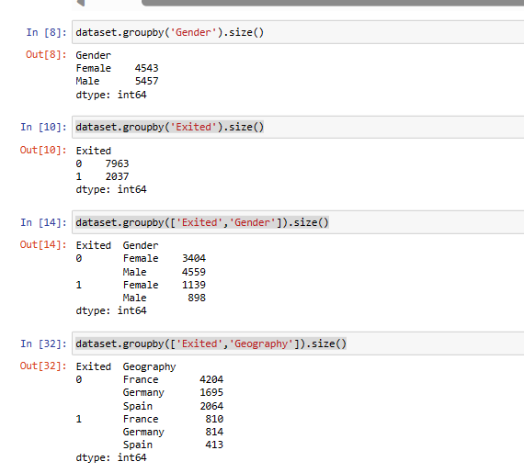
Data Pre-Processing
Importing Dataset
Data Pre-processing

Slide 4
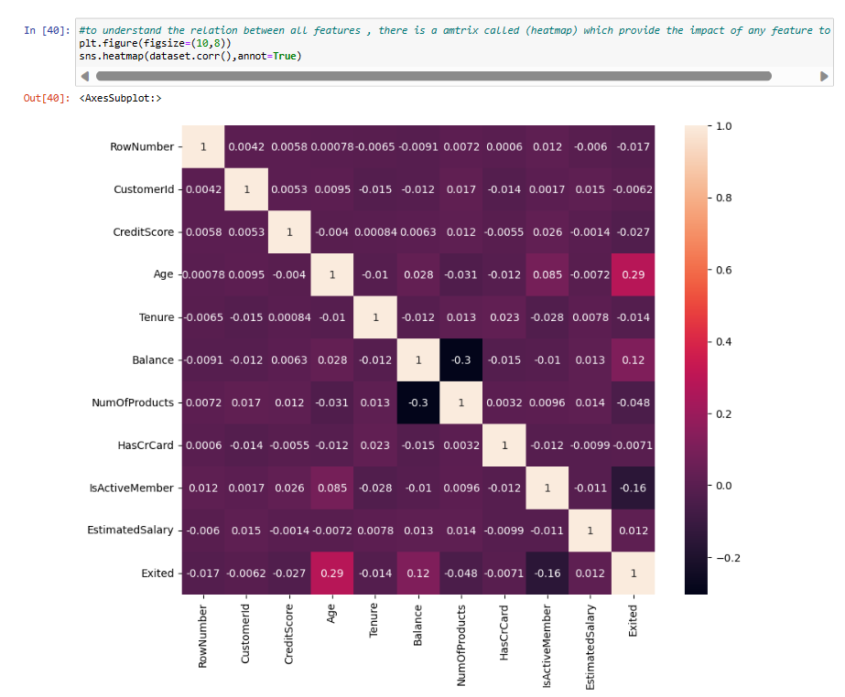
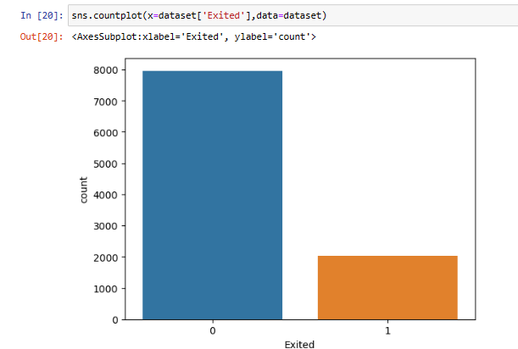
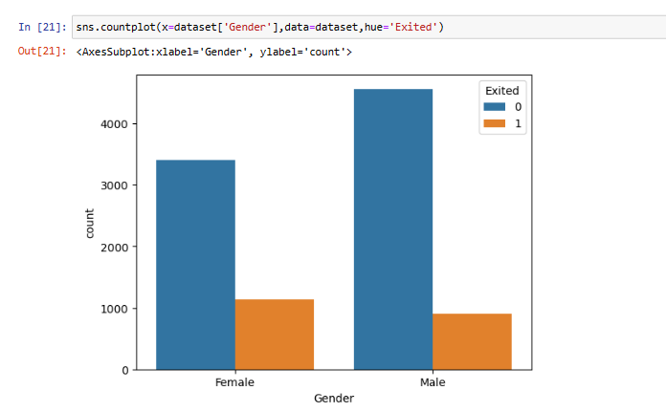
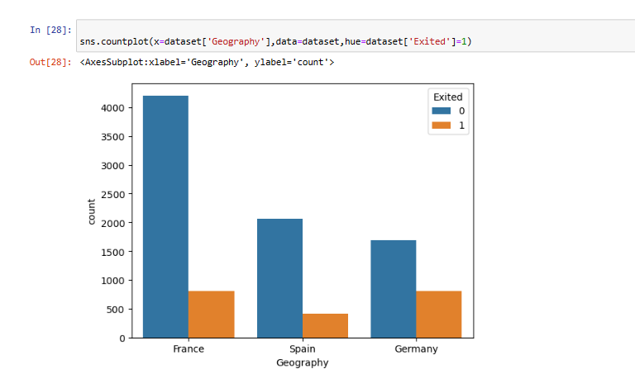
Data Visualisation

Slide 5
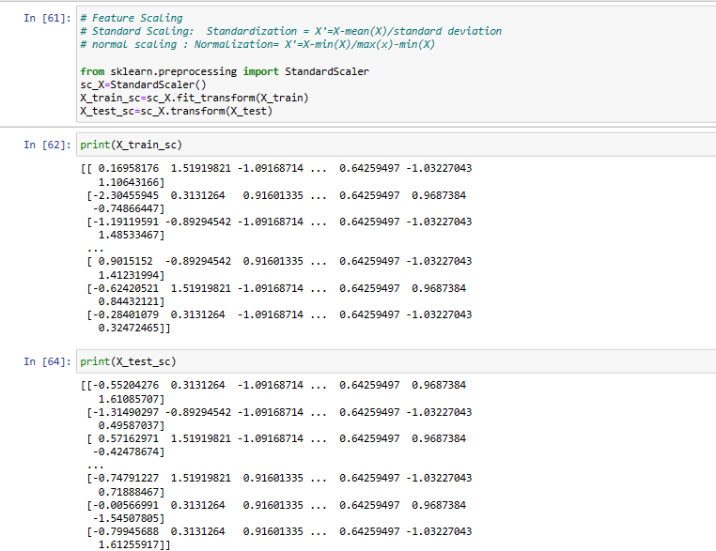
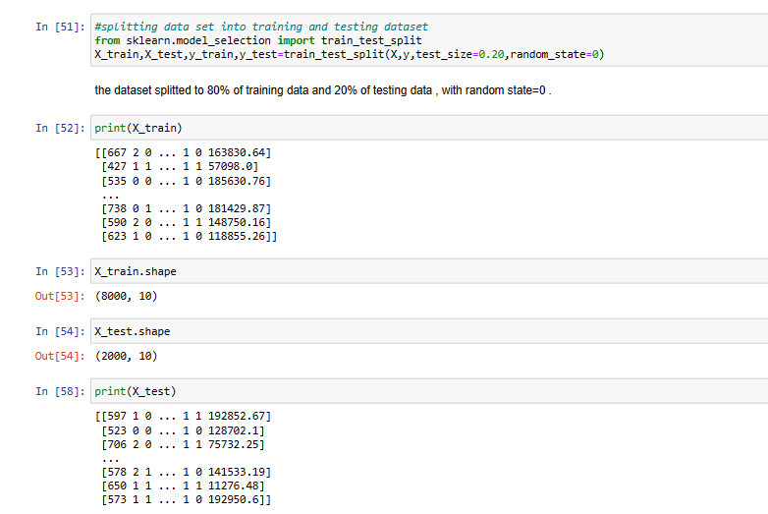
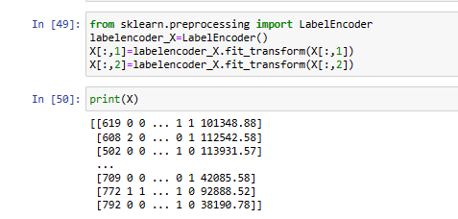
Data Transformation
Data Transformation
Data Scaling , Training and Testing

Slide 6
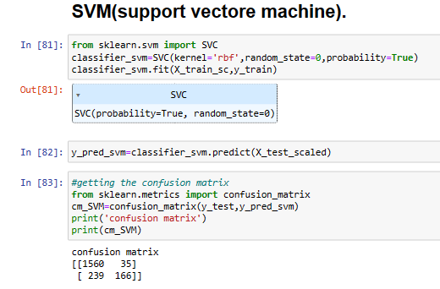
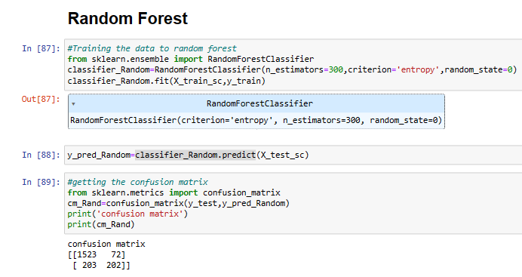
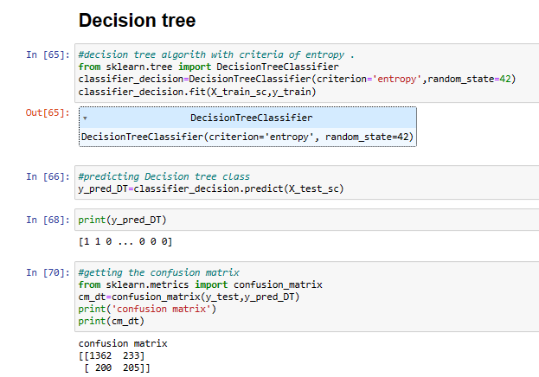
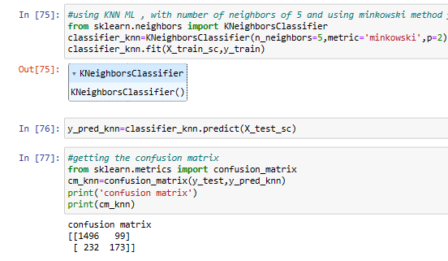
Machine learning algorithms
Decision Tree
KNN
SVM
Random Forest

Slide 7
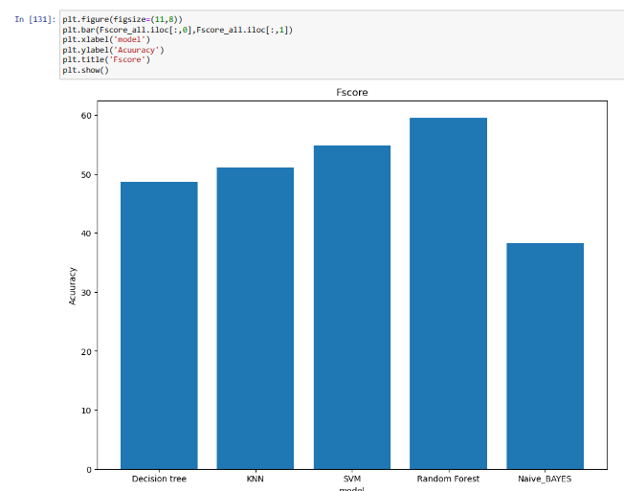
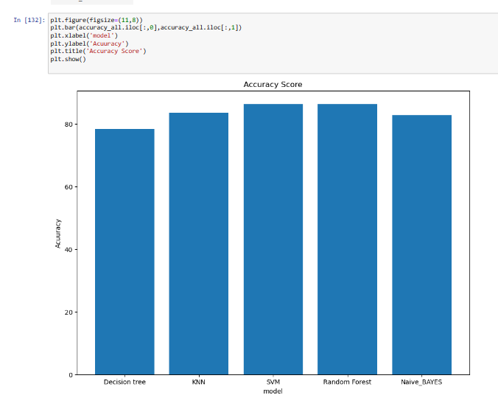
Results
From Performance parameters , we reach to a conclusion that Random Forest and SVM was the highest modules to predict the data and be a reference in Machine learning .

Slide 8
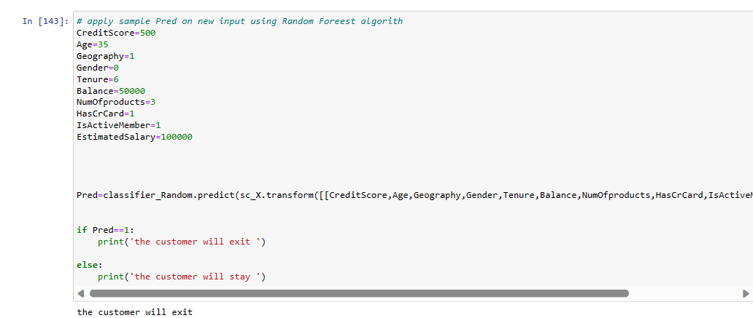
Sample Test

