Slide 1

Midap-tools: a python package for post-processing and visualization of midap results
Lukas von Ziegler
Scientific IT services ETHZ
CDSS group

Slide 2
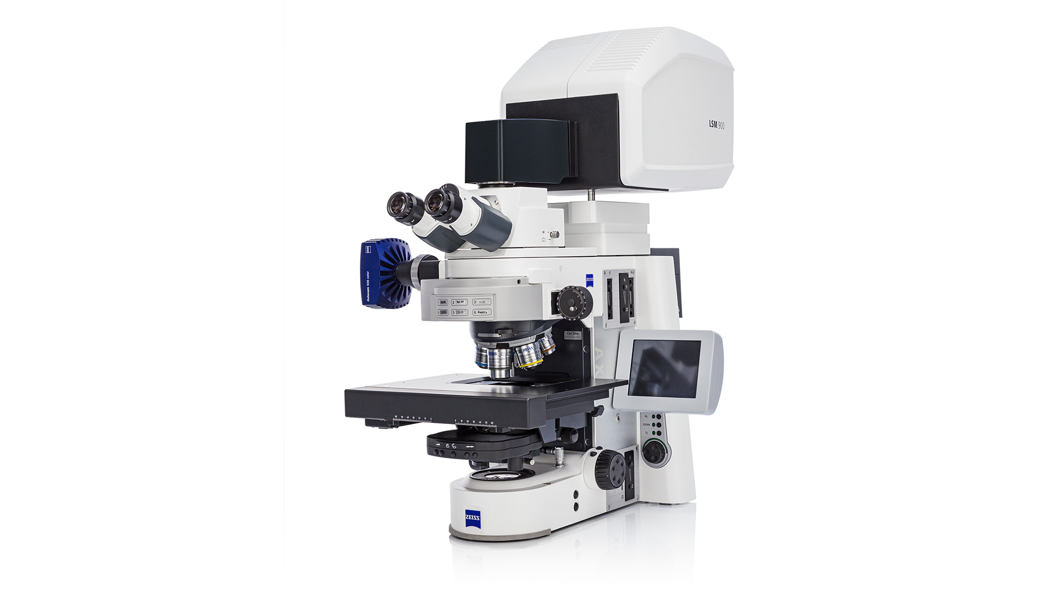
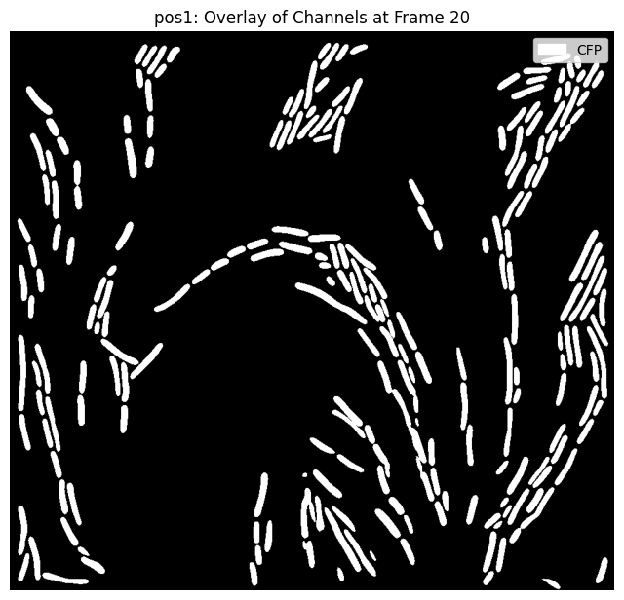
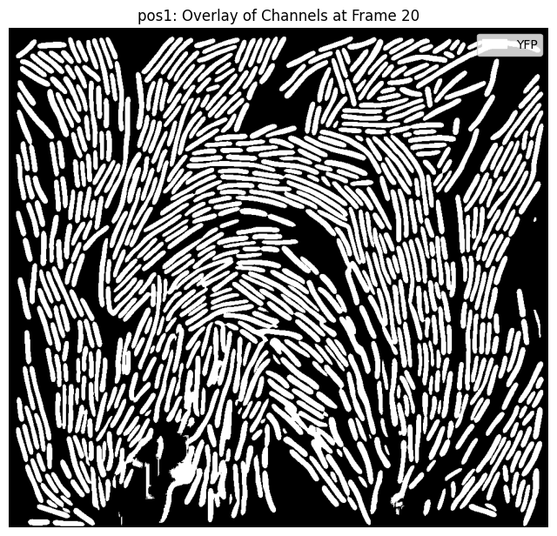
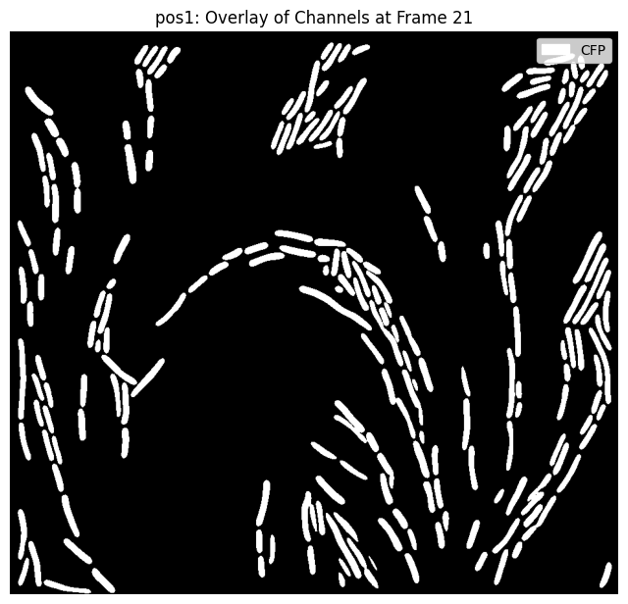
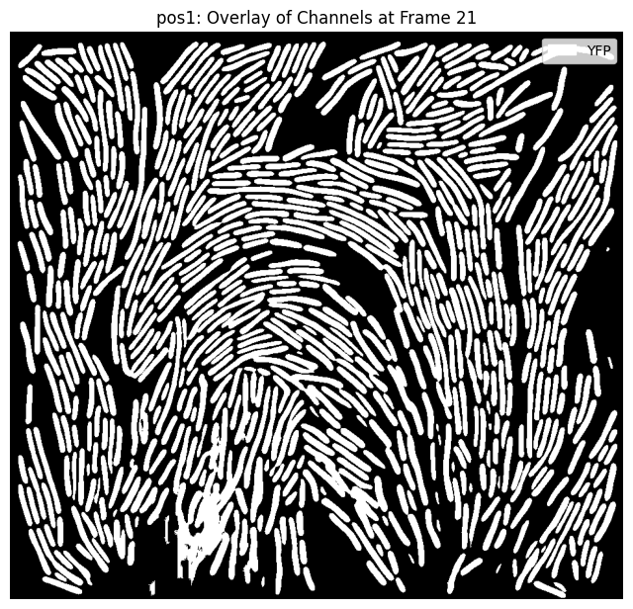
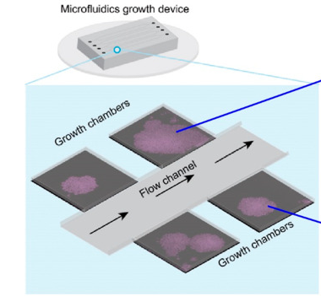
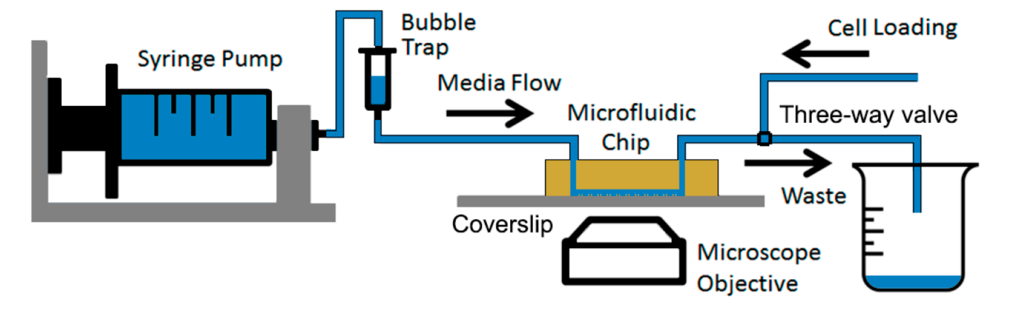
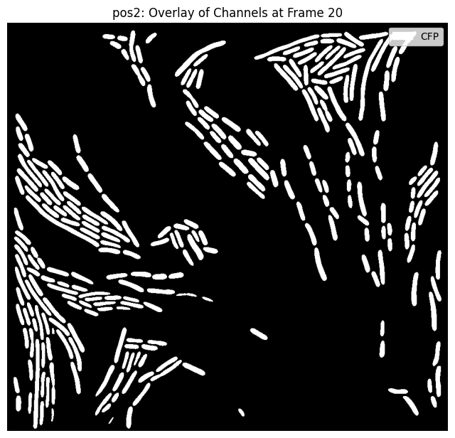
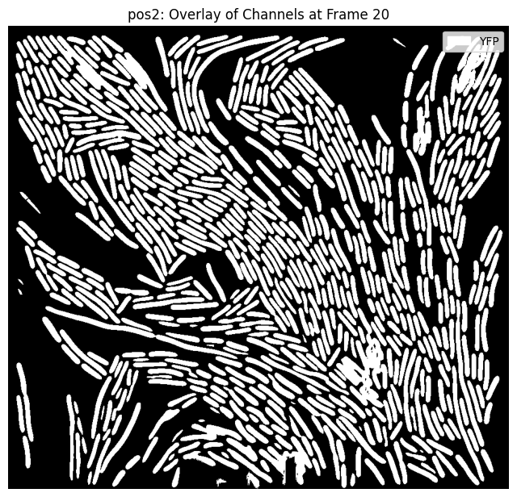
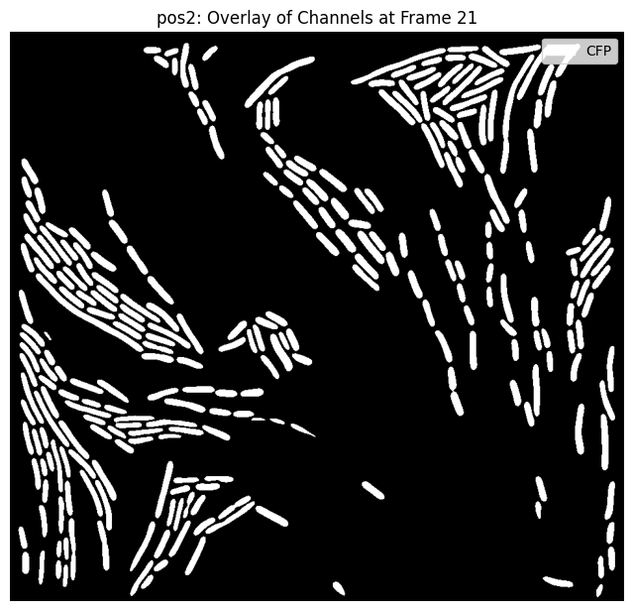
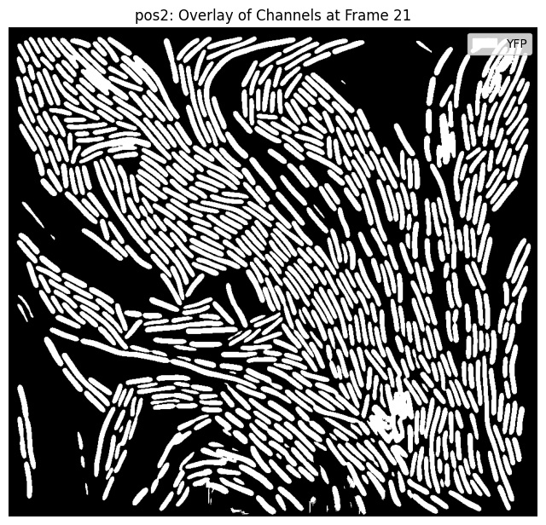
Microfluidic experiments
Channel 1
Channel 2
Channel N
…
Position 1
Position 2
…

Slide 3
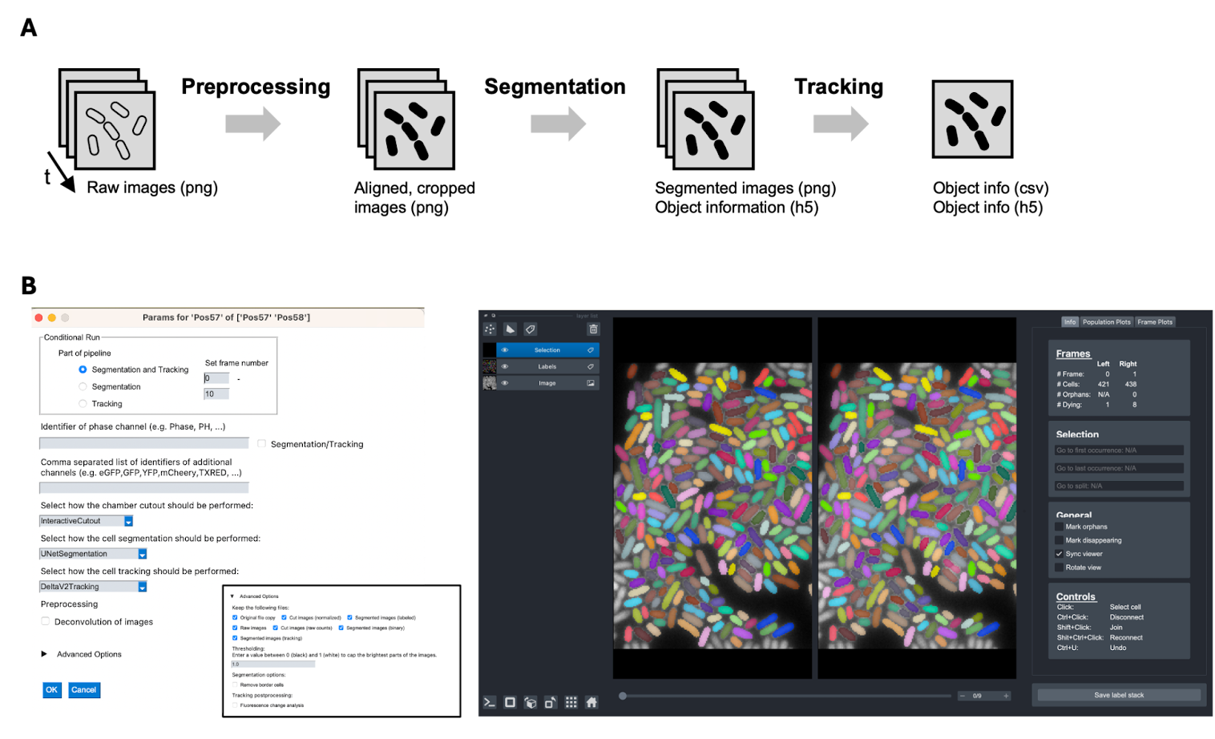
What is midap?
An image analysis pipeline written for the Microbial Systems Ecology Group at the Eawag
?
Individual jupyter notebooks for post analysis. Unclarity about best practice methods and no horizontal integration.

Slide 4

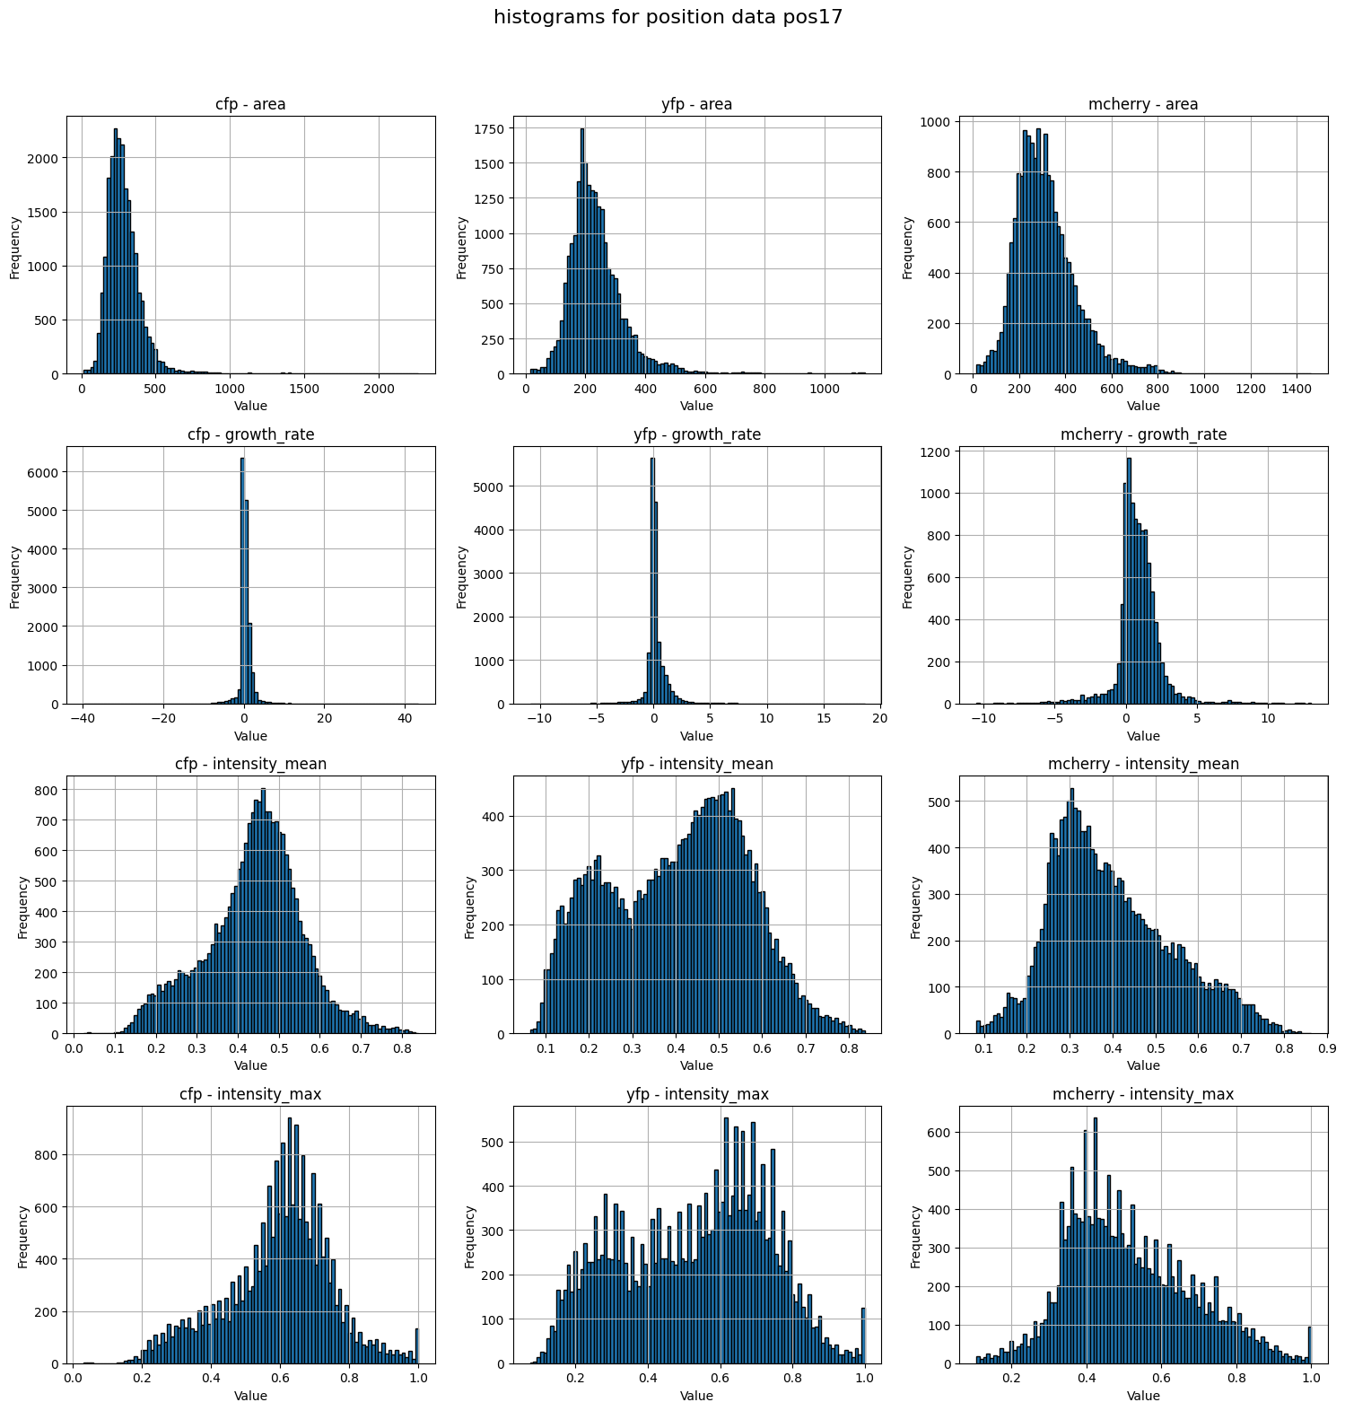
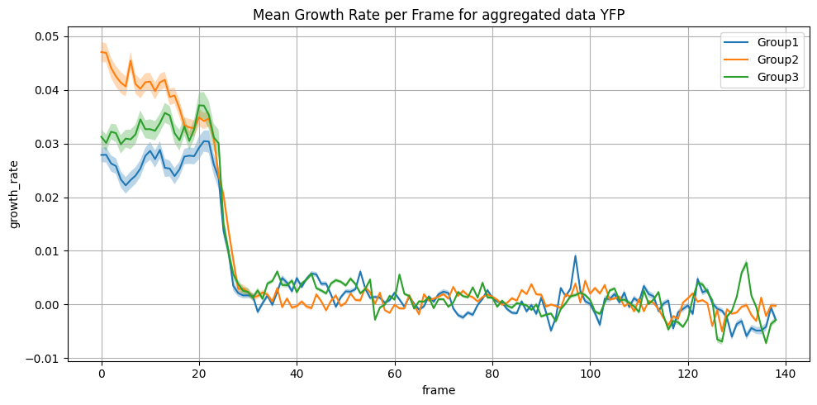
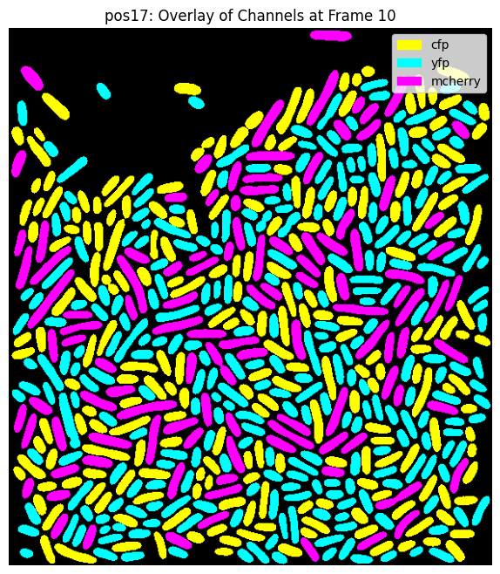
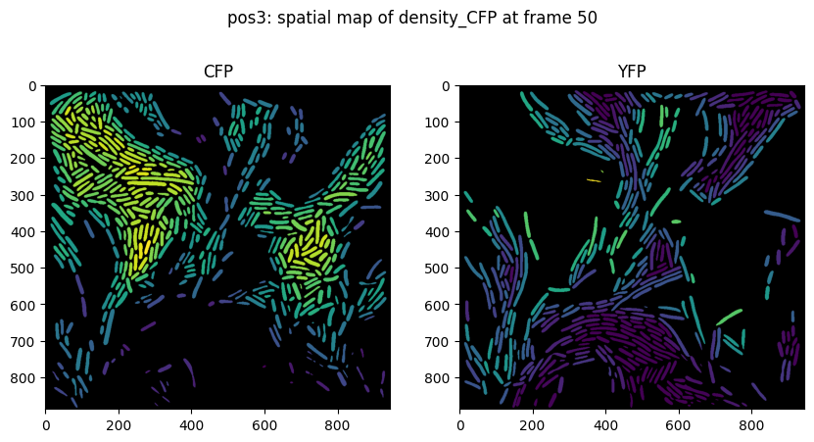
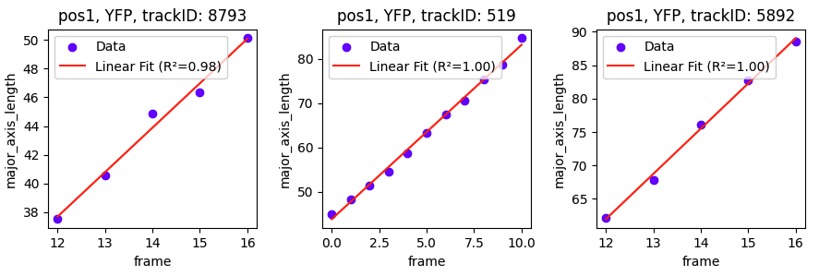
What benefits does midap-tools bring to the user?
A python package that enables standardized analysis and visualization of midap results
Quality controls
Growth rates from tracking data
https://github.com/Microbial-Systems-Ecology/midap-tools
Density calculation from segmentation/tracking data

Slide 5
The architecture of midap-tools
Individual analysis methods with defined IO structure
Power user methods
Mutable data
FluidExperiment Object (data organizer and function dispatcher)
Save state
Immutable data layer (midap output)

Slide 6
The FluidExperiment object
Session
Fluid Experiment
Raw file locations
Mutable data
Methods
Constructors
Position 1
Channel 1
Data frame
Constructors
Channel A
Mutators
metadata
Channel 2
Data frame
Mutators
Position 2
Position B
add
Plotters / Reporters
Channel N
Data frame
Plotters / Reporters
Filter history
Position N
Calculators
Calculators
Exporters
Exporters
fuse
Raw data
Save file
Other experiment object
Plots
Data summaries
Functions

Slide 7

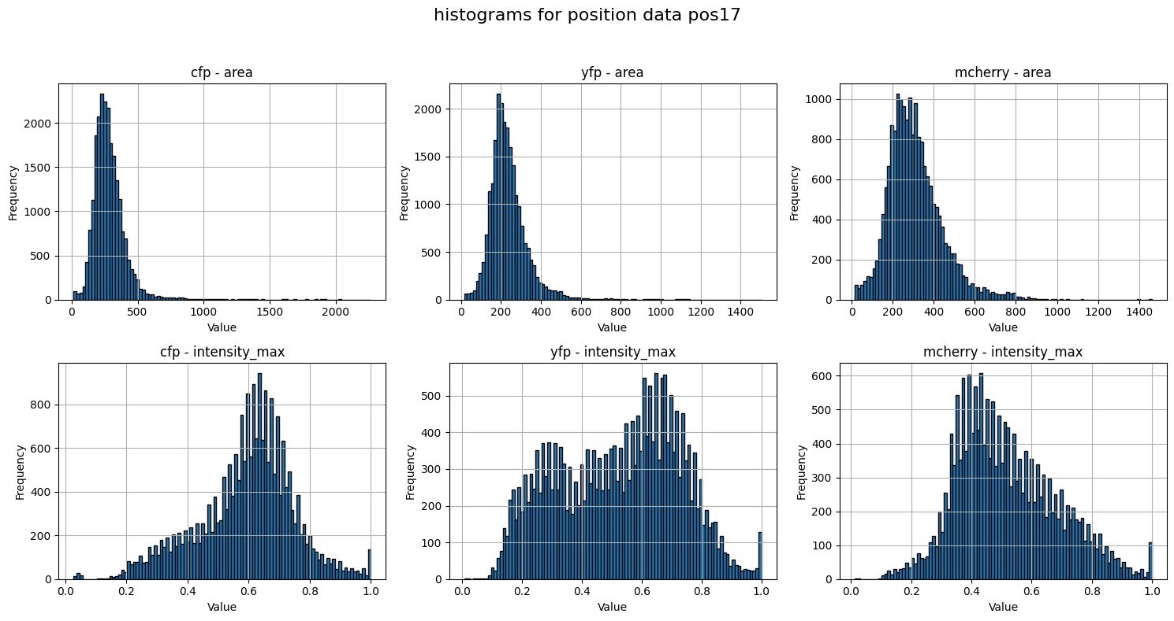
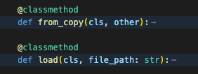
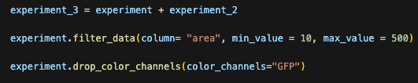
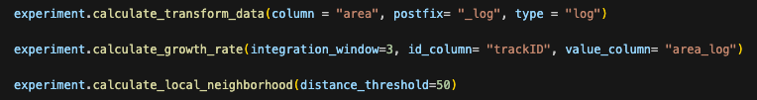
How users interact with midap-tools
Midap-tools has been optimized for interactive use in jupyter notebooks
Convenient initialization
Experiment visualizations
Experiment mutations
Experiment analyses
Experiment saving

Slide 8
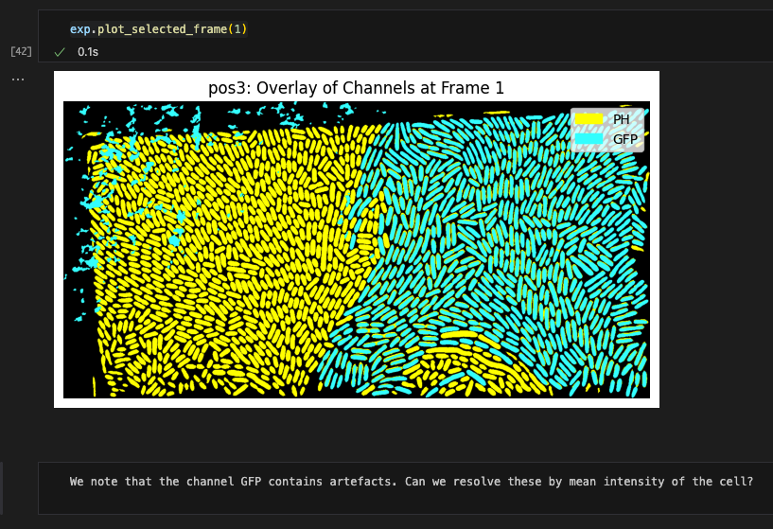
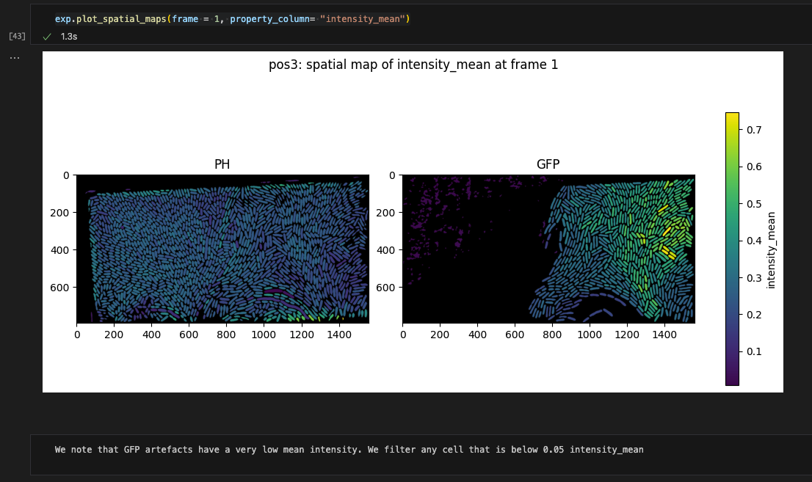
How users interact with midap-tools
Example of an analysis flow

Slide 9
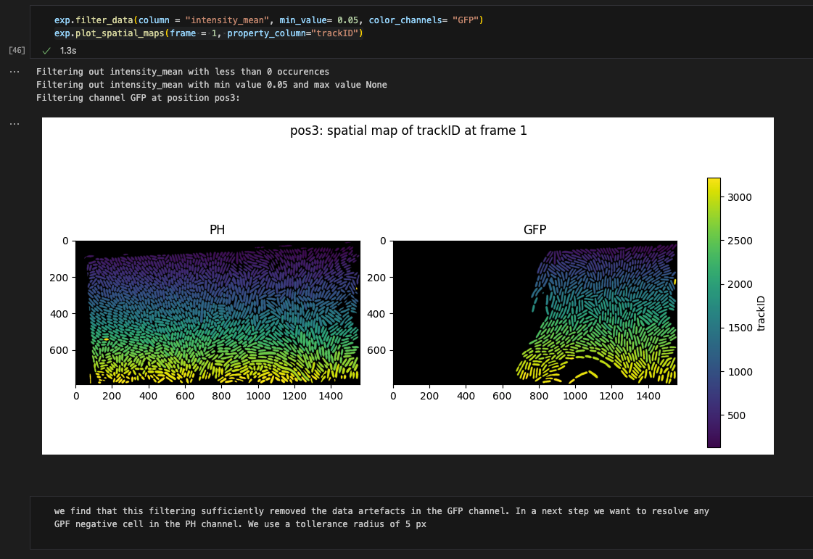
How users interact with midap-tools
Example of an analysis flow

Slide 10
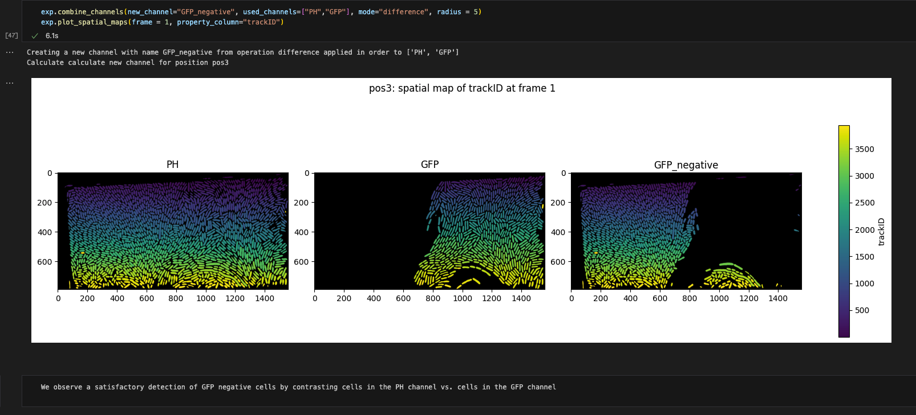
How users interact with midap-tools
Example of an analysis flow

Slide 11
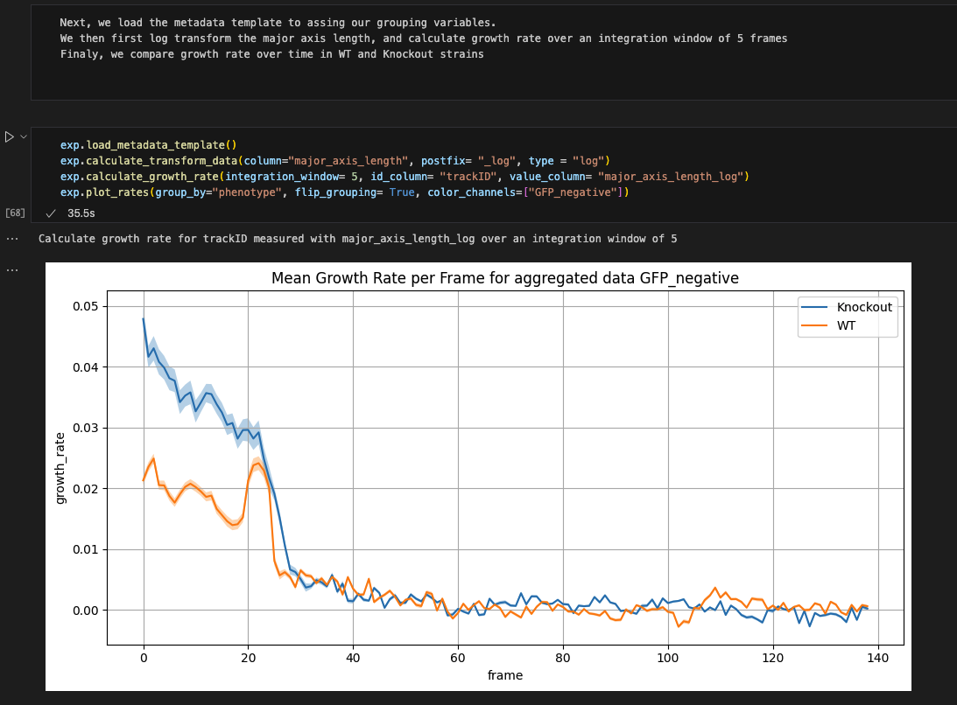
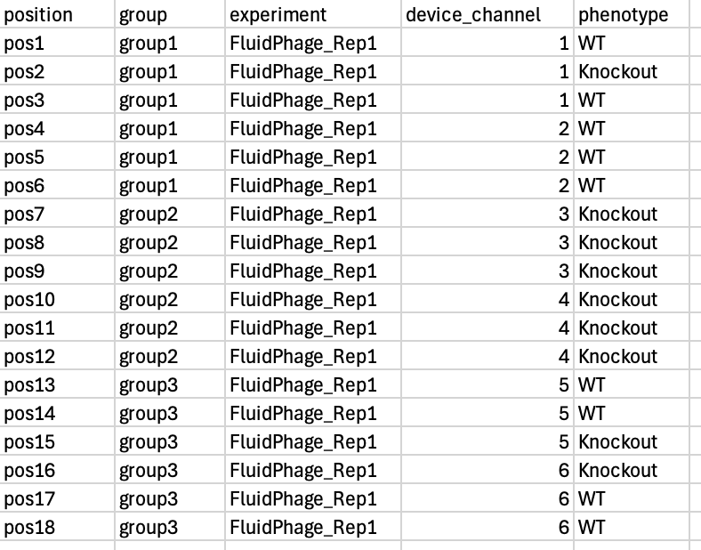
How users interact with midap-tools
Example of an analysis flow

Slide 12
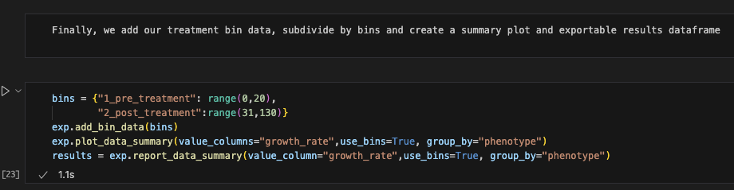
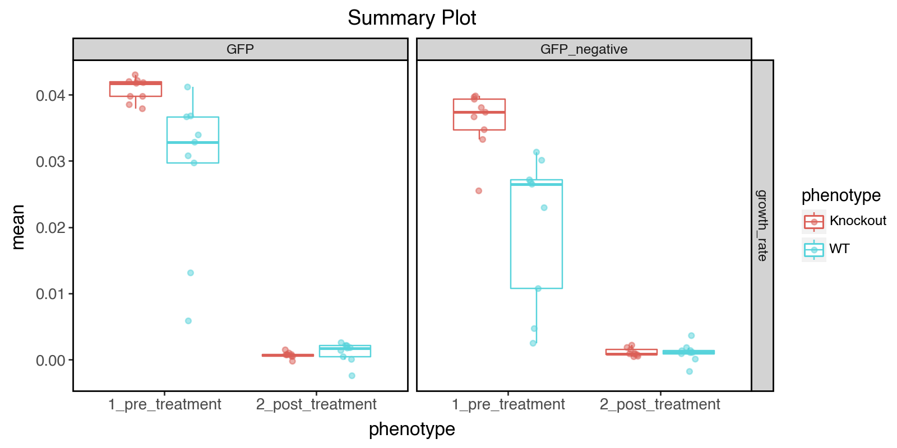
How users interact with midap-tools
Example of an analysis flow

Slide 13
Power user options
Goal: To enable the user to use his own methods with the FluidExperiment object
Includes 5 methods that can be overloaded with custom functions and keyword arguments
On a data series, applied to selected column of a sample
On a data frame, applied to each sample
custom filter
custom growth calculation
custom density calculation

Slide 14
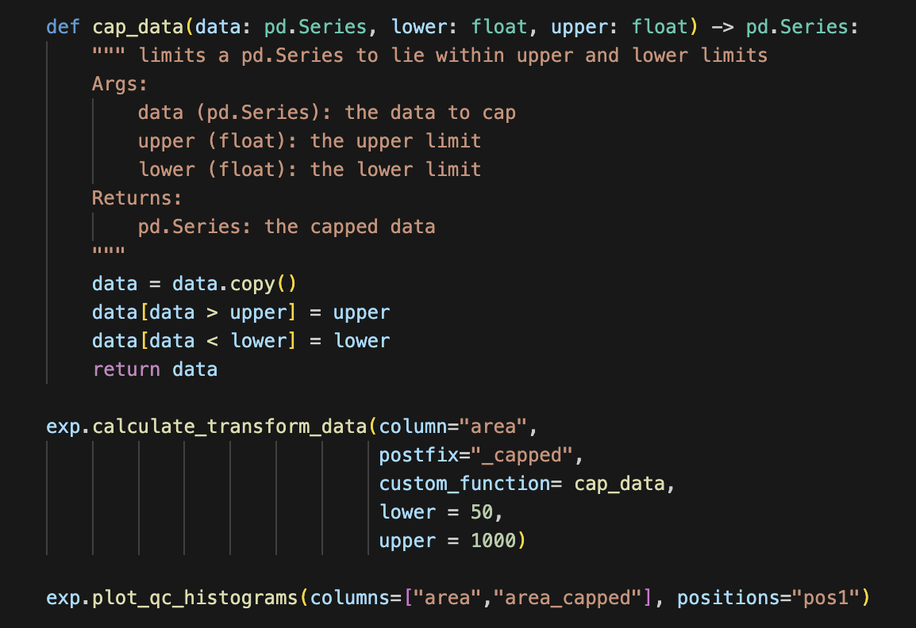
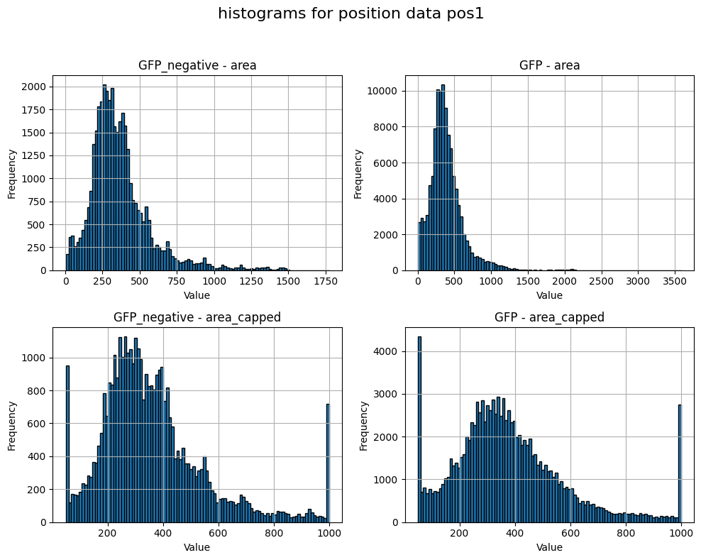
Implementation of power user methods
Example of an analysis flow

Slide 15
How to ensure usability and low entry barrier for the tool
Multi-chapter user guide with increasing complexity
Includes automatically downloadable example data that works with the guide out of the box
Clear docstring documentation for each FluidExperiment method and sensible/understandable pre-set defaults where possible
Class documentation with high level overview over all available methods and a short description
Recorded on site workshop with shareholders
Responsive user support

Slide 16



Acknowledgements
midap:
Developed by Janis Fluri and Franziska Oschman (SIS ETHZ)
Microbial Systems Ecology group (Eawag)

