Slide 1
iLog Workshop Show and Tell
Simone Baffelli and the iLog team
Scientific IT – Empa
Notes:
welcome, thanks for joining Workshop on our ORD Explore project iLog
We appreciate your active involvement to help us shape this project
Especially thank the volunteers for preparing some slides about their research activities and digitization needs of instrumentation

Slide 2
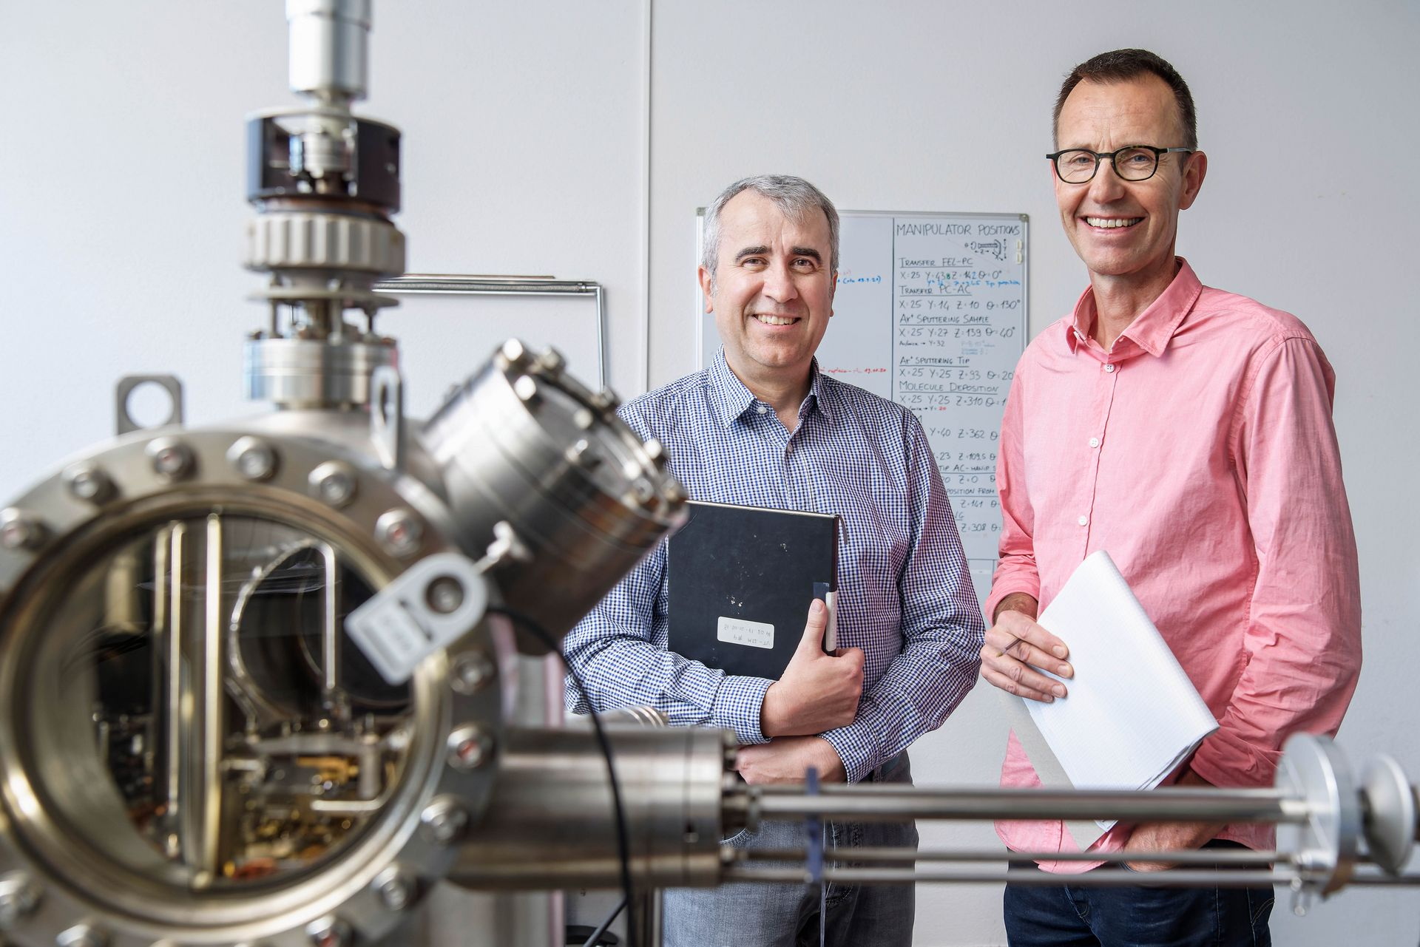
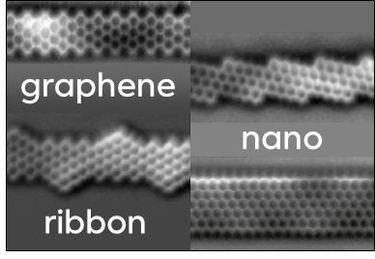
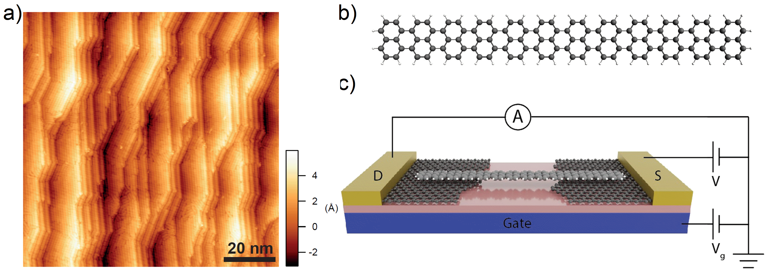
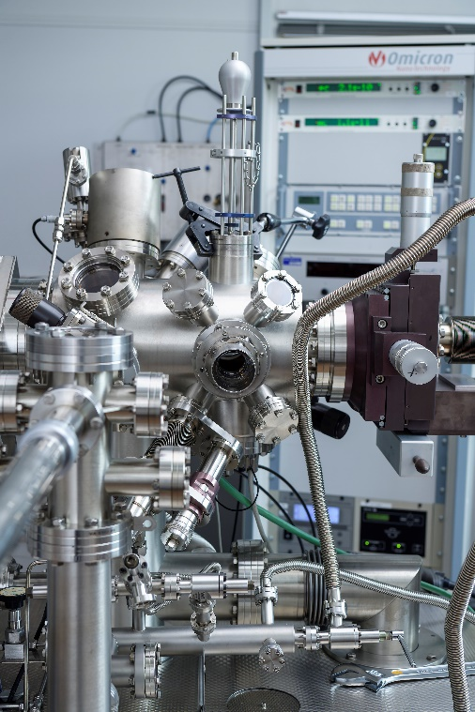
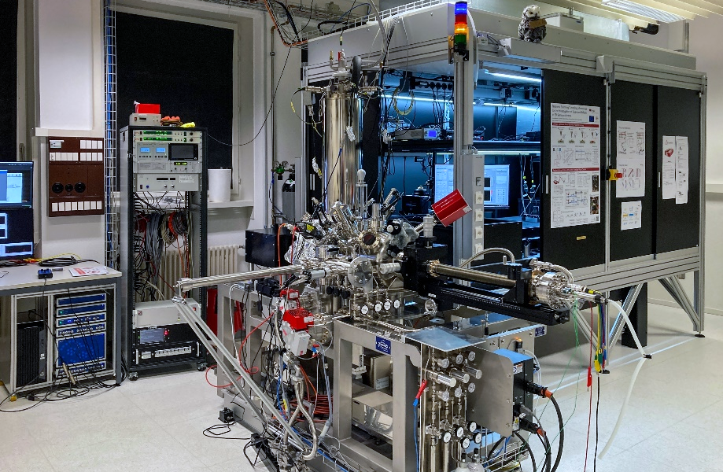

Initial use case: Lab 205
Scanning Probe Microscopy
Devices
Head of laboratory: Roman Fasel
Deputy: Oliver Gröning
Simulations
THz-STM
Notes:
Group of ~40 people, led by Roman Fasel & Oliver Gröning, 5 sub groups, including …
Study low-dimensional nanoscale materials mostly by scanning probe microscopy

Slide 3

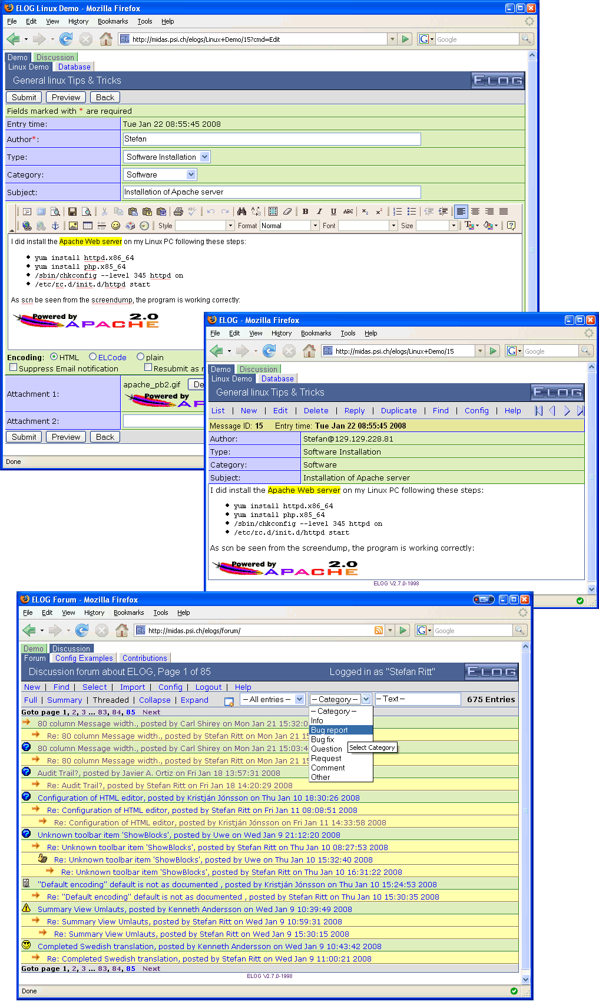


Ilog: Goals
Define practices and tools for reproducible lab workflows
Easily define and model complex laboratory setups
Track changes and events related to the setups
Leverage and integrate with existing ELN/LIMS infrastructure
"Like elog, but modern"

Slide 4

iLog: Value added
Our contribution:
Reuse existing OpenBIS concepts to better model experimental work
Provide a simplified UI that makes it pleasant
Make ORD practices and reproducibility easy through good UX/UI/DX (the right path is the easy path)

Slide 5

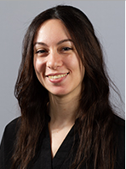



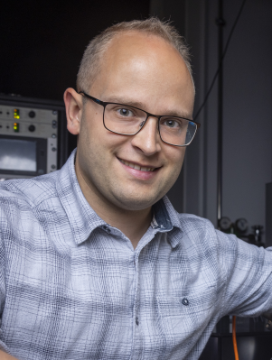

ilog: Project Team
Scientific IT
nanotech@surfaces Lab (205)
Simone
Project coord.,
Software architecture
Despina
Software engineer
Bruno
Project coord.,
Conceptualisation
Fabio
Data scientist
Carlo
Advisor
Lysander
User
today
iLog project ORD Explore
start
finish
09/2024
18 months
02/2026
Notes:
Let me first introduce our project team
Simone, Scientific IT, project cord.
Despina…
This is a ORD Explore project that runs for 18 m.
Just got started… not work on it full time..

Slide 6



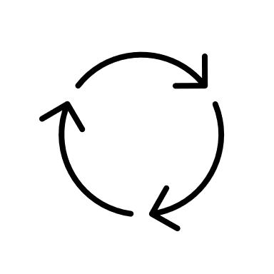

iLog: Collaboration
Lab 205
user needs
Initial sketch
Iteration
Scientific IT
Discussion, specification
Development, engineering

Slide 7





iLog: Principles
User-friendly
Extensible
Visually appealing
Focused application
Runs everywhere
Great DX

Slide 8
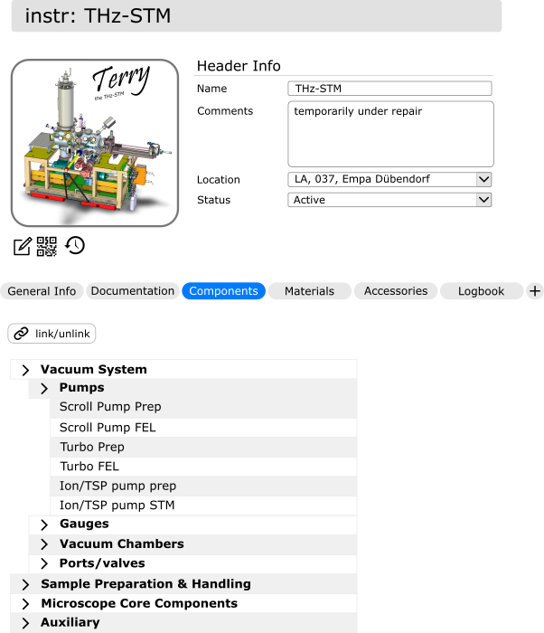
ilog Workflow: Composite Objects
Composite objects
Intuitive UI/UX, not spreadsheet
Trace history of object/experimental setups
Composable objects to represent complex setups
Overview of instrument status at a specific time
Mockup
Notes:
Mockup

Slide 9
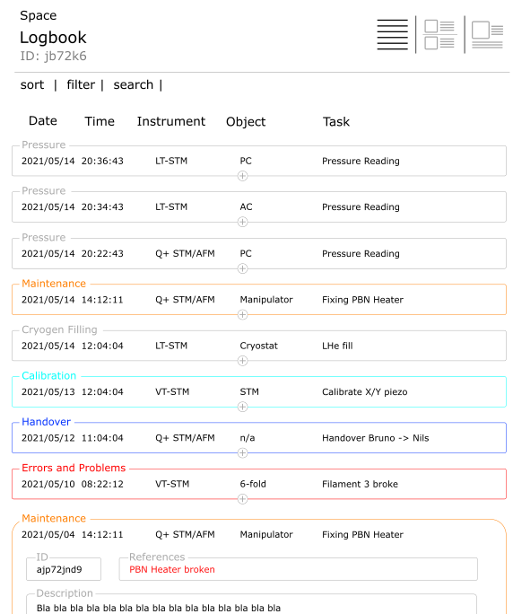
iLog Workflow: Logbook
Logbook
Diary of object status + user recorder actions
Automated system status
Shared among users
Notes:
Mockup

Slide 10


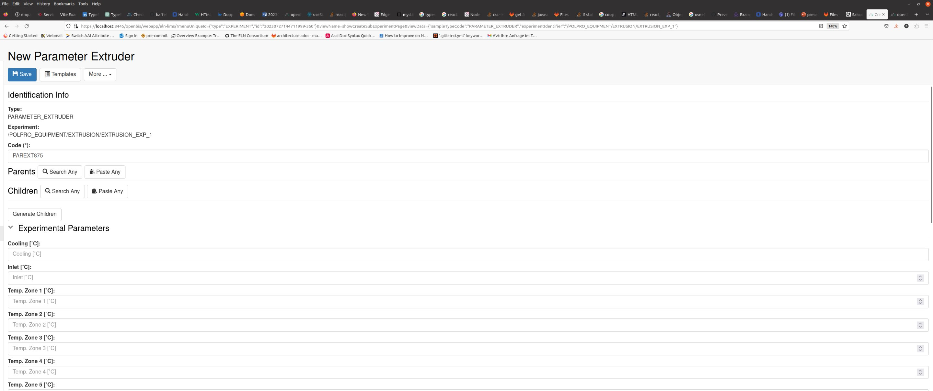
Why building iLog?
Everything is already possible in OpenBIS, so why build it?
Workflows are complex
Adopting a ORD-specific UI is difficult for users

Slide 11
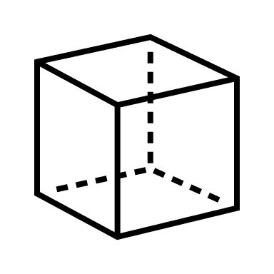

iLog Concepts: Types, Objects and Composites
Object Types:
Describe the shape of things.
What properties do we record?
Example
Type «Chair»:
Color
Weight
Material
Manufacturer
Objects:
Store specific properties of one item of a specific type.
Example
Object «Office chair 1»:
Color: red
Weight: 10 kg
Material: fabric
Manufacturer: Giroflex
Composite Object Types: (i.e. instruments)
Object types composed of other objects. Each «slot» can be another object.
Example
Type «Chair»:
Color
Weight
Wheels
Armrests

Slide 12



iLog Concepts: Event Sourcing
To support reconstruction of state, store all operations and replay them. This pattern is known as Event Sourcing
Date | Events (Stored) | State (Reconstructed)
01.09.2025 | Washing machine purchased | {machine:”a”, pump:”A”, heater:”H:}
02.09.2025 | Pump “A” replaced with “B” | {machine:”a”, pump:”B”, heater:”H:}
03.09.2025 | Heater “H” replaced with “S” | {machine:”a”, pump:”B”, heater:”S:}

Slide 13












iLog Concepts: Example of Types
Types
(Classes)
BUILDING
ROOM
FURNITURE
Objects
(Instances)
HOUSE
KITCHEN
CHAIR
LOGBOOK
Create | 01-Nov-2024 17:24
Update | 07-Nov-2024 09:12
Update | 23-Nov-2024 14:39
...
...

Slide 14
iLog Concepts: Definitions
iLog Generic Type
Lab's Inventory Space
Type
Type
Instrument
Component
iLog Project
. . .
Equipment
Subtype
Subtype
Component A
Component B
Subtype
Instrument A
Collection
Subtype
Component A.1
Object
Object
Instrument A
Component B
Object
Component A.1

Slide 15


iLog Development: Architecture
2. App runs in browser
1. Serves interactive webapp
5. Perform operations
Web server
(iLog)
3. OpenBIS operation
(API)
4. Forward request
7. Response
6. Response
User PC
8. Display result

Slide 16


iLog Development : Technical choices
Written in React using Typescript
React:
Component based architecture
State management
Typescript:
Type checking
Structured and readable code
Uses OpenBIS as a backend
Uses OpenBIS V3 API

Slide 17

Enjoy the Demo
Besprechung mit Baffelli, Simone-20250903_155136-Besprechungsaufzeichnung.mp4

Slide 18


iLog Development: Wishes
Sum types - Unions to represent alternatives
Inheritance - to reuse properties of parent
type SittingFurniture = Sofa | Chair
type Chair = {
color: String
}
type OfficeChair: Chair = {
color: String,
numberOfWheels: Int
}

Slide 19

ILog: Retrospective and lesson learnt
Use a custom backend (BFFE)
Ship the app earlier (CI/CD)
Iterate even
faster

