Slide 1
National Parking Platform
Phase 3 – Pilot Extension
Information Pack
June 2021

Slide 2
The National Parking Platform
The National Parking Platform project is funded by Department for Transport, led by Manchester City Council and managed by Parking Matters.
The current phase of the project (Phase 3) is an extension of the proof of concept. The subsequent phase(s) will deliver a comprehensive publicly owned platform capable of managing data exchange across the full range of off and on-street parking in the UK.
Phase 2/3 is focussed on delivering the multi-vendor payment aspect of the platform, with three on and off street Use Cases.
Operator partners will be able to offer the ability to find, purchase and pay for parking through the Platform from July 2021.

Slide 3
Pilot Objectives
Commercial
Develop a multi-vendor model that can be used to manage payments for the proof of concept phase
Develop a commercial model, allowing multiple operators and service providers to co-operate at scale
Enable public sector partners to explore the governance options for the platform, including long-term funding proposals
Technical
Carry out a 6 month pilot with commercial and public sector partners to demonstrate proof of concept
Provide APDS compliant interfaces for:
Multi-vendor payments
Space availability
Tariff information
Parking Session details

Slide 4
Phase 3 Pilots - Key Dates
Existing partners go live (July 2021)
Finalise new partners involvement (July 2021)
Set up financial, operational and contractual arrangements for new partners (July- Sept 2021)
Partners ‘go live’ (from October 2021)
Technical Pilot period (to 2022)
Evaluation (December 2021)

Slide 5

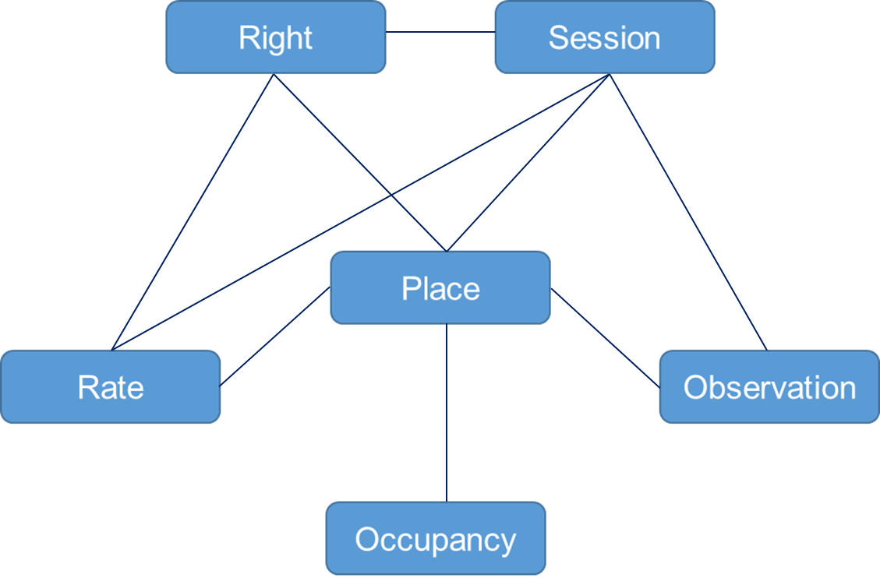


Smarter Parking – APDS Data Domains

Slide 6
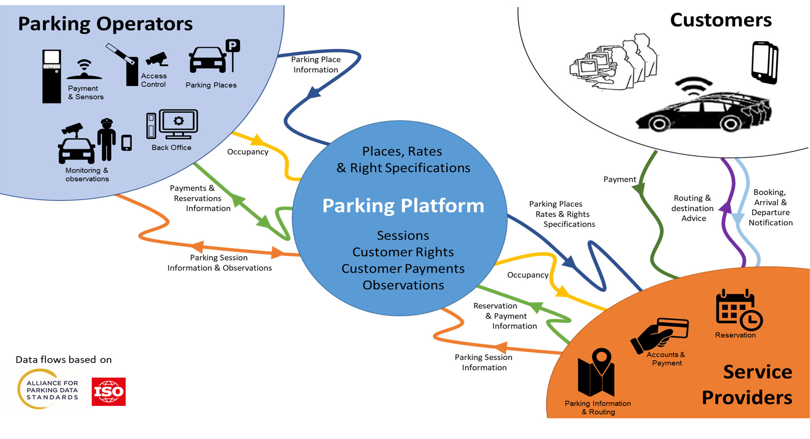
The National Parking Platform – Concept Diagram
A publicly owned, national facility that enables Parking Operators (public and private) to communicate digitally with Service Providers.
The Platform is open to all Operators and Service Providers, enabling them to exchange the full range of parking information using APDS (ISO) standard interfaces.
Operators will be able to:
Describe the parking they offer (including rates, times, restrictions etc)
Publicise occupancy in real time*
Accept payments and reservations* from Service Providers without the need for a contract with each one
Digitise compliance monitoring without the need for local digital infrastructure
Service Providers will be able to:
Offer their customers the ability to park in any participating Operator’s facility
Pay Operators for parking used by their Customers without the need for a contract with each one
Negotiate rates and access with Operators for their Customers
Reserve spaces in Operator’s facilities*
Develop value added services (e.g. guidance to space, frictionless parking) based on standard, available information*.
* This feature may be dependent on site suitability and installed equipment

Slide 7
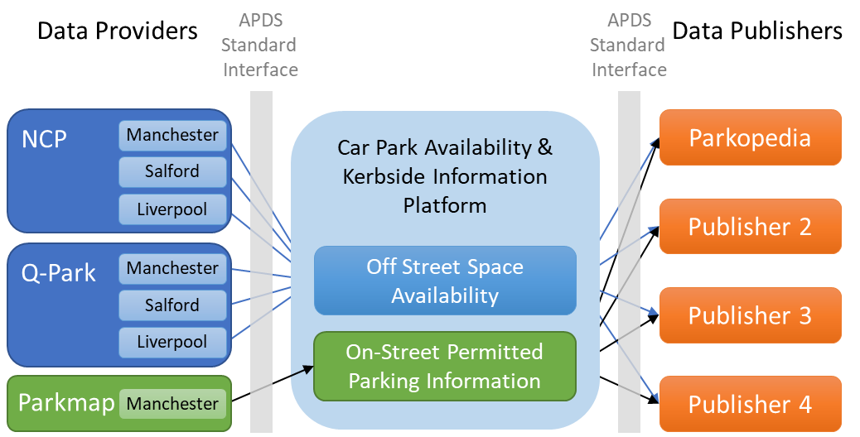
Pilots Phase 1 - Space availability
Phase 1, completed at the end of 2019 demonstrated the potential for a platform based on APDS standards.
Off street providers (NCP and Q-Park) provided data on occupancy in their Manchester, Salford and Liverpool multi storey car parks.
Manchester City Council provided data direct from their TRO database, providing a list of all on-street parking in the City including restrictions and tariffs.
This data was made available on a set of standard APDS compliant APIs, which were used by Parkopedia to enhance the data in their system.
The data is available to other potential publishers.

Slide 8
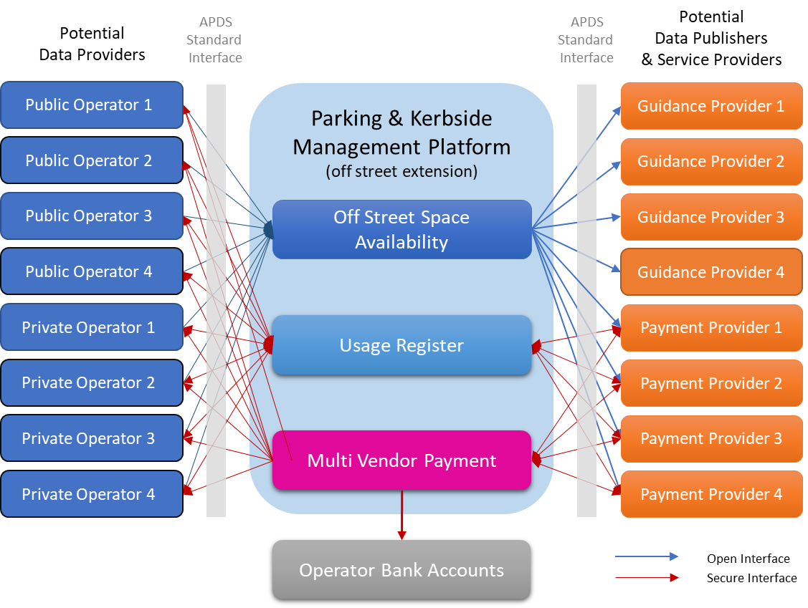
Pilots Phases 2/3 - Multi Vendor Payment
Phases 2/3 build on the Phase 1 parking platform and the APDS-based interface.
They continue to open parking data and hold it in public ownership, thereby removing commercial conflicts from the provision of parking data to the market. Phases 2/3 will bring together Parking Operators and Service Providers to demonstrate:
The potential for the platform to have nationwide coverage (Phase 1 covered car parks in Manchester, Salford and Liverpool).
Multi-vendor payment functionality allowing motorists a choice of payment provider
Reconciliation of payments from multiple sources across multiple parking operators/car parks
The potential for commercial app usage, innovation and reporting

Slide 9







Pilots Phase 2/3 - Use Cases – Improving The Customer Journey
In all cases details of location, tariff and availability are supplied to the service provider to help them guide their customer to the most suitable parking space
Use Case 1 - Payment on arrival
Service Provider
Customer enters parking session details & pays on app
Operator
Session checked by enforcement
Parking session & payment details
Session & payment details
Use Case 2 – ANPR frictionless payment
Payment details
Parking Platform
Payment details
Service Provider
Operator
Customer enters & leaves car park
Parking session details
Parking session details
Use Case 3 - Pay on departure ticket payment
Parking session & payment details
Session & payment details
Service Provider
Operator
Customer pays on app when returning to car
Barrier raises for customer at exit
Notes:
Also, focus on capability – valet parking, automated transactions will really interest them.

Slide 10
Current Partners

Slide 11
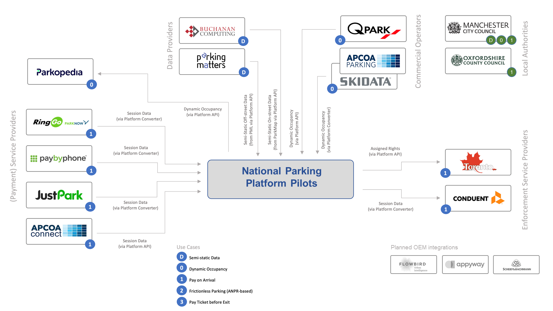
Current Pilot Partners

Slide 12
NPP Partner Role
Depending on whether you are an Operator, Service Provider or Equipment Supplier you will be asked to:
Enable some of your on and/or off-street parking to accept payment from Service Provider Partners
Use the Platform to communicate parking sessions at Places managed by participating Operators
Develop APDS compliant interfaces to communicate with the Platform
Send and receive funds in line with agreements between participating Operators and Service Providers.
In return, you will:
Help define the future of parking in the UK
Be able to advertise your involvement in this ground breaking initiative
Gain insights into the potential for new opportunities and business models
Accept payment from a range of participating service providers
Gain practical knowledge in the use and implementation of APDS (future ISO TS 5206) standards.

Slide 13
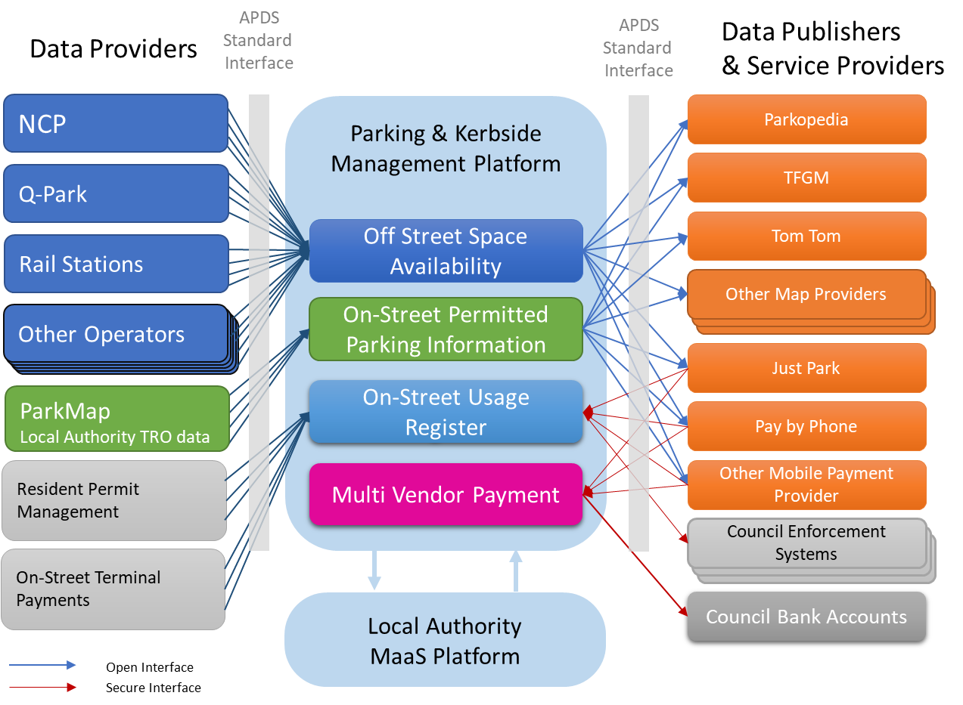
Phase 3 and beyond - National Parking Platform
Value Added Services
The Future!
A Multi-Modal Platform
Platform functionality could be further extended:
To integrate with MaaS platforms
To other forms of rights such as emissions zones
As part of a wider kerbside management and monetisation strategy
Data held in the Platform could also be monetised by reporting & analysis functionality to inform planning and policy development.

