Slide 1
Module-7 Assignment – 2 Cloudformation
You have been asked to:
Create a template with 1 VPC and 1 Public Subnet
Launch an Amazon Linux EC2 instance in the public subnet and tag the instance as “CFinstance”

Slide 2
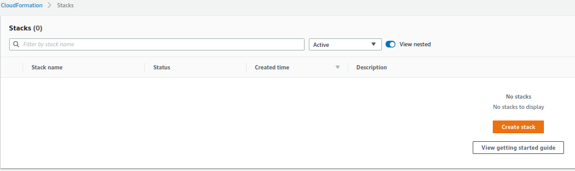
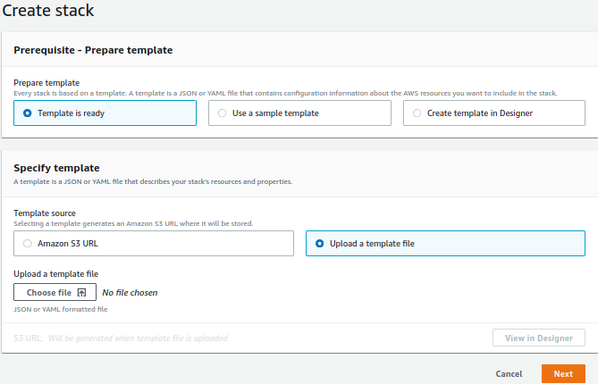
1. Open cloudformation in AWS console
2. Click on Create stack
3. Upload YAML template
4. Click Next and Finish all steps to create stack and verify

Slide 3
YAML Preamble
AWSTemplateFormatVersion: 2010-09-09
Description: "Module 7 Assignment 2 - YAML file to create a VPC, 1 public subnet, and an Amazon Linux EC2 instance, named CFInstance, in the public subnet."

Slide 4
VPC YAML
Resources:
#VPC
m7a2vpc:
Type: 'AWS::EC2::VPC'
Properties:
CidrBlock: 10.0.0.0/16
InstanceTenancy: Default
Tags:
- Key: Name
Value: m7a2vpc
- Key: CreatedBy
Value: Hariharan Narayanan

Slide 5
Public Subnet YAML
#Public Subnet
m7a2publicsubnet:
Type: 'AWS::EC2::Subnet'
Properties:
VpcId:
Ref: m7a2vpc
CidrBlock: 10.0.1.0/24
AvailabilityZone: "us-east-1a"
MapPublicIpOnLaunch: true # Map a public IP on launch since this is a public subnet
Tags:
- Key: Name
Value: m7a2publicsubnet
- Key: CreatedBy
Value: Hariharan Narayanan

Slide 6
Public Route Table YAML
#Public route table
m7a2publicroutetable:
Type: AWS::EC2::RouteTable
Properties:
VpcId:
Ref: m7a2vpc
Tags:
- Key: Name
Value: m7a2publicroutetable
- Key: CreatedBy
Value: Hariharan Narayanan

Slide 7
Attach route table to subnet - YAML
#Attach public route table to public subnet
m7a2attachpublicrttosubnet:
Type: AWS::EC2::SubnetRouteTableAssociation
Properties:
SubnetId:
Ref: m7a2publicsubnet
RouteTableId:
Ref: m7a2publicroutetable

Slide 8
Internet gateway YAML
#Internet gateway
m7a2internetgw:
Type: 'AWS::EC2::InternetGateway'
Properties:
Tags:
- Key: Name
Value: m7a2internetgw
- Key: CreatedBy
Value: Hariharan Narayanan

Slide 9
Attach internet gateway to VPC - YAML
#Attach internet gateway to vpc
m7a2attachigwtovpc:
Type: AWS::EC2::VPCGatewayAttachment
Properties:
VpcId:
Ref: m7a2vpc
InternetGatewayId:
Ref: m7a2internetgw

Slide 10
Route entry in public route table - YAML
#Route entry in public route table for instances in the public subnet to reach the Internet and vice-versa.
m7a2publicroutetableroute:
Type: AWS::EC2::Route
Properties:
DestinationCidrBlock: 0.0.0.0/0
GatewayId: m7a2internetgw
RouteTableId: m7a2publicroutetable

Slide 11
EC2 instance YAML
#Route entry in public route table for instances in the public subnet to reach the Internet and vice-versa.
m7a2publicroutetableroute:
Type: AWS::EC2::Route
Properties:
DestinationCidrBlock: 0.0.0.0/0
GatewayId: m7a2internetgw
RouteTableId: m7a2publicroutetable
#Create an EC2 instance of Aazon Linux called CFinstance in the public subnet
CFinstance:
Type: AWS::EC2::Instance
Properties:
AvailabilityZone: "us-east-1a"
ImageId: "ami-08e4e35cccc6189f4"
InstanceType: "t3.micro"
KeyName: "hariharan_aws_us_east_1"
SubnetId:
Ref: m7a2publicsubnet
Tags:
- Key: Name
Value: CFinstance
- Key: CreatedBy
Value: Hariharan Narayanan

