Slide 1
Module-2: Case Study
Problem Statement:
You work for XYZ Corporation. Your corporation is working on an application, and they require secured web servers on Linux to launch the application.
You have been asked to:
Create an Instance in us-east-1 (N. Virginia) region with Linux OS and manage the requirement of web servers of your company using AMI
Replicate the instance in us-west-2 (Oregon) region
Build two EBS volumes and attach them to the instance in us-east-1 (N. Virginia) region
Delete one volume after detaching it and extend the size of other volume
Take backup of this EBS volume

Slide 2
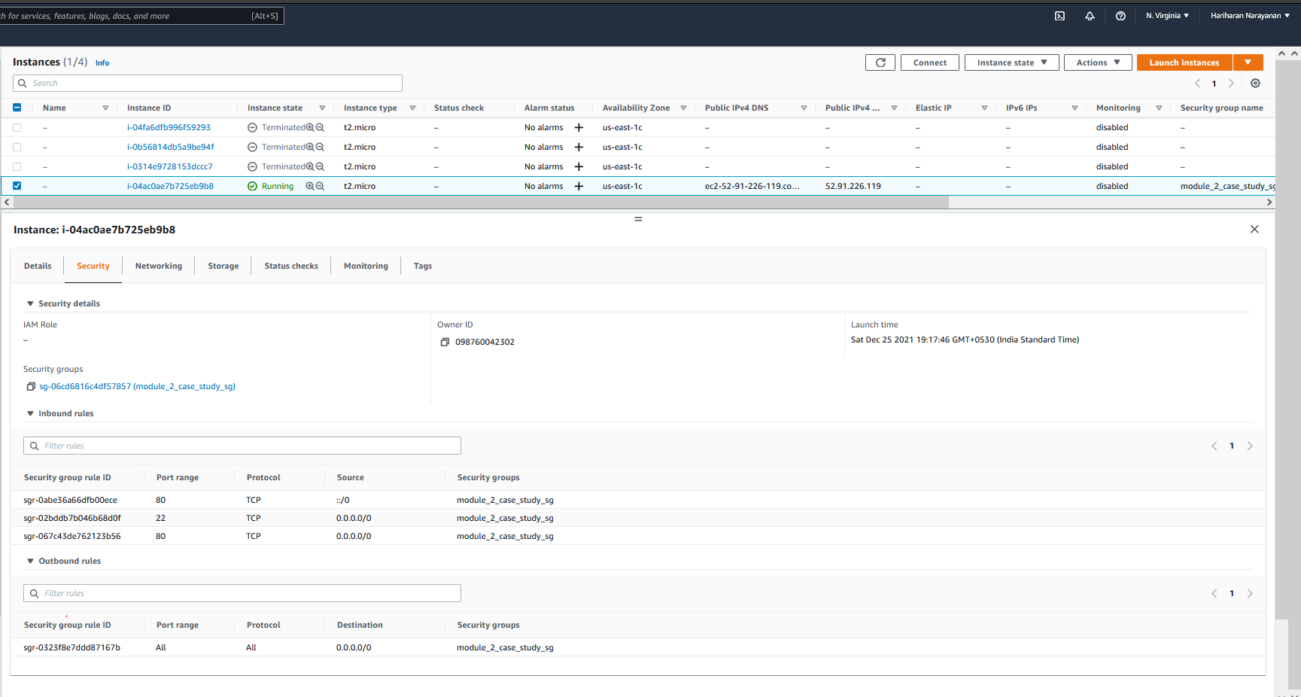
1. Set region as N. Virginia (use-east-1)
2. As per steps provided in Module 2 assignment 1
2.1. Create an Ubuntu EC2 instance
2.2 Add inbound security group rules to allow for SSH and HTTP requests
2.3 Install nginx in the instance
2.4. Open the IP address of the instance in a browser and verify nginx default landing page is displayed

Slide 3
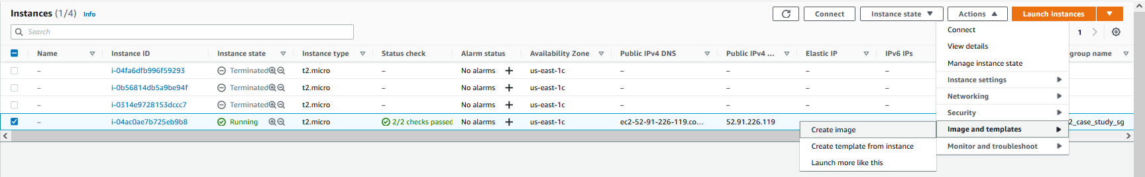
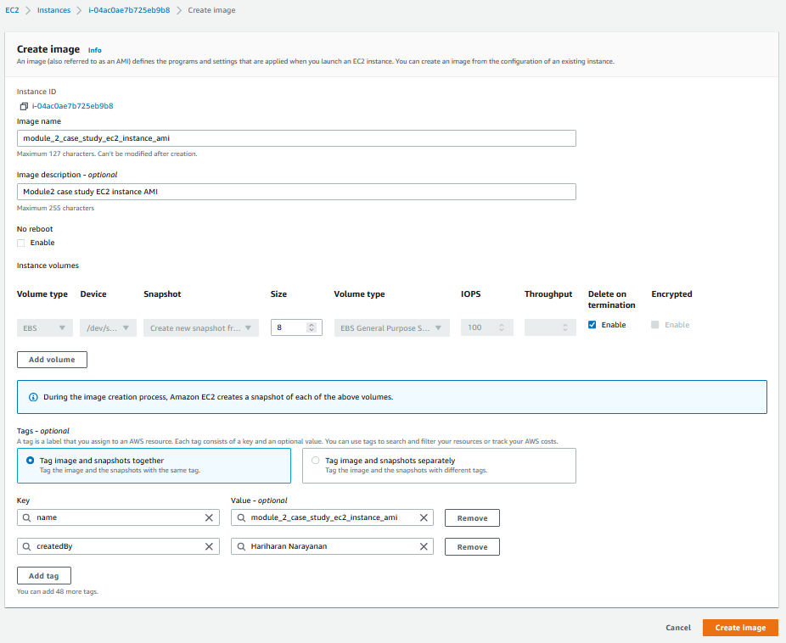
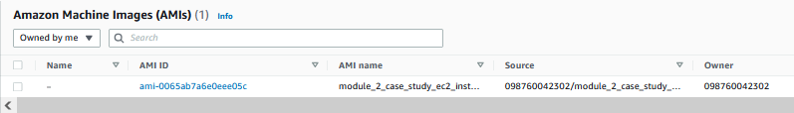
3. Select the image and then select Action → Image and Templates → Create AMI
4. Type the AMI name
5. Type AMI description
8. Go to AMIs page in the EC2 dashboard. Wait until AMI image state shows as Available
6. Create Tags as needed
7. Create image

Slide 4
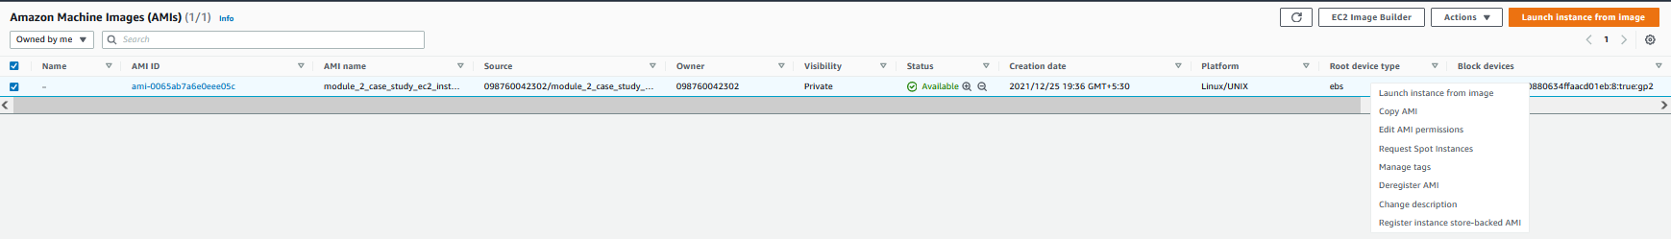
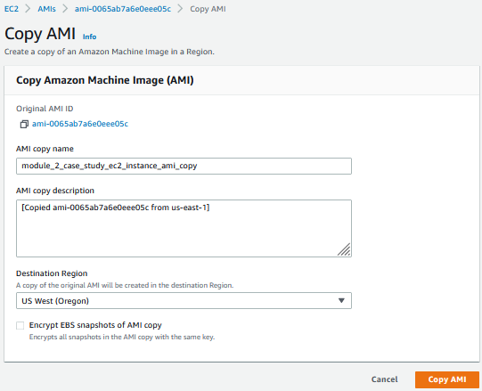
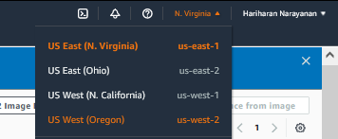
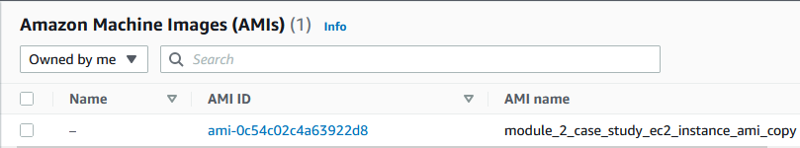
9. Right-Click on the AMI created and select “Copy AMI”
13. In the top-right, choose US West (Oregon) us-west-2 as the region
10. Enter name
11. Choose destination Oregon
14. Verify that the AMI copy from step 12 is visible in Oregon region
12. Copy AMI

Slide 5
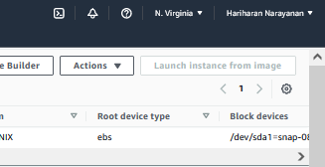
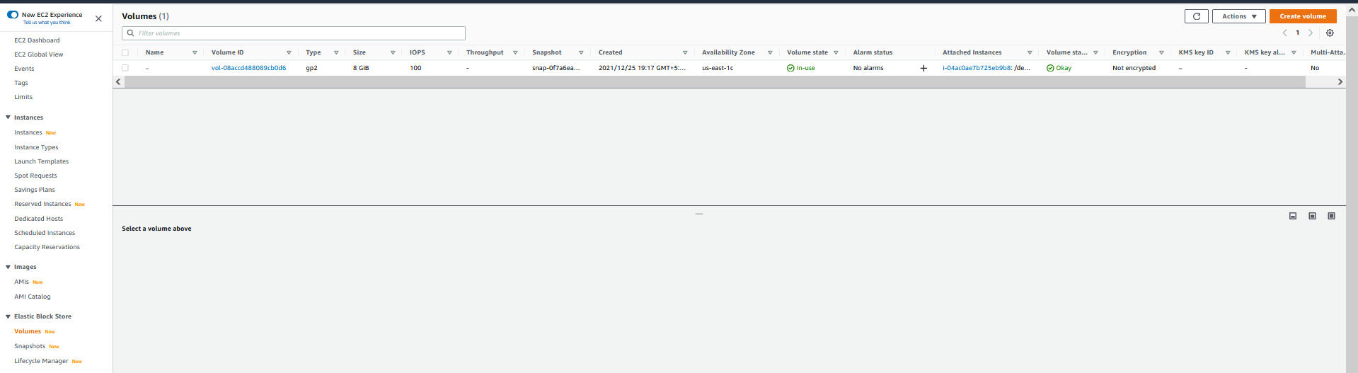
15. Go back to N. Virgina region
17. Create volume
16. Choose “Volumes” under “Elastic Block Store”

Slide 6
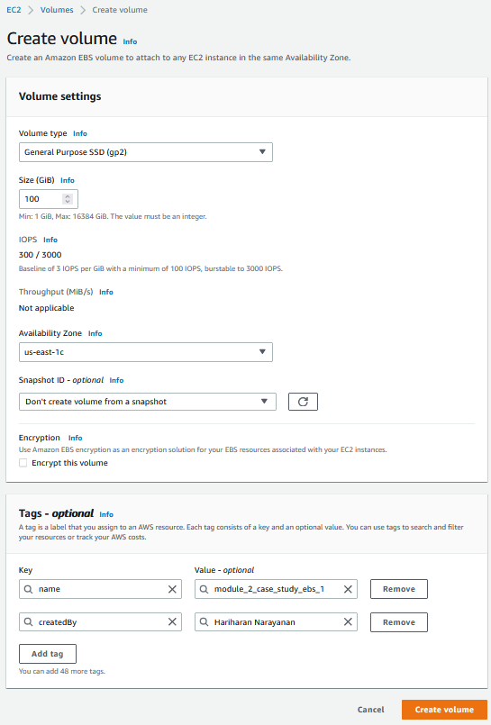
21. Repeat same steps to create another EBS volume
18. Select same region given for EC2 instance
19. Create tags as needed
20. Create Volume

Slide 7
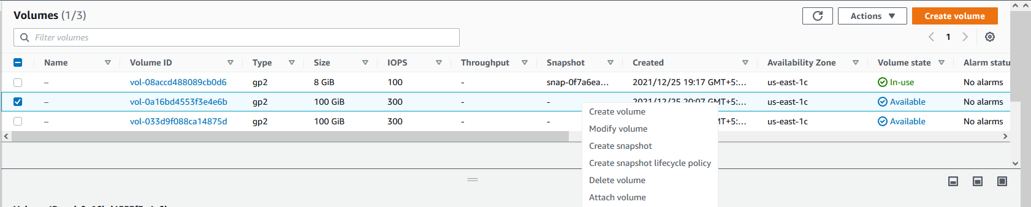
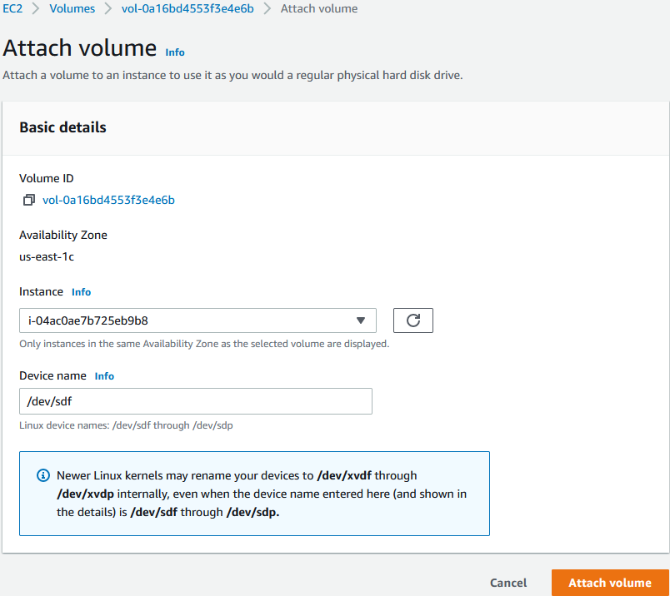
22. Right-click on an EBS volume, select “Attach Volume”
23. Select the EBS instance created earlier to attach
25. Repeat steps 20-24 for the 2nd EBS instance
24. Select Attach Volume

Slide 8
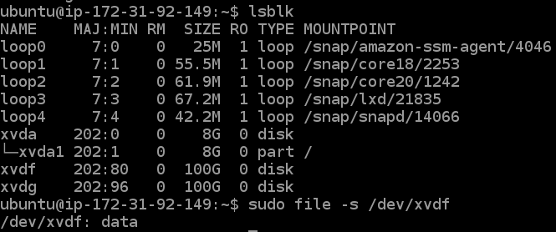
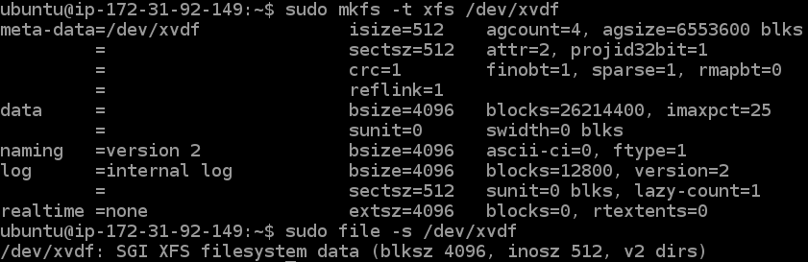
26. In EBS instance, confirm that both EBS instances are visible as xvdf and xvdg
27. Check that file type is “data” confirming no file system is created
28. Create an XFS file system mounted on /dev/xvdf corresponding to one EBS volume
29. Verify that XFS filesystem is created on /dev/xvdf
30. Repeat steps 25-28 on the other EBS volume

Slide 9
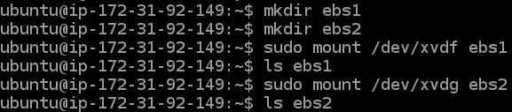
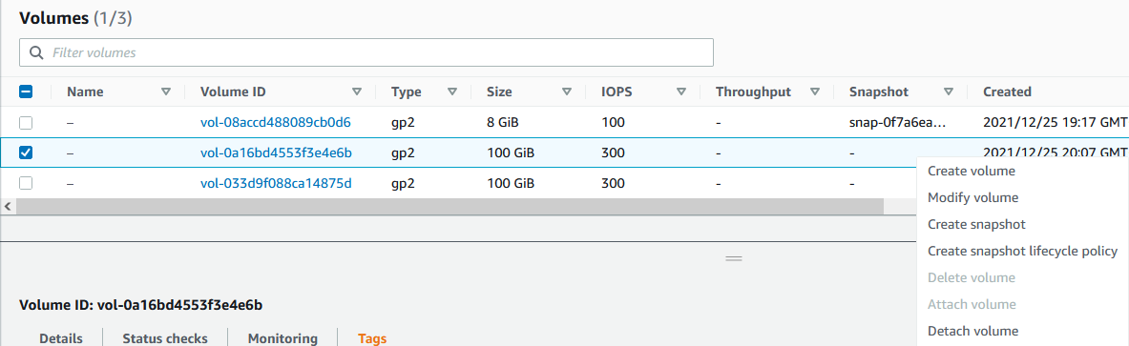
31. Mount both the EBS volumes
32. Unmount the volume for one EBS and confirm that it is removed
33. Detach the volume corresponding to ebs1
34. Delete the volume similarly after Detach

Slide 10
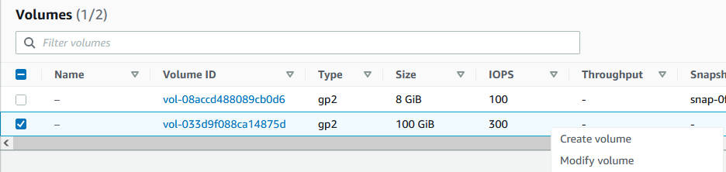
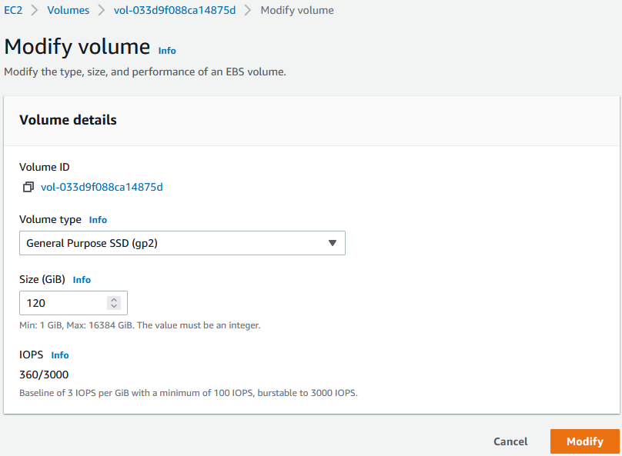
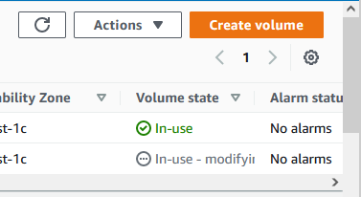
35. Select Modify Volume on second EBS volume
38. Wait for Modify status to change to “In-use”
36. Change size from 100 to 120 GiB
37. Click on Modify

Slide 11
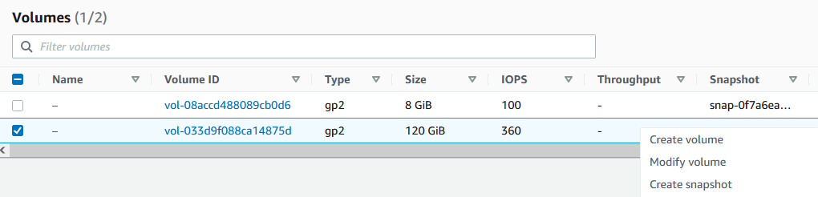
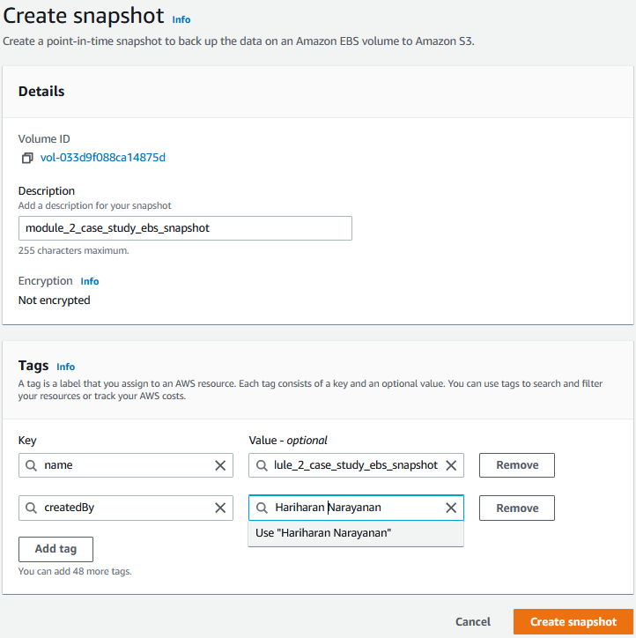
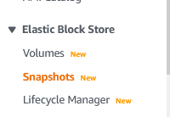
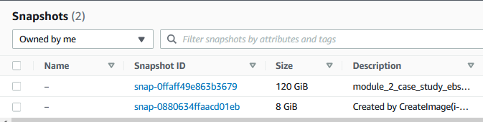
39. right-click on resized volume and select “Create Snapshot”
43. Select Snapshots under EBS menu
40. Select a name
41. Create Tags as needed
44. Verify that snapshot is created
42. Create Snapshot

