Slide 1
Module 5: S3 Assignment - 1
You have been asked to:
Create an S3 bucket
Upload 2 objects

Slide 2
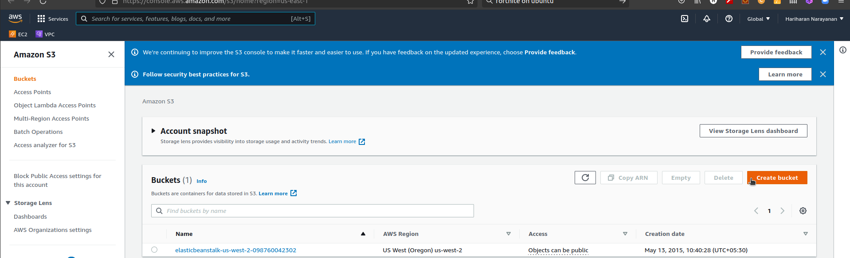
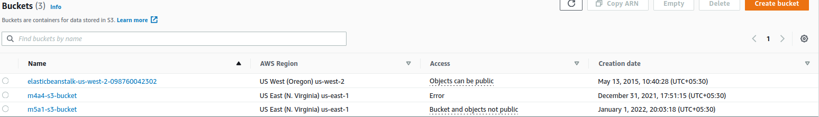
1. Type S3 in search bar. Open S3 dashboard
2. Note that region changes to Global
3. Create bucket
4. Verify new S3 bucket in dashboard.
Click on it

Slide 3
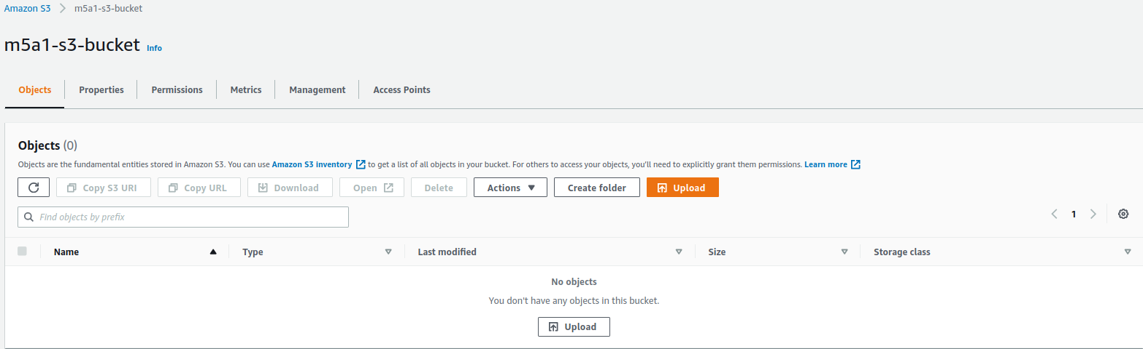
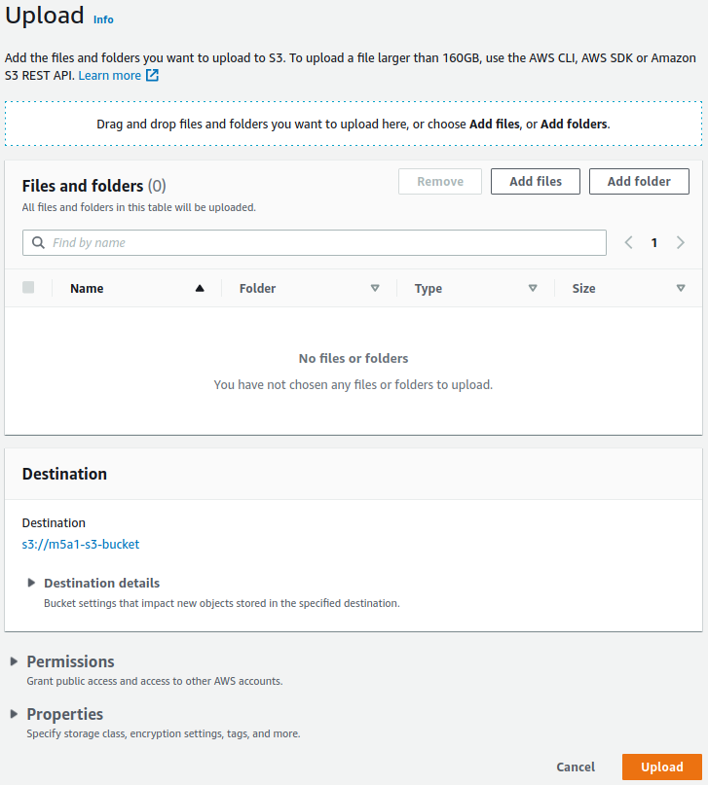
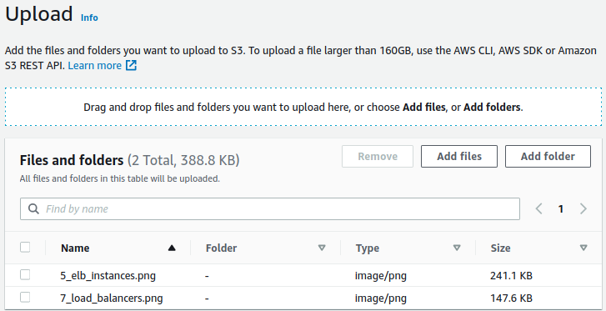
5. Click on Upload
6. Add file
7. Add 2 files. Click on Upload

Slide 4
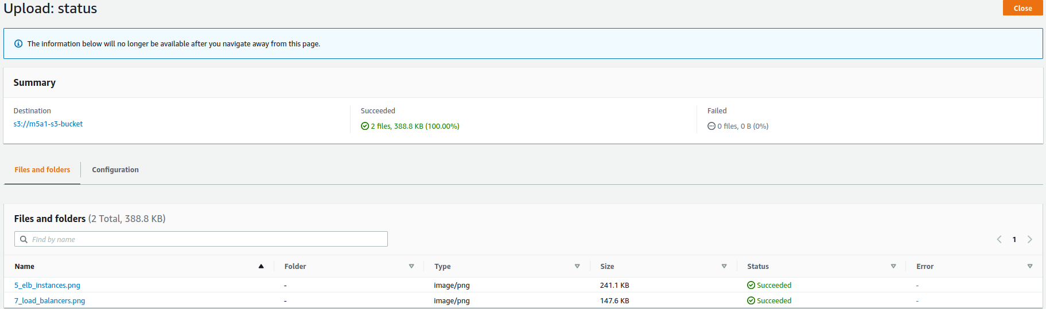
9. Close
8. Verify that files are uploaded

