Slide 1
Module 5: S3 Assignment - 2
You have been asked to:
Enable versioning for the bucket created in task 1
Now upload the same 2 objects and verify if the versioning works

Slide 2
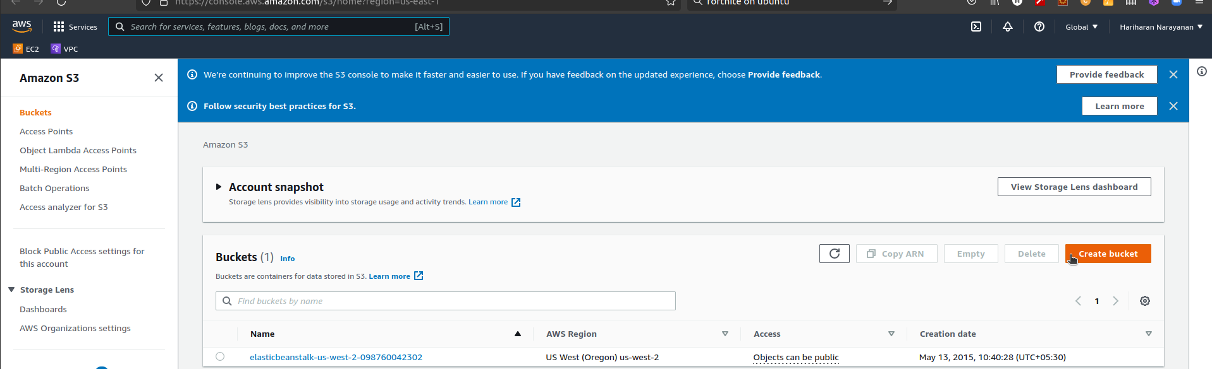
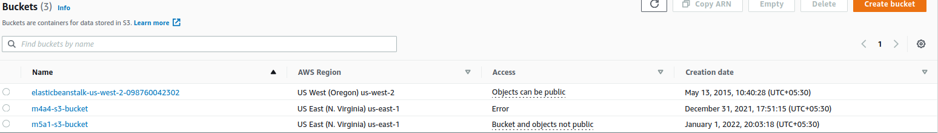
1. Type S3 in search bar. Open S3 dashboard
2. Note that region changes to Global
3. Select m5a1-s3-bucket

Slide 3
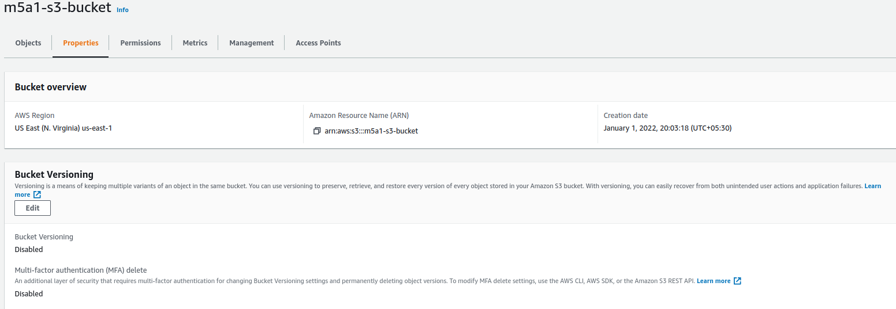
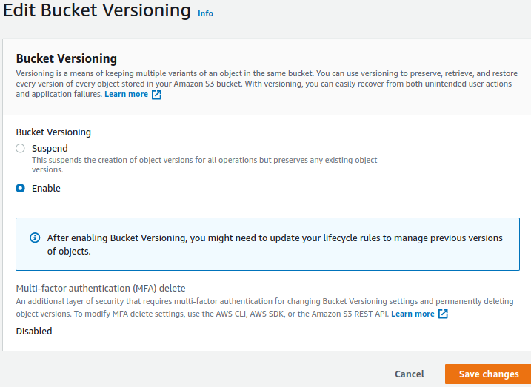
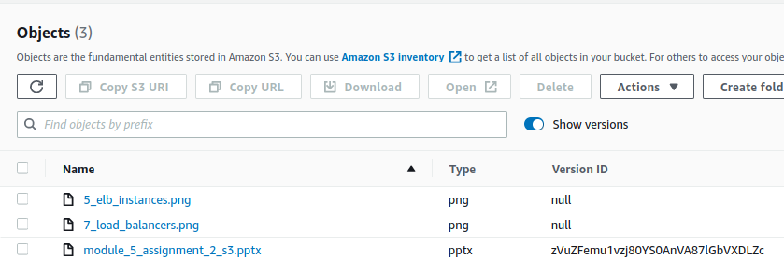
4. Select Properties
5. Edit Bucket Versioning
6. Enable versioning
8. Upload new file
9. Note the version
7. Save

Slide 4
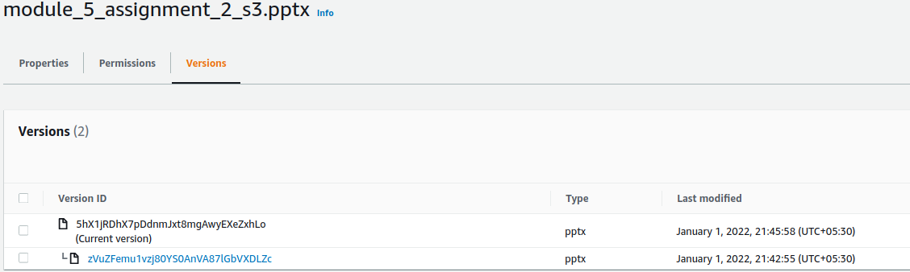
10. Make changes to file uploaded in (8) and upload again
11. Click on the file object
12. Select Versions
13. Observe multiple Versions

