Slide 1
Module-2: EC2 and EFS Assignment - 3
You have been asked to:
1. Create an EFS and connect it to 3 different EC2 instances. Make sure the all instances have different Operating System. For instance, Ubuntu, Red Hat Linux and Amazon Linux 2

Slide 2
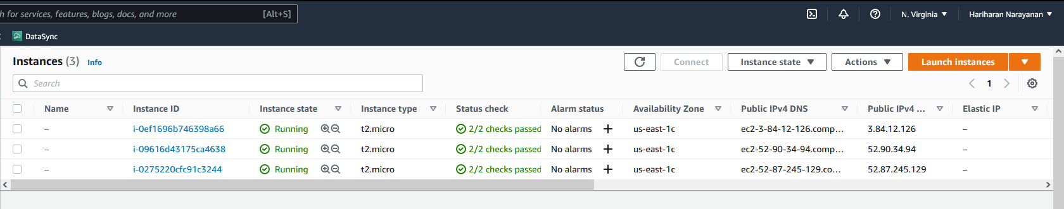
RHEL
Amazon Linux
Ubuntu
1. Use the same steps mentioned in module_2_assignment_1 to create 3 new EC2 instances

Slide 3
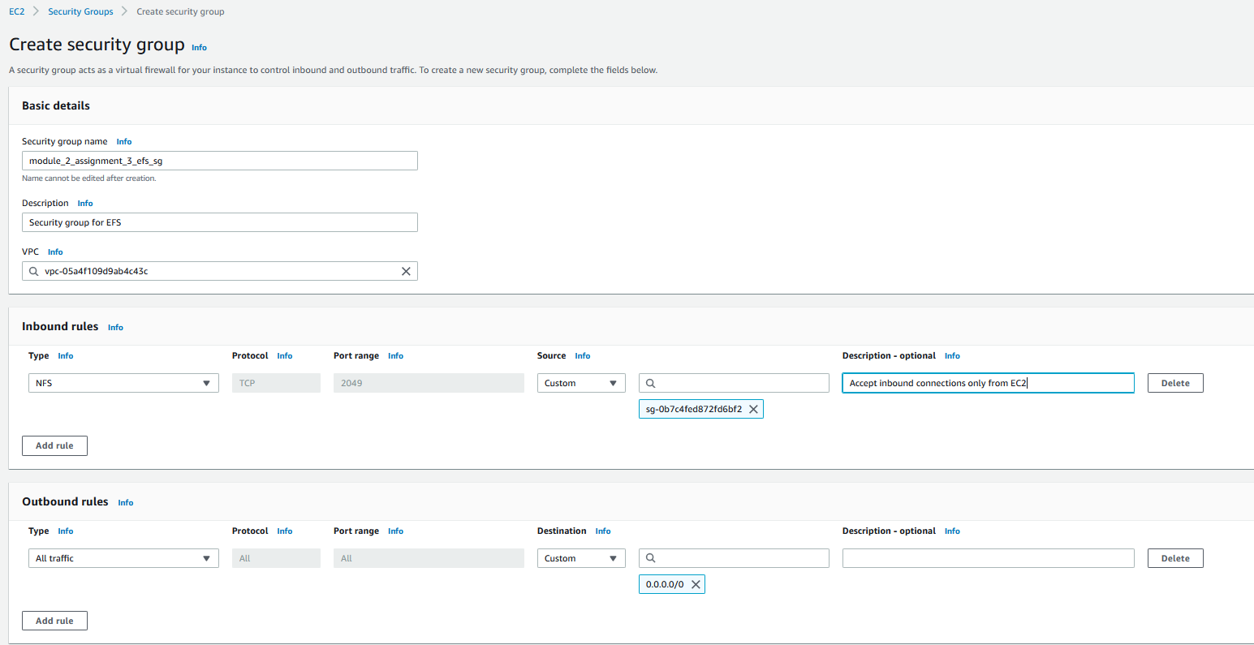
2. Create a new security group for EFS only
3. Create inbound rule for NFS. Provide the sg of the EC2 instances to accept incoming connections only from EC2
4. Create an outbound rule to any connection.

Slide 4
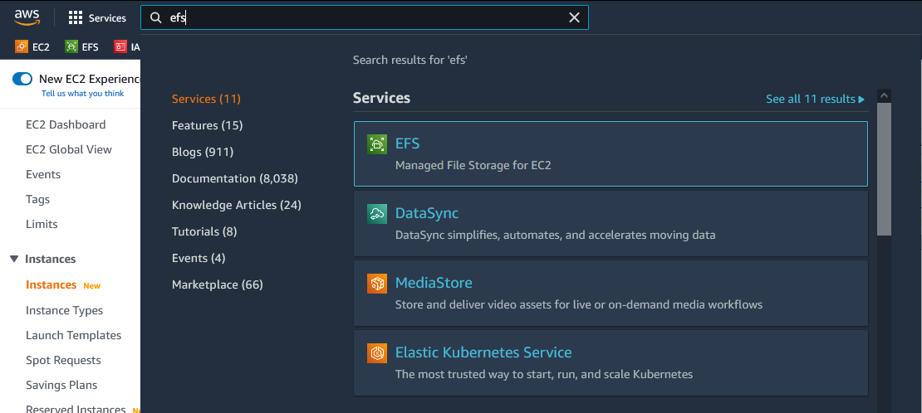
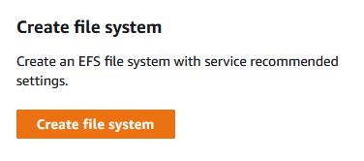
5. Type “efs” in search bar and select EFS
6. In the EFS page, select to create new file system

Slide 5
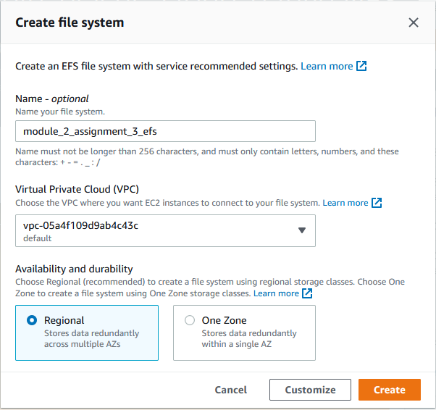
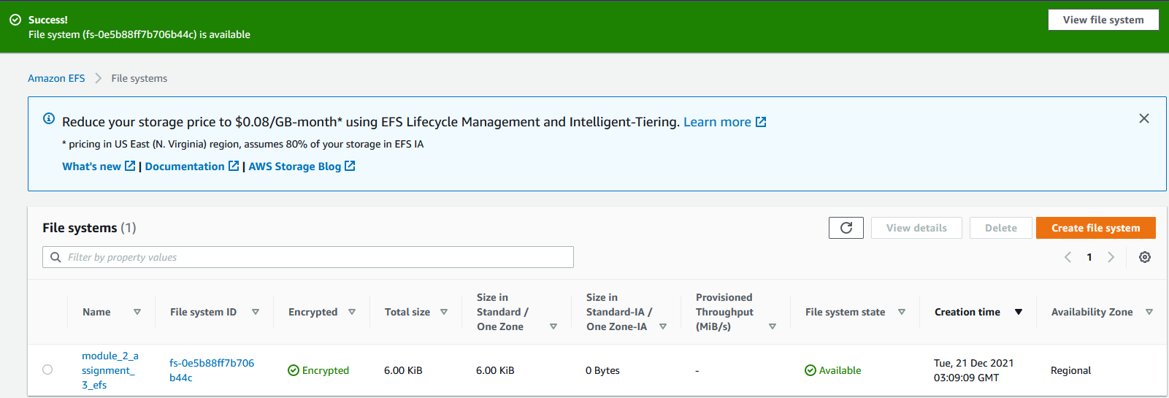
7. Type a name for the EFS
8. Leave default VPC as it is
10. Select Create
9. Select Regional
11. Wait until EFS status becomes “Available”

Slide 6
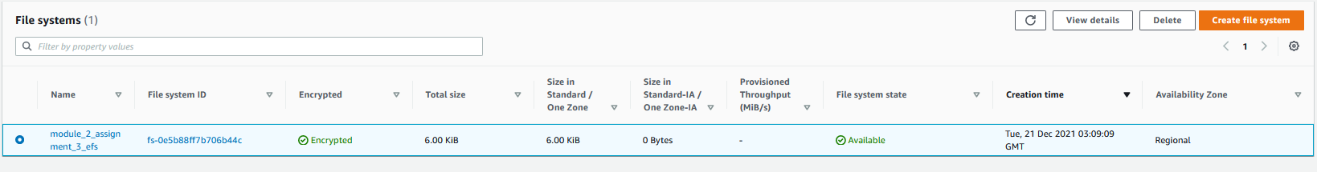
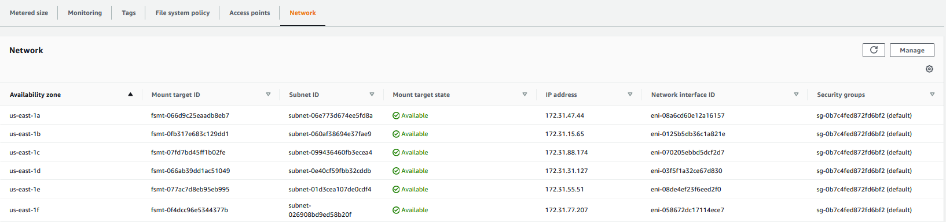
13. Select to view details
12. Select the EFS created
14. Select “Network” tab to view mount targets
15. Select “Manage”

Slide 7
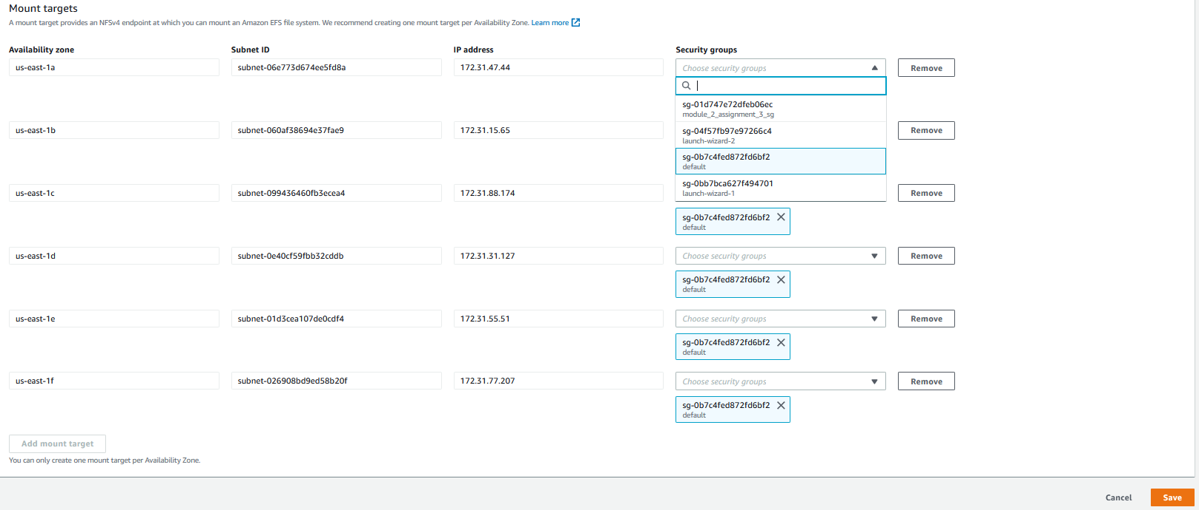
16. For each mount target repeat the below 2 steps (a) and (b) …
(a) Select the security group created in slide 2 steps 2-4
(a) Delete the default security group assigned
17. Save

Slide 8
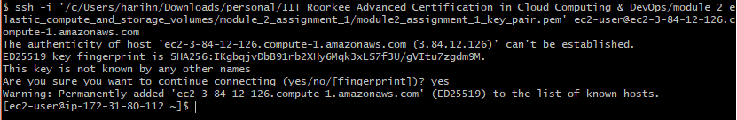
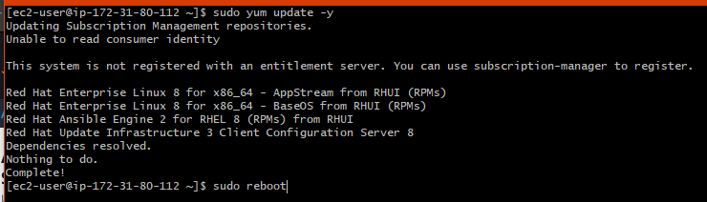
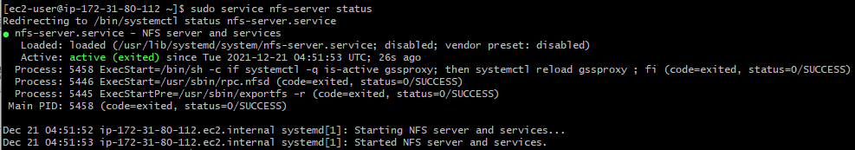
18. Login by SSH into RHEL instance
19. First execute “sudo yum update”
11. Then reboot the EC2 instance
20. Install nfs-utils
21. Restart nfs
22. Verify that nfs-server is started and running correctly

Slide 9
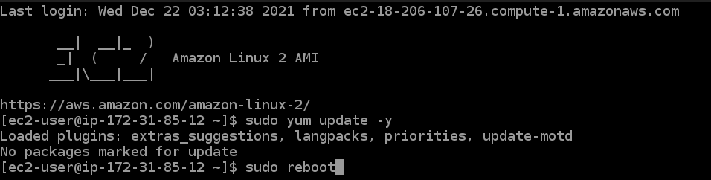
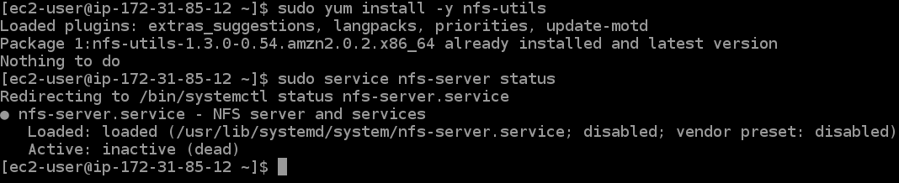
23. Login by SSH into AmazonLinux instance
24. Execute “sudo yum update”
25. Then reboot the EC2 instance
26. Verify that nfs-server is started and running correctly

Slide 10
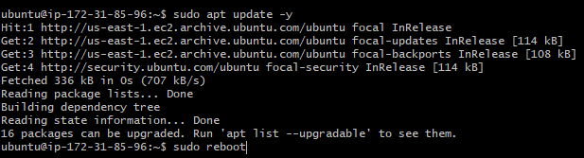

27. Login by SSH into Ubuntu instance
28. Execute “sudo apt update”
29. Then reboot the EC2 instance
30. Verify that nfs is started and running correctly

Slide 11
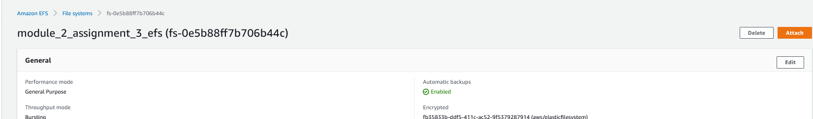
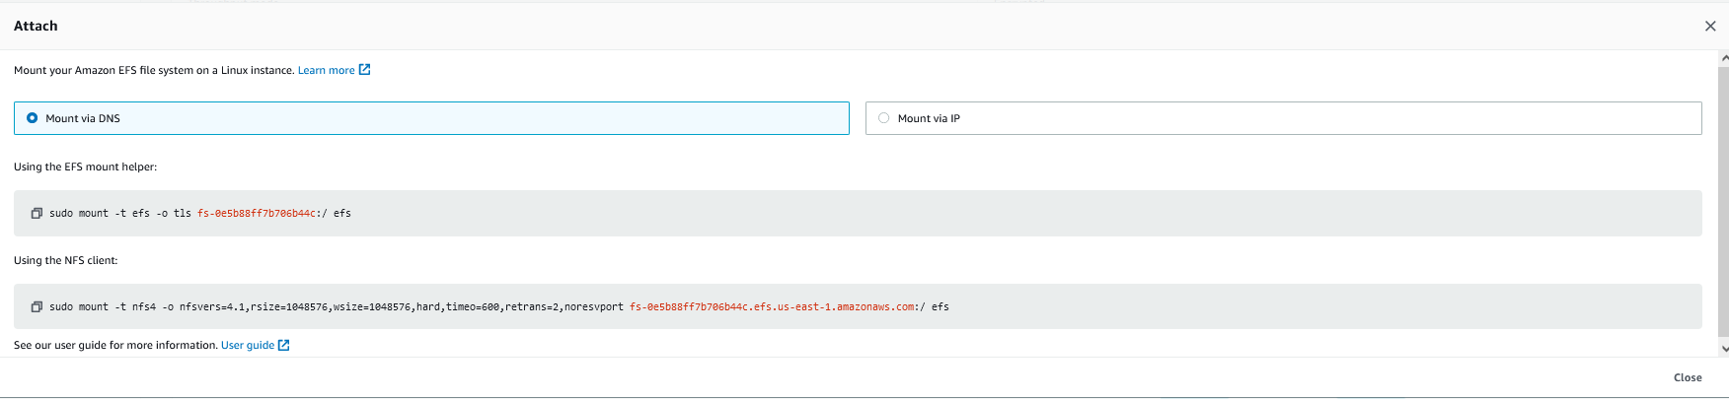
31. In the EFS page, select the EFS and select “View Details”. Then select “Attach”
32. Copy the mount command
33. Close

Slide 12
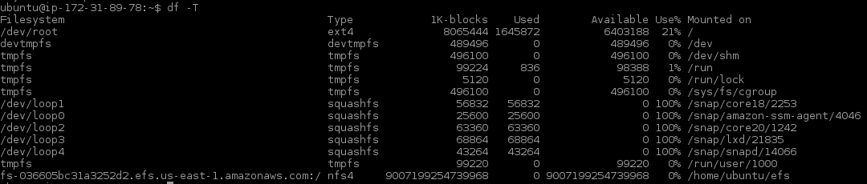
34. In the Ubuntu instance, Create a local directory ~/efs
35. Type this comment to mount the EFS as a local directory ~/efs
36. Execute the command “df –T” to see that the new EFS is mounted as local directory /home/ubuntu/efs
37. Repeat the same steps 32..34 in the RHEL and Amazon Linux EC2 instances also.

