Slide 1
Module 8 Assignment 3 - IAM
You have been asked to:
Create a Role which only lets user1 and user2 from task 1 to have complete access to VPCs and DynamoDB
Login into user1 and shift to the role to test out the feature

Slide 2
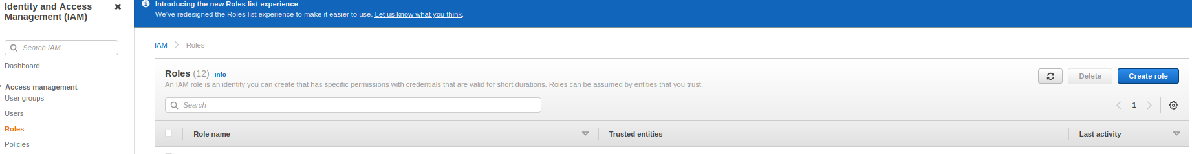
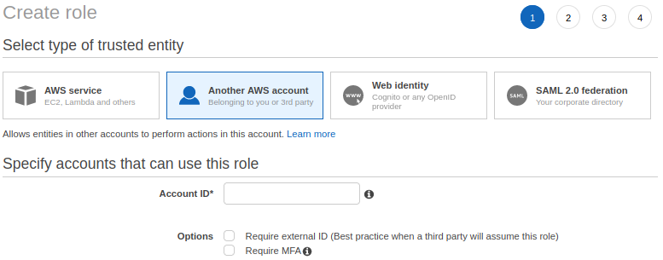
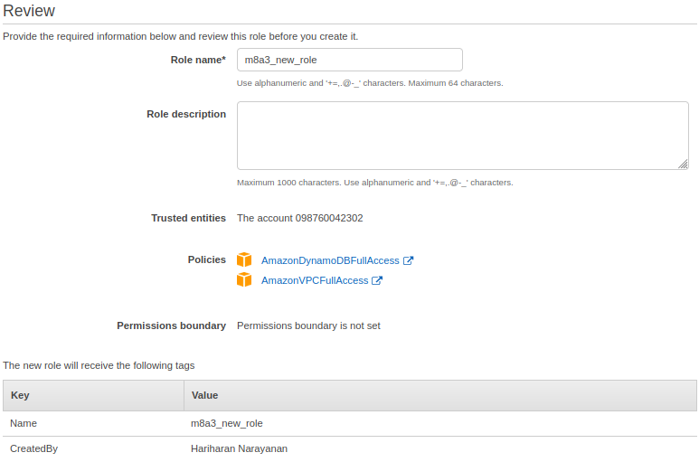
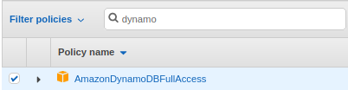

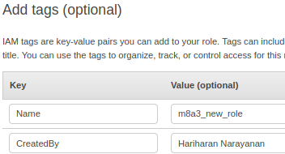
2
1
3
6
4
7
1. Open IAM Console and click on “Roles”
2. In the Roles Console, click on “Create role”
3. In Step 1, select “Another AWS account” and provide your AWS account ID
4. Search and select DynamoDBFullAccess and VPCFullAccess. Click “Next”
5. Create Tags and click “Next”
6. In the Review page, name the role as “m8a3_new_role” and click on “Create role”
7. Verify that new role is created.
5

Slide 3

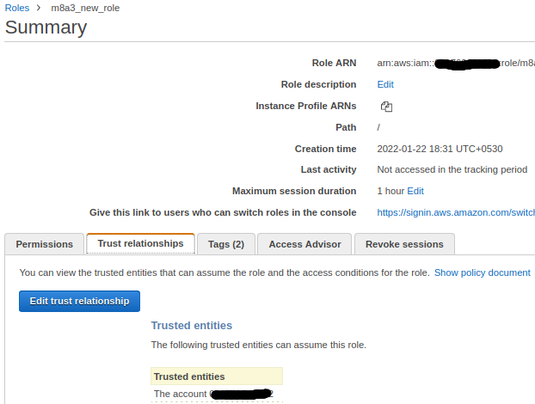
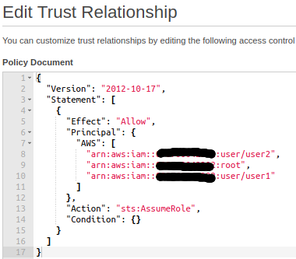
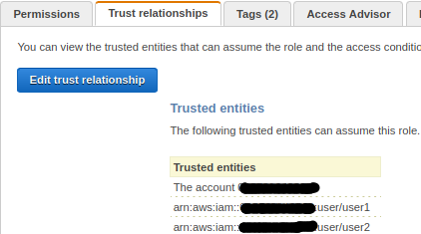
8
9
10
8. Open Roles Console. Click on the newly created role “m8a3_new_role”
9. Click on “Trust Relationships”. Click on “Edit trust relationship”
10. . Add users user1 and user2 in the JSON. Save and return
11. In the Roles console, verify that the users user1 and user2 are now visible in Trusted entities.
11

Slide 4
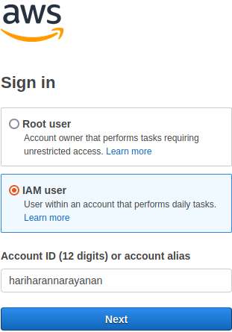
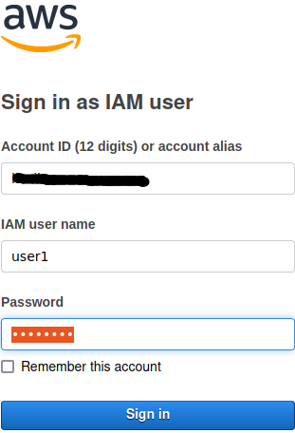
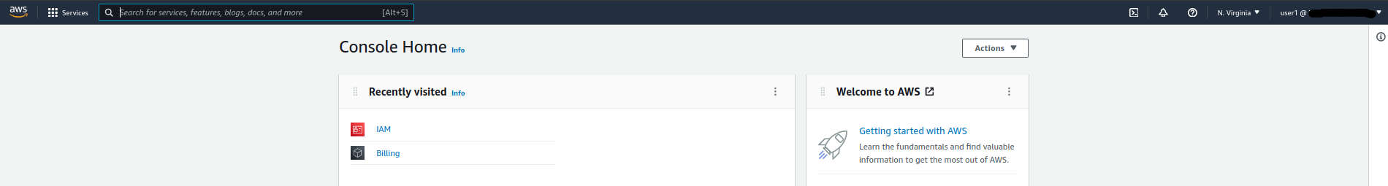
12. Logout. In the Login screen, choose “IAM user”
13. Type account ID or alias, choose “user1” as user name, type password, and sign in.
14. After login, verify from top-right that “user1” is logged in.
12
13
14

Slide 5
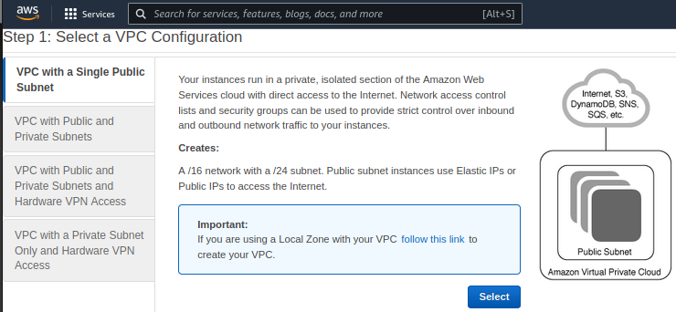
15
15. Open VPC wizard from VPC console to confirm that User1 has assumed the role correctly to create VPC.

