Slide 1
Module 6: Database Services Assignment - 2
You have been asked to:
Create an Amazon Aurora database with 2 Read Replicas

Slide 2
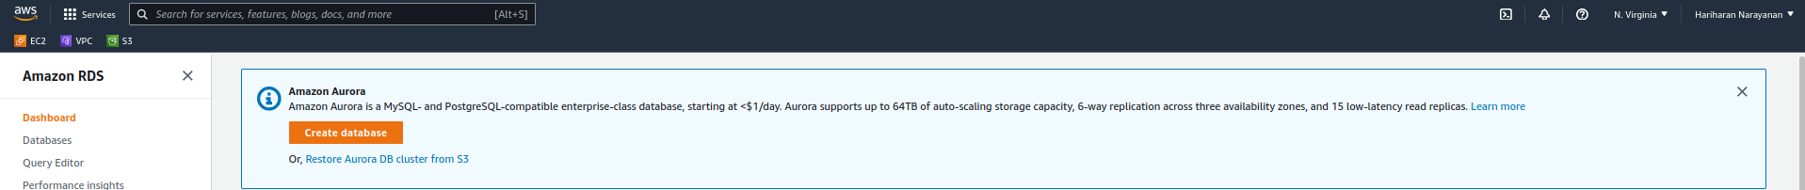
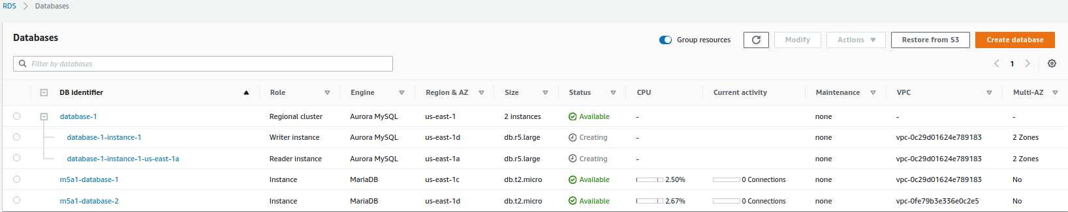
1. Type RDS in search bar. Open dashboard
2. Let region remain N.Virgina
3. Create database
4. Set admin password as admin123.
Leave all other options as it is.
4. Set admin password as admin123.
Leave all other options as it is.
5. Create a new DB cluster param group. Set binlogs format to ROW in this. Finally set “DB cluster parameter group” in create db to this
6. Wait until Aurora db becomes available

Slide 3
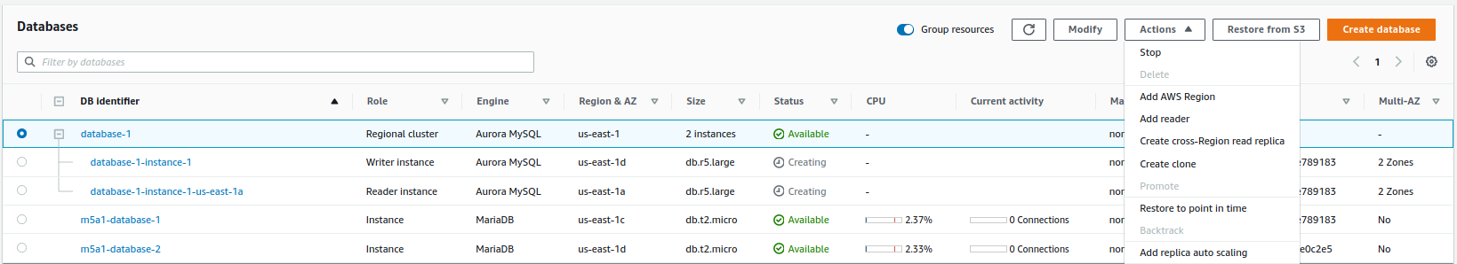
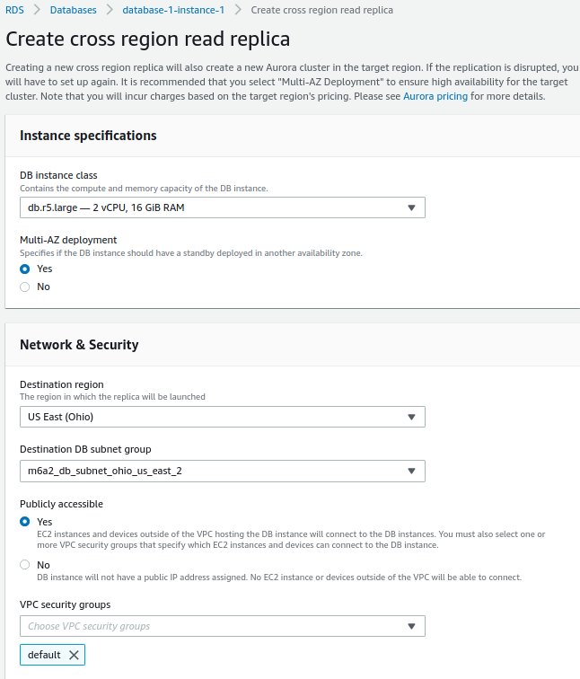
7. Wait until created DB instances become available
8. Select DB. Select to create read replica
9. Choose a destination region
10. Ensure that this subnet is created in the destination region beforehand. Choose this region
11. Select “Create”
12. Repeat same steps from 7-10 to create another read replica

