Slide 1
Module-6: Database Services Assignment-3
You have been asked to:
Create a DynamoDB table with a partition key as ID
Add 3 items to the DynamoDB table
Take a back up and delete the table

Slide 2
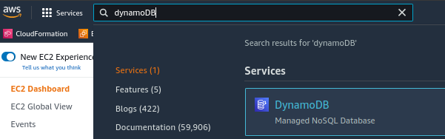
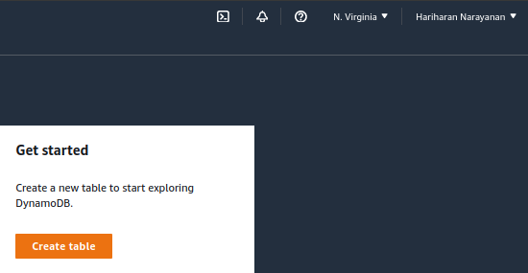
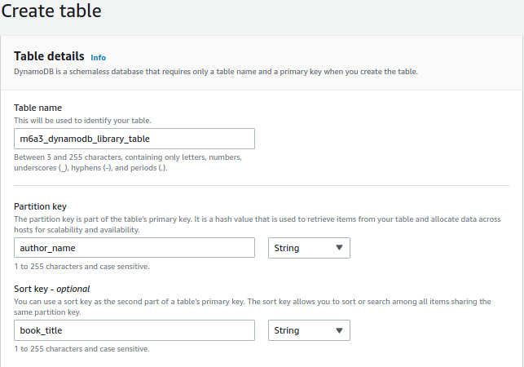
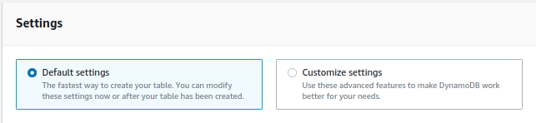
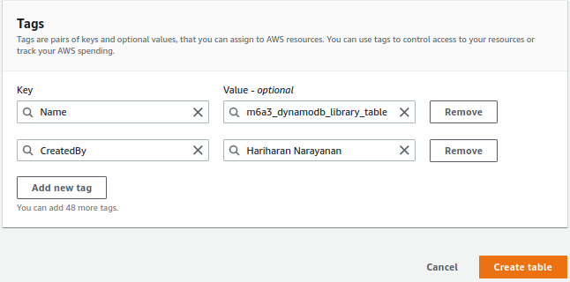
1. Type DynamoDB in AWS Console search bar
3. Ensure region is N. Virgina
2. Select DynamoDB
4. Click on Create Table
8. Leave default settings
5. Name the table
9. Create tags as needed
6. Provide partition key
7. Provide sort key
10. Create table

Slide 3
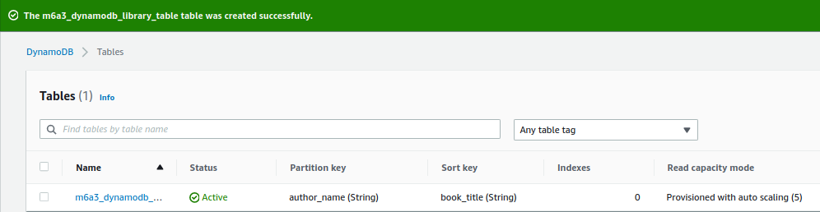
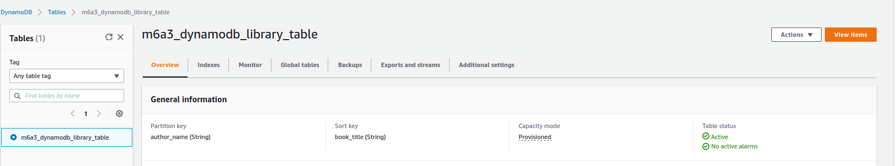
12. Click on table to open details
11. Wait until table is created successfully
13. View items

Slide 4
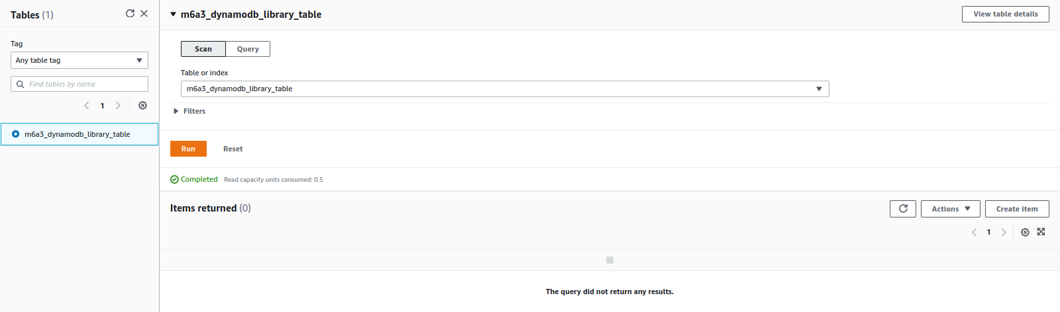
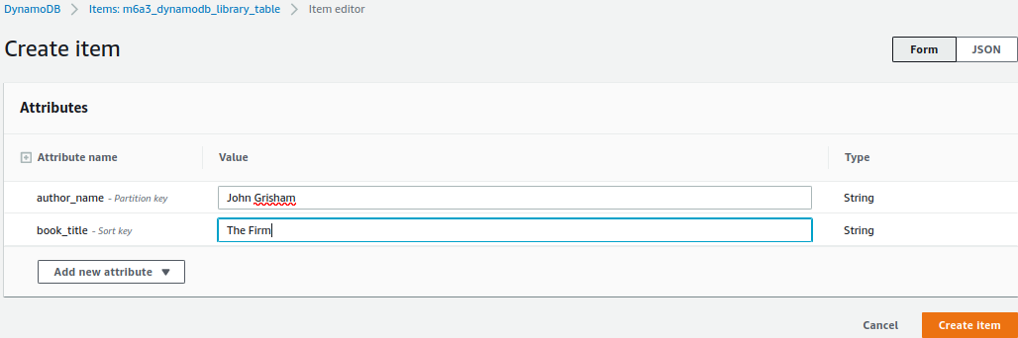
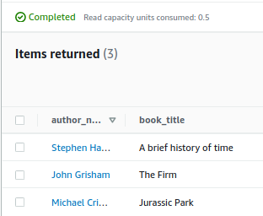
14. Create item
17. Repeat steps 14-16 to create 3 such records
15. Enter values
16. Save

Slide 5
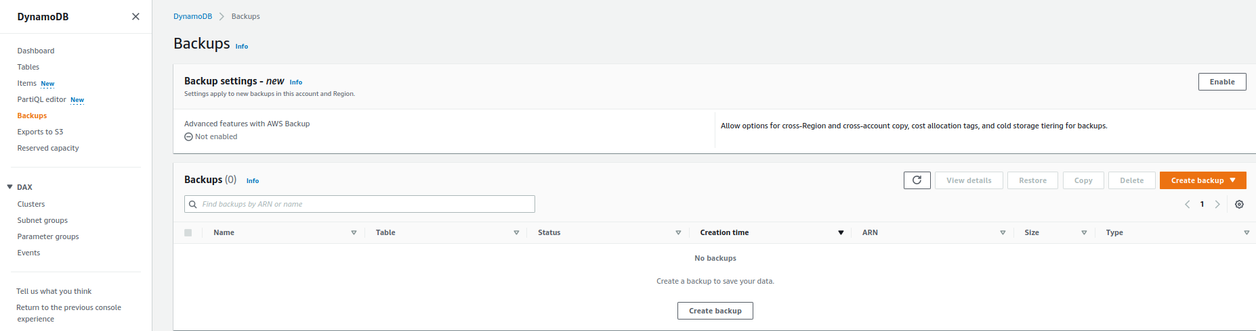
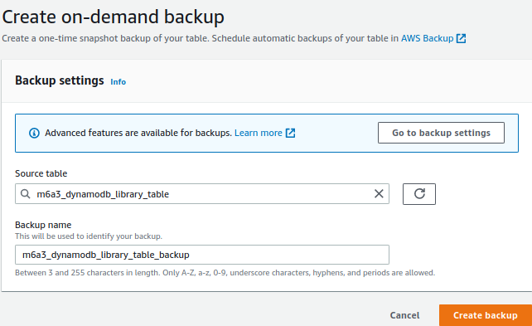
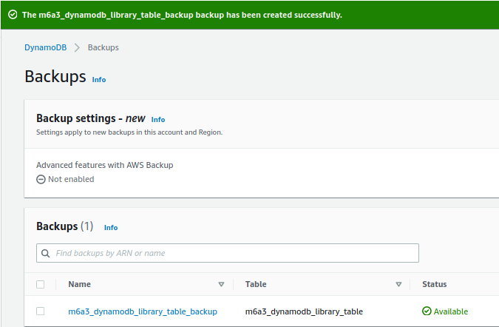
18. Select Backups in DynamoDB console
19. Create backup
20. Select table to backup
21. Select name of backup
22. Create backup
23. Verify that backup is created

Slide 6
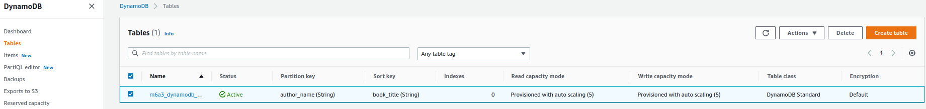
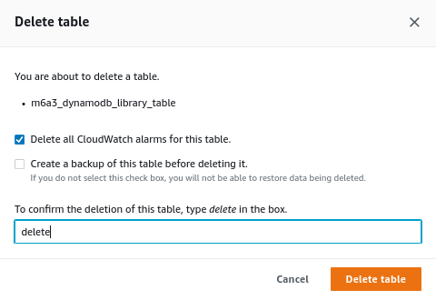
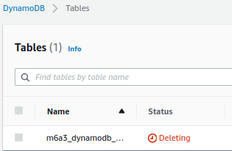
24. Select Tables
26. Delete
25. Select Tables
29. Wait until table is deleted
28. Confirm
27. Type “delete”

