Slide 1
Module-8 Assignment – 1 IAM
You have been asked to:
1. Create 4 IAM users named “user1”, “user2”, “user3”, and “user4”
2. Create 2 Groups named “Dev Team” and “Ops Team”
3. Add user1 and user2 to the Dev Team
4. Add user1, user3 and user4 to the Ops team

Slide 2
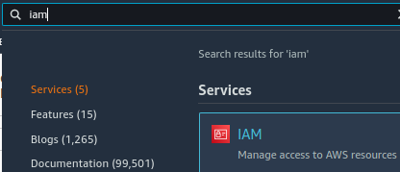
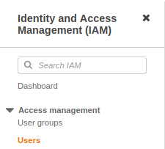

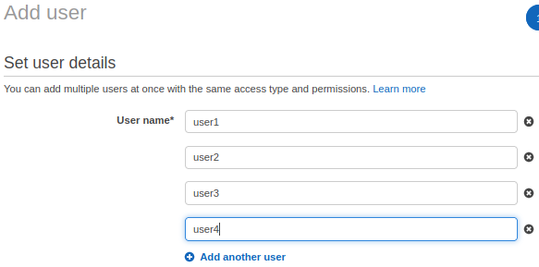
3
1
2
4
1. Open IAM console
2. Select Uses console
3. Select Add users
4. Add 4 users

Slide 3
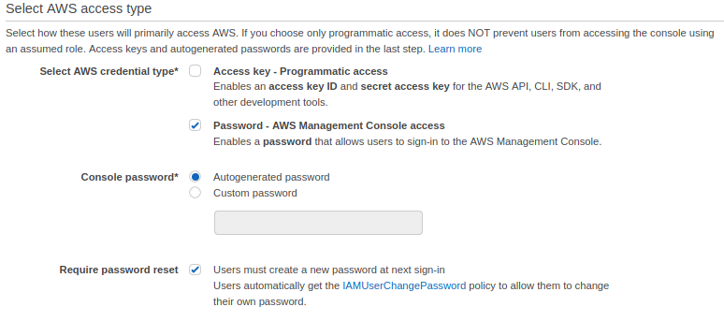
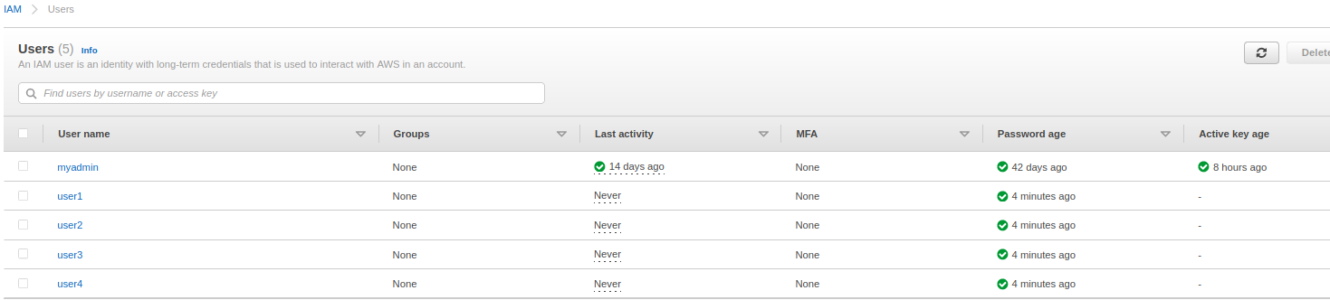
5
6
5. Select password policies
6. Complete the process and verify that users are created

Slide 4
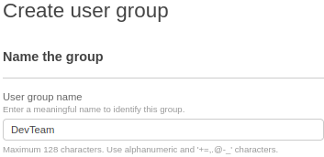
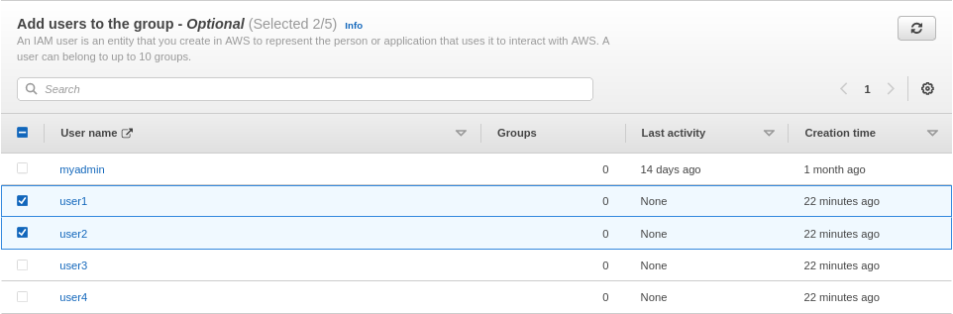
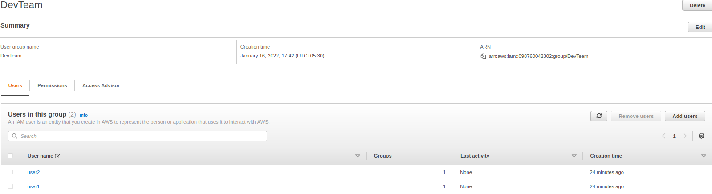
7
8
9
7. Select user groups and select create group
8. Name the group “DevTeam”
9. Select users to add to group
10. Create group
11. Verify that group is created correctly
10
11

Slide 5
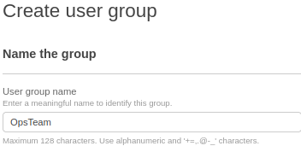
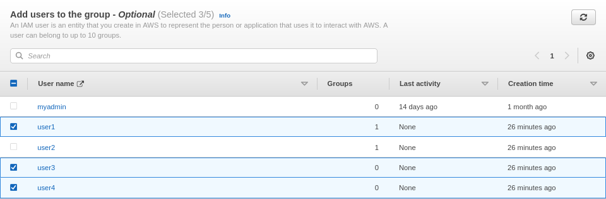
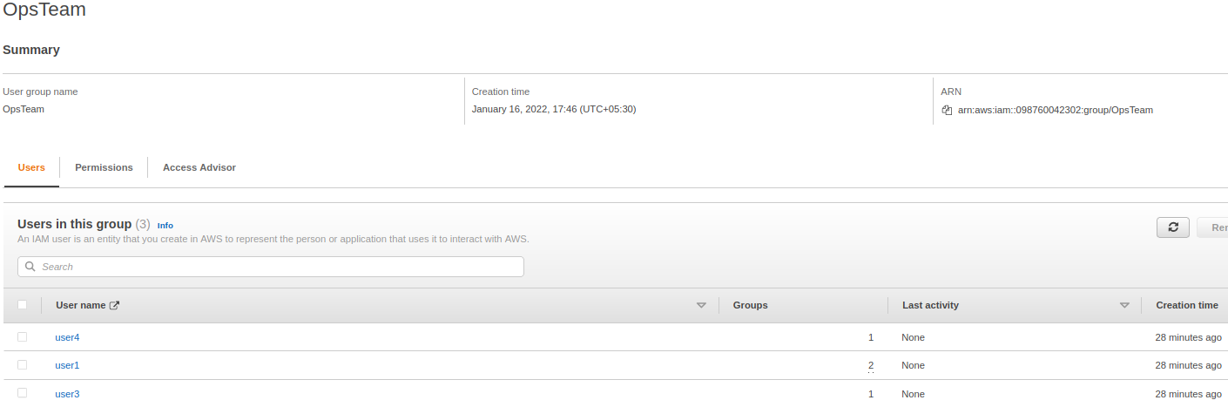
12
13
14
15
12-15. Repeat the same steps as in 7-12 to create the group “OpsTeam”

