Slide 1
Module-10: Global Accelerator Assignment - 3
You have been asked to:
Create a Global Accelerator
Make an EC2 instance as an endpoint
Make a Load Balancer as an endpoint and should be different region than the EC2 instance

Slide 2
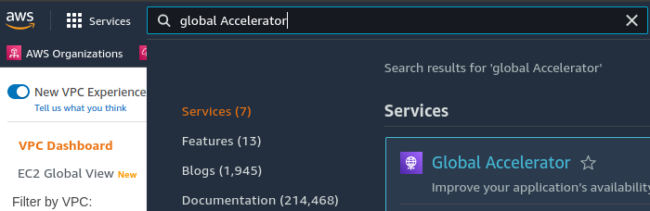
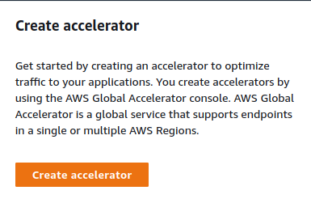
01
02
1. Ensure that an EC2 instance is created
2. Ensure that an ELB instance is created
3. Search for “Global Accelerator” in AWS console and open it
4. Click on “Create accelerator”
03
04

Slide 3
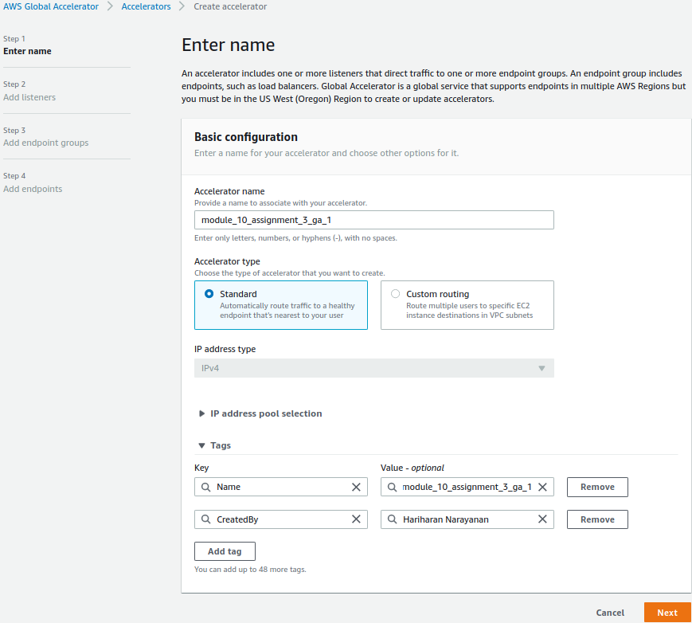
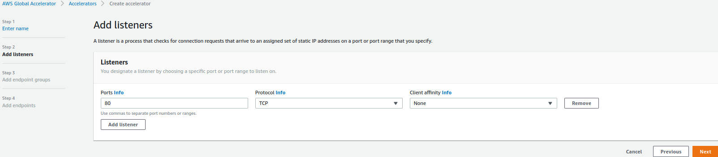
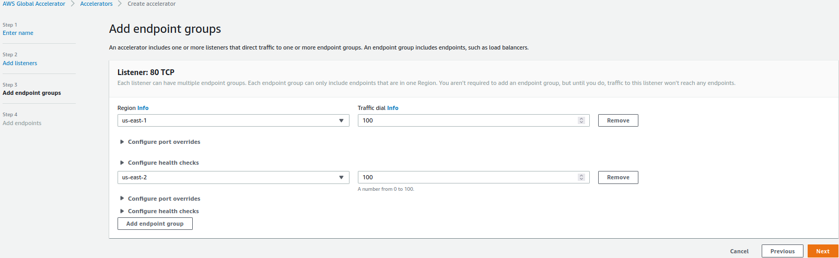
06
05
module-10-assignment-3-ga-1
07
5. Name the accelerator. Create tags as needed. Click Next
6. Add listeners to listen to 80
7. Add endpoint groups to us-east-1 and us-east-2

Slide 4
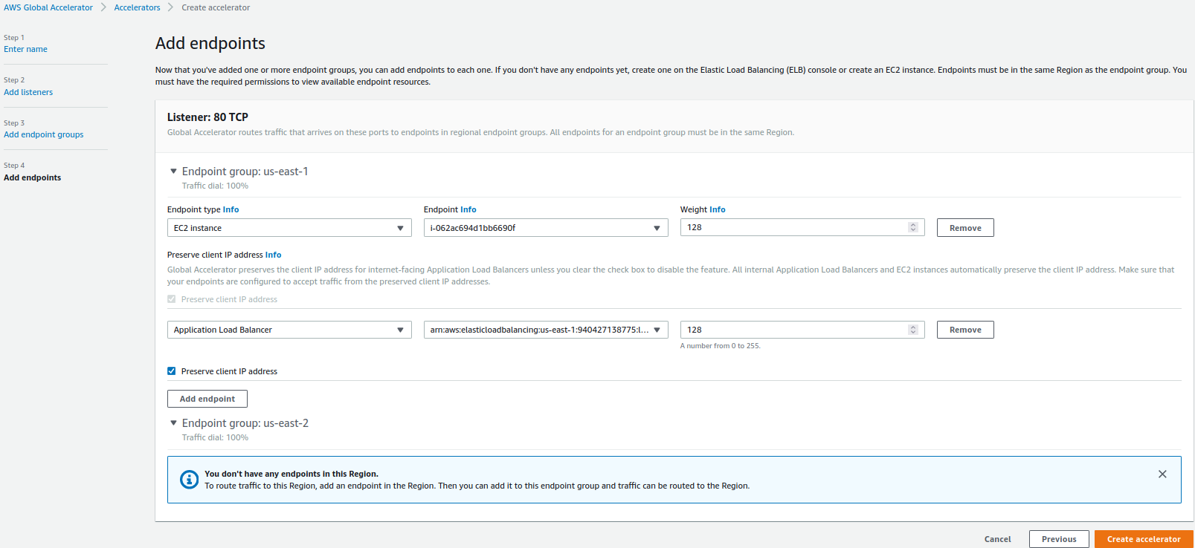
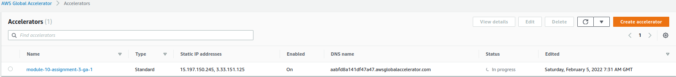
08
09
8. Add the EC2 instance and ELB instance created in (1) and (2) as endpoints. Click on “Create accelerator”
9. Verify that global accelerator is created correctly. This will take some time to show status as “deployed”

