Slide 1
Module-7 Assignment – 4 SQS and SES
You have been asked to:
Create a FIFO SQS Queue and test by sending messages
Register your mail in SES and send a test mail to yourself

Slide 2
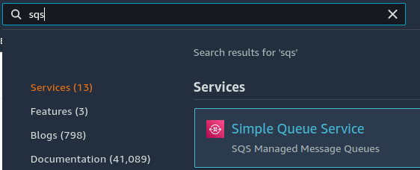
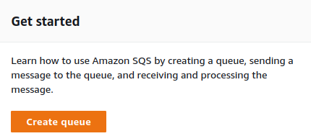
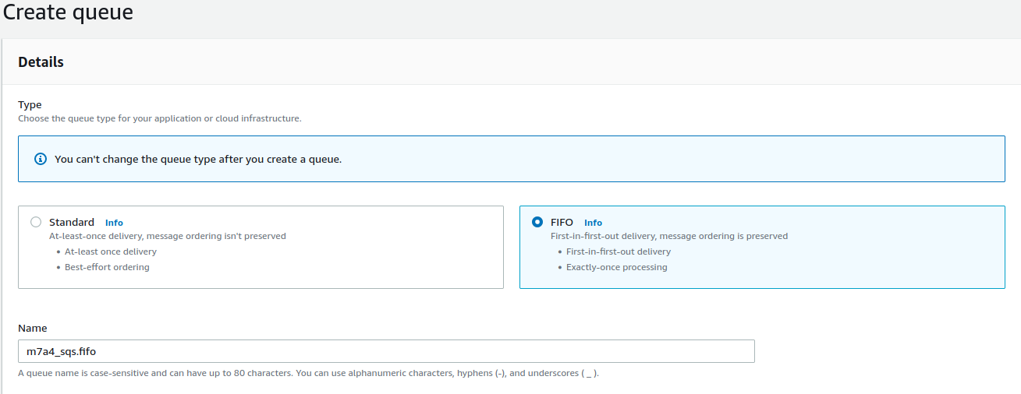
1
2
3
Search for “SQS”
Select and open SQS
Click on Create Queue
Select FIFO as type
Give it a name ending with “.fifo”
4
5

Slide 3
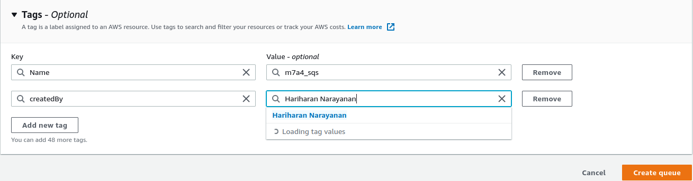
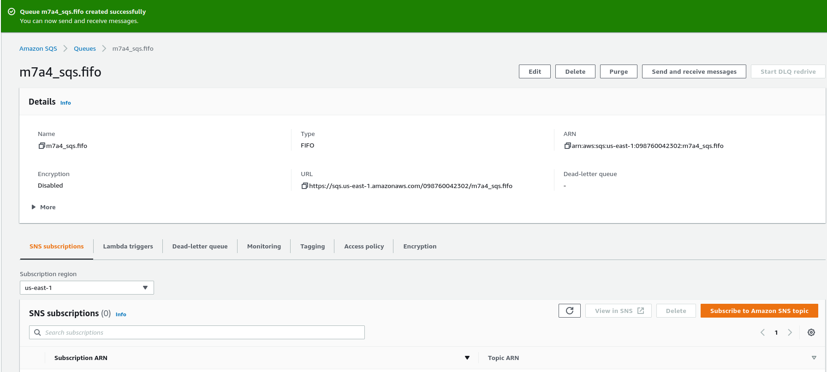
6
3
7
8
6. Create tags as needed
7. Create queue
8. Verify that SQS is created corectly

Slide 4
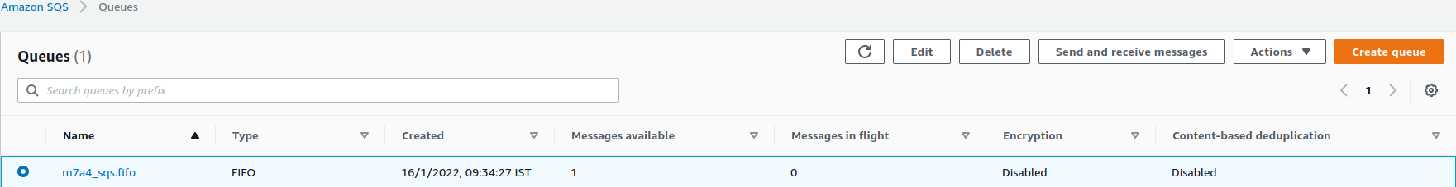
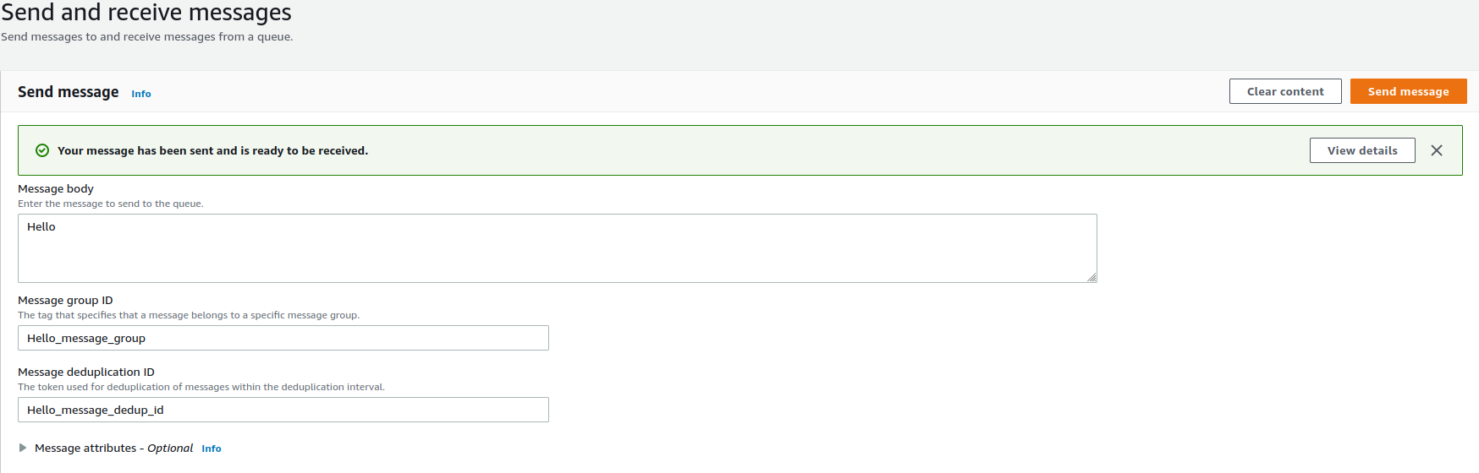
10
9
14
11
12
13
9. Select the SQS queue
10. Select “send and receive messages”
11. Fill the message
12. Give the message group id
13. Give deduplication id
14. Send the message

Slide 5
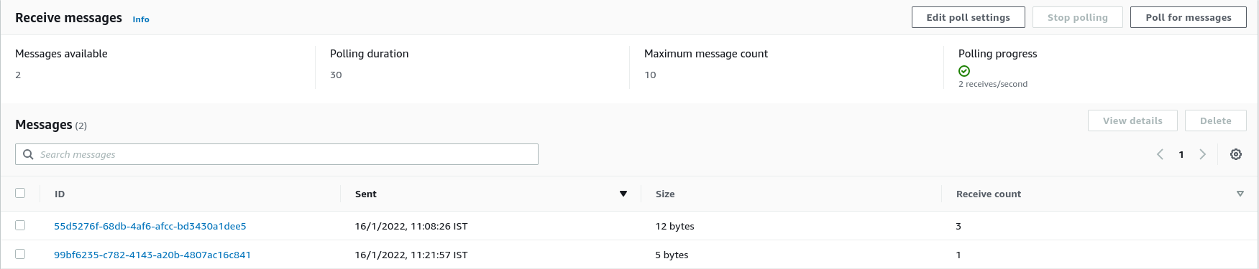
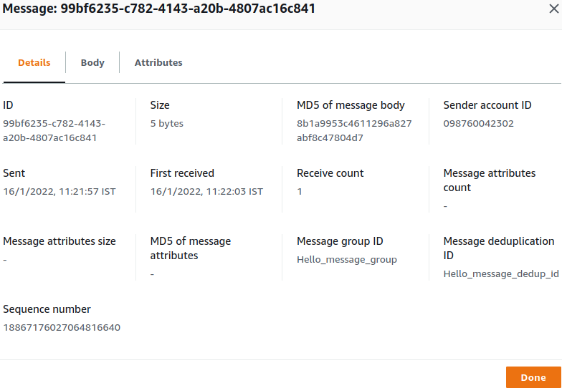
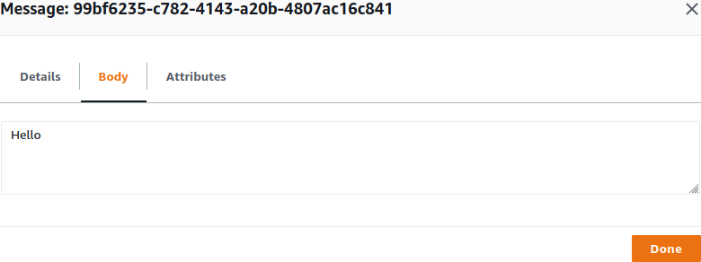
15
16
17
18
19
15. Click to poll for messages
16. Click on the message we wish to see
17. Verify details of the message
18. Verify body of the message
19. Click on Done

Slide 6
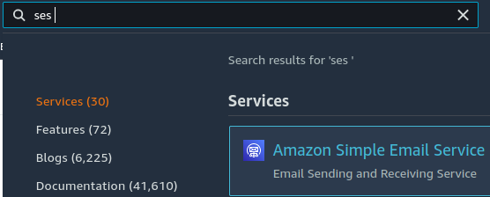
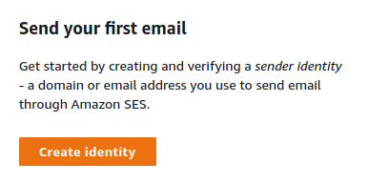
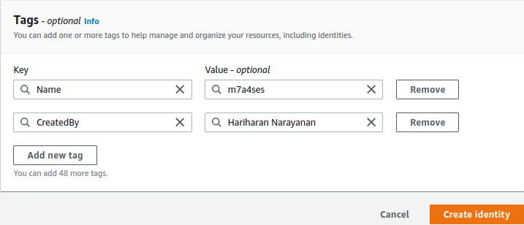
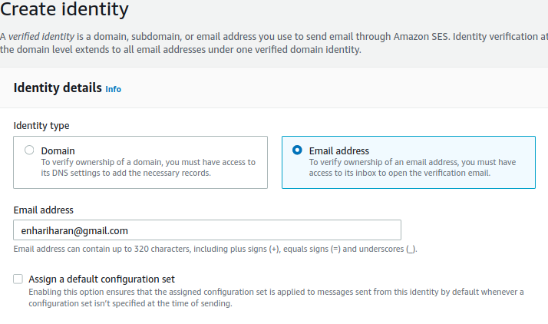
20
21
22
25
26
23
20. Type “ses “ in search
21. Click to open SES
22. Create identity
23. Select email address
24. Provide email
25. Create tags as needed
26. Create identity
24

Slide 7
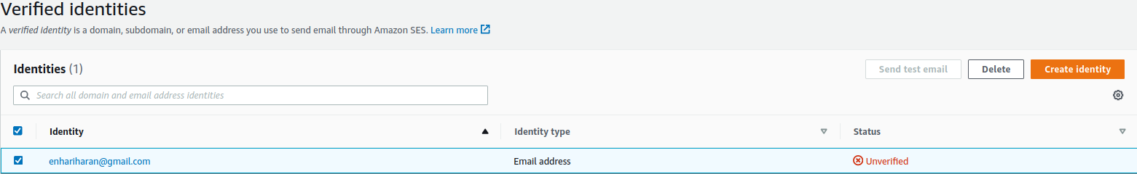
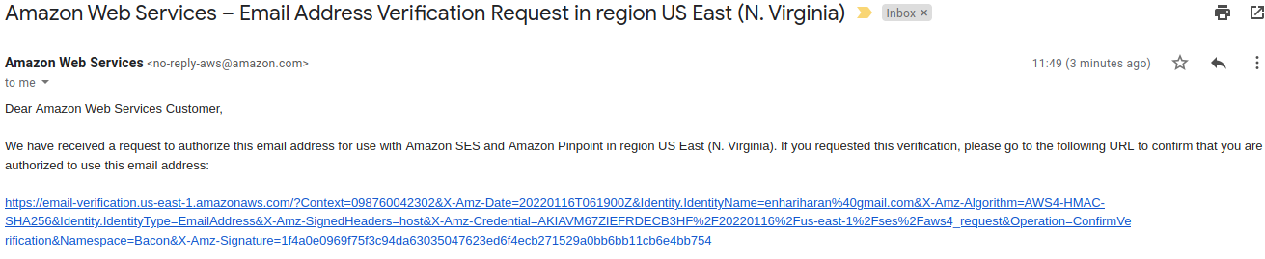

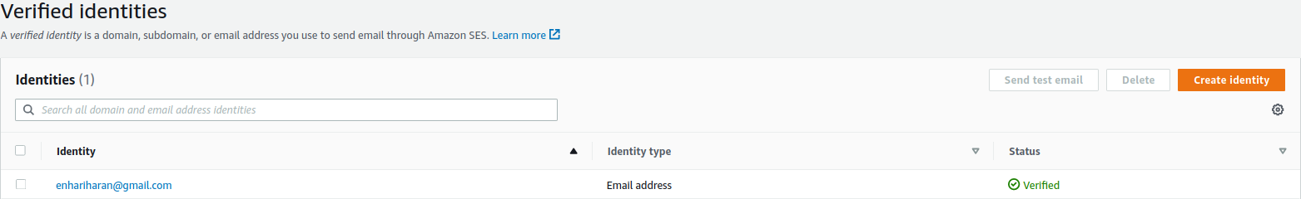
27
28
29
27. e-mail will be unverified
28. Check email for verification link. Click on it
29. It should open a new page to confirm that email is verified
30. Go back to SES console to check if email is verified
30

Slide 8
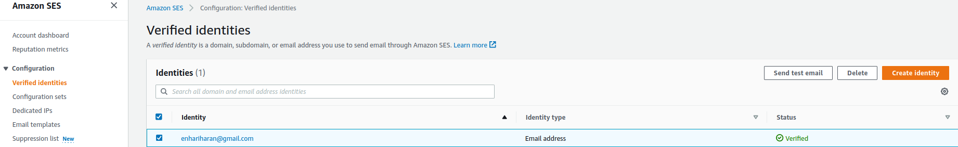
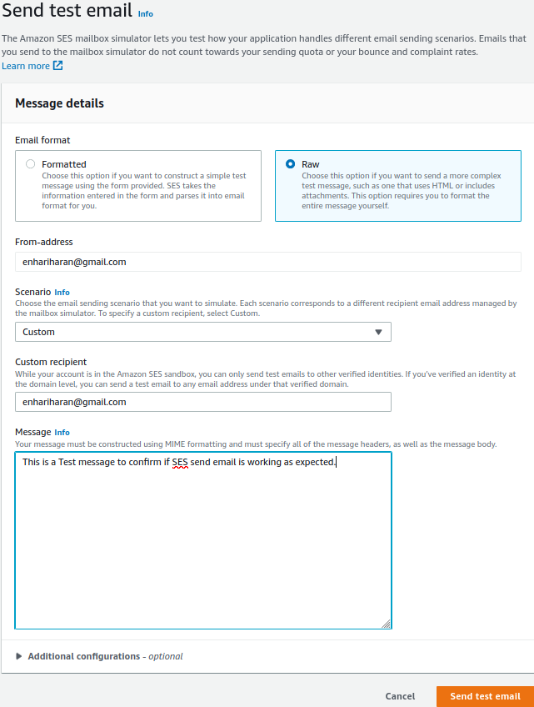

32
31
33
39
34
35
31. Select the email
32. Select send test email
33. Select a format
34. Select from email
35. Select a scenario
36. Select a recipient
37. Type the message
38. Send the email
39. Verify that test email is sent successfully
36
37
38

