Slide 1
Module 6: Database Services Assignment - 1
You have been asked to:
Create an RDS MariaDB database
Login into the DB from your PC

Slide 2
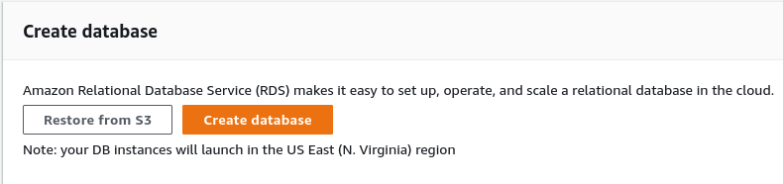
1. Type RDS in search bar. Open dashboard
2. Let region remain N.Virgina
3. Create database

Slide 3
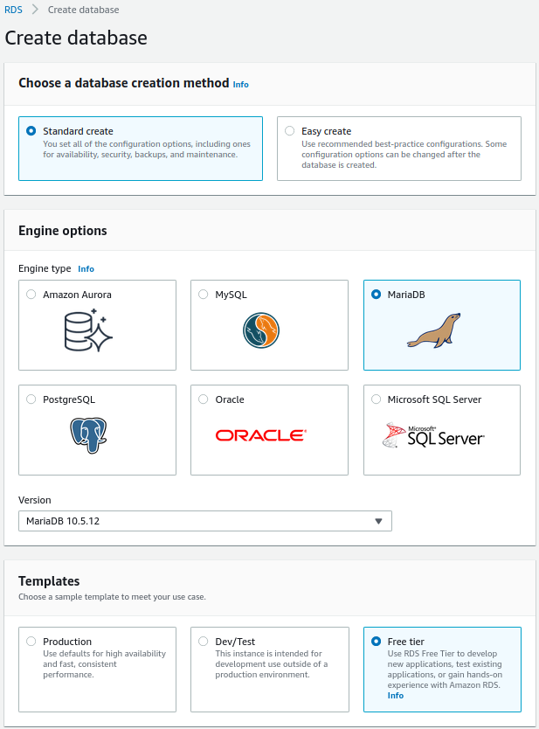
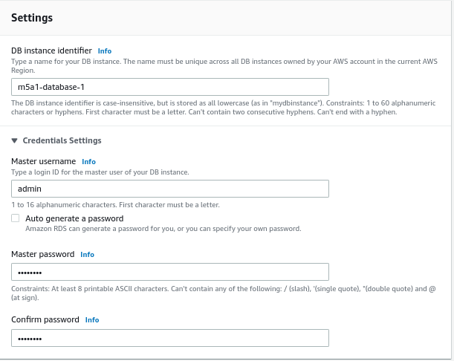
4. Choose Standard
7. Choose a name
5. Choose MariaDB
8. Keep password as “admin123”
6. Choose Free Tier

Slide 4
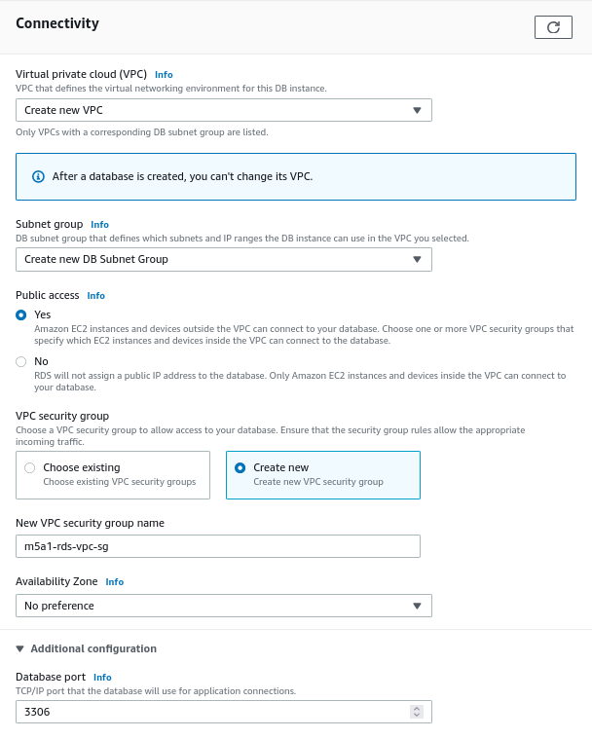
9. Select to create new vpc
10. Select to create new subnet
11. Select public access
12. Create new security group

Slide 5
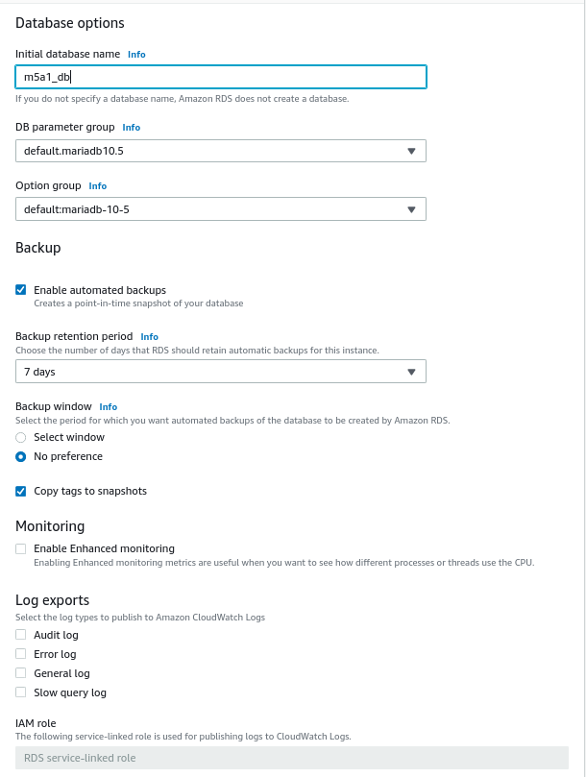
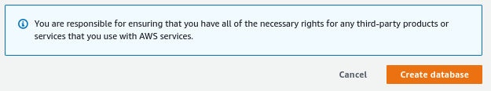
13. Create a new name for db
14. Create Database

Slide 6
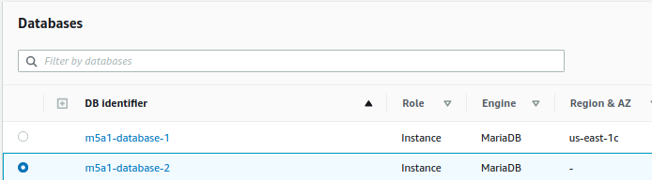
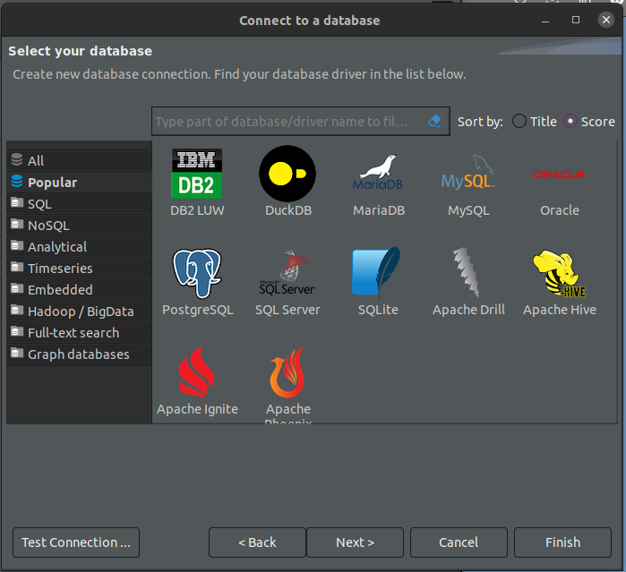
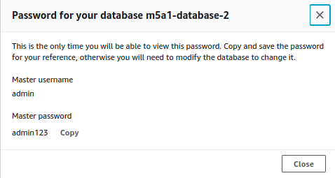
17. Install DB GUI client – DBeaver – and open it
15. Verify DB is created and status is Available. Click on the DB
18. Select MariaDB
16. Note the credentials to connect
15. Next

Slide 7
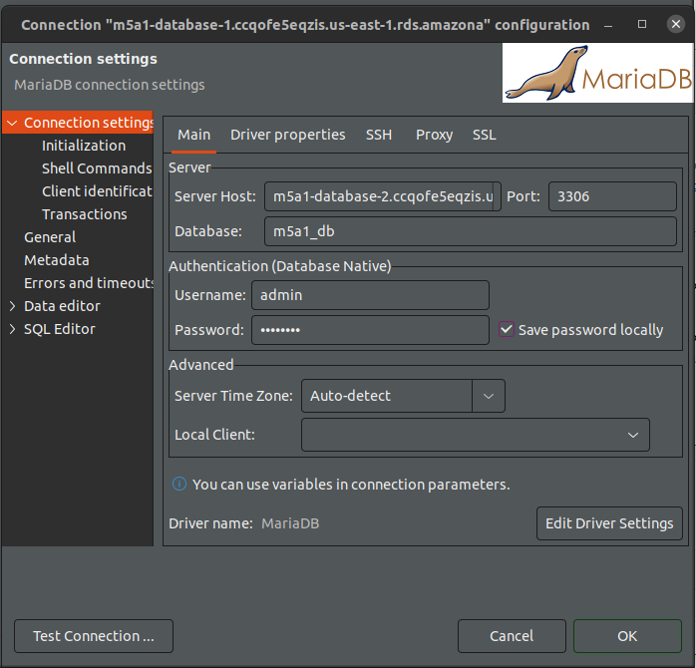
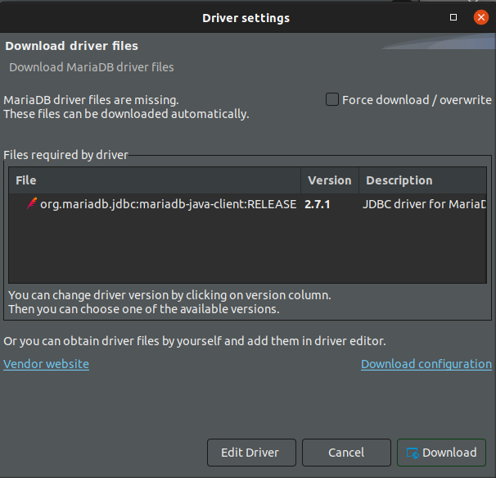
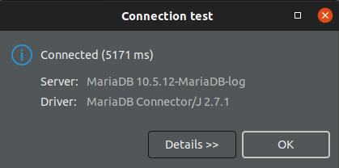
19. Enter server endpoint
20. Provide port
21. Provide username (admin) and password (admin123)
22. Test connection
24. Verify that connection test passed
23. Download JDBC driver

Slide 8
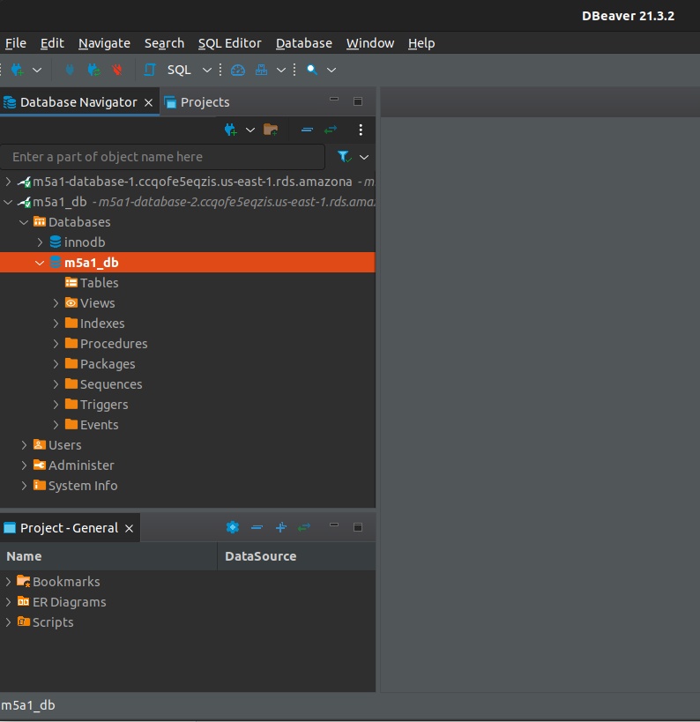
25. Verify that db opened correctly in DBeaver

