Slide 1
Module 2 Assignment 1
You have been asked to:
Create an Instance in us-east-1 (N. Virginia) region with anUbuntu OS and install Nginx for making them web servers
2. Change the default website with a hello world pag

Slide 2
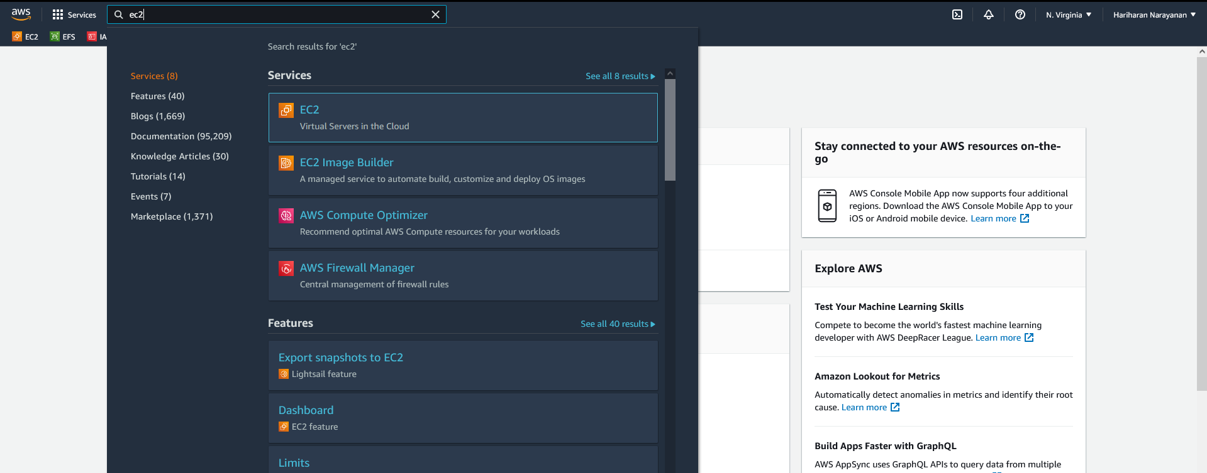
3. Type “EC2” in search bar
1. Login into https://aws/amazon.com
4. Select EC2
2. Change region to US East (N. Virgina) us-east-1

Slide 3
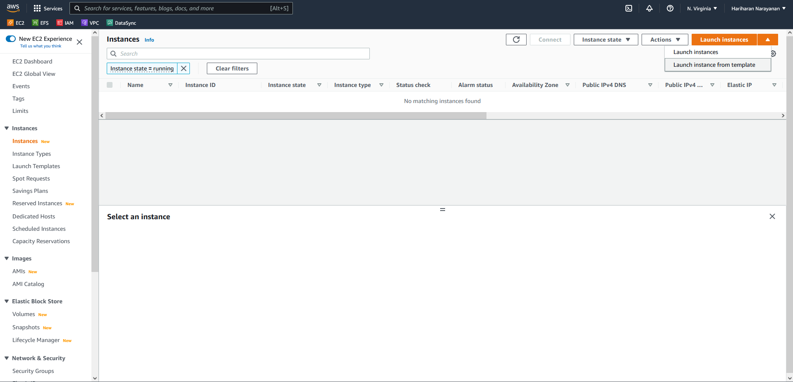
5. Select “Launch Instances”
6. Select “Launch Instances”

Slide 4
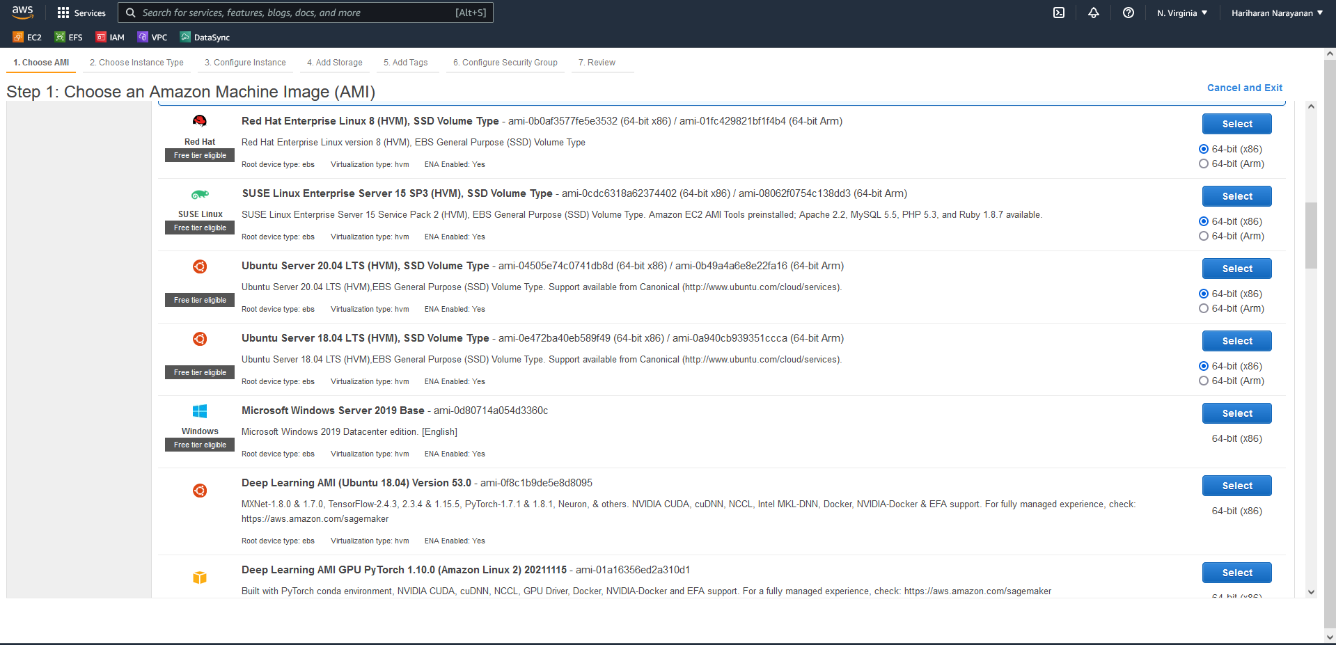
7. Select Ubuntu Server 20.04
8. Click on Select

Slide 5
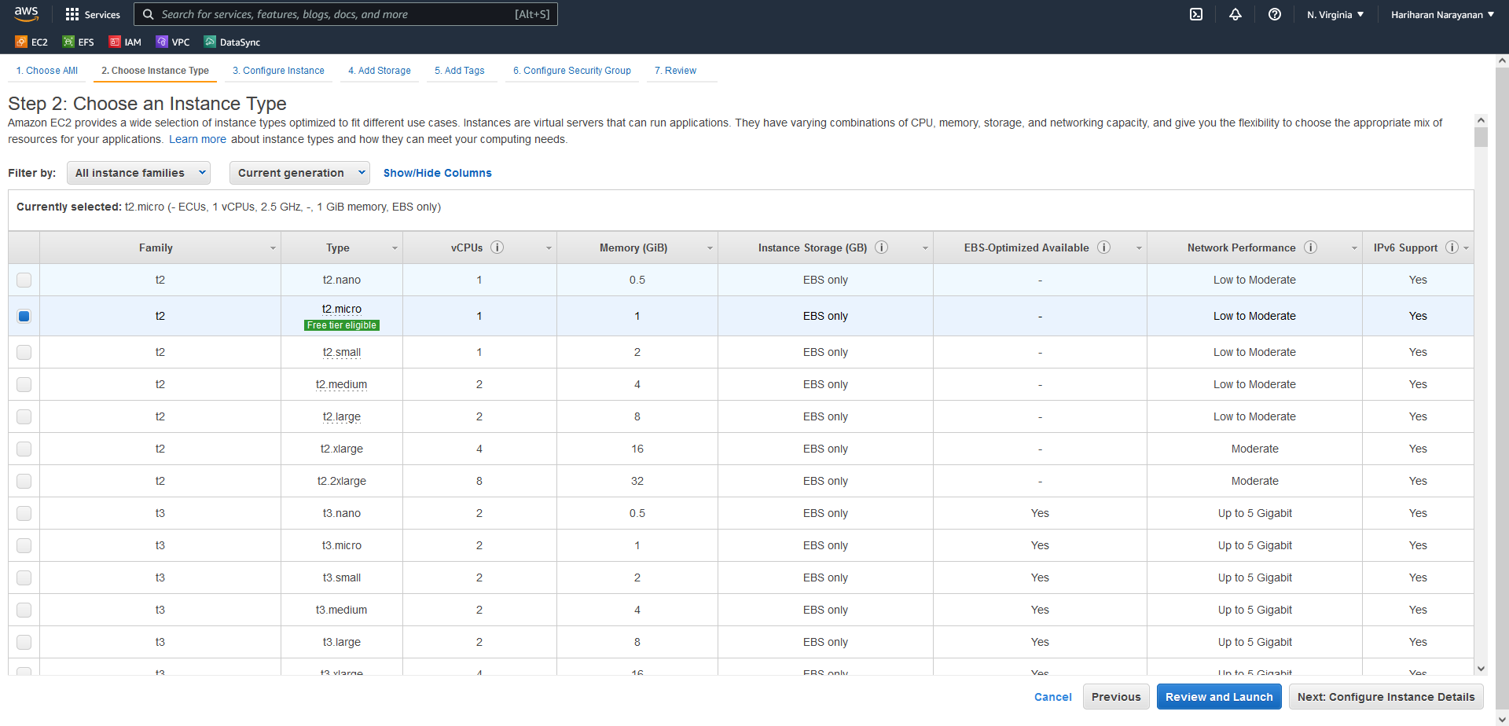
9. Select t2.micro
10. Click Next

Slide 6
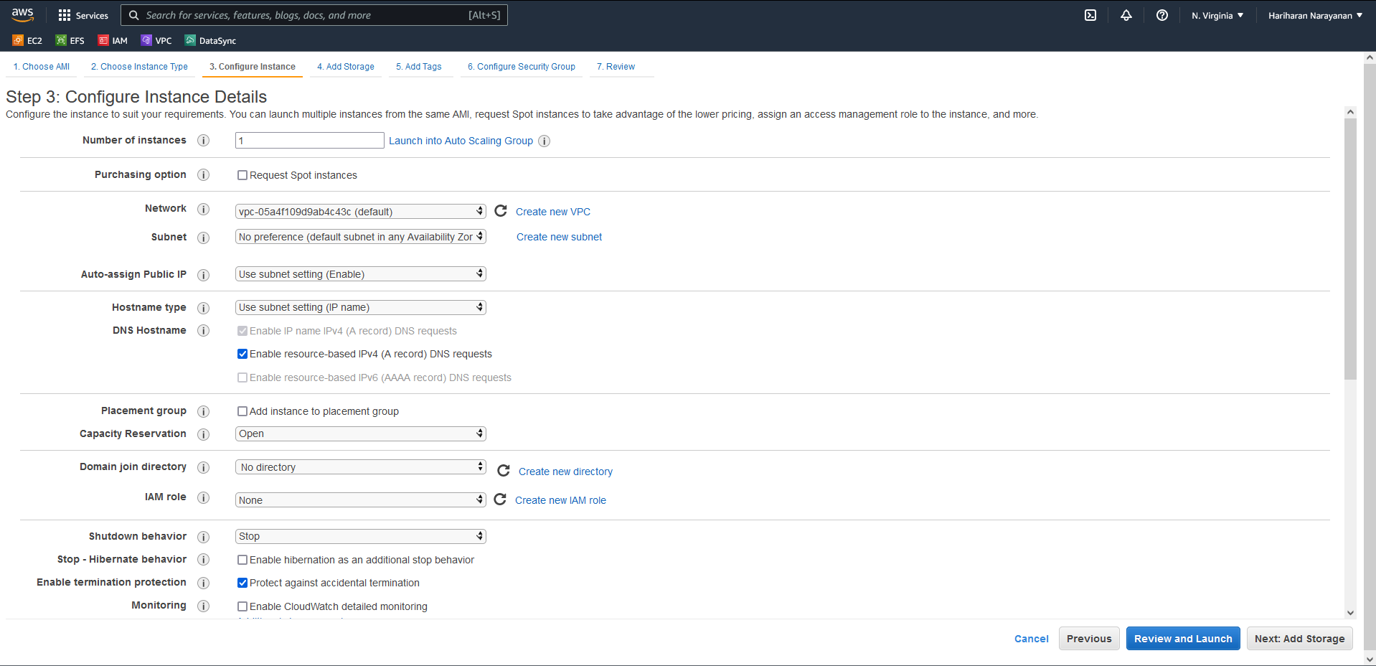
11. Enable termination protection
12. Click Next

Slide 7
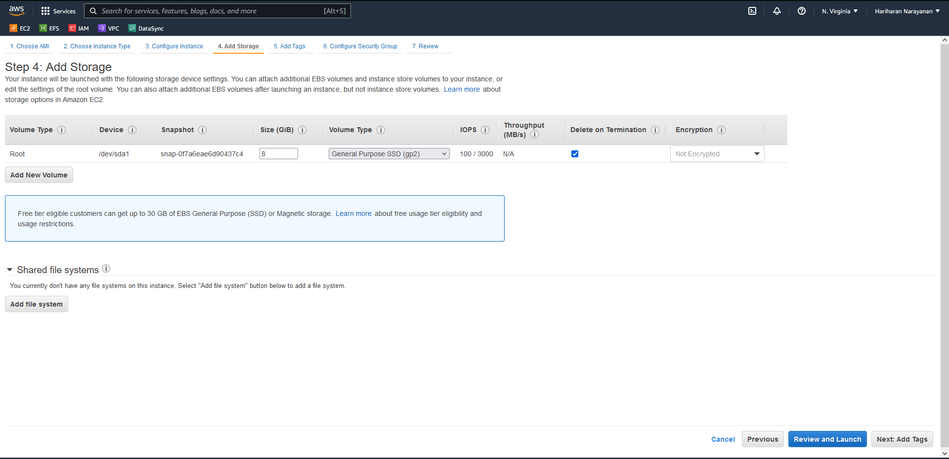
13. Keep storage options unchanged and Click Next

Slide 8
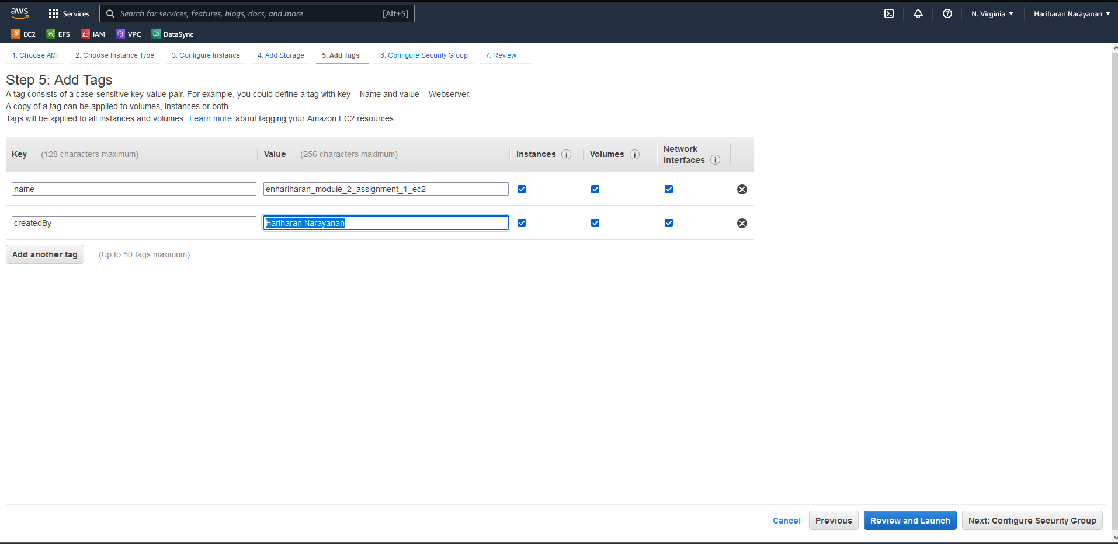
14. Add tags as needed
15. Click Next

Slide 9
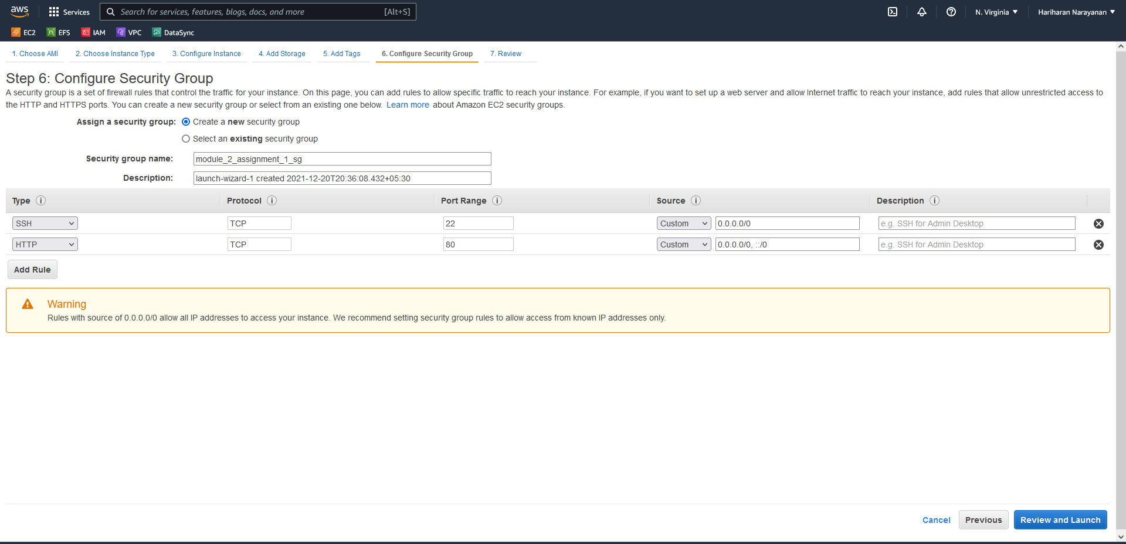
16. Opt to create new security group
17. Rename security group name
18. Add a rule to allow http requests from everyone.
19. Click on review and launch

Slide 10
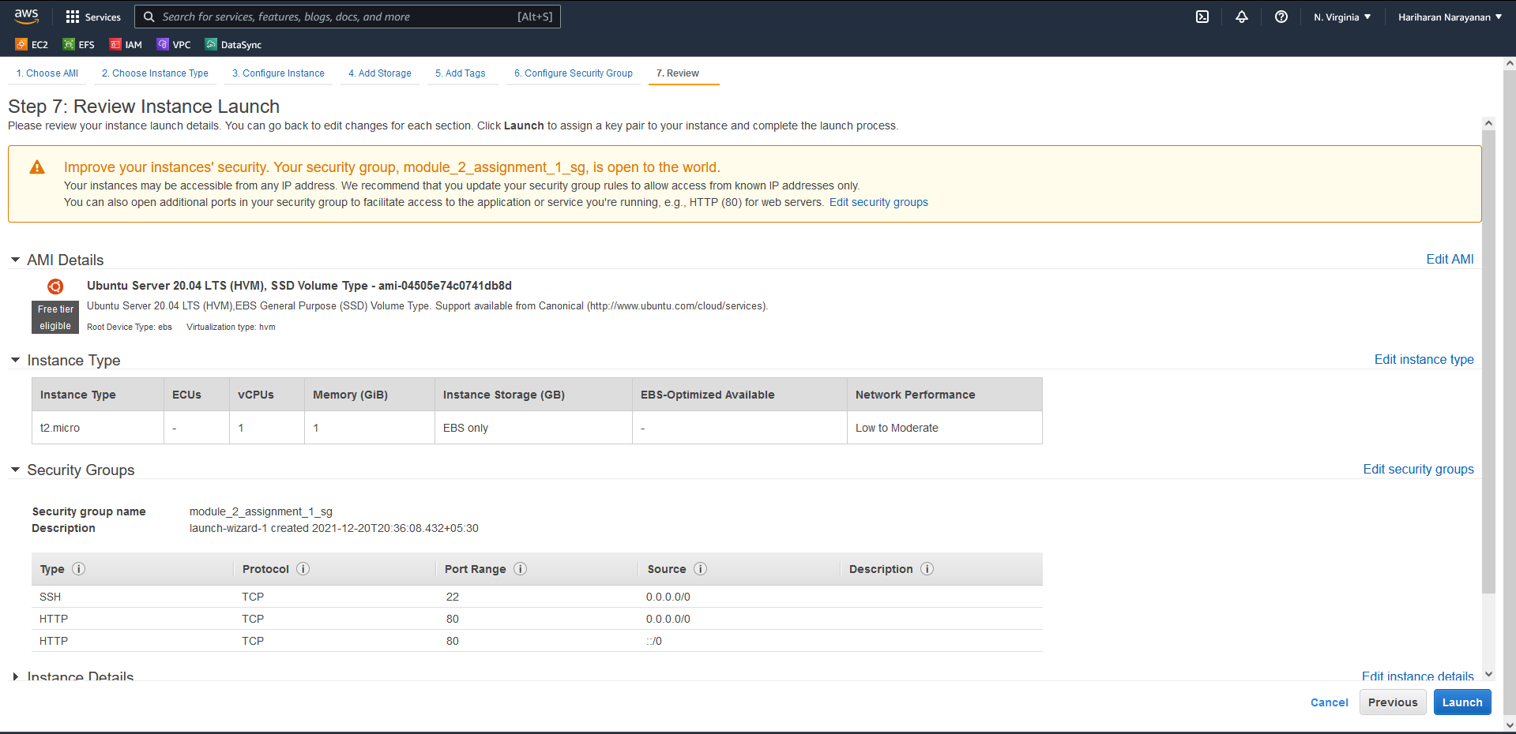
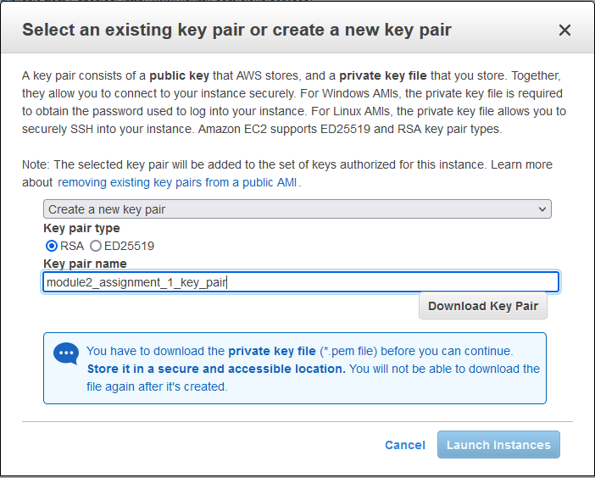
21. Select to choose a key pair
22. Select a name
20. Click on Launch
23. Download and save the key pair
24. Launch

Slide 11
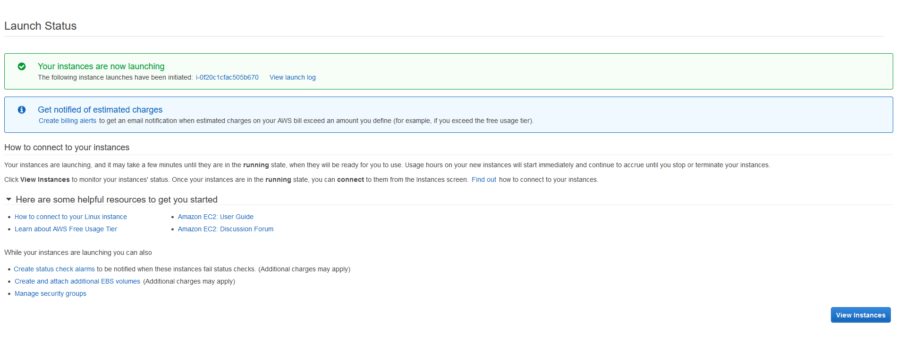
25. Click on view instances

Slide 12
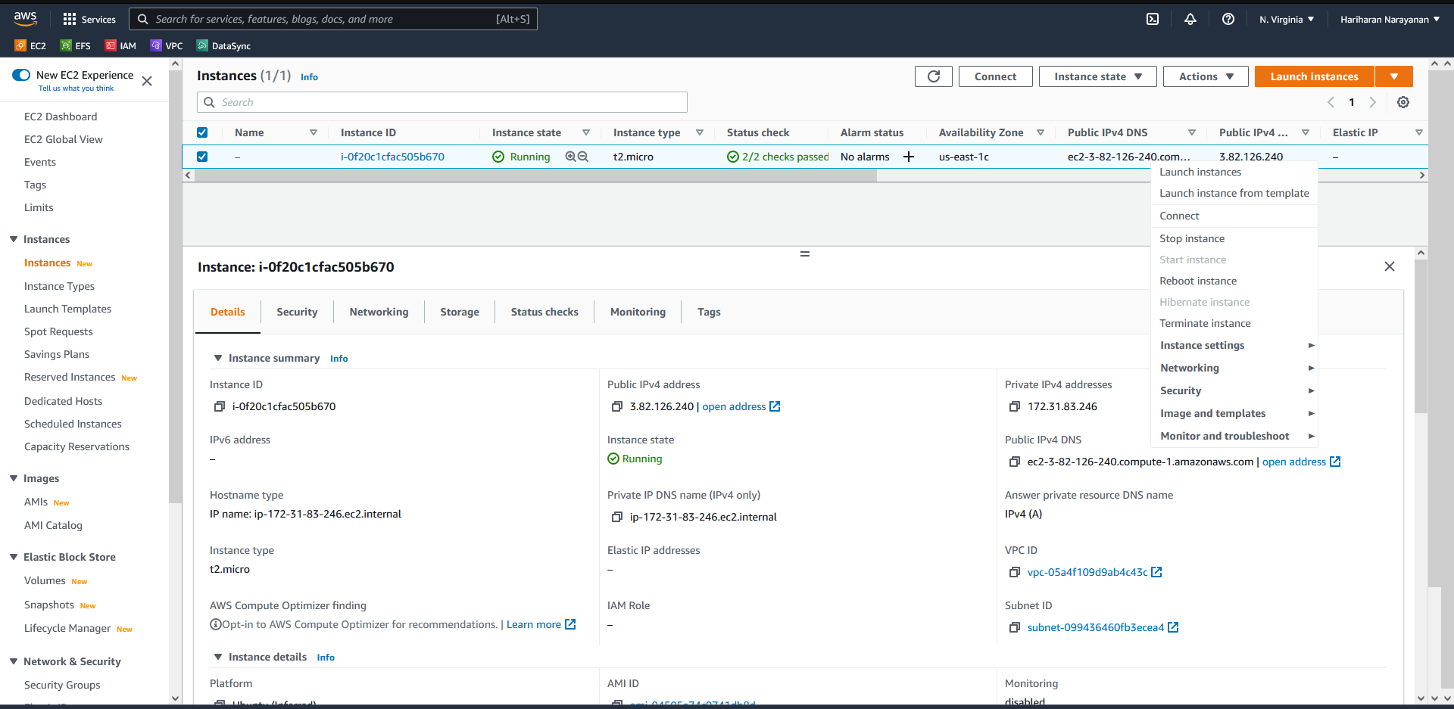
26. The instance should be successfully launched
27. Connect to the instance in a new web terminal window

Slide 13
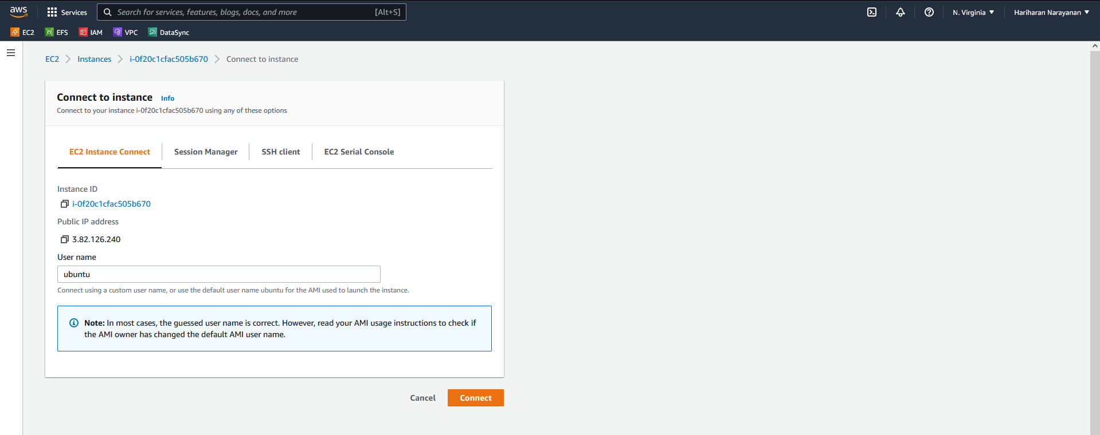
28. Connect

Slide 14
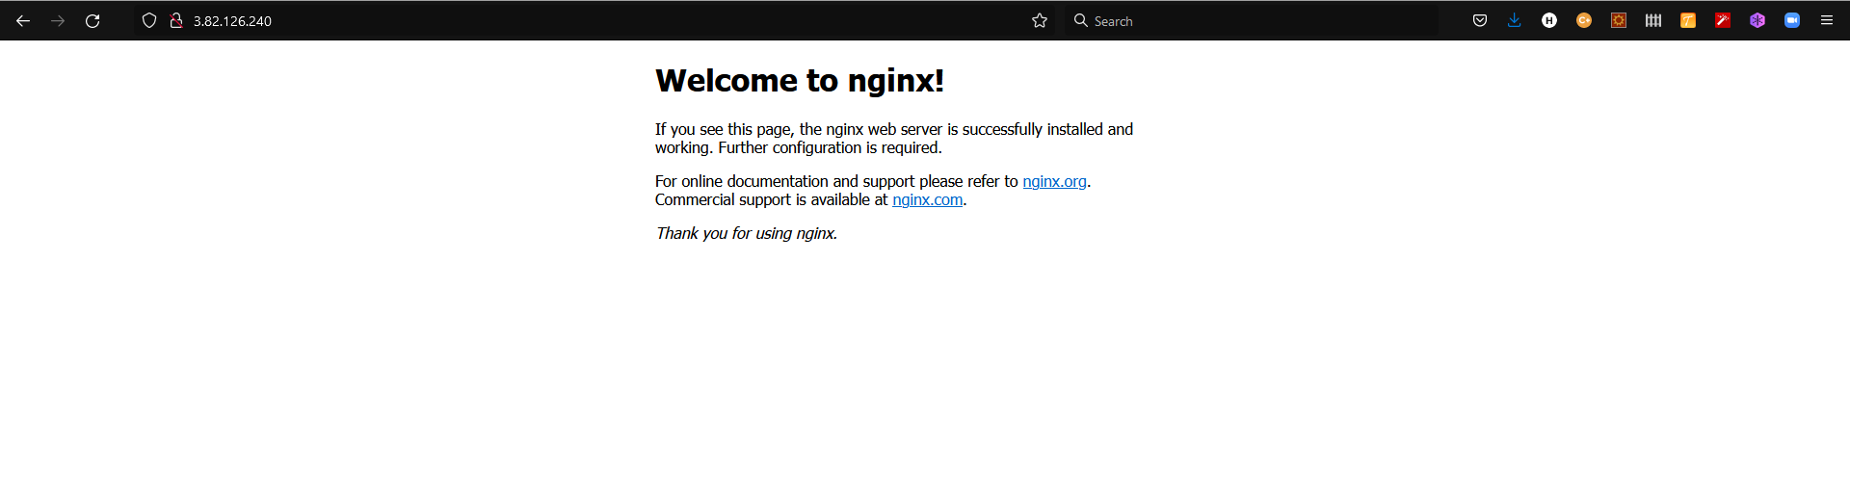
29. Install nginx
30. Open the public IP address in a browser to verify that nginx is correctly installed

Slide 15
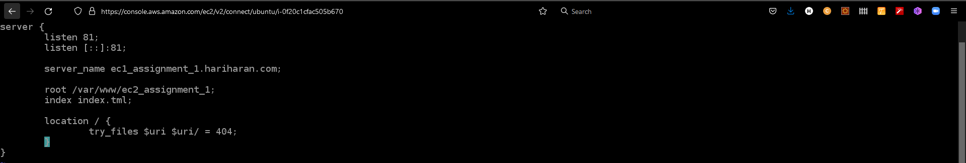
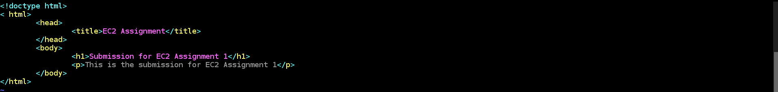
31. Create an nginx site and save it in /etc/nginx/sites-enabled/module2_assignment_1_site
32. Create the HTML file /var/www/ec2_assignment_1/index.html

Slide 16
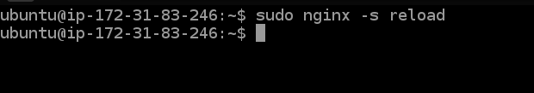
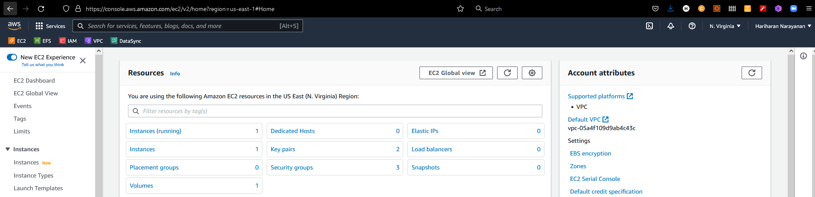
33. Restart nginx to load the new configuration
34. Click on security groups

Slide 17
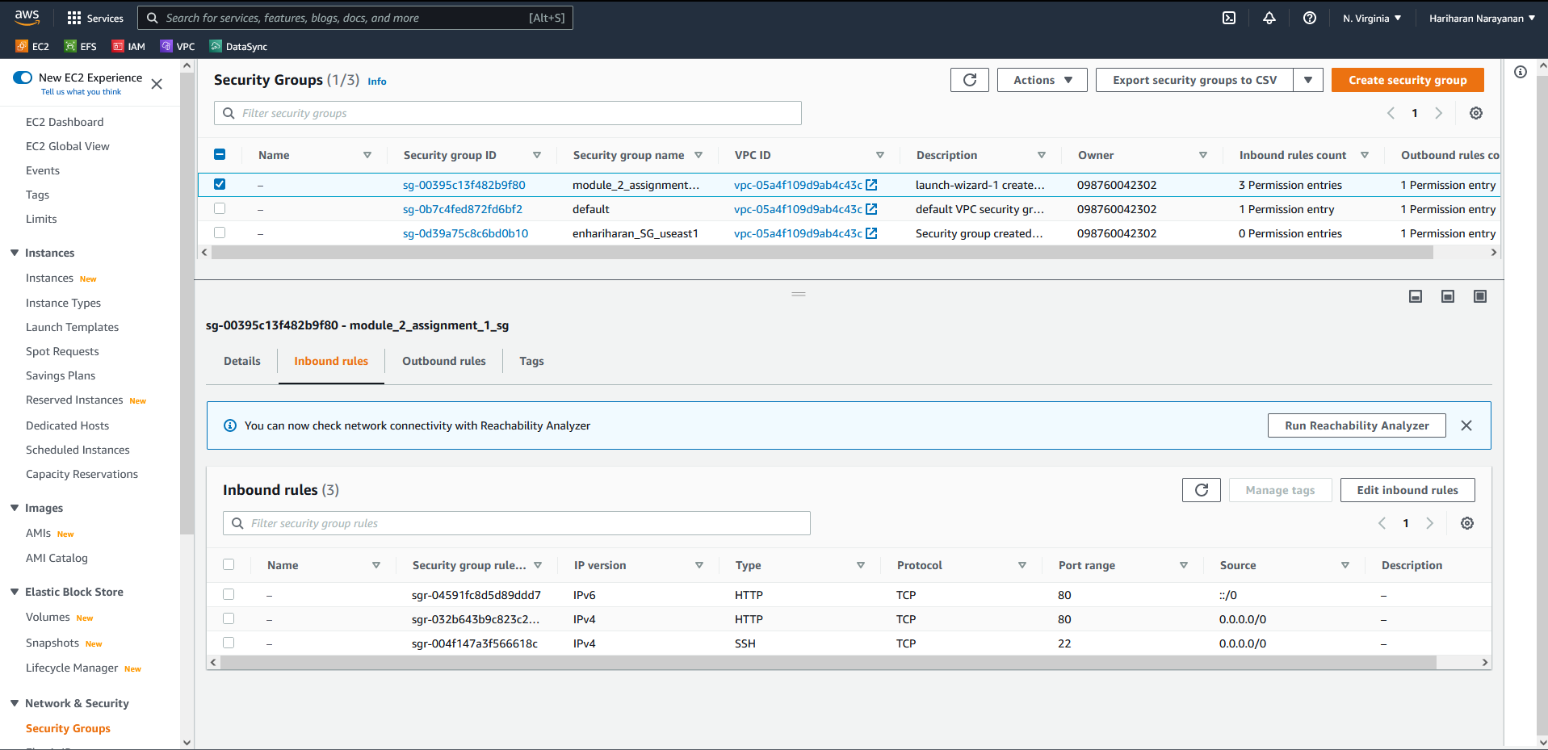
35. Select the security group created
36. Select to edit inbound rules

Slide 18
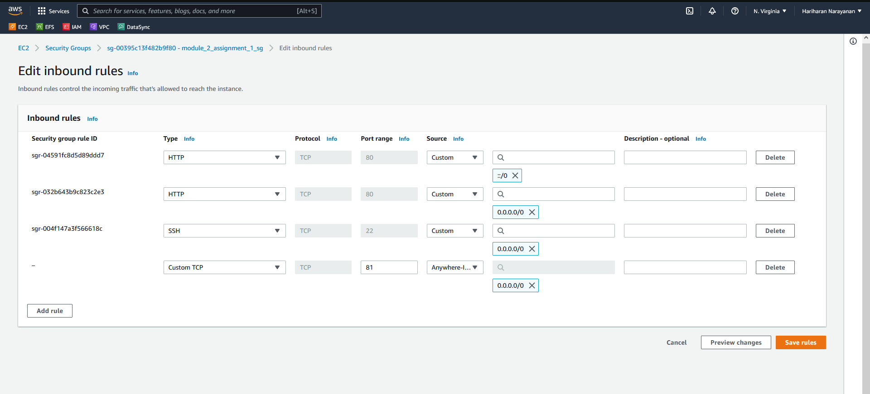
38. Add custom TCP rule to accept all inbound connections on port 81
37. Select to add rule
39. Save

Slide 19
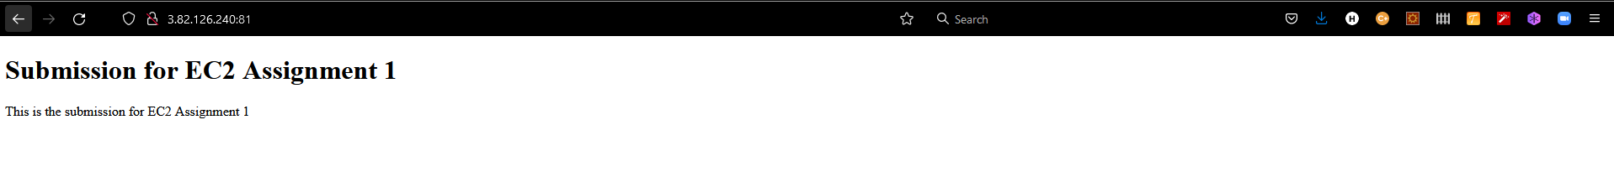
40. Open the IP address with port 81 in a web browser (using http:// only). The new website must open successfully

