Slide 1
Module-3: Route 53 Assignment - 3
You have been asked to:
Use the Route 53 Hosted Zone created in the Assignment
Route the traffic to an EC2 instance with an Apache web server running in it using it’s IP address

Slide 2
1. Create an EC2 instance with Apache web server running in it
The steps for this were already provided in answer to module 2 assignment 2
Follow the same steps to create an EC2 instance named **module_2_assignment_3_ec2_vm1** and install and configure apache2 in it.
Verify from a browser that typing the dns name of the EC2 instance in the address bar will take to the **Apache2 Ubuntu Default Page**.

Slide 3
2. Use Route 53 to register a DNS name called _hariharan.link_
Open the AWS Route 53 console - https://console.aws.amazon.com/route53
In "Route 53 Dashboard", enter **hariharan.link** in the text box under "Register Domain"
Finish the purchase of this domain.

Slide 4
3. Use Route 53 to route traffic
Open the AWS Route 53 console - https://console.aws.amazon.com/route53
Navigate to **Hosted zones** and select **hariharan.link**. Click on **View details**
In the "hariharan.link" page, click on **Create record**
In the "Quick create record" page...
In the field "Record name", enter **awsassignment** so that the full DNS name reads as **awsassignment.hariharan.link**
In the field "Routing policy", choose **Simple routing**
In the field "Value", paste the value of **IPv4 Public IP** copied from the EC2 console of the EC2 instance created above. Finally click on **Create records**
In the "hariharan.link" page, verify that a record for _awsassignment.hariharan.link_ is now added
Finally, open the link http://awsassignment.hariharan.link in a browser to verify that the **Apache2 Ubuntu Default Page** is opened. This confirms that the DNS record in Route 53 created correctly.

Slide 5
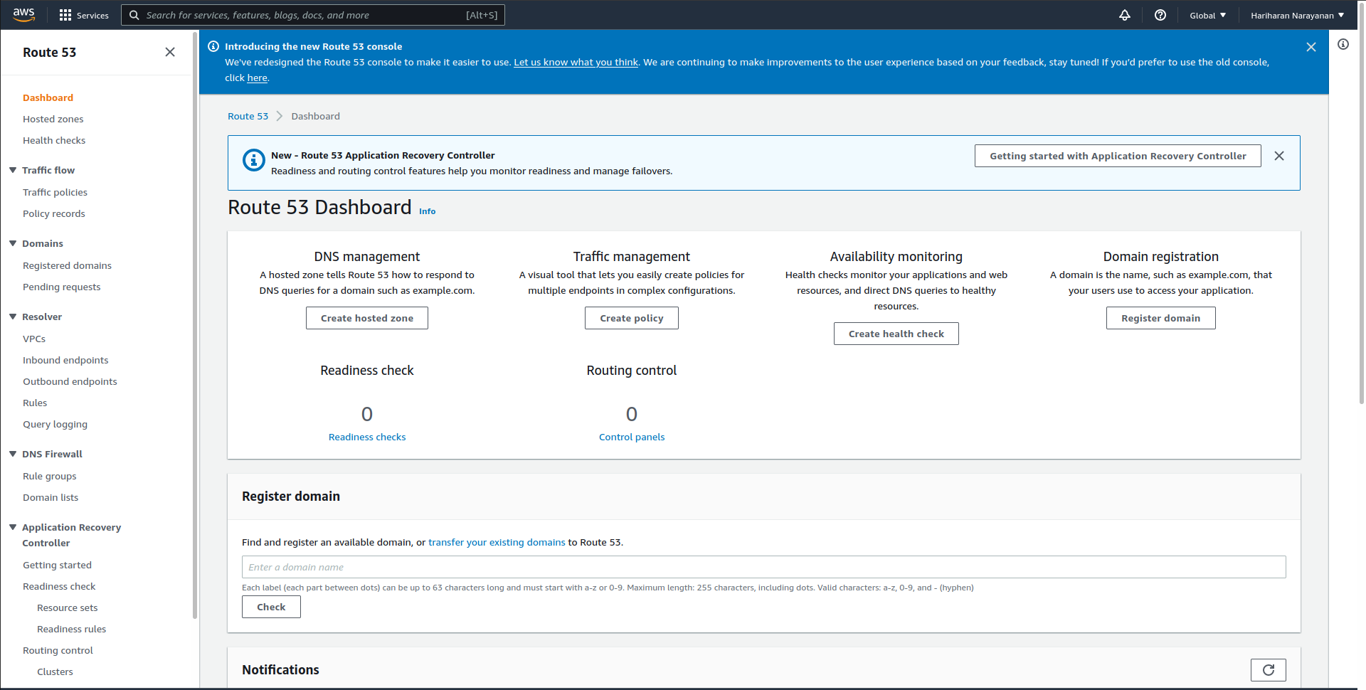

Slide 6
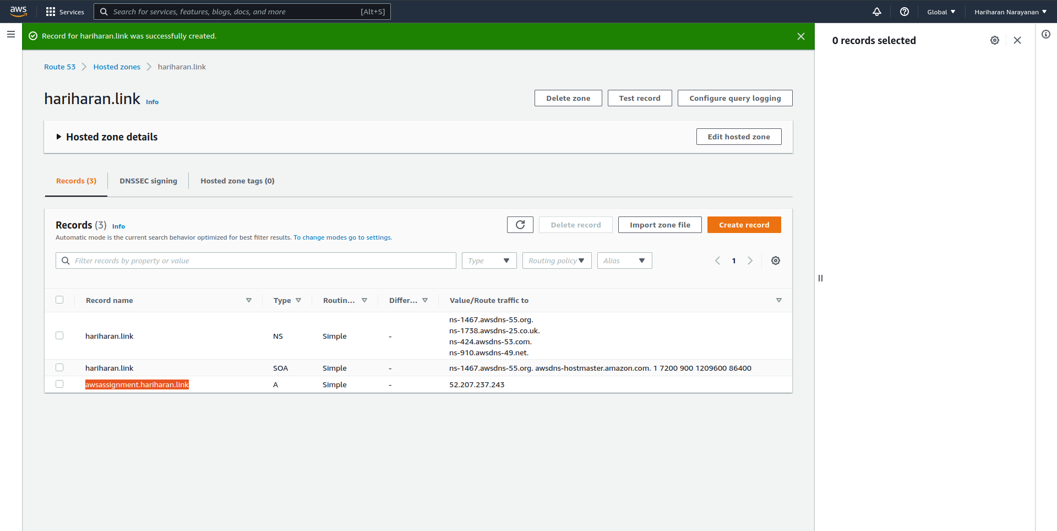

Slide 7
