Slide 1
Module-10: Organizations Assignments - 2
You have been asked to:
Create an AWS Organization
Create 3 organization units – OU1, OU2, and OU3
Attach a service control policy which only allows access to EC2

Slide 2
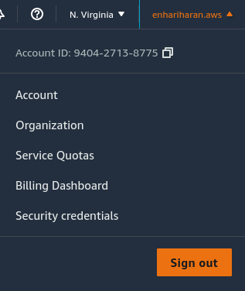
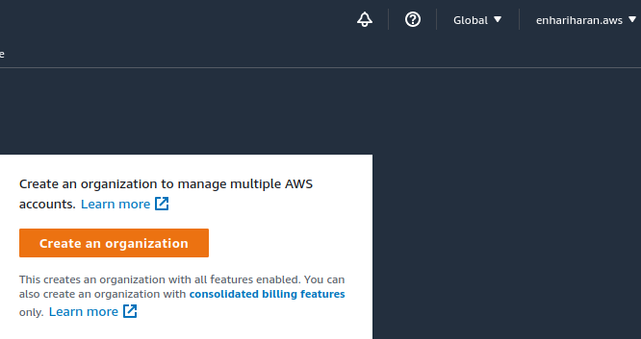
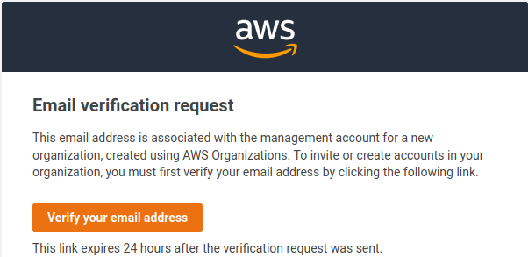
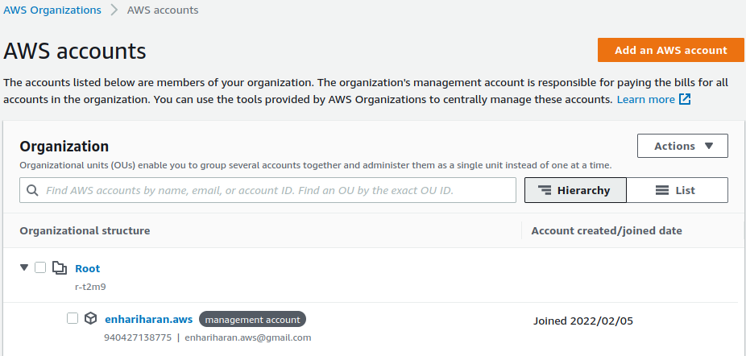
01
02
03
1. Open AWS Console. Clck on account-name in top-right corner. Click on Organization.
2. Click on button “Create an organization”
3. An email will be sent to registered email account. Open email and Click on likk to verify email address.
4. Verify that an organization is created with your account name linked as “management account”.
04

Slide 3
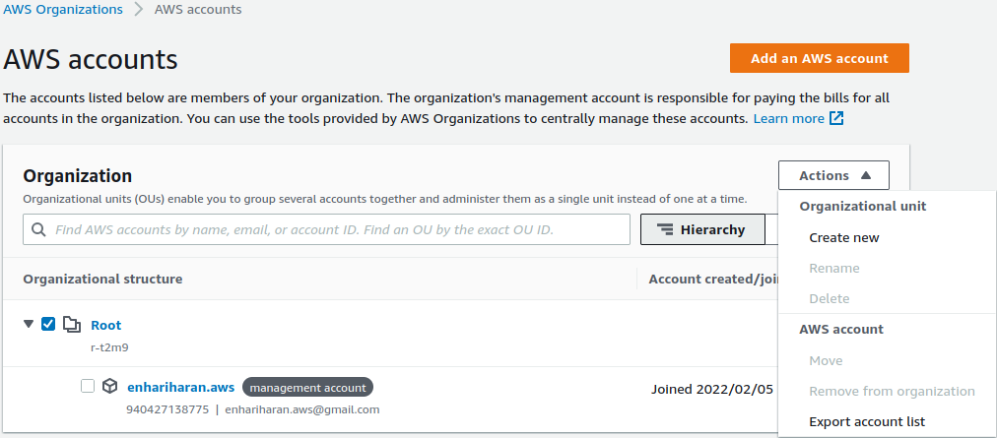
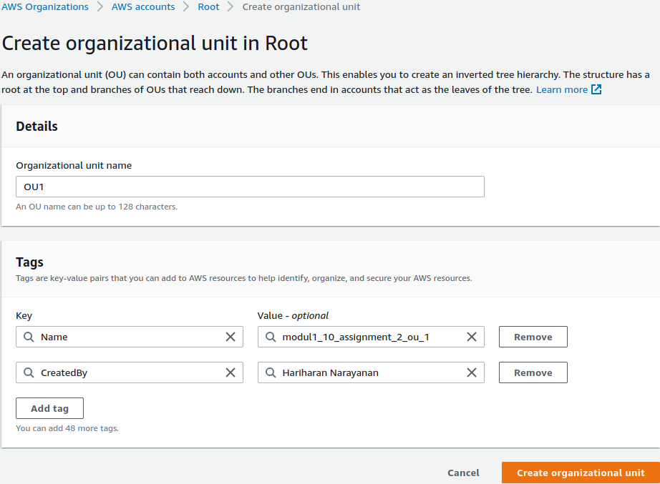
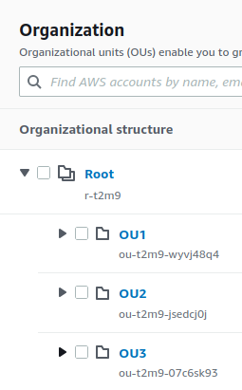
05
06
5. Select “Root”. Click on “Actions” --> ”Organization unit” --> ”Create new”
6. Provide Organizational unit name as “OU1”. Create tags as needed. Click on “Create organizational unit”. Repate same process to create organizational units called “OU2”, and “OU3”
7. Go back to “AWS Organizations” console and verify that all 3 organizations are visible here
07

Slide 4
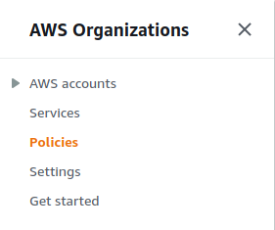
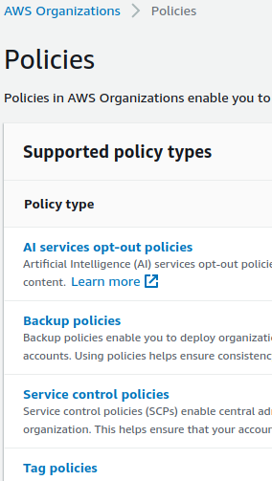
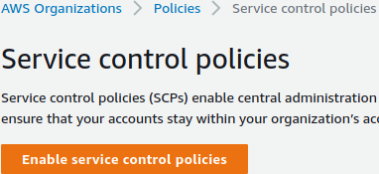
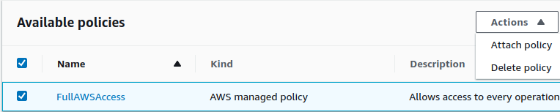
10
08
09
8. Go to “AWS Organizations” console. Select Policies
9. Select “Service control policies”
10. Click on “Wnable service control policies”
11. Select “FullAWSAccess” policy. Click on “Actions” --> “Attach policy”
11

Slide 5
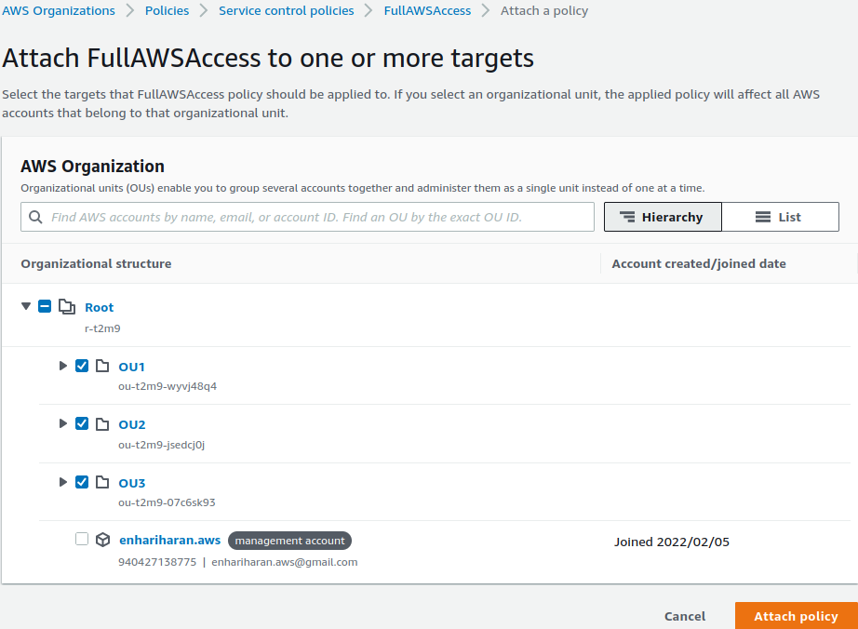
12
12. Select all 3 organizational accounts – OU1, OU2, and OU3 – to attach the policy created in (11). Click on “Attach policy”

Slide 6
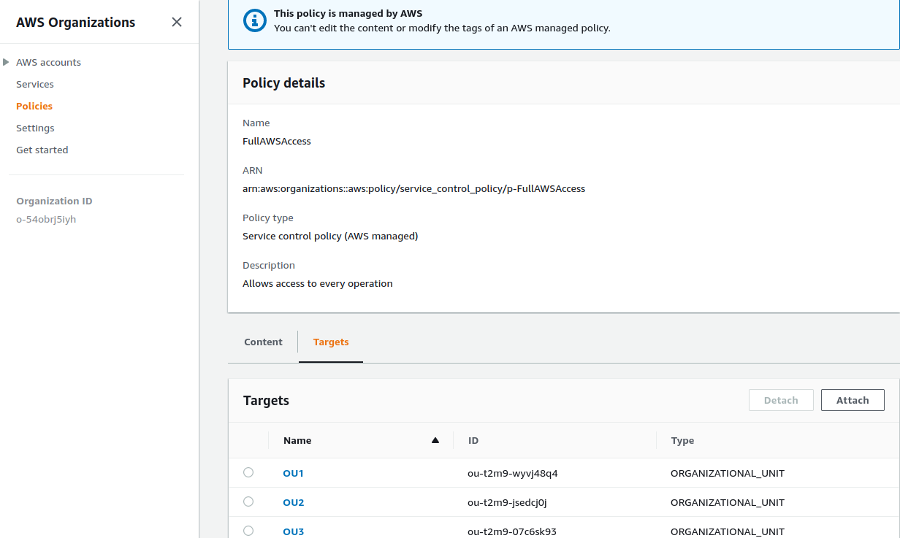
13
13. Go back to “Policies” console to verify that “FullAWSAccess” policy is attached to Targets OU1, OU2, and OU3.

