Slide 1
Module-8 Assignment – 2 IAM
You have been asked to:
Create a policy number 1 which lets the users to:
Access S3 completely
Only create EC2 instances
And full access to RDS
Create a policy number 2 which allows the users to:
Access CloudWatch and Billing completely
And can only list EC2 and S3 resources
Attach policy number 1 to Dev Team from task 1
Attach policy number 2 to Ops Team form task 1

Slide 2
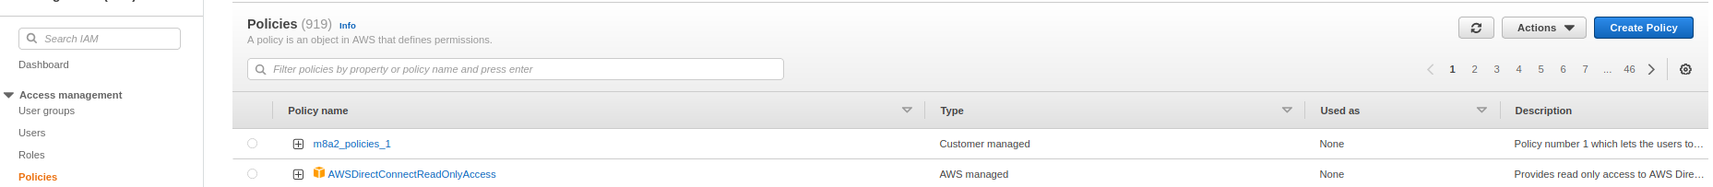

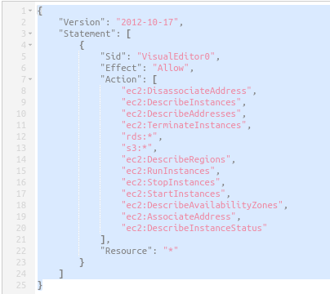
2
1
3
4
1. Open Policies in IAM console
2. Click on create policy
3. Click on JSON
4. Enter this JSON and finish all remaining steps to create policy

Slide 3
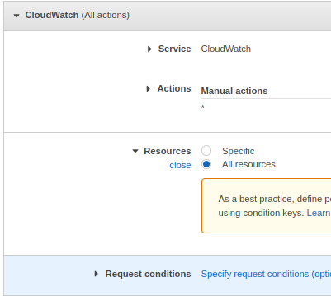
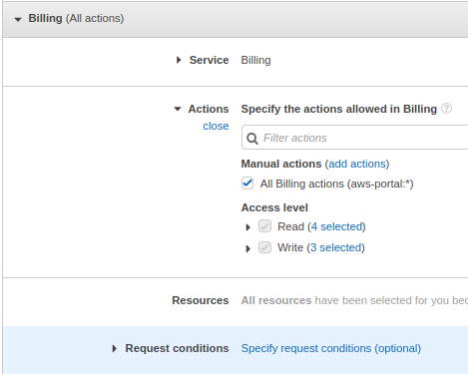
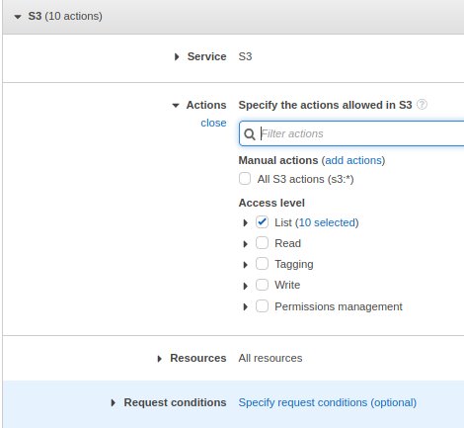
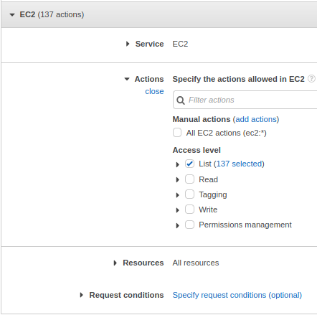
5
6
7
8
9
5. Repeat steps 1 & 2
6. Search for service coudwatch and add all actions
7. Search for service billing and add all actions
8. Search for service S3 and add only List actions
9. Search for service EC2 and add only List actions. Also, finish all remaining steps to create policy

Slide 4
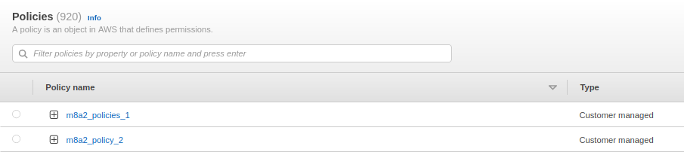
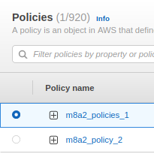
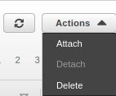
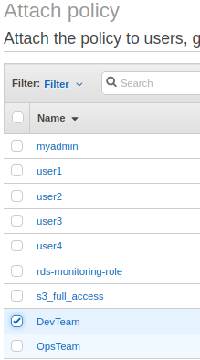

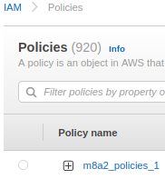
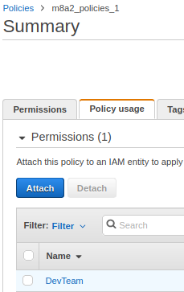
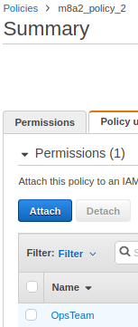
10
14
12
12
11
15
13
16
10. Verify that both policies are created in IAM Policies console
11. Select policy 1
12. Select Actions-->Attach
13. Select DevTeam
14. Click on Attach policy
15. In IAM Policy Console, click on m8a2_policies_1
16. Click on Policy usage to verify that DevTeam is attached
17. Repeat steps 10-16 to attach m8a2_policies_2 to OpsTeam and verify
17

