Slide 1
Module 8 Assignment 4 - CloudWatch
You have been asked to:
Create a dashboard which lets to check the CPU Utilization and NetworkIn for a particular EC2 instance

Slide 2
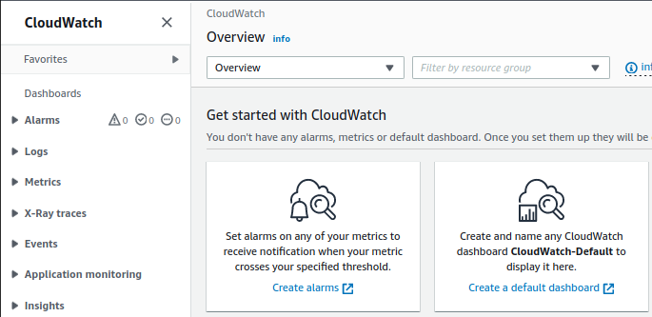
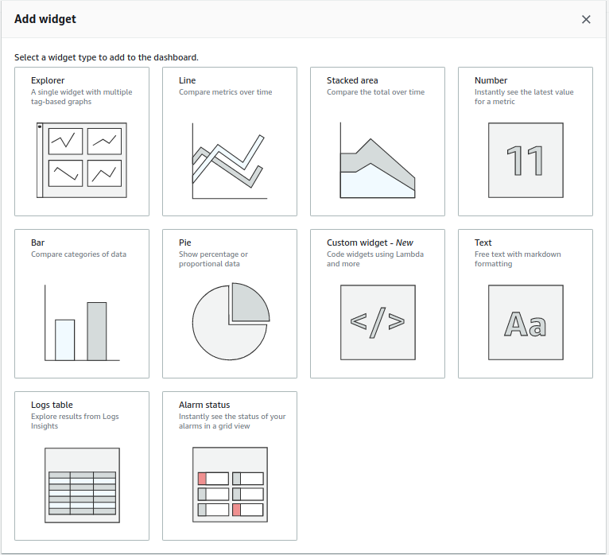
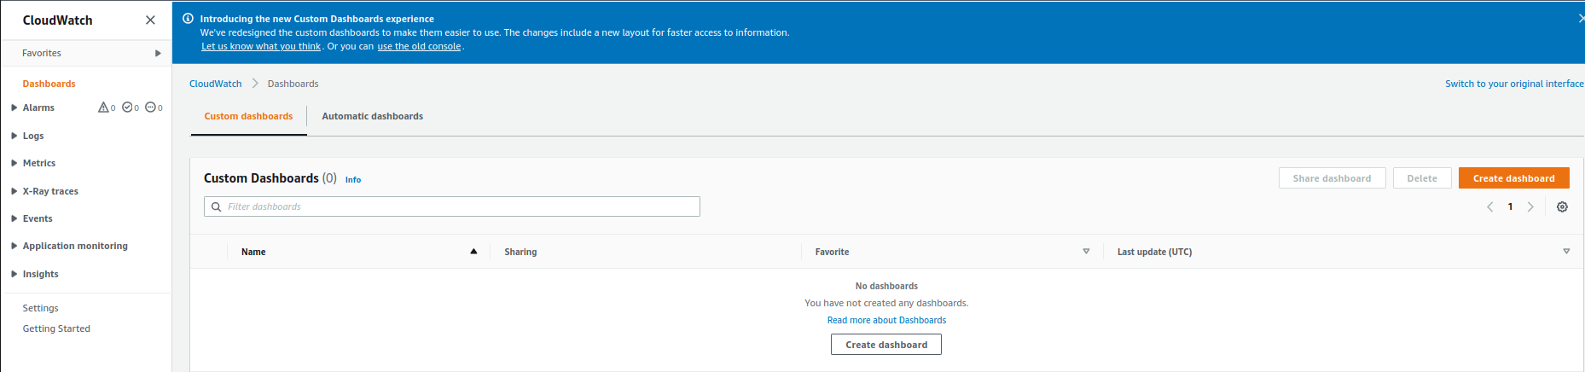
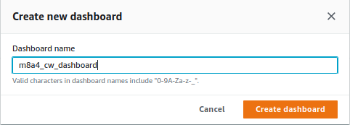
4
1
2
3
1. Open “CloudWatch” Console from Search bar. Click on “Create a default dashboard”
2. Click on “Create Dashboard”
3. Name the dashboard
4. Select “Explorer”

Slide 3
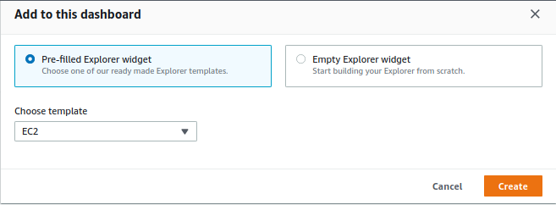
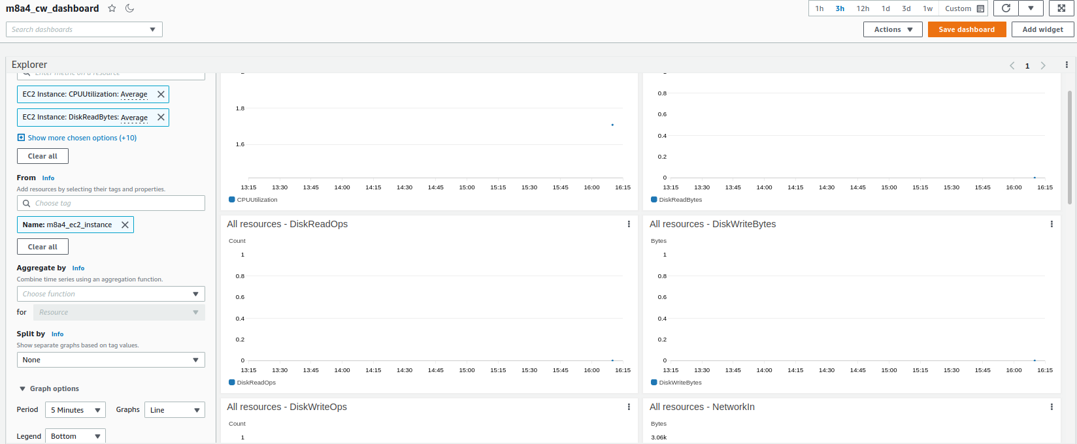
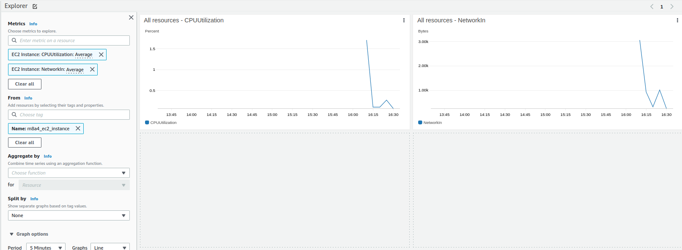
7
5
6
5. Choose “EC2” as template
6. In the “From” box, choose the EC2 instance we already created earlier for this assignment – “m8a4_ec2_instance”.
- From “Metrics” ensure that “CPUUtilization” and “NetworkIn” are chosen. If needed, the other metrics can be deleted.
7. Save dashboard
8. The dashboard should look like this monitoring the 2 metrics asked in this assignment.
8

