Slide 1
Module 4: VPC Assignment-2
You have been asked to:
Create 2 VPCs in the North Virginia region named MYVPC1 and MYVPC2
Create one VPC in Oregon region named VPCOregon1
Create a peering connection between MYVPC1 and MYVPC2
Create a peering connection between MYVPC2 and VPCOregon1

Slide 2
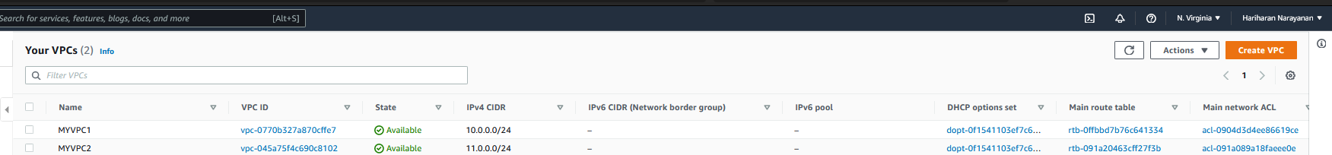
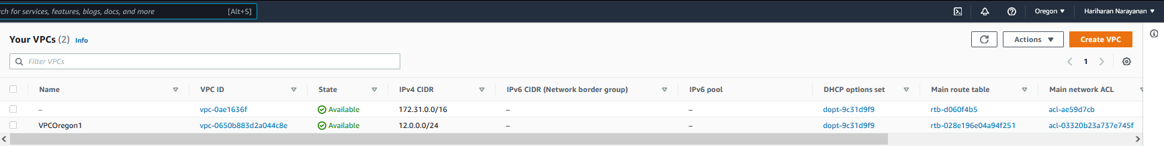
1. Login into AWS. Select N. Virginia
2. Create 2 VPCs – MYVPC1 & MYVPC2 - as explained in Module 4 Assignment 1
3. Change region to Oregon
4. Create 1 VPC – VPCOregon1 - as explained in Module 4 Assignment 1

Slide 3
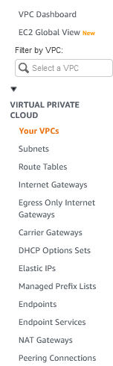
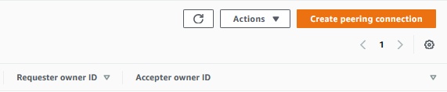
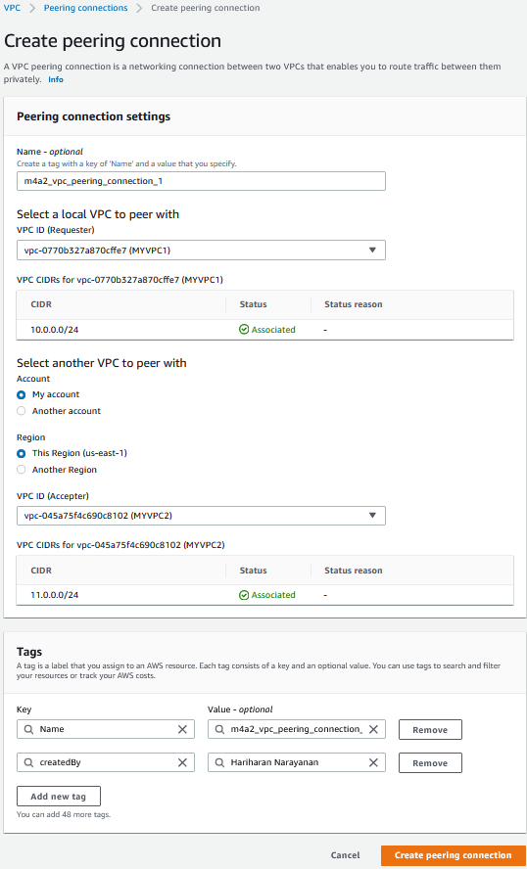
6. Create new Peering Connection
7. Name the peering connection
8. Select requester VPC
9. Select acceptor VPC
5. Select N.Virgina region.
Open VPC dashboard.
Select “Peering Connections”.
10. Create Tags as needed
11. Create

Slide 4
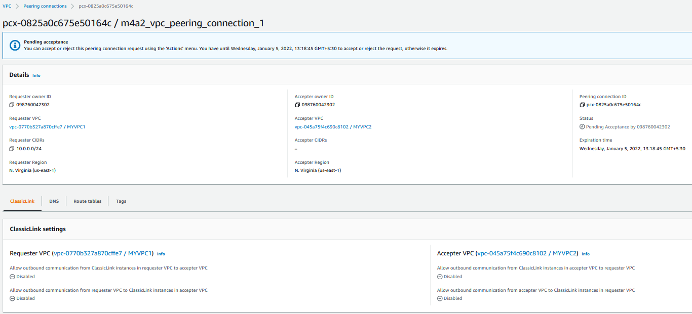
12. Verify that Peering connection is created as created.

Slide 5
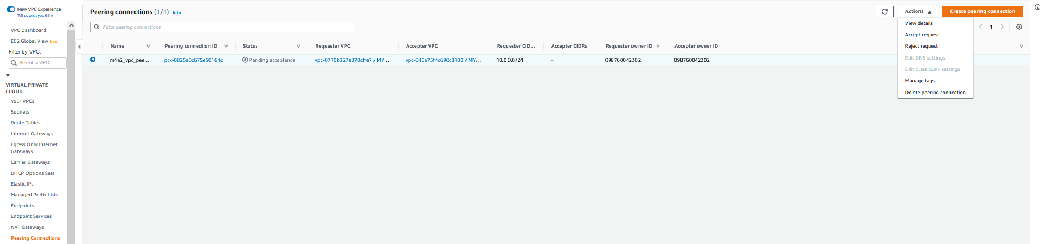
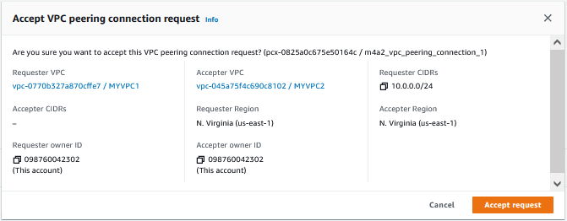
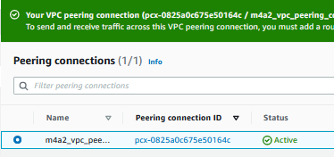
16. Select Actions → Accept Request to accept the Peering request
15. Verify that status is not Active
14. Select the Peering Connection
13. Go back to Peering Connection dashboard
18. Verify that status is now Active
17. Accept

Slide 6
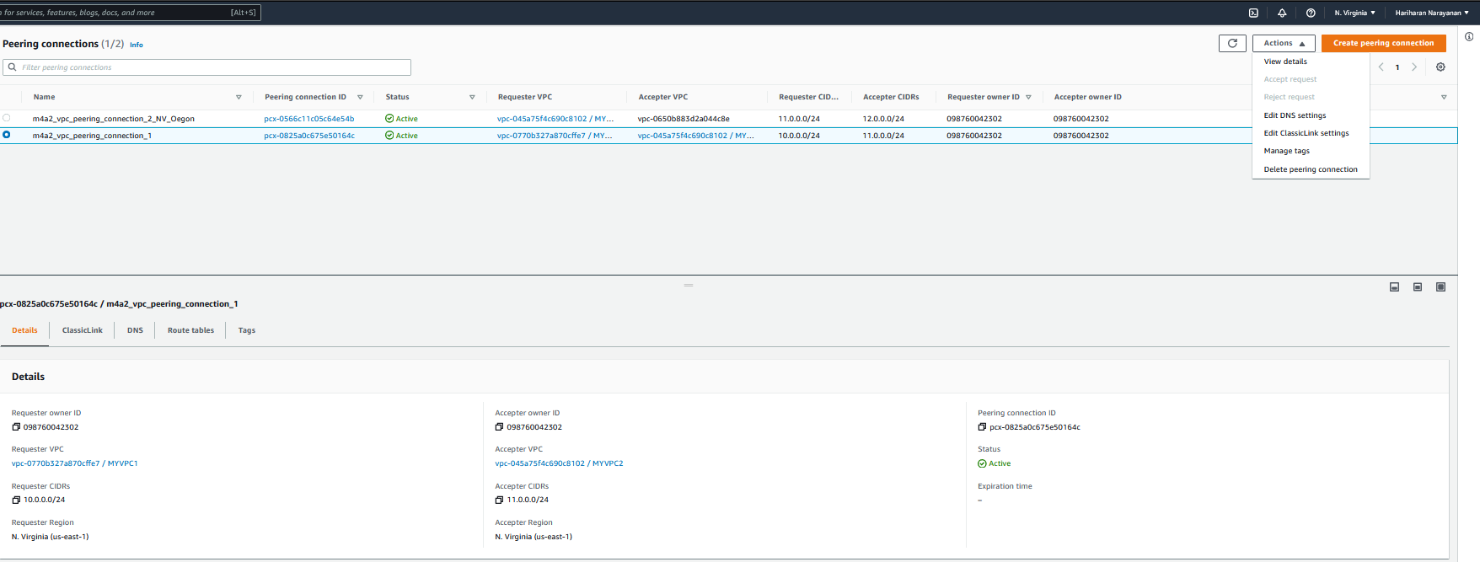
21. Select Actions → Edit DNS Settings
20. Verify that status is Active
19. Select the Peering Connection

Slide 7
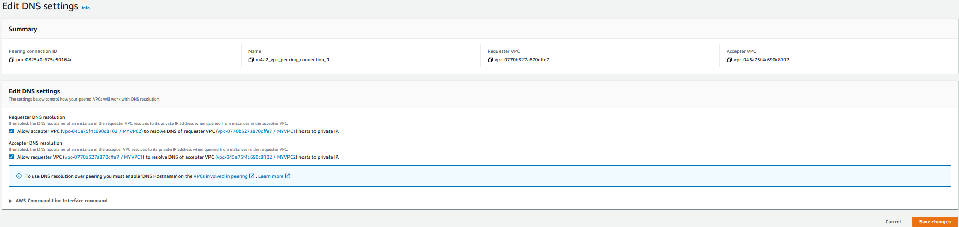
22. Select this to allow requests from requestor VPC to resolve to private IP of acceptor VPC
23. Select this to allow requests from acceptor VPC to resolve to private IP of requestor VPC
24. Save

Slide 8
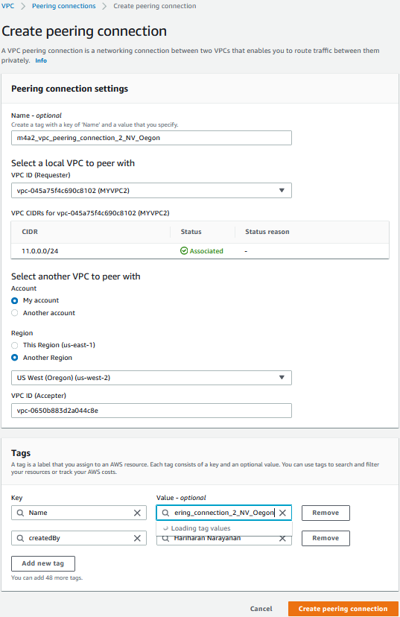
26. Create new Peering Connection
27. Name the peering connection
28. Select requester VPC
29. Select another region for acceptor VPC
30. Choose Oregon
25. Select N.Virgina region.
Open VPC dashboard.
Select “Peering Connections”.
31. Paste VPC ID of VPCOregon1
32. Create Tags as needed
33. Create

Slide 9
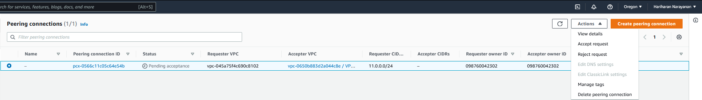
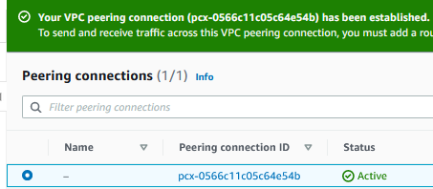
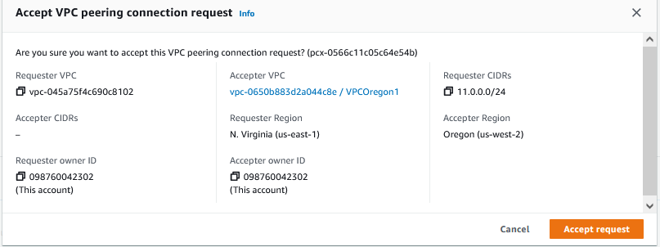
34. Change region to Oregon
37. Select Actions → Accept Request to accept the Peering request
36. Verify that status is not Active
35. Select the Peering Connection
38. Verify that status is now Active
39. Accept

Slide 10
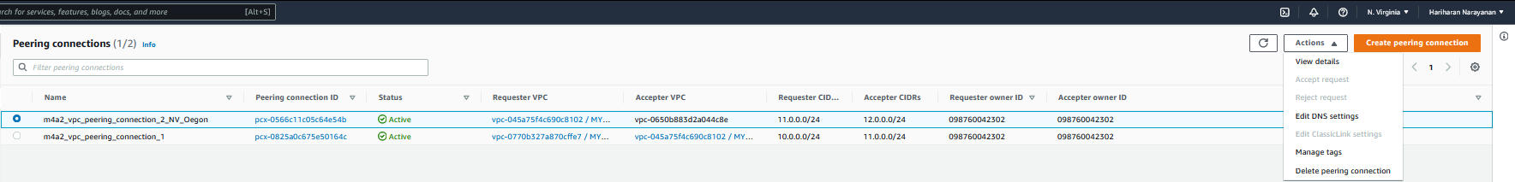
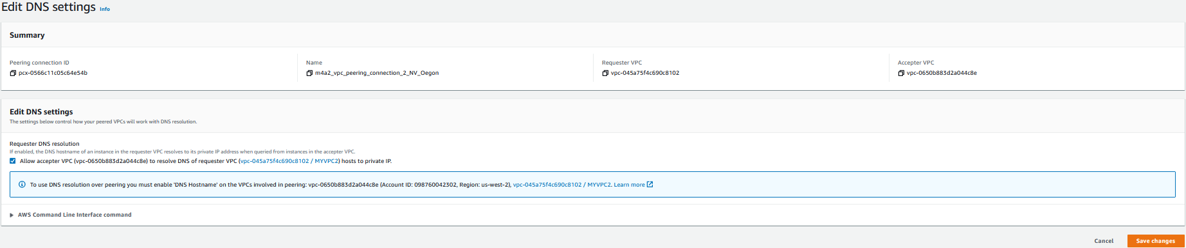
42. Select Actions → Edit DNS Settings
41. Verify that status is Active
40. Select the Peering Connection to OregonVPC
43. Select to resolve DNS of MYVPC2 as local IP of OregonVPC
44. Save

