Slide 1
Module 9 Assignment 2: Elastic BeanStalk
You have been asked to:
Create an Elastic Beanstalk environment with the runtime as PHP
Upload a simple PHP file to the environment once created

Slide 2
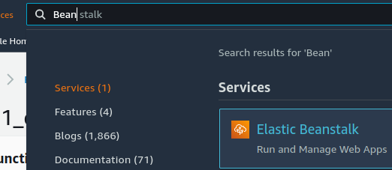
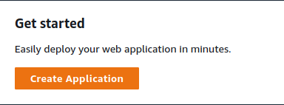
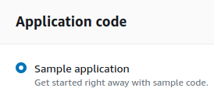
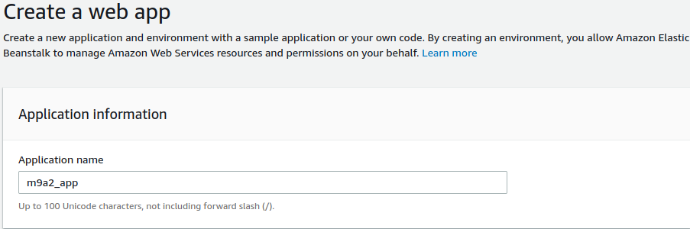
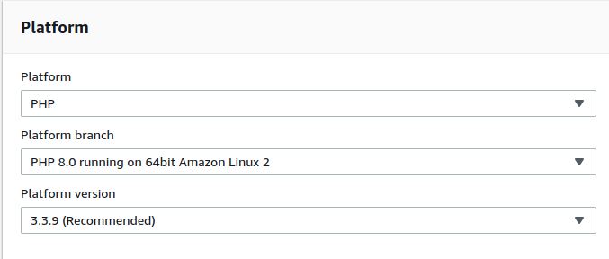
5
2
1
6
3
1. Open AWS Console. Search for “Bean stalk”. Open Elastic Beanstalk console
2. Select “Create Application”
3. Name the app
4. Select PHP as the platform
5. Select “sample application” as the application code
6. Click on “Create application”
4

Slide 3
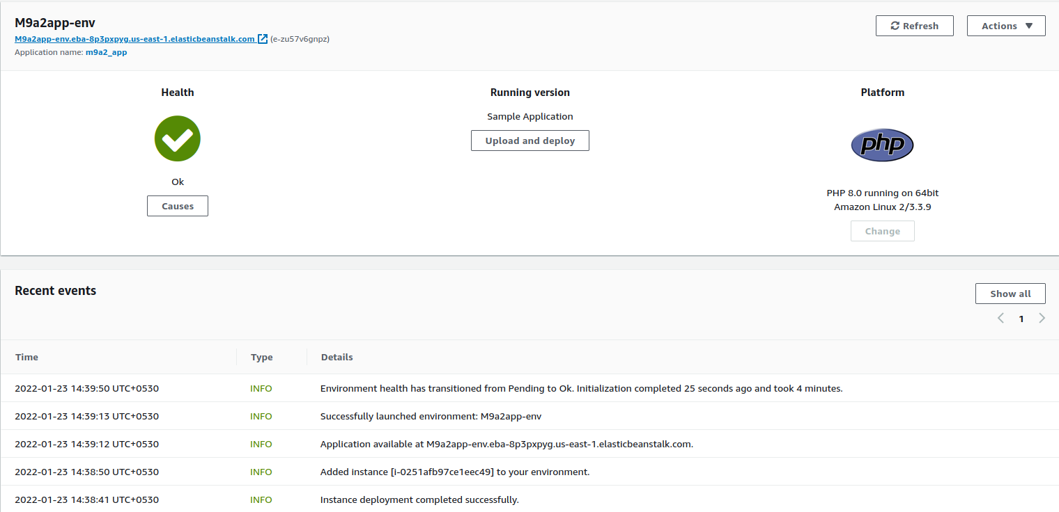
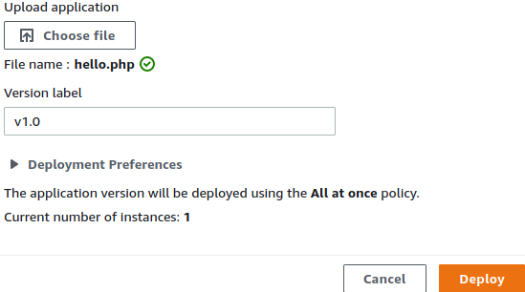
7
9
7. Wait until the app environment is fully created. Click on “Upload and deploy”. Verify that app is loaded properly in the browser (see next slide for output)
8. Prepare a new PHP source code file called hello.php
9. Upload hello.php and click “Deploy”
8

Slide 4
