Slide 1
Module 4: VPC Assignment-3
You have been asked to:
Create 2 EC2 instances in any public subnet of any VPC and name them Master and Client
Using security groups, make sure that Client instance can only be accessed (SSH) through the Master instance

Slide 2
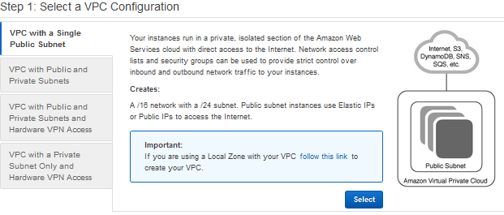
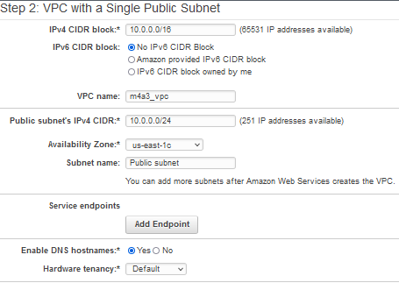

1. Login into AWS. Select N. Virginia
2. Launch VPC wizard
4. Update CIDR block as needed
3. Select a VPC with single public subnet
5. Name the VPC
6. Select availability zone and subnet name
7. Create VPC

Slide 3
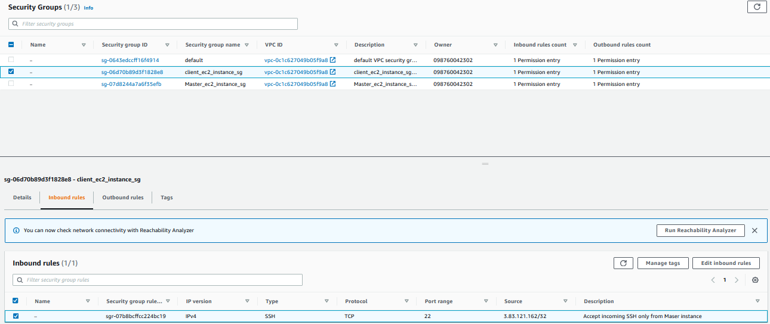
8. Create 2 EC2 instances – Master and Client
10. Ensure only master instance has public IP
11. Ensure each instance has separate security group
Before (12), ensure that the PEM keys are copied into both EC2 instances – Master and Client
12. Client sg must allow inbound SSH only from Master instance public IP

Slide 4
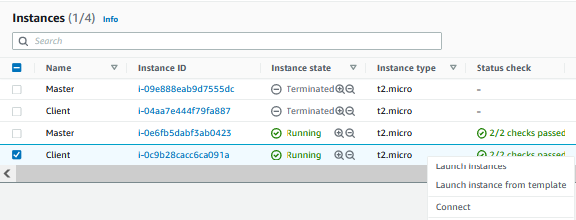
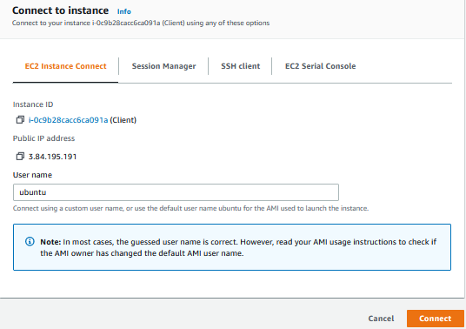

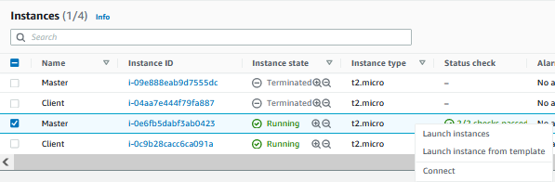
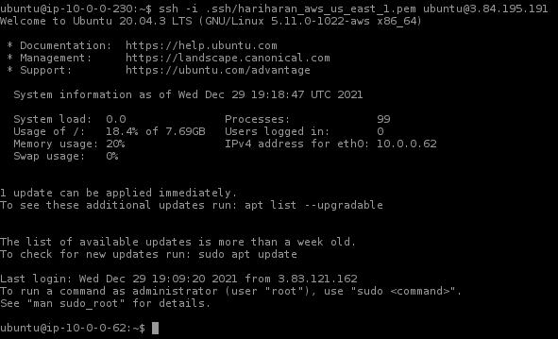
13. Try to connect to client instance. This must fail.
14. Connect to Master instance
15. From Master, open SSH to Client instance. This must Pass

