Slide 1
Module 9 Assignment 3: Elastic BeanStalk
You have been asked to:
Create an OpsWorks sample stack, start the instances and deploy the application
Add 2 more t2.medium instances
Make a change to the repository code and check if it reflects in all the instances

Slide 2
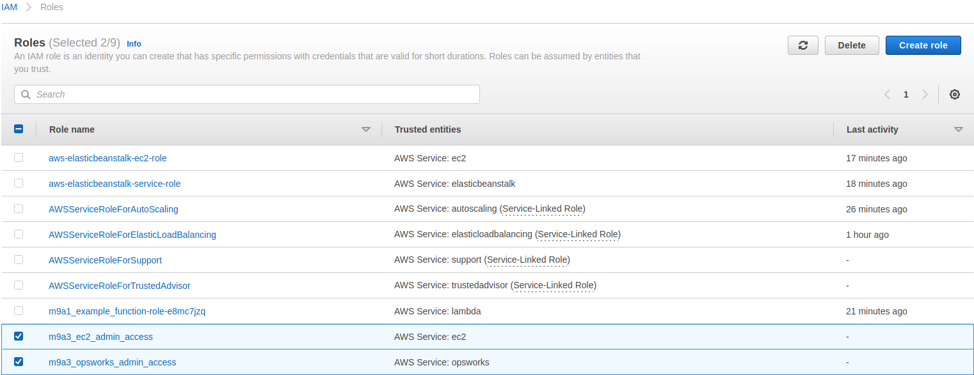
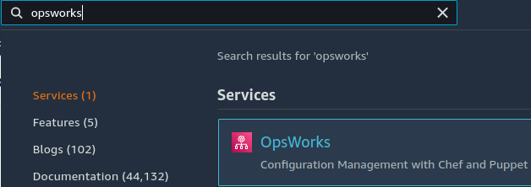
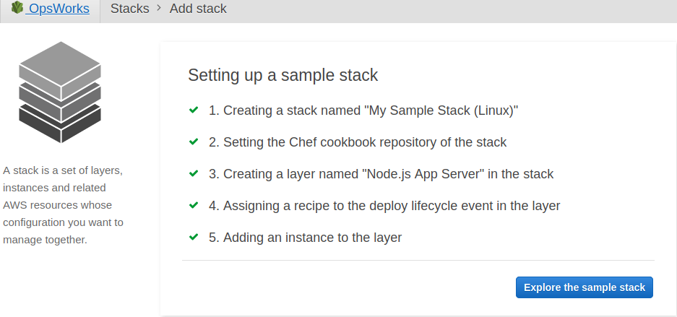
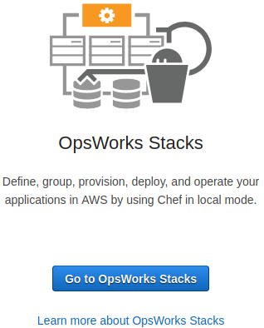
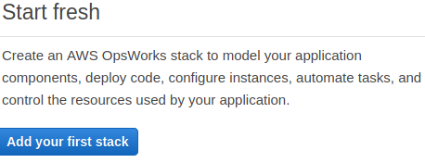
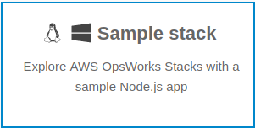

2
1
6
4
1. Open IAM Console. Create roles to provide EC2 admin access and OpsWorks admin access
2. Open AWS Console. Search for “Opsworks”. Open AWS OpsWorks console
3. Select “OpsWorks Stacks”
4. Select “Add your first stack”
5. Select “sample stack”, select “Linux” as operating system type. Click on “Create stack”. Ensure that the IAM role has rights to create AWS OpsWorks stack. Else, create an IAM role for this
6. Wait till stack is created
3
5

Slide 3
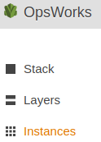
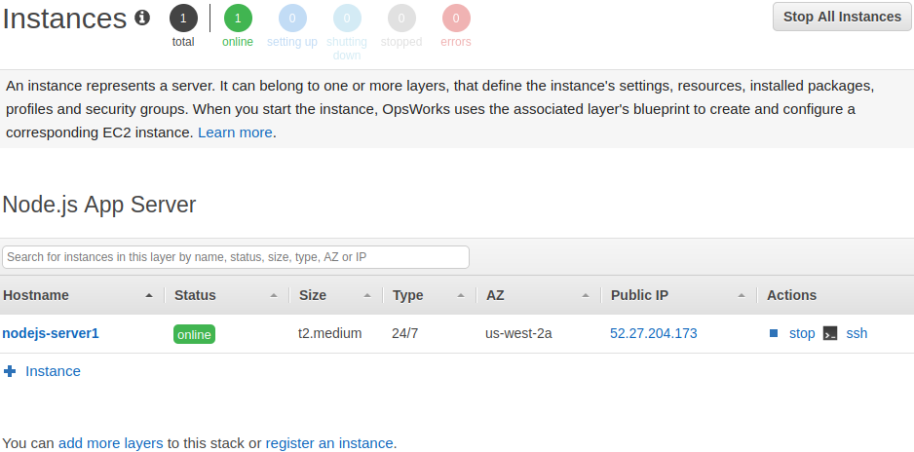
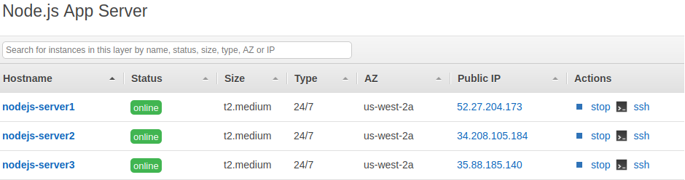
6
8
7
6. Open “Instances” console. Start all instances
7. Start the app instance and verify that it is successfully started
8. Click on “instance” to create 2 more “t2.medium” instances
9. Start all instances and verify that they are started correctly. Click on the public IP of each instance and verify that we are able to see the app frontend UI in the browser
9

