Slide 1
Module-6: Database Services Assignment - 4
You have been asked to:
Create a Redshift Data Warehouse
Using the Query editor
Load some data
Query the data

Slide 2

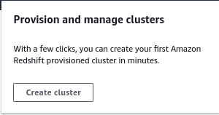



Slide 3
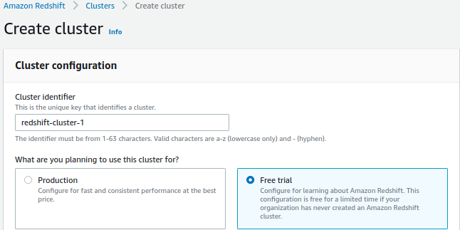
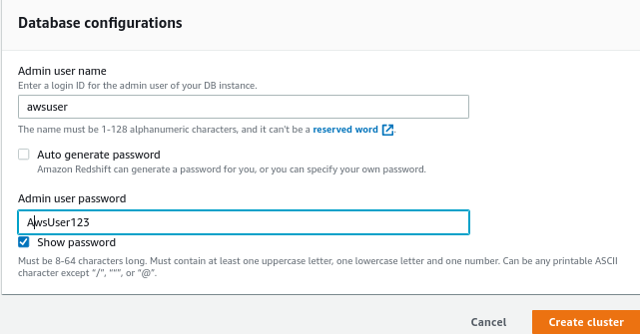

Slide 4

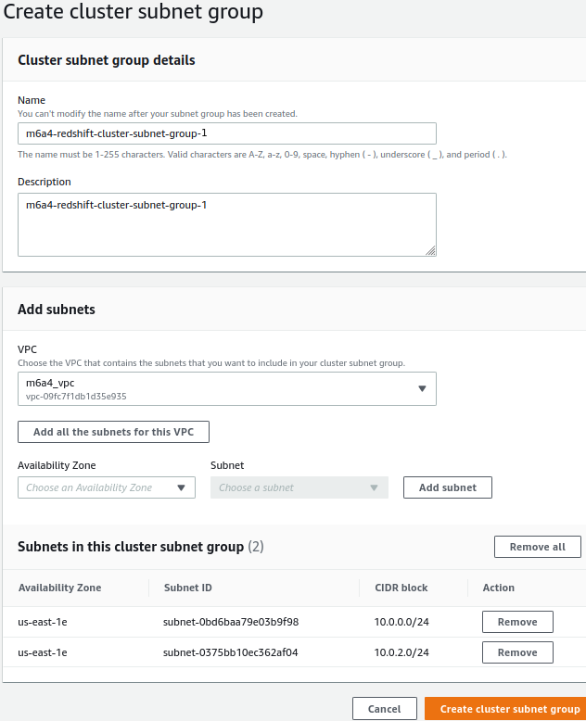

Slide 5


