Slide 1
Module-7 Assignment – 3 Cloudformation and SNS
You have been asked to:
Use the template from CloudFormation task 1
Add Notification to the CloudFormation stack using SNS, so you get a notification via mail for every step of the stack creation process

Slide 2
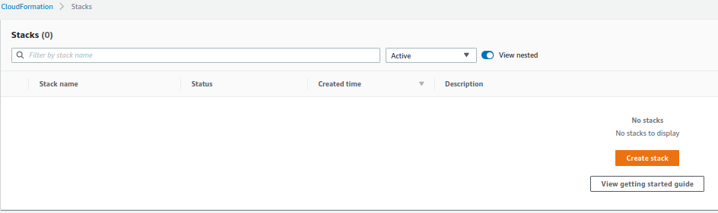
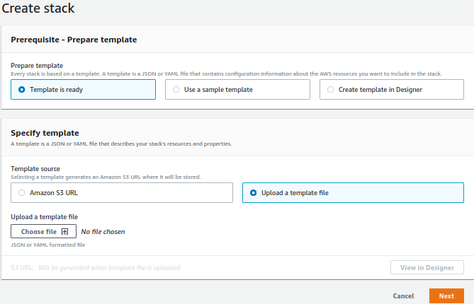
1. Open cloudformation in AWS console
2. Click on Create stack
3. Upload YAML template
4. Click Next

Slide 3
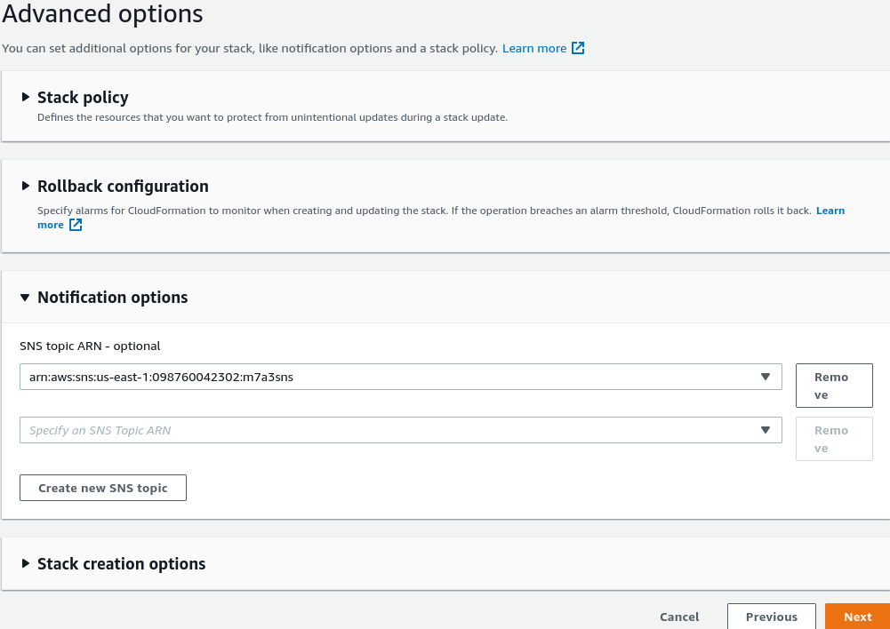
5. Select the SNS topic
4. Click Next and create stack

